Slide 1

Business Data Management Capstone Project
Enhancing Xerox shop Operations through Data-Driven Strategies
By- Sanskar Bansal
23f1002258
Page 1

Slide 2
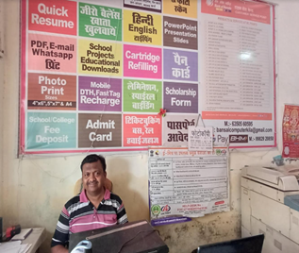

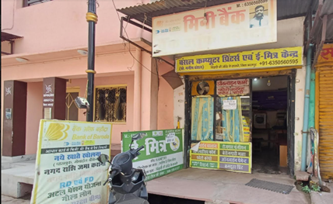
ABOUT THE BUSINESS
Bansal Computers and Printers, located near the Bihariji Temple at Lohagarh Fort, Bharatpur, has served the community for over 20 years. Established by Mr. Manish Bansal as one of the city's first cyber cafes, the shop quickly adapted as internet access became widespread. Today, it offers a variety of essential services, including Xerox, printing, form filling, typing, bill payments, and government-related tasks through a Common Service Center (CSC).
During the COVID-19 pandemic, Bansal Computers expanded further by adding Bank of Baroda’s mini bank services, providing money transfers, withdrawals, and account opening to the local community. With a strong commitment to accessible, community-centered services, Bansal Computers remains a reliable destination for digital, document, and financial needs in Bharatpur.
Page 2

Slide 3



Challenges and Problem Statements
To enhance financial tracking by identifying irregular cash flow patterns during peak and normal business days
Improving customer acquisition in specific regions and assess the effectiveness of geographical marketing campaigns in increasing the number of account openings
To analyze customer segmentation and Xerox service usage patterns to identify areas for optimizing bulk orders and overall service demand
Page 3

Slide 4
Data Overview
Columns
Period
Transaction Date
Debit
Credit
Difference
Comulative Credit
January 24 to June 24
1
Daily Debit and Credit Data
Account Opening date
Customer Name
Father’s Name
Mother’s Name
Address
February 24 to June 24
2
Account Data
Date
Customer Type
Number of customers
Copies made
Bulk orders
July 24
3
Xerox Categorization Data
Link to the data: Click Here
Page 4

Slide 5
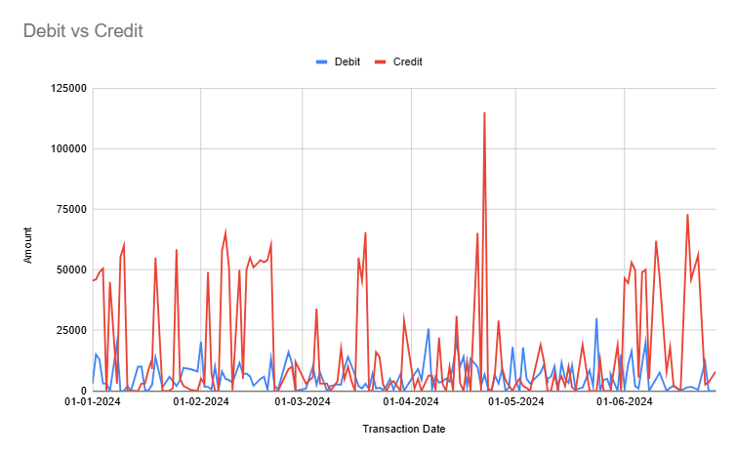
Debit and Credit Analysis
From this line chart, It can be clearly seen that in most of the days credit amount in shop is more than debit amount.
Debit transactions are more stable, with occasional peaks up to 25,000.
Frequent credit peaks suggest seasonal demand patterns for certain services like form filling and money transfer.
Page 5

Slide 6
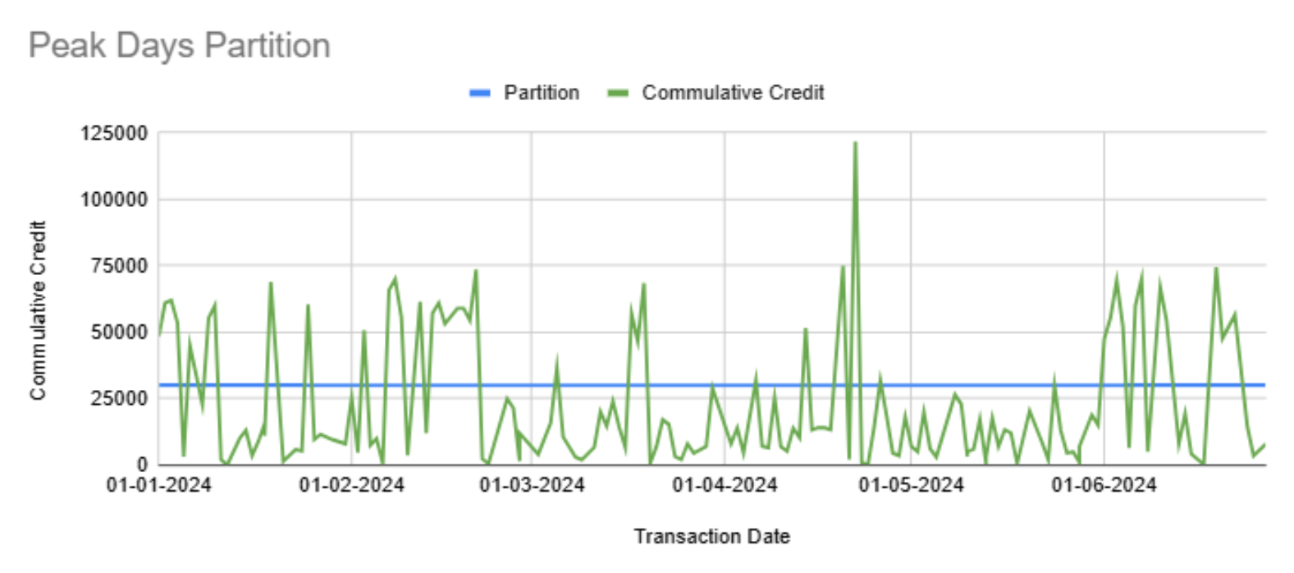
Debit and Credit Analysis
Cumulative credit represents the total amount of money flowing into the business over time. Each day’s credit transaction adds to the overall total, creating a continuous view of how much credit has been accumulated.
Division of Peak Days vs Normal Days was done on the basis of partition line of Rs 30,000.
From Pivot table it was analyzed that out of 152 total working days in 6 months 37 was Peak days
Page 6

Slide 7
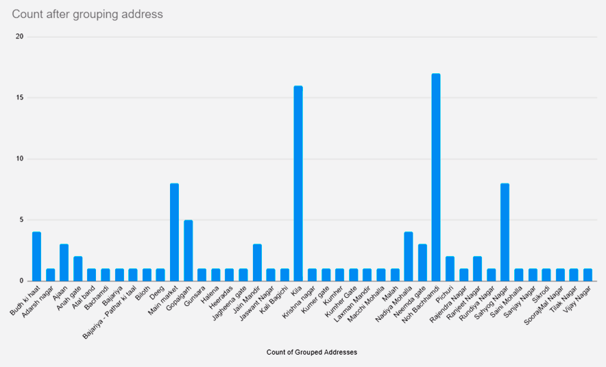
Geographical Analysis
The distribution of customers across different areas shows that some locations, such as Kila and Noh Bacchamdi, have significantly higher customer counts. This indicates strong customer interest in these areas.
A two-day promotional campaign in Noh Bacchamdi resulted in a 16.2% increase in account openings, demonstrating the positive impact of targeted marketing on customer engagement.
Some areas have only one or two customers, which may indicate lower interest due to factors like distance or competing services.
Page 7

Slide 8
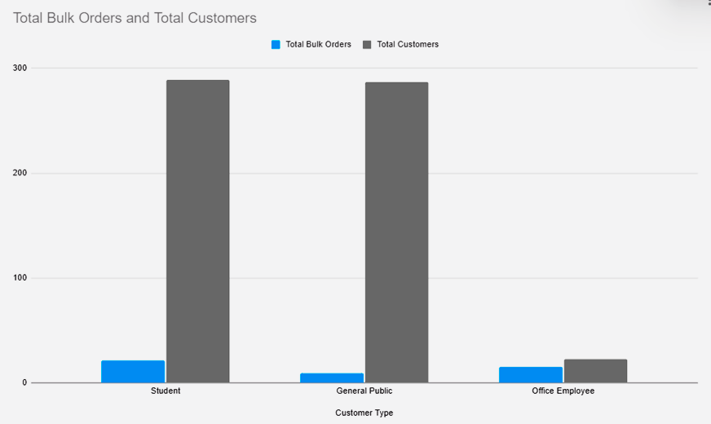
Xerox Bulk order analysis
As it is clearly seen that bulk orders are mostly done by office employees according to dataset , that’s because of direct contracts of the offices for xerox services , and shop provide them bulk rates of xerox so same we can do for students to attract more bulk orders as it is very less seeing current situation.
Page 8

Slide 9


Reccomendations
Maintain around ₹60,000 in cash on peak days based on monthly trends, while encouraging UPI payments to streamline transactions and improve record-keeping. Staff training and visible signage can help increase cashless payments.
Focus marketing efforts on areas like Sahyog Nagar, Nadiya Mohalla, and the Main Market where there’s more business potential. Collect phone numbers from these areas and send automatic messages to inform people about deals, account opening offers, or other services. This could bring in more customers and boost sales.
01
02
The 25% discount on student orders over 30 copies has effectively doubled student bulk orders. With public demand for similar discounts, I recommend implementing a tiered discount system for all large orders, offering increased discounts as the order size grows (e.g., a modest discount for mid-sized orders and a higher discount for very large orders). Adjusting the bulk order minimum could also enhance efficiency and meet varying customer needs.
Establish partnerships with educational institutions by offering special rates and organizing promotional events. This could secure long-term contracts and bring steady business from high-volume copying needs.
03
04
Page 9

Slide 10
Thank You
Page 10

