Slide 1

Akka HTTP course
Pim Verkerk
www.codestar.nl

Slide 2
Schedule
TBD

Slide 3
Akka HTTP course
Part 1
Getting Started

Slide 4

History
http://spray.io

Slide 5
Spray
spray is an open-source toolkit for building REST/HTTP-based integration layers on top of Scala and Akka.
Being asynchronous, actor-based, fast, lightweight, modular and testable it's a great way to connect your Scala applications to the world.

Slide 6
Spray
Elegant, high-performance HTTP for your Akka Actors
Fast, lightweight HTTP Server
Elegant DSL for API Construction
Support for Servlet 3.0 Containers

Slide 7
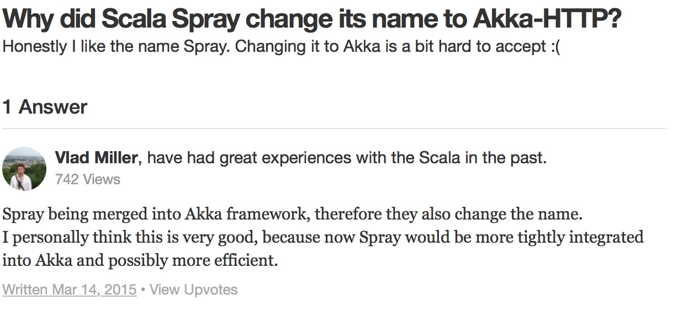
Akka-HTTP
Acquired by Lightbend
‘Spray 2.0’

Slide 8
REST
Akka HTTP
The Akka HTTP modules implement a full server- and client-side HTTP stack on top of akka-actor and akka-stream. It's not a web-framework but rather a more general toolkit for providing and consuming HTTP-based services. While interaction with a browser is of course also in scope it is not the primary focus of Akka HTTP.

Slide 9
Akka HTTP is structured into several modules
akka-http-core
A complete, mostly low-level, server- and client-side implementation of HTTP (incl. WebSockets)
akka-http
Higher-level functionality, like (un)marshalling, (de)compression as well as a powerful DSL for defining HTTP-based APIs on the server-side
akka-http-testkit
A test harness and set of utilities for verifying server-side service implementations
akka-http-spray-json
Predefined glue-code for (de)serializing custom types from/to JSON with spray-json
akka-http-xml
Predefined glue-code for (de)serializing custom types from/to XML with scala-xml

Slide 10
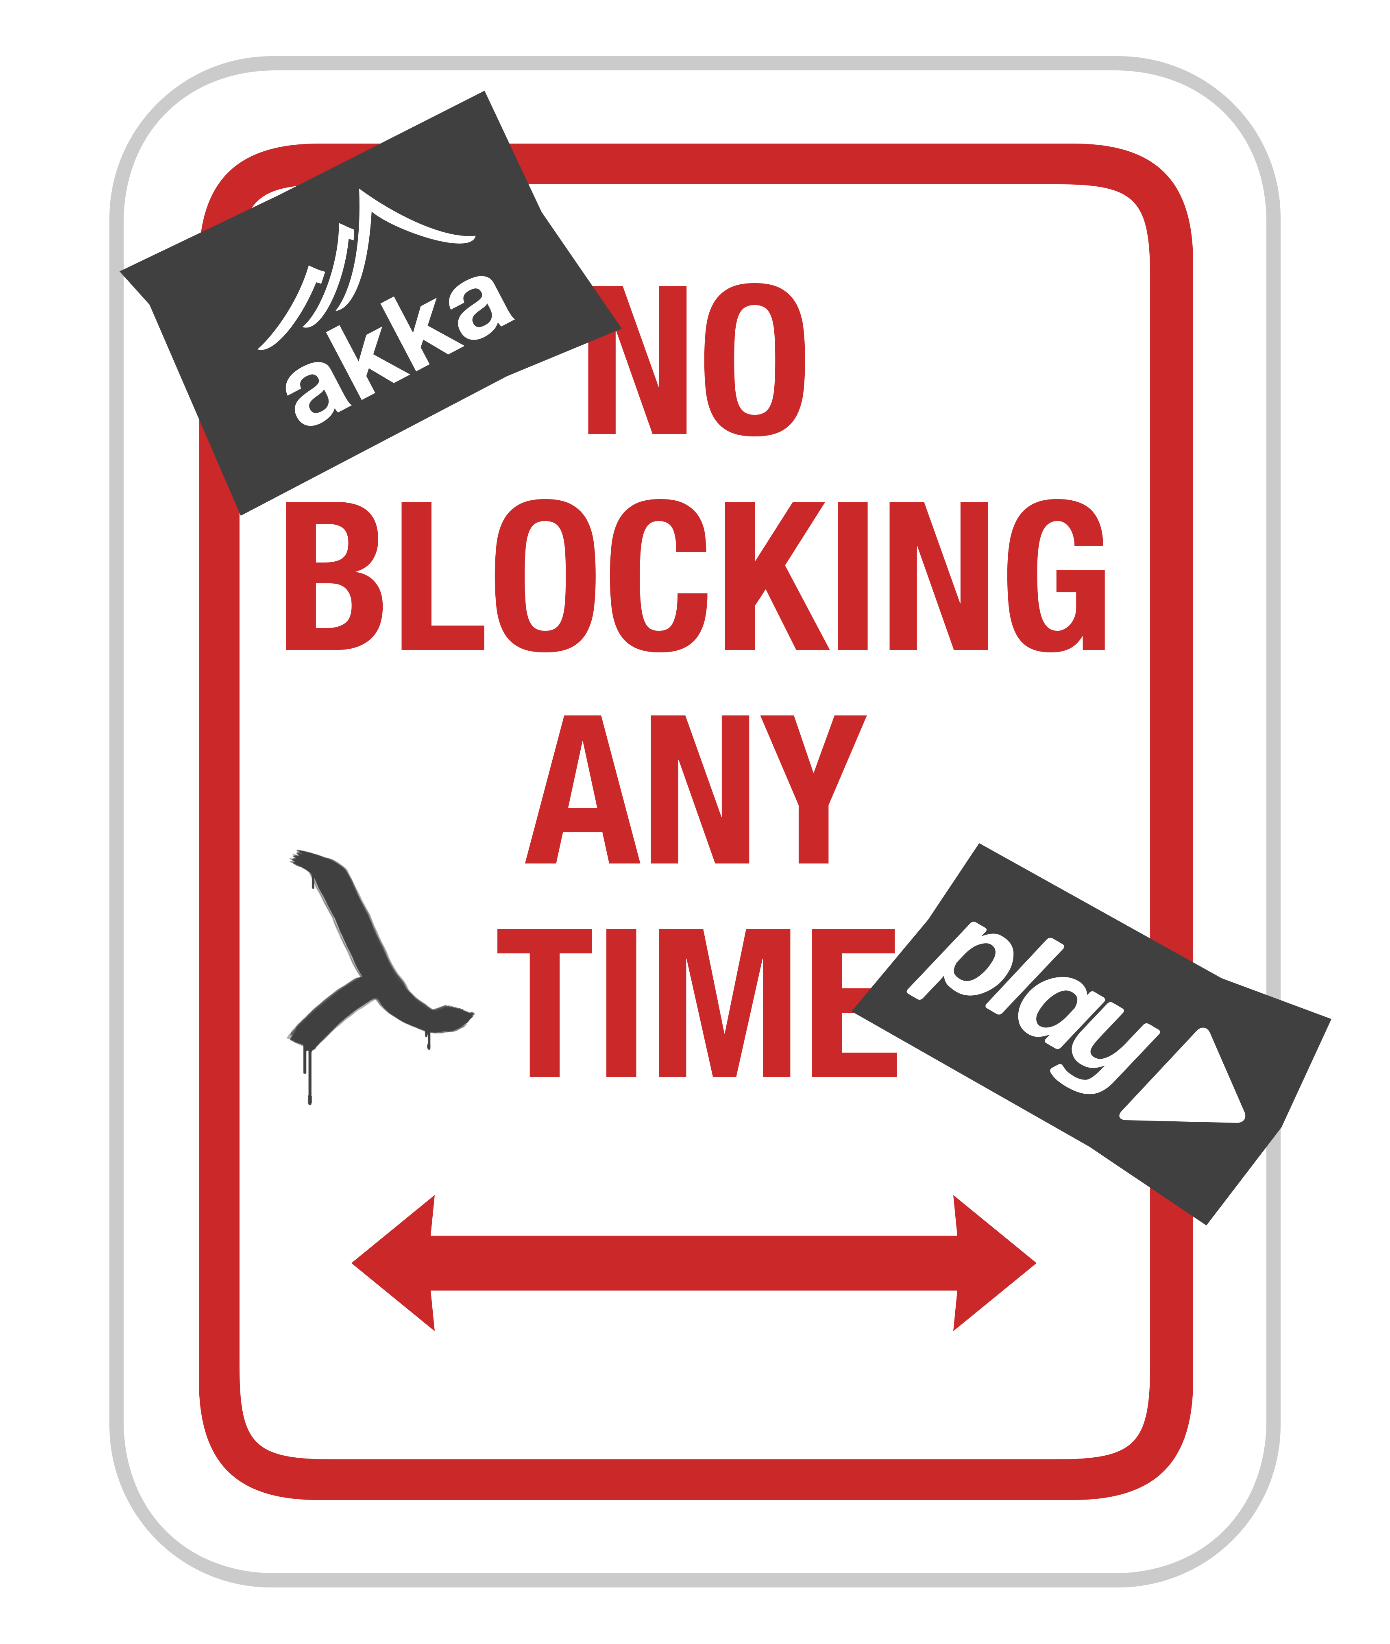
Threading model
Thread per core
Don’t block

Slide 11


Slide 12
Getting started
import akka.http.scaladsl.model._
This brings all of the most relevant types in scope, mainly:
HttpRequest and HttpResponse, the central message model
headers, the package containing all the predefined HTTP header models and supporting types
Supporting types like Uri, HttpMethods, MediaTypes, StatusCodes, etc.

Slide 13
Getting started
// construct a simple GET request to `homeUri`
val homeUri = Uri("/abc")
HttpRequest(GET, uri = homeUri)
// construct simple GET request to "/index" (implicit string to Uri conversion)
HttpRequest(GET, uri = "/index")

Slide 14
Getting started
// construct simple POST request containing entity
val data = ByteString("abc")
HttpRequest(POST, uri = "/receive", entity = data)

Slide 15
Complex request
// customize every detail of HTTP request
import HttpProtocols._
import MediaTypes._
import HttpCharsets._
val userData = ByteString("abc")
val authorization = headers.Authorization(BasicHttpCredentials("user", "pass"))
HttpRequest(
PUT,
uri = "/user",
entity = HttpEntity(`text/plain` withCharset `UTF-8`, userData),
headers = List(authorization),
protocol = `HTTP/1.0`)

Slide 16
Getting started
import StatusCodes._
// simple OK response without data created using the integer status code
HttpResponse(200)
// 404 response created using the named StatusCode constant
HttpResponse(NotFound)
// 404 response with a body explaining the error
HttpResponse(404, entity = "Unfortunately, the resource couldn't be found.")
// A redirecting response containing an extra header
val locationHeader = headers.Location("http://example.com/other")
HttpResponse(Found, headers = List(locationHeader))

Slide 17
Main
import akka.http.scaladsl.server.Directives._
import …
object Main extends App {
implicit val system = ActorSystem("hello-api")
implicit val executor = system.dispatcher
implicit val timeout = Timeout(1000.millis)
implicit val materializer = ActorMaterializer()
val serverBinding = Http().bindAndHandle(interface = "0.0.0.0", port = 8080, handler = mainFlow)
def mainFlow(implicit system: ActorSystem, timeout: Timeout, executor: ExecutionContext): Route = {
get {
complete {
"Hello World!"
}
}
}
}

Slide 18
DSL / Directives
get { … }
complete {
path("orders")
post
entity(as[Order]) { order =>
get { … } ~ post { … }
…

Slide 19


Slide 20
Exercise one
Clone https://github.com/code-star/akka-http-hello-world
Make a “Hello world” on a ‘get’
Add a page saying “Not so much hello?” on /noHello
Try to do a ‘post’ to /noHello
Make ‘post’ work also
Extra: Check if the header ‘IsCool’ is ‘true’
Tip:
https://chrome.google.com/webstore/detail/postman/

Slide 21
Akka HTTP course
Part 2
Build in Features

Slide 22

Composing Routes

Slide 23
Sub-Optimal
get {
headerValueByName("IsCool") {
case "true" => complete { "Your request is cool!" }
case _ => reject
} ~
complete {
"Hello World!"
}
}

Slide 24
Better!
def getRoute: Route = get { checkCool ~ notCool }
def checkCool: Route =
headerValueByName("IsCool") {
case "true" => complete { "Your request is cool!" }
case _ => reject
}
def notCool: Route =
complete {
"Hello World!"
}

Slide 25


Slide 26
Easy Future’s
Die.roll gives a Future[Int]
get {
onSuccess(Die.roll) { roll =>
complete { s"You rolled a $roll" }
}
}

Slide 27
Async
We have native support for concurrency with Future[ToResponseMarshallable]
This means we should have an implicit conversion from your response class to a akka-http response.
A String is ToResponseMarshallable so we use this in the next example

Slide 28
Complete with a Future[Reponse]
Introducing => ctx
get { ctx =>
val dieRoll: Future[Int] = Die.roll
ctx.complete(
dieRoll.map(roll => s"You rolled a $roll")
)
}

Slide 29
JSON support
import spray.json.DefaultJsonProtocol
case class Die(sides: Int)
case class Roll(die: Die, result: Int)
object RollProtocol extends DefaultJsonProtocol {
implicit val fmtDie = jsonFormat1(Die.apply)
implicit val fmtRoll = jsonFormat2(Roll.apply)
}

Slide 30
JSON support
import akka.http.scaladsl.marshallers.sprayjson.SprayJsonSupport._
import RollProtocol._
get {
onSuccess(Roller.roll(Die(6))) { roll =>
complete {
roll
}
}
}
roll is implicitly converted
Result:
{
"die": {
"sides": 6
},
"result": 6
}

Slide 31
Circuit breaker Pattern
Provides circuit breaker functionality to provide stability when working with "dangerous" operations, e.g. calls to remote systems
Or die rollers which are a bit sluggish ;)

Slide 32
Circuit breaker
val guard = CircuitBreaker (system.scheduler, 1, 1.second, 5.second)
path("slow") {
get {
complete {
guard.withCircuitBreaker(Roller.rollSlow(Die(6)))
}
}
}

Slide 33
Error Handling
path("slow") {
get {
val guarded = guard.withCircuitBreaker(Roller.rollSlow(Die(6)))
onComplete(guarded) {
case Success(roll) => complete(roll)
case _ => complete("Server Busy")
}
}
}

Slide 35
Exercise two
Checkout branch ‘exercise-two’
Give a Json response
Use the Circuit Breaker
Add error handling
Can you make a ‘loaded die’ behind a secret call ;)
Tip:
http://doc.akka.io/docs/akka-stream-and-http-experimental/2.0.3/scala/http/index.html

Slide 36
Akka HTTP course
Part 3
WebSockets and Testing

Slide 37
Reactive Streams
Source
A processing stage with exactly one output, emitting data elements whenever downstream processing stages are ready to receive them.
Sink
A processing stage with exactly one input, requesting and accepting data elements possibly slowing down the upstream producer of elements
Flow
A processing stage which has exactly one input and output, which connects its up- and downstreams by transforming the data elements flowing through it.

Slide 38
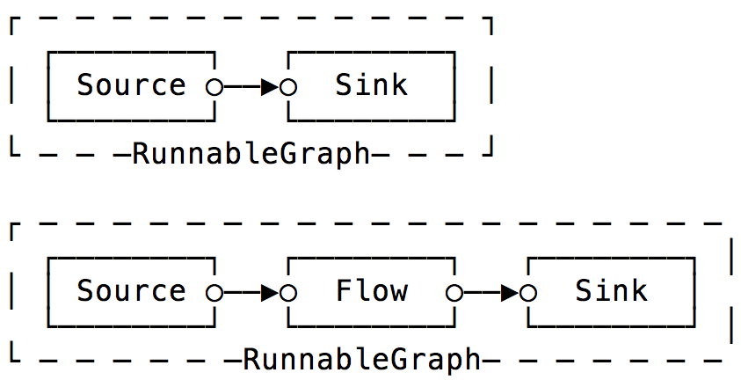
In a picture

Slide 39
Running a Stream
RunnableGraph
A Flow that has both ends "attached" to a Source and Sink respectively, and is ready to be run().
val source = Source(1 to 10)
val sink = Sink.fold[Int, Int](0)(_ + _)
// connect the Source to the Sink, obtaining a RunnableGraph
val runnable: RunnableGraph[Future[Int]] = source.toMat(sink)(Keep.right)
// materialize the flow and get the value of the FoldSink
val sum: Future[Int] = runnable.run()

Slide 40
Async
Streams can create Future’s to
val source = Source(1 to 10)
val sink = Sink.fold[Int, Int](0)(_ + _)
// materialize the flow, getting the Sinks materialized value
val sum: Future[Int] = source.runWith(sink)

Slide 41
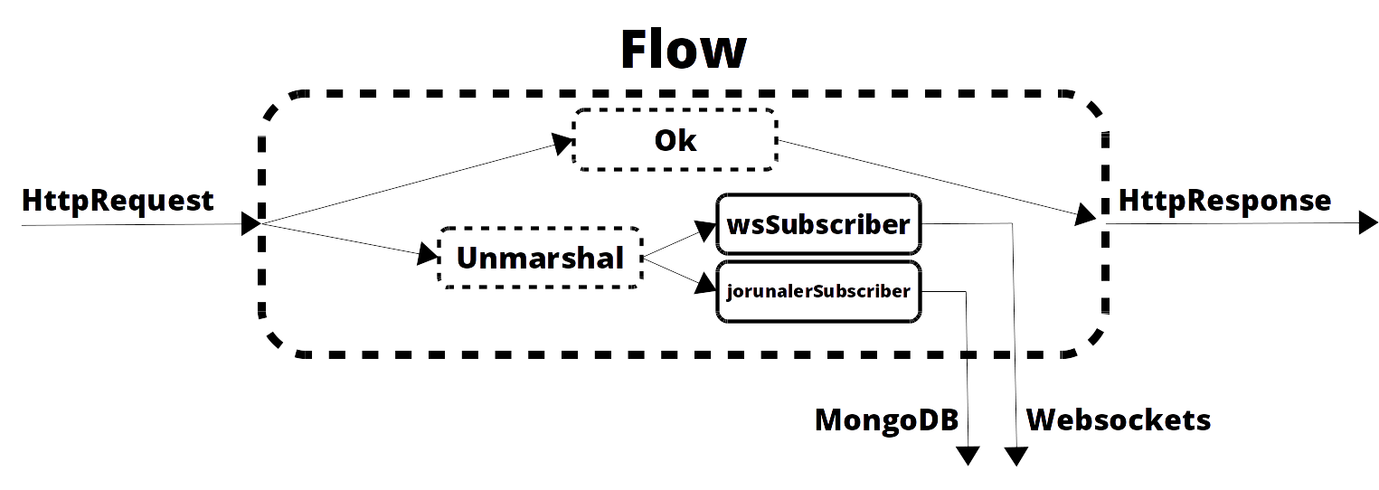
Websockets

Slide 42
Websockets
Create a websocket binding
def allTweetsSocket = path("all") {
handleWebSocketMessages(tweetFlow)
}
Create a flow for a websocket
private def tweetFlow: Flow[Message, Message, Unit] =
Flow.fromSinkAndSource(Sink.ignore, tweetSource map toMessage)
The source
private val tweetSource: Source[Tweet, ActorRef] = Source.actorPublisher[Tweet](TweetPublisher.props)
Sink.ignore?

Slide 43
Websockets

Slide 44
Testing
class MainRoutingSpec extends FlatSpec with Matchers with ScalatestRouteTest with TweetJsonProtocol {
implicit val timeout = Timeout(1000.millis)
val tweetActorManager = system.actorOf(TweetActorManager.props)
"Main" should "serve the index page on /" in {
Get("/") ~> Main.mainFlow ~> check {
status shouldBe OK
}
}
}

Slide 45
Check REST status code
it should "allow to post a tweet for a user" in {
Post("/resources/tweets", Tweet(User("test"), "Some tweet")) ~> Main.mainFlow ~> check {
status shouldBe NoContent
}
}

Slide 46
Check result entity
it should "serve tweets of a user on /resources/tweets/users/test" in {
Get("/resources/tweets/users/test") ~> Main.mainFlow ~> check {
status shouldBe OK
contentType shouldBe `application/json`
entityAs[String] should include regex ("Some tweet")
}
}

Slide 47
Check WebSocket responses
it should "send tweets to the all websocket" in {
val wsClient = WSProbe()
WS("http://localhost/ws/tweets/all", wsClient.flow) ~> Main.mainFlow ~>
check {
isWebSocketUpgrade shouldEqual true
tweetActorManager ! Tweet(User("test"), "Hello World!")
wsClient.expectMessage("""{"user":{"name":"test"},"text":"Hello World!"}""")
}
}

Slide 49
Exercise three
Clone https://github.com/J-Technologies/akka-http-websocket-activator-template.git
Added the template to Activator
https://www.lightbend.com/activator/download
Follow the tutorial
Bonus: Look at the Low level API
http://doc.akka.io/docs/akka-stream-and-http-experimental/2.0.3/scala/http/low-level-server-side-api.html
Redo exercise-one in the low level API
Note: You might find some actors already. If you don’t understand them immediately, no worries; we will explain them tomorrow!

Slide 50
Wrap Up
Did you notice akka-http almost always find the correct http status en response type?
Akka-http does not force a single way to do things, you can choose from a lot of patterns
The testing DSL is very cool
Any comments?

