Slide 1

Project Presentation
Page - 1
Topic: Detect Fake News from Social Media or News Websites Presented by:
Rudranil Guchhait- 27600122099
Apurba Mondal – 27600122140
Subhendu Maiti - 27600122053
Sujan Samanta - 27600122204
Hafijul Mondal - 27600122234
Supervisor: Prof. Prof.(Dr.) Himadri Biswas
Department of Computer Science & Engineering
Budge Budge Institute of Technology, Kolkata
June , 2026

Slide 2
Page - 1
Content
Introduction
Objective
Abstraction
Literature review
Comparison Between Different Types of Models
Review research paper
SDLC Model
Model Diagram
Data Collection
Data cleaning & preprocessing
Data Training & Testing
Our model
Our model code and output
User Interface Of Our Model
Future work
Conclusion
References

Slide 3
Introduction
Page - 2
In today’s digital world, fake news has become a serious problem. With the rapid growth of social media and online platforms, false information spreads very quickly and can easily mislead people. Many users share news articles or posts without checking their authenticity, which often causes confusion and misinformation among the public.
Our project, titled “Fake News Detection from Social Media or News Websites,” aims to build a web-based system that can automatically detect whether a given news article is real or fake. The system will analyze the content using Machine Learning (ML) and Natural Language Processing (NLP) techniques. Users will be able to provide the news in different forms — such as a URL, direct text input, or even an uploaded image or screenshot — and the system will generate the result instantly. The goal of this project is to help users verify the authenticity of online information and reduce the spread of fake news across social and digital media platforms.

Slide 4
Page - 3
Objective
The main objective of our project is to develop a web-based system that can detect whether a given news article is real or fake using machine learning and natural language processing techniques.
Users can check news through URL, direct text, or uploaded image (screenshot).
The system will analyze the content and show a result with confidence score.
The goal is to help people verify information and reduce misinformation spread.
Future plans include fake social media account detection.

Slide 5
Page - 4
Abstract
This project aims to develop a web-based system that can detect whether a news article is real or fake using Machine Learning (ML) and Natural Language Processing (NLP). The system allows users to check news by entering a URL, text, or image of the article. It will analyze the content and display the result as “Real” or “Fake.” The model will be trained using datasets from Kaggle, FakeNewsNet, and LIAR. The frontend is built with React.js, and the backend will use Python Flask. In the future, we plan to add a feature to detect fake social media accounts and enhance the model’s accuracy.

Slide 6
Page - 5
Literature Review
Several studies on fake news detection focus on using Machine Learning (ML) and Natural Language Processing (NLP) to analyze text patterns. Algorithms like Logistic Regression and Random Forest, as well as deep learning models like LSTM, CNN, and transformer-based models such as BERT, have been shown to improve detection accuracy. Combining multiple models (ensemble methods) further enhances performance. These insights guided our approach using Python, Flask, and NLP techniques to build an effective fake news detection system.

Slide 7
Page - 6
Comparison Between Different Types of Models
POINT | LOGISTIC REGRESSION | ADABOOST | SVM | LSTM | CNN | CNN+LSTM (LSTMCNN)
Model type | ML | ML | ML | DL | DL | Hybrid DL
Accuracy | 0.95 | 0.97 | 0.98 | 0.54 | 0.925 | 0.982
Precision | 0.94 | 0.96 | 0.98 | 0.65 | 0.92 | 0.989
Recall | 0.943 | 0.95 | 0.98 | 0.62 | 0.93 | 0.984
F1-Score | 0.93 | 0.94 | 0.98 | 0.32 | 0.925 | 0.99

Slide 8
Review Research Paper
Page - 7
Paper | Abstract Summary | Main Findings | Outcome measured
Detection of fake news from social media using support vector machine learning algorithms Authors: M. Sudhakar, K.P. Kaliyamurthie Journal/Year: Measurement: Sensors, 2024 *https://www.sciencedirect.com/science/article/pii/S2665917424000047 | The paper investigates the capability of various machine learning classifiers and deep learning models for the task of fake news detection. >The models tested include Naive Bayes, Logistic Regression, Support Vector Machine (SVM), Convolutional Neural Networks (CNN), and Long Short-Term Memory (LSTM). >All models were trained and tested using a COVID-19 dataset composed of 1,375,592 tweets. | The study concluded that for their specific dataset, two machine learning algorithms provided a better solution than the deep learning model tested. > SVM model achieved 98 % accuracy and Logistic Regression model also providing 95% accuracy. >LSTM model was the lowest performing classifier, achieving an accuracy of 54%. The paper notes this result indicated that this type of data "doesn't need neural networks". | The primary outcomes measured to evaluate the performance of the different models were Accuracy precision score Recall F1 Score
LSTMCNN: A hybrid machine learning model to unmask fake news Authors: Deepali Goyal Dev, Vishal Bhatnagar, Bhoopesh Singh Bhati, Manoj Gupta, Aziz Nanthaamornphong Journal/Year: Heliyon, 2024 *https://www.cell.com/heliyon/fulltext/S2405-8440(24)01275-1 | The paper addresses the widespread dissemination of false information on online platforms, which poses a potential harm to individuals and society. To handle text data efficiently, the paper recommends using feature abstraction and vectorization tools, such as the Count Vectorizer and Tfidf Vectorizer from Python's sci-kit-learn module. | The hybrid CNN + LSTM model achieved an accuracy of 98% in detecting fake news. >This hybrid approach outperformed other models tested, such as SNN (93% accuracy) and RNN + LSTM (91% accuracy). >When compared with other baseline studies, the proposed hybrid model demonstrated superior performance. | The primary outcomes measured to evaluate the performance of the different models were Accuracy precision score Recall F1 Score

Slide 9
Planning
*Goal Definition
*Problem Identification
*Feasibility Study
Page - 8
Maintenance
*Continuous Model Retraining on new data
*Ongoing accuracy enhancements
Requirements
*Multimodal Input
*Performance Target
*Speed
Fake News Detection SDLC
Design
*System Architecture Definition
*Model Selection
Deployment
*Release as a live application for user
queries.
Testing
*Model Performance Evaluation
*Key Metrics: Accuracy, Precision, Recall, F1- Score
Development
*Data Collection
*Feature Extraction
*Model Training

Slide 10
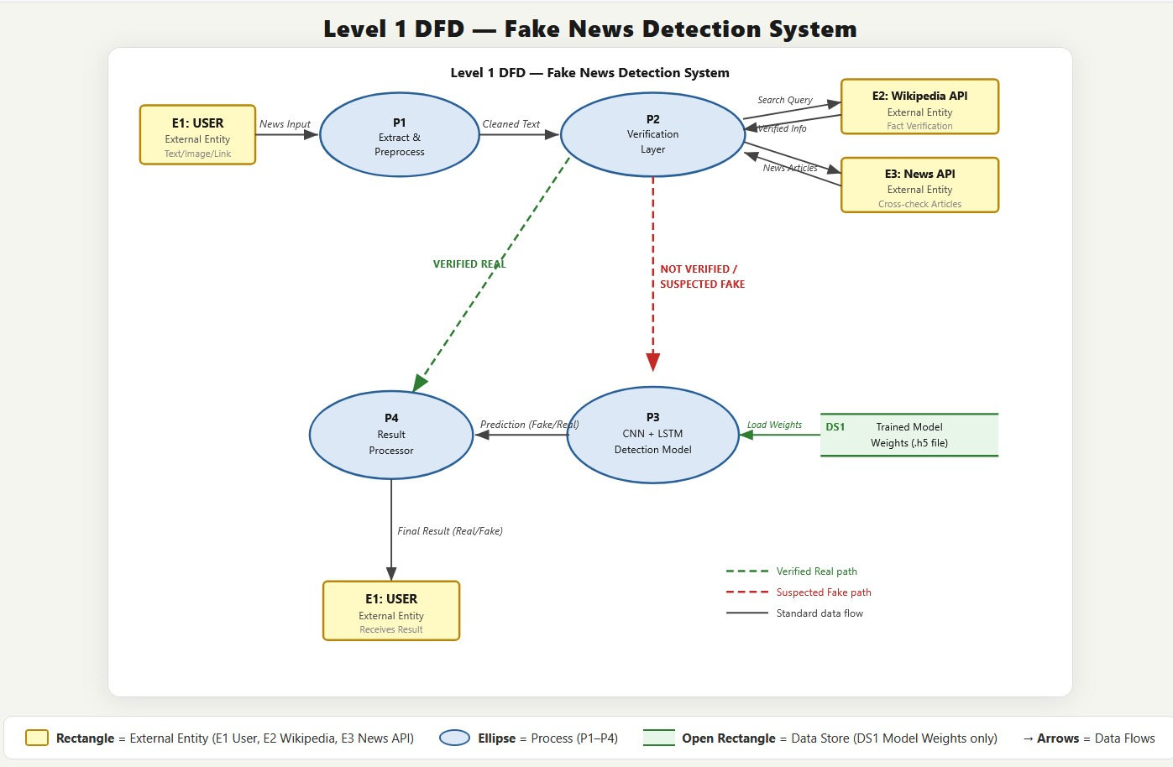
Page - 9

Slide 11
Page - 11
Data Collection
Collect a reliable dataset of fake and real news to train and evaluate machine learning models . Ensure data is representative of real-world scenarios, including short social media posts and full-length news articles.
Sources of Data
Social Media Platforms
Twitter: tweets collected using keywords or hashtags.
Facebook or Reddit posts (if available publicly).
Public Datasets
ISOT Fake News Dataset (Fake.csv & True.csv)
Fake news articles vs real news from online sources.
Kaggle Fake News Dataset
Includes title, text, and labels (fake/real).
News Websites
Scraping from verified sources (BBC, Reuters) for real news.
Scraping clickbait or known fake news websites for fake news.

Slide 12
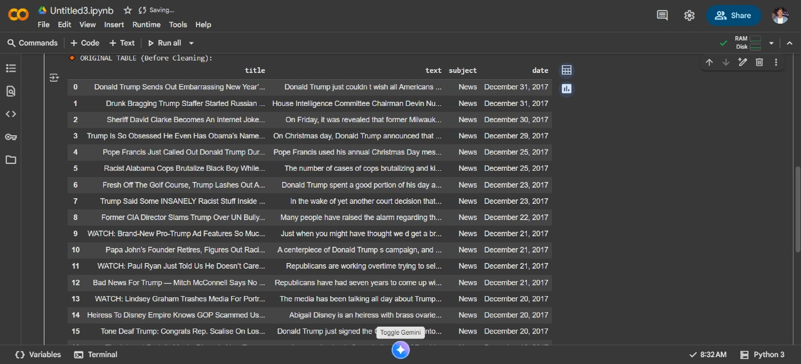
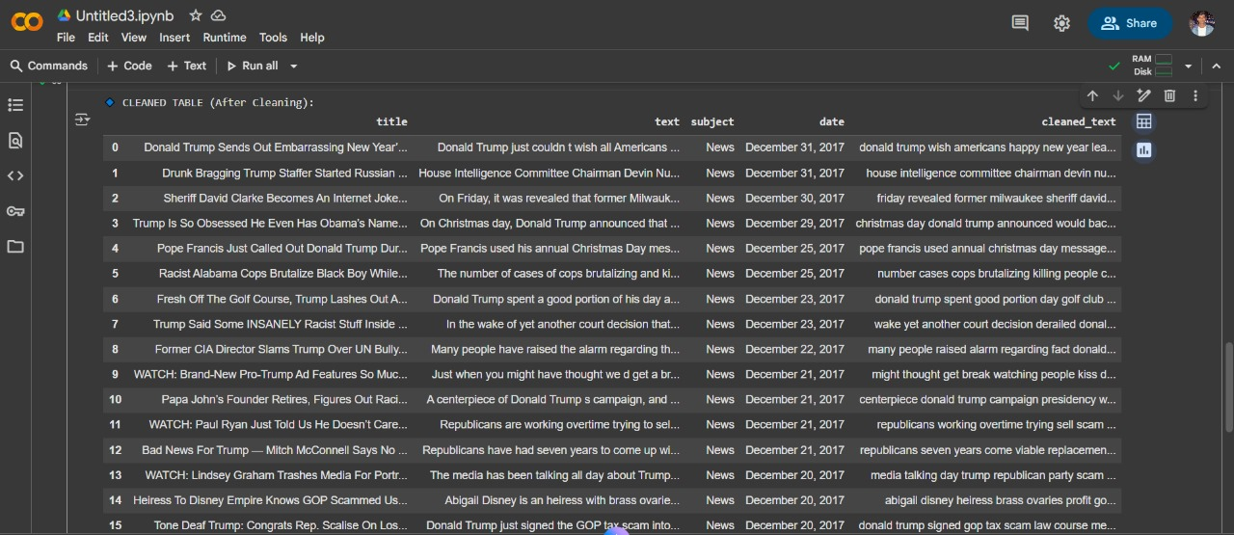
Page - 12
Data Cleaning & Preprocessing
Remove unwanted characters, lowercasing
Tokenization, stop-word removal, lemmatization
Handling missing values
Label encoding: Fake = 0, Real = 1
Before Data Cleaning
After Data Cleaning

Slide 13
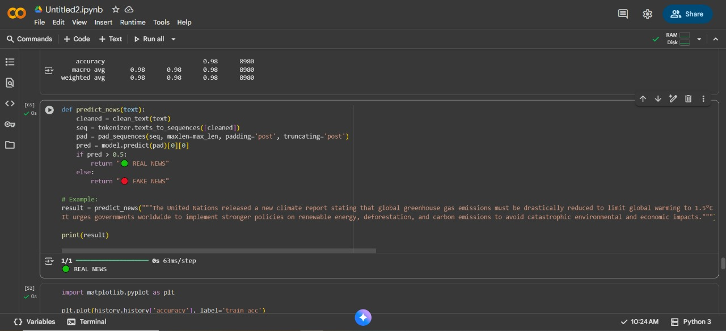
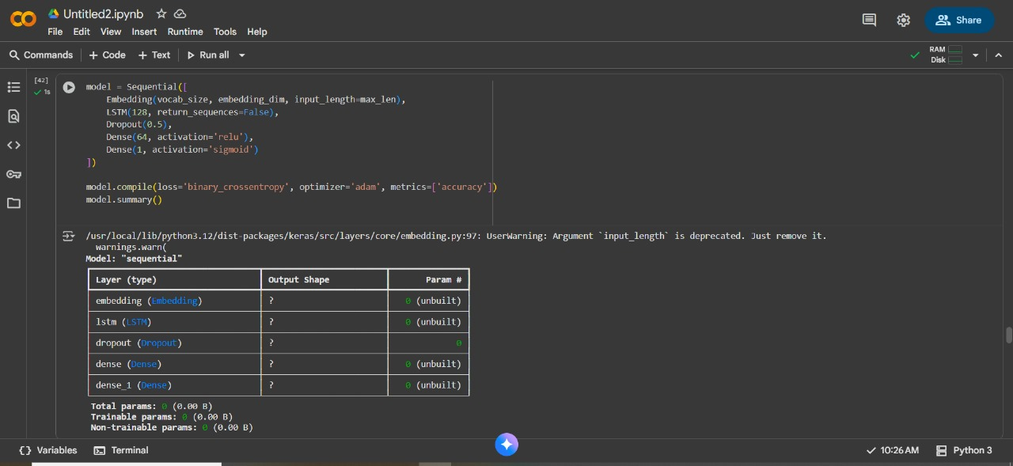
Page - 13
Dataset Training & Testing
Trained the model on Fake & Real News Dataset in Google Colab.
Enter any news text or passage to test.
The model predicts whether the news is Fake or Real instantly.
This Screenshot shows real-time testing output with prediction results.

Slide 14
Our Model (LSTM + CNN)
We implemented a hybrid LSTM + CNN model for fake news detection.
CNN extracts important words and key phrases from news text.
LSTM captures the sequence and overall context of the news.
Combining both helps in better understanding what is said and how it is said.
This model gave the best balance of accuracy and efficiency among all tested models.
Final accuracy achieved: ~98.4%
Hence, LSTM + CNN was selected as the final deployed model for our project.

Slide 15
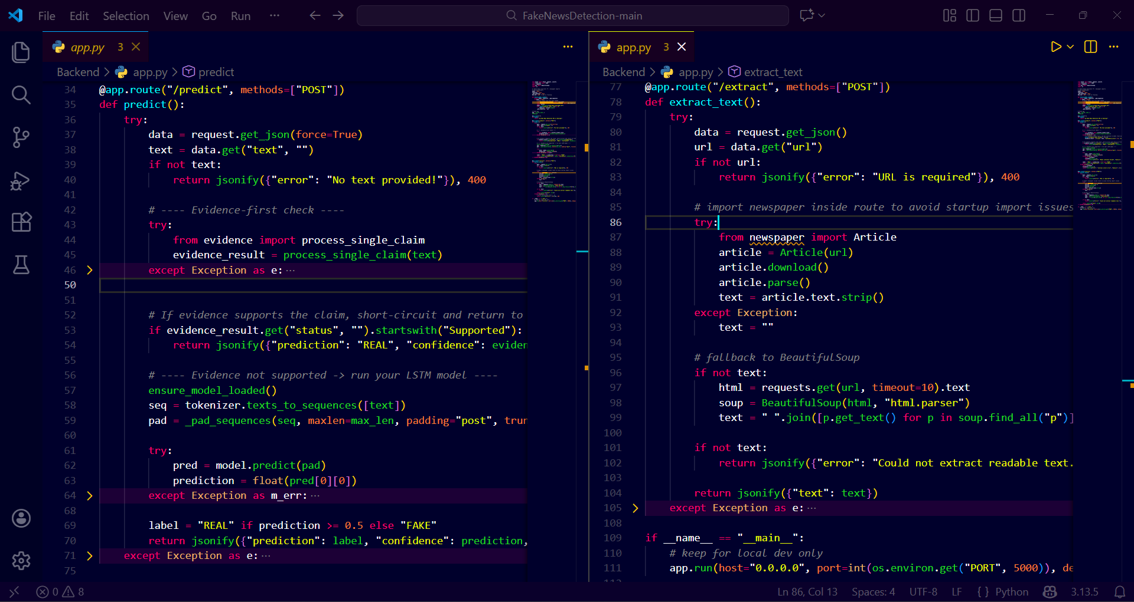
Our Backend Sample Code:

Slide 16
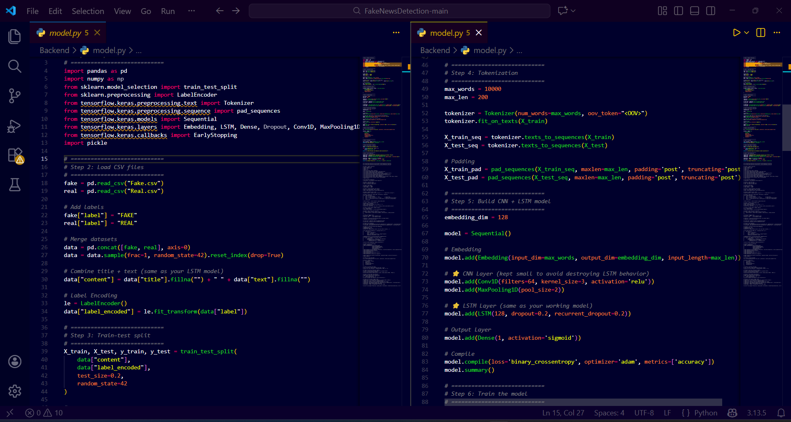
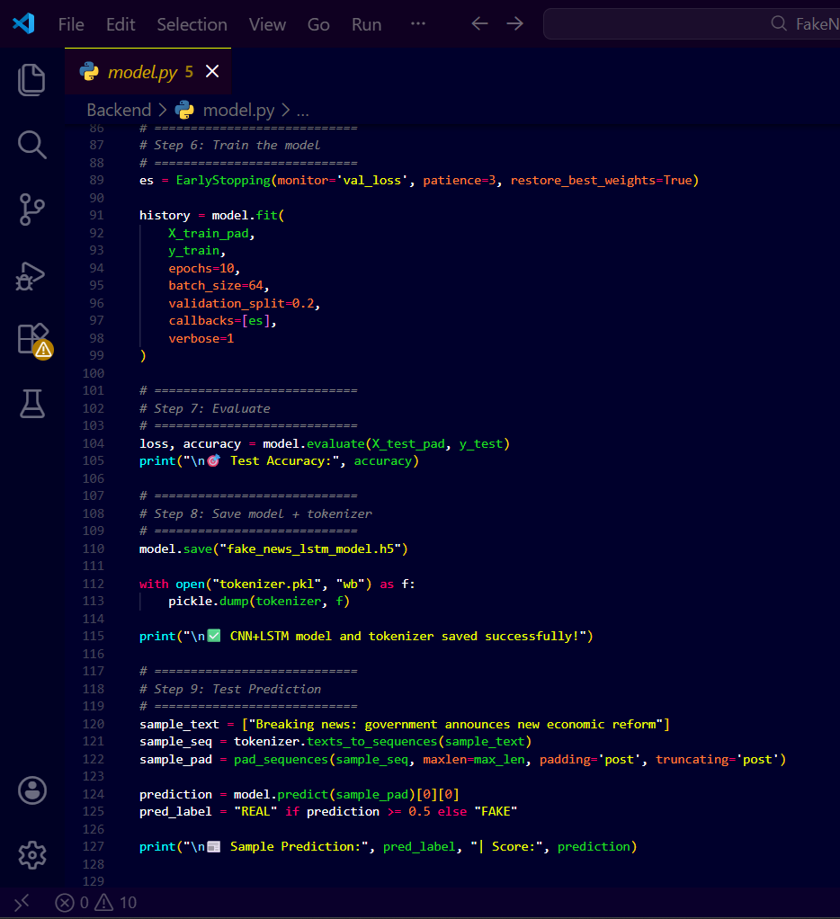
Our Model Sample Code:

Slide 17
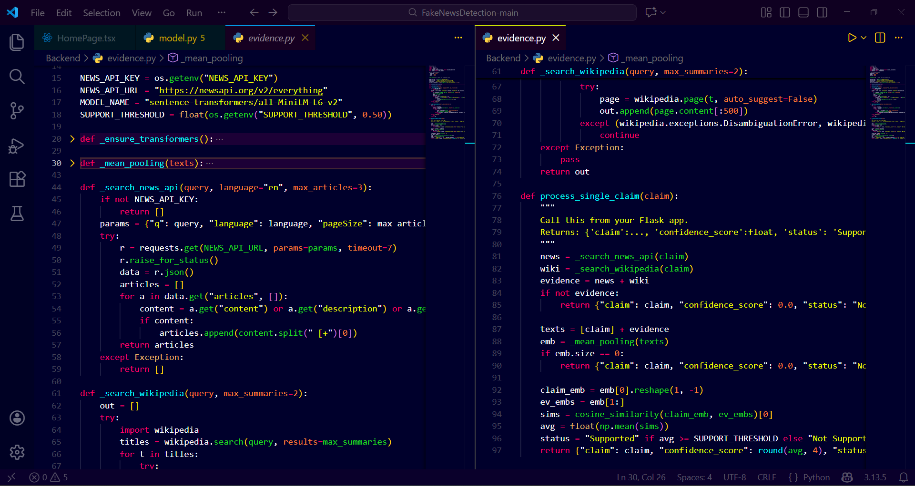
Evidence Checking Sample Code:

Slide 18

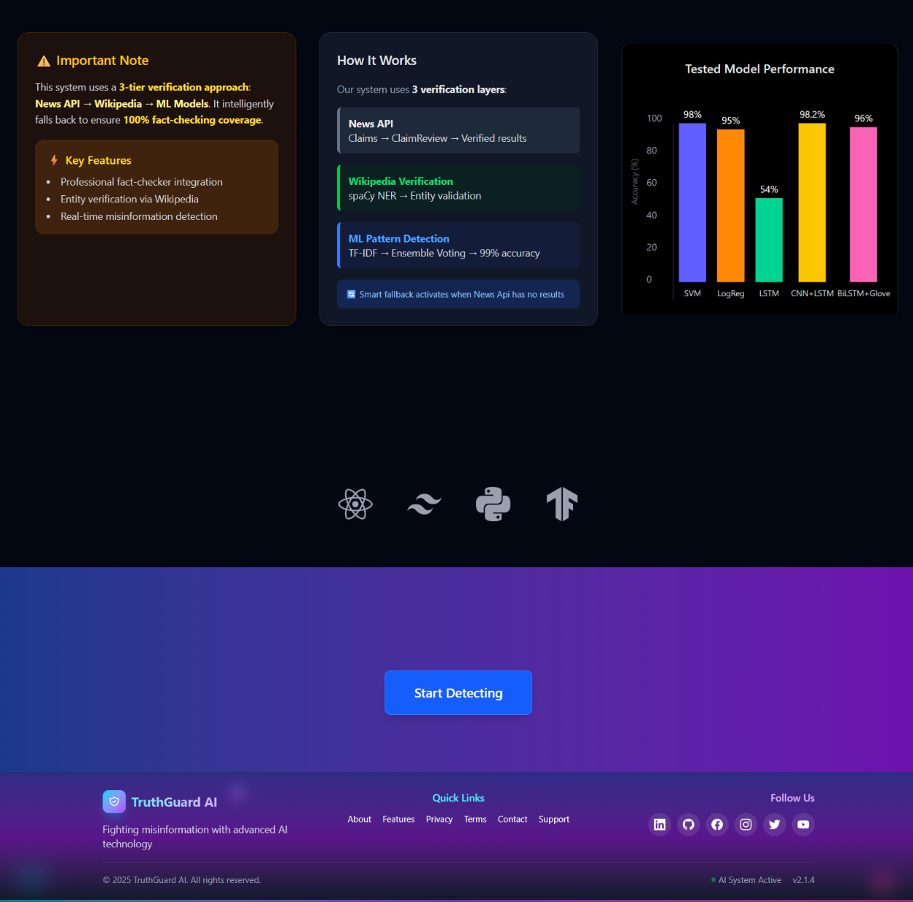
User Interface Of Our Model
Page - 14
Home Page:

Slide 19
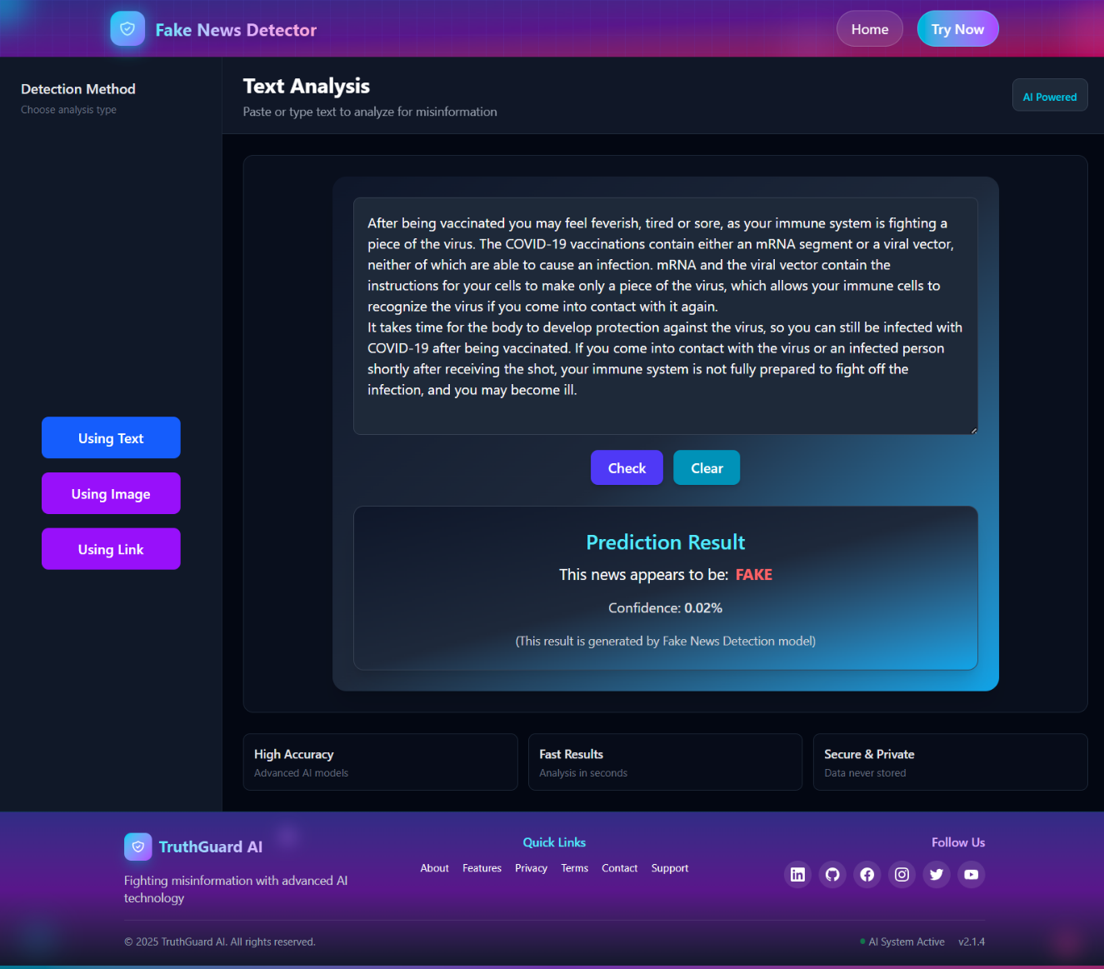

User Interface Of Our Model
News Detection Section
Using Text:
Using Link:

Slide 20
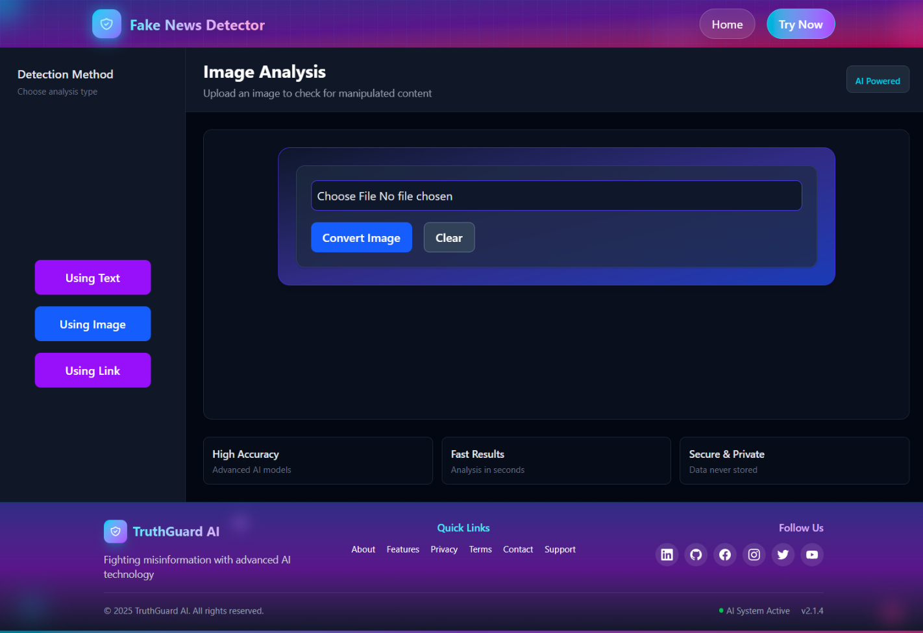
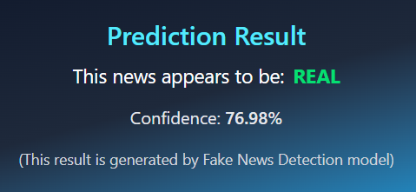
User Interface Of Our Model
Page - 15
Using Image:
Result

Slide 21
Page - 18
Future Work
1. Social Account Verification
Detect whether a social media account is real or fake.
Features to analyze:
Profile picture authenticity
Account creation date
Location
Post frequency and activity patterns
Behavior patterns and interaction analysis
Goal: Prevent fake accounts from spreading misinformation.
2. Multi-Language Support
Expand detection to multiple languages.
Preprocess text in other languages and use language-specific embeddings.
Helps make the system more globally applicable.

Slide 22
Page - 19
Future Work
3. Real-Time Social Media Monitoring (Future Extension)
Scan social media posts in real time to detect potential fake news.
Flag suspicious content instantly.
Future extension: Can be developed into a real-time alert system or browser plugin that warns users when they encounter potential fake news.
Can also integrate trending topic detection for proactive monitoring.
4. Exploring a New DistilBERT + CNN Model
Replace LSTM with DistilBERT, a pre-trained transformer model.
Combine with CNN for feature extraction from rich contextual embeddings.
Uses transfer learning → better language understanding with less data.
Expected to achieve higher accuracy and faster processing.

Slide 23
Page - 20
Conclusion
We successfully developed a fake news detection system using machine learning and deep learning.
After training and comparing multiple models, LSTM + CNN was selected as the final model due to its strong performance and deployment efficiency.
The system is implemented as a web application using React and Flask.
Our work shows how AI and NLP can be effectively used to reduce the spread of misinformation.

Slide 24
Page - 21
References
M. Alsmadi, et al. “A Comparative Study of Machine Learning Algorithms for Fake News Detection on Social Media,” Journal of King Saud University - Computer and Information Sciences, Elsevier, 2025. Available at: https://www.sciencedirect.com/science/article/pii/S2590123025008291
A. Adnan and S. Hasan, “Deep Learning Models for Fake News Classification using NLP,” Heliyon Journal, Elsevier, 2024. Available at: https://www.sciencedirect.com/science/article/pii/S2665917424000047
G. Kumar and R. Singh, “Fake News Detection Using Hybrid Machine Learning Techniques,” Journal of Applied Soft Computing, Elsevier, 2024. Available at: https://www.sciencedirect.com/science/article/pii/S2405844024012751
R. Rani and P. Verma, “Fake News Detection using NLP and Deep Learning: A Review,” Journal of Engineering Science (JES), ESR Group, 2023. Available at: https://journal.esrgroups.org/jes/article/view/8618/5775
ChatGPT - https://chatgpt.com/c/68f0cee0-6114-8322-8cfe-2eb7f275791d

Slide 25

Page - 22

