Slide 1
protect the Internet of Things
Web Authentication and Encryption Services
Shuang Zhang
SEIS 720
University of St. Thomas

Slide 2
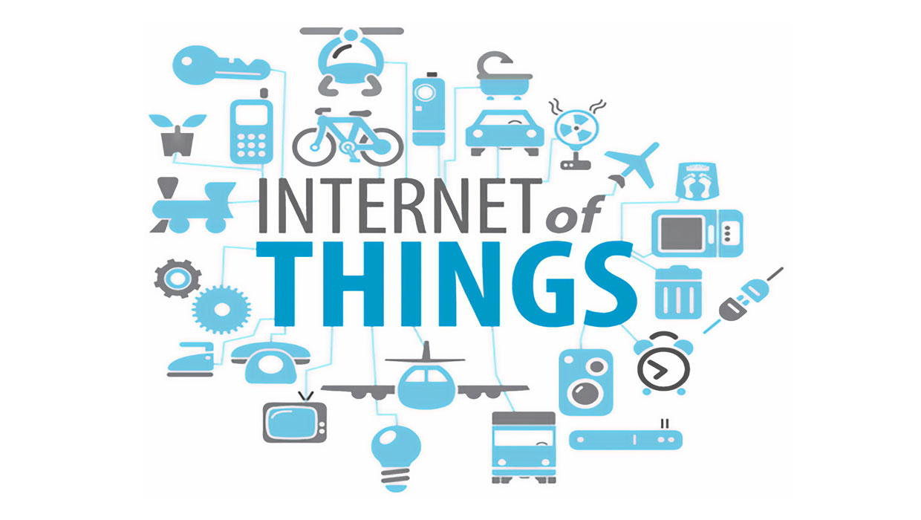

Slide 3
IoT Characteristics
Ubiquitous
Focused
Less powerful
Battery dependent

Slide 4
IoT Security Problems
Low computing power
Small RAM
Easy to spread virus

Slide 5
Web Services for IoT Security
Registration
Authentication
Encryption

Slide 6
Registration
APPID | TOKEN | PRI | PUB
USER1 | ****** | ***** | *****
Server
device
Register(APPID)
TOKEN

Slide 7
Authentication
APPID | TOKEN | PRI | PUB
USER1 | ***** | **** | ****
Server
device
sign(message)
signature
Verify(Message+signature)
device
True/false

Slide 8
Encryption
APPID | TOKEN | PRI | PUB
USER1 | ***** | **** | ****
USER2 | **** | **** | ****
Server
device
encrypt(message)
Ek(message)+Epub(K)
device
Decrypt(Ek(message)+Epub(K))
message

Slide 9
Improvements
TOKEN can be stolen
Eavesdrop is available

