Slide 1
Project Title
3D Dendritic spine analysis using DeepD3

Slide 2
Introduction
Dendritic spines are small protrusions on dendrites that are essential for learning and memory.
DeepD3 is a deep learning framework that can automatically quantify dendritic spines from microscopy data.
This project aims to create 3D regions of interest (ROIs) for dendritic spines using DeepD3 technology.
The results of this project will be a set of 3D ROIs for dendritic spines that can be used for analyzing the morphology and density of dendritic spines.

Slide 3
Basic Workflow
Training Custom DeepD3 network
Data collection
Spine Prediction using Benchmark DataSet
ROI creation
Evaluation using Precision and Recall

Slide 4
DeepD3 framework
DeepD3 is a deep learning framework for the automatic quantification of dendritic spines from microscopy data.
The framework is based on a convolutional neural network (CNN) that is trained on a dataset of manually annotated spines.
The architecture of the DeepD3 CNN is a dual-decoder structure that emerges from a common latent space.
The encoder is based on residual layers together with max pooling operations, whereas the decoder contains upsampling operations, incorporates encoder input and uses conventional convolutional layers.

Slide 5
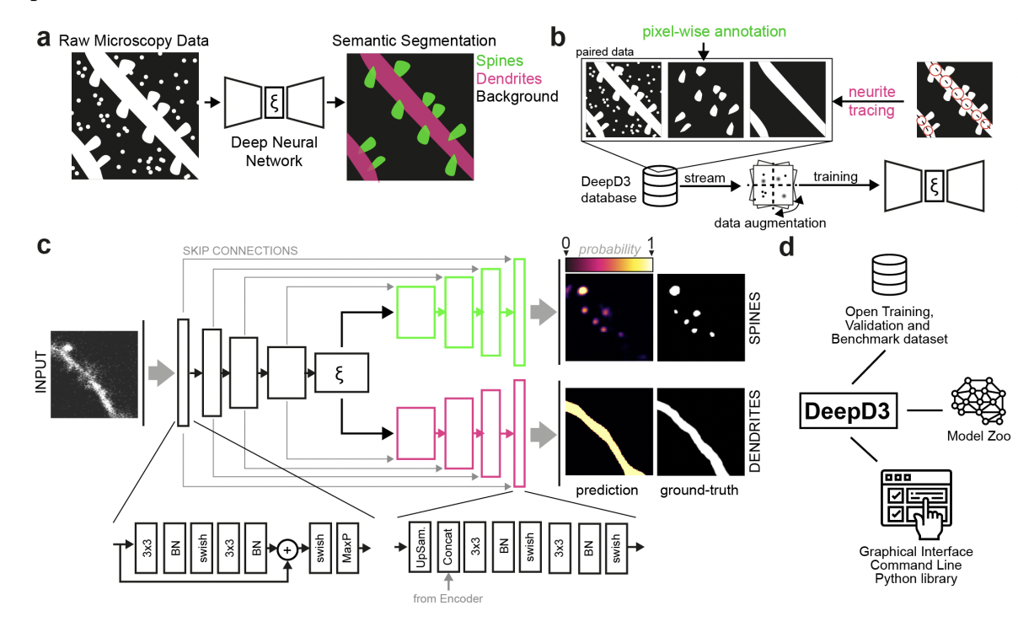
DeepD3 Architecture

Slide 6
Training custom DeepD3
The Hyperparameters used for training the DeepD3 network.
Batch size: 32
Number of Epochs: 20
Learning Rate: 0.0005
Learning Rate Scheduler: lrs function is used as a learning rate scheduler to adjust the learning rate during training.
Optimizer: Adam optimizer
Loss function: Mean squared error (MSE)
These settings were employed to train the network effectively and optimize its performance in achieving the desired results.

Slide 7
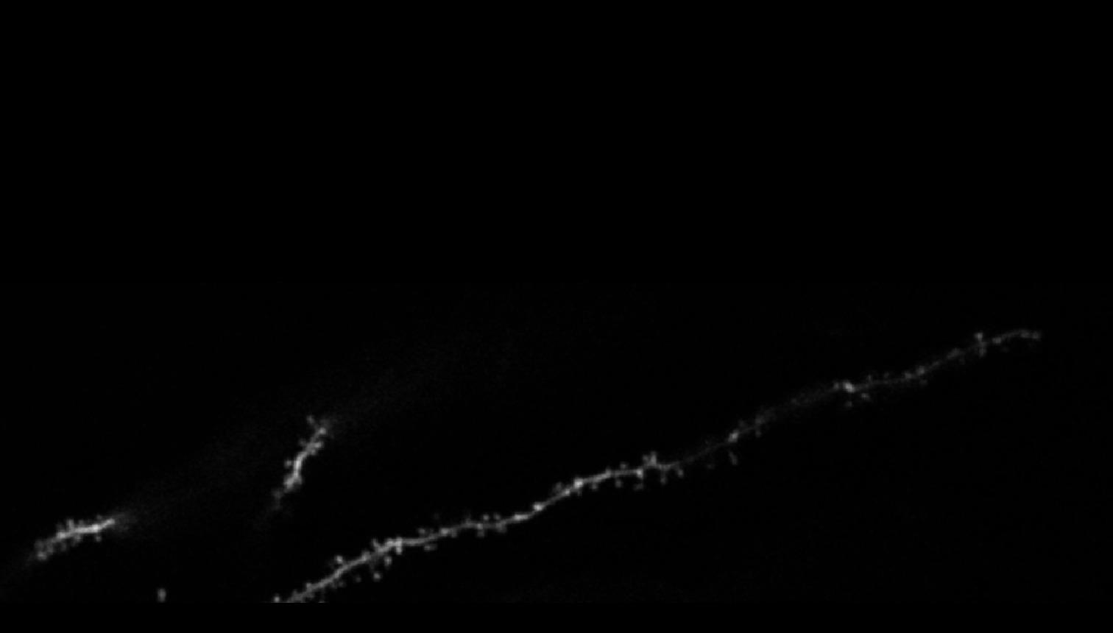
Benchmark dataset
The benchmark dataset is a set of 3D image stacks that have been manually segmented by human experts .(input shape = (384,1472,1))

Slide 8
Prediction using benchmark dataset
Utilizing the benchmark dataset to develop a specialized model for predicting dendritic spine presence and absence.
Predict whole image plane by plane using the trained model on the benchmark 3D image stack.
These predictions are used to generate 3D ROIs of dendritic spines , also be used to evaluate the performance of the model.

Slide 9
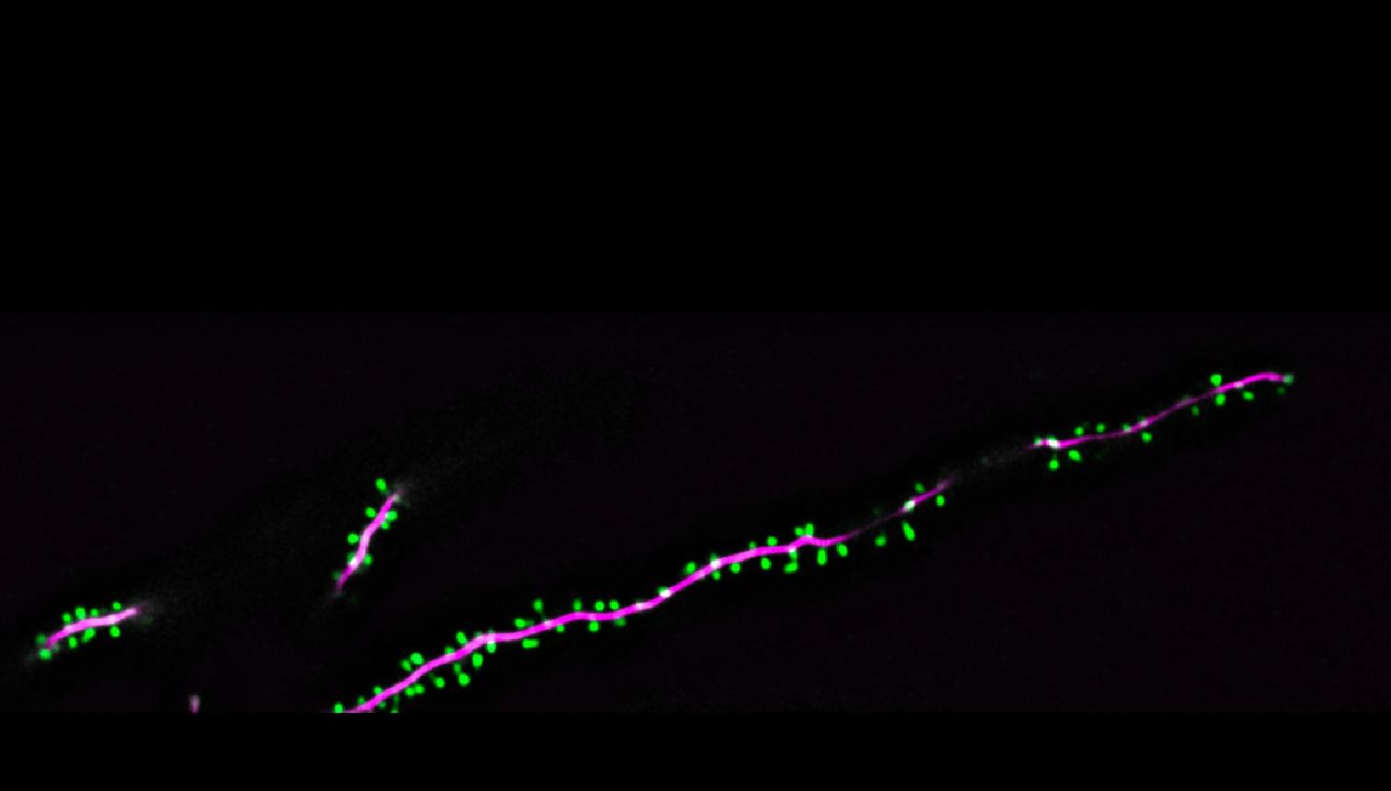
Prediction Output
Dendrites
Spines

Slide 10
3D Custom ROI
Custom ROI generation algorithms are developed to address the need for accurate segmentation and extraction of dendritic spines from 3D microscopy data.
Our custom ROI generation algorithms leverage a graph-based approach for constructing 3D ROIs from dendritic spine prediction probability stack.
These probability stacks are 3D arrays where each voxel value corresponds to the prediction probability of a dendrite or spine being present at that voxel.
We utilize the NetworkX library to construct a graph representation of the 3D volume based on the prediction probabilities.

Slide 11
The method works by creating a graph where each node represents a voxel in the spine prediction volume that is above the areaThreshold.
Edges are added between neighboring voxels to create connections within the graph.(by 26 possible neighboring voxels in a 3D space )
Connected components of the graph are found, with each connected component representing a candidate ROI.
These connected components are then converted to a label volume, where each voxel in an ROI is given a unique label.
We then apply the watershed algorithm to separate overlapping 3D regions of interest (ROIs) in a labeled volume.

Slide 12
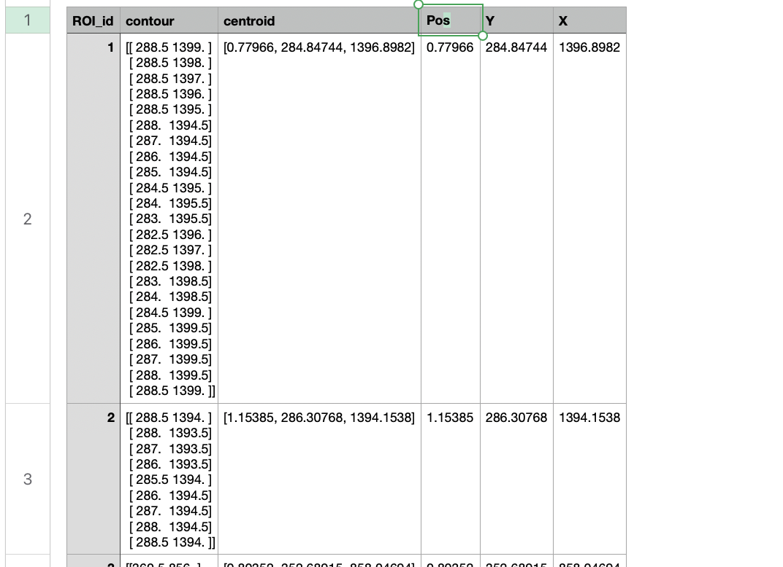
Computes the centroid and contours for each label in an 3D stack containing image labels.
Region of Interest CSV file

Slide 13
Comparison of ROI algorithm
Graph based Custom ROI | Flood-fill based method
Criteria for connectivity: It uses spatial contiguity as the criterion for connecting voxels. Two voxels are considered connected if they are neighbors. | This method not only considers spatial contiguity but also the intensity of the voxel and its distance from the seed pixel.
Region growing strategy: The regions are essentially defined by the topology of the graph, which is determined solely by the spatial arrangement of voxels. | This method grows regions from seed pixels. The regions are iteratively grown by adding neighboring pixels that meet certain criteria.
Role of pixel intensity and Physical distance: It does not directly consider the intensity of voxels and physical distance when defining regions. | It consider the intensity of voxels (above a certain threshold) and physical distance when defining regions(below a certain threshold).

Slide 14
Evaluation Metrics: Recall and Precision
True Positives (TP): The number of algorithm-detected Regions of Interest (ROIs) that match with a human-annotated ROI.
False Positives (FP): The number of algorithm-detected ROIs that do not match with any human-annotated ROI. This could be calculated as the total number of ROIs in a cluster minus the number of true positives.
False Negatives (FN): The number of human-annotated ROIs that do not have a corresponding algorithm-detected ROI.

Slide 15
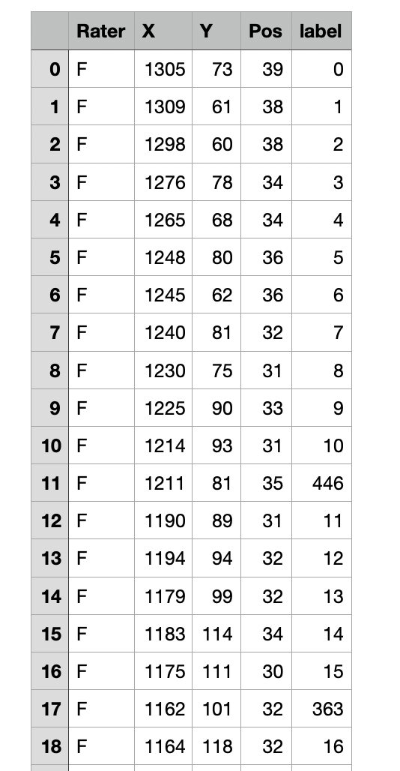
Comparison of custom ROI vs Human annotated

Slide 16
Recall = True Positives / (True Positives + False Negatives)
it tells us how many of the ROIs identified by the human rater were also identified by the algorithm.
Precision = True Positives / (True Positives + False Positives)
it tells us how many of the ROIs identified by the algorithm were also identified by the human rater.
The ROIs generated are grouped into clusters using DBSCAN (Density-Based Spatial Clustering of Applications with Noise).
This algorithm groups together points that are packed closely together (points with many nearby neighbors), marking as outliers points that lie alone in low-density regions.

Slide 17
Split larger clusters using KMeans, removing outliers, and merging smaller clusters if they are close enough.
Calculate Euclidean distance between centroids and is less than or equal to threshold then it is a match.
Then final output is refined clusters displayed in scatter plots and calculated the recall, precision, and F1 score.

Slide 18
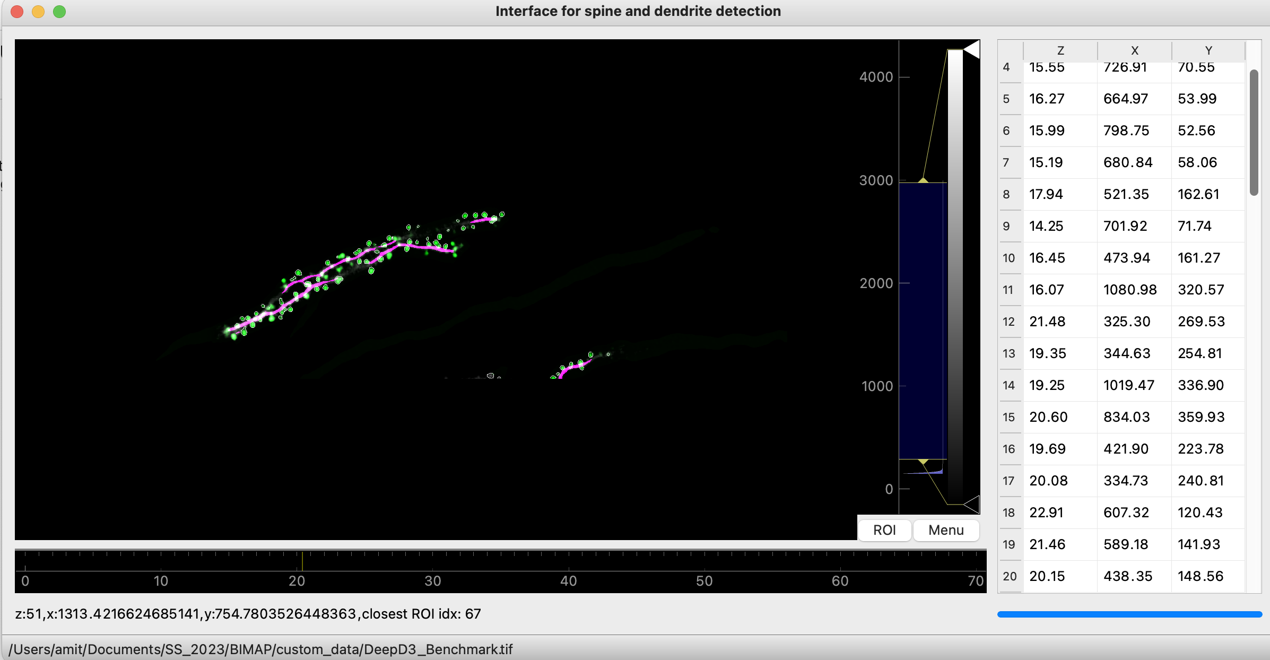
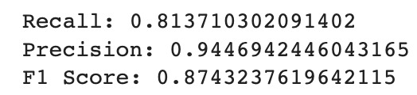
Results
Visualization of 3D ROI with centroids values

Slide 19
Responsibilities
Training Custom ROI DeepD3 : Gresßhma and Amit
Dendrict Spine Prediction & Custom ROI generation: Amit
Evaluation using Precision and Recall : Greshma
Link to the GitHub repository: hthttps://github.com/code-ultron/DeepD3_ROI

Slide 20
Thank you for your attention

