Slide 1

The Stretcher

Slide 2
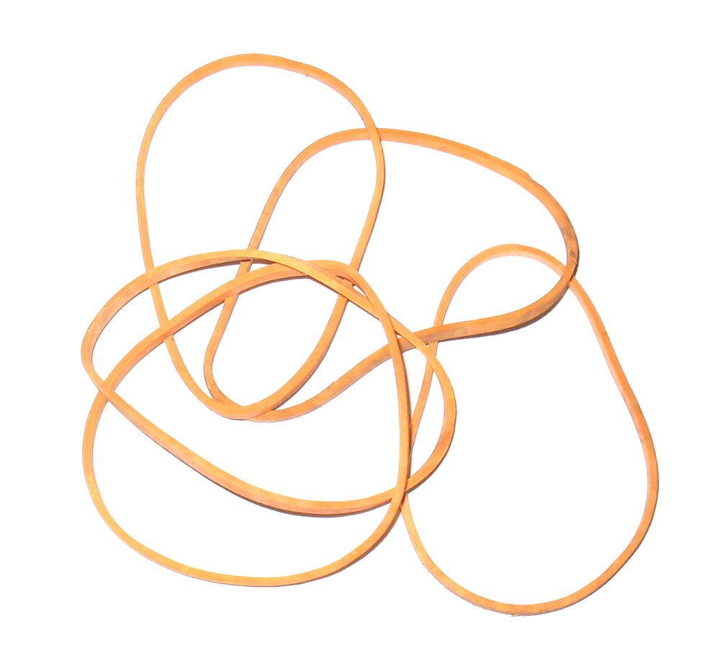
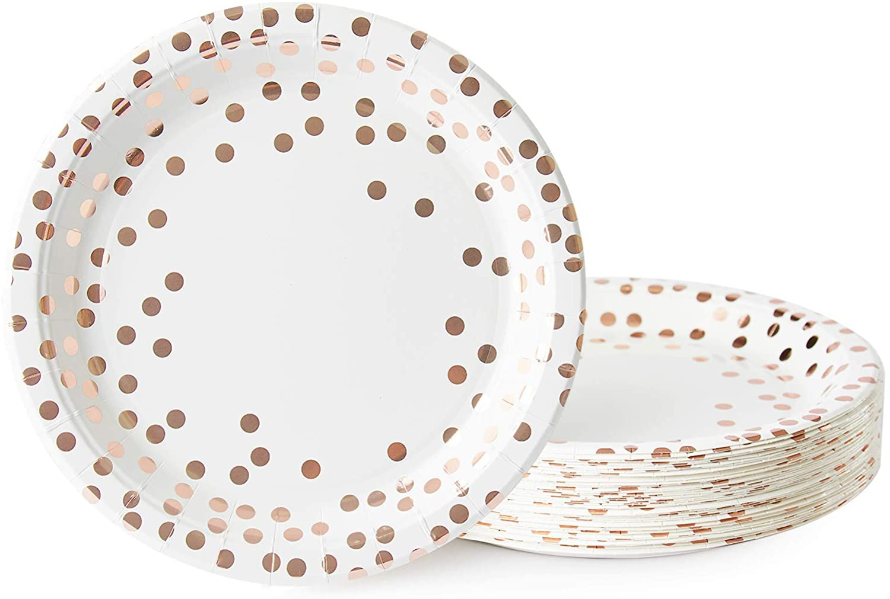
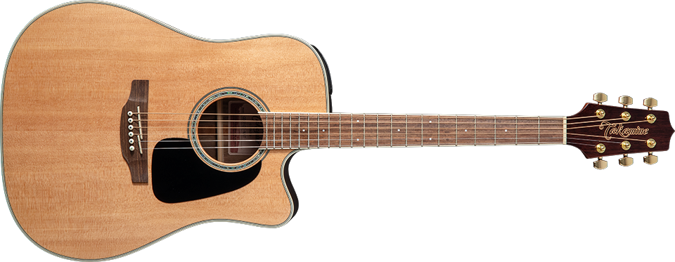
Sales Pitch
Derived from the simple concept of rubber bands and cardboard
Each plate has a different sample that will play at a different pitch based on the intensity of the vibration from the rubber band
Different from guitar because these “strings” are not on one body
Resonantly independent from each other
Resembles a stretcher

Slide 3
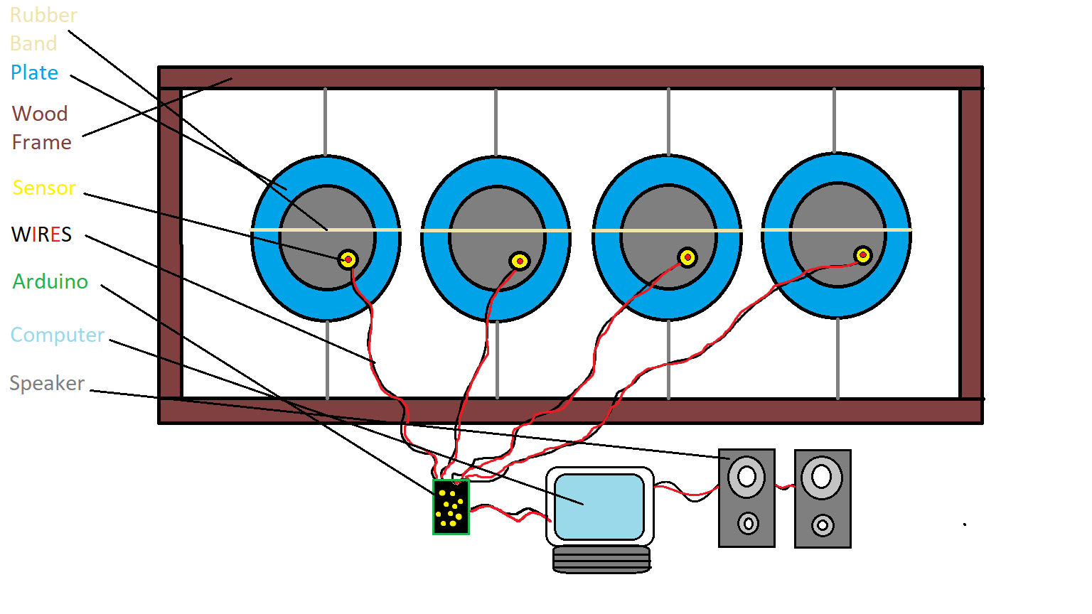

Slide 4


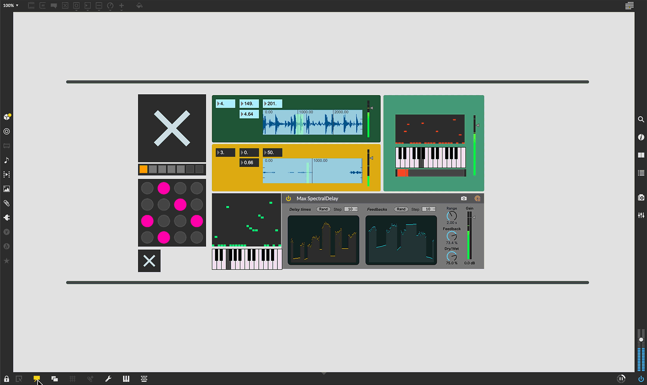
Required Components
Hardware
2 pieces of wood (One 4-foot 2x4 and One 8-foot 2x4)
4 Paper Plates
4 Rubber Bands
4 Wire Extensions
Computer
Speaker
4 Piezo Vibration Sensor Modules
Arduino
Software
Max Sound Software (https://cycling74.com/products/max)

Slide 5
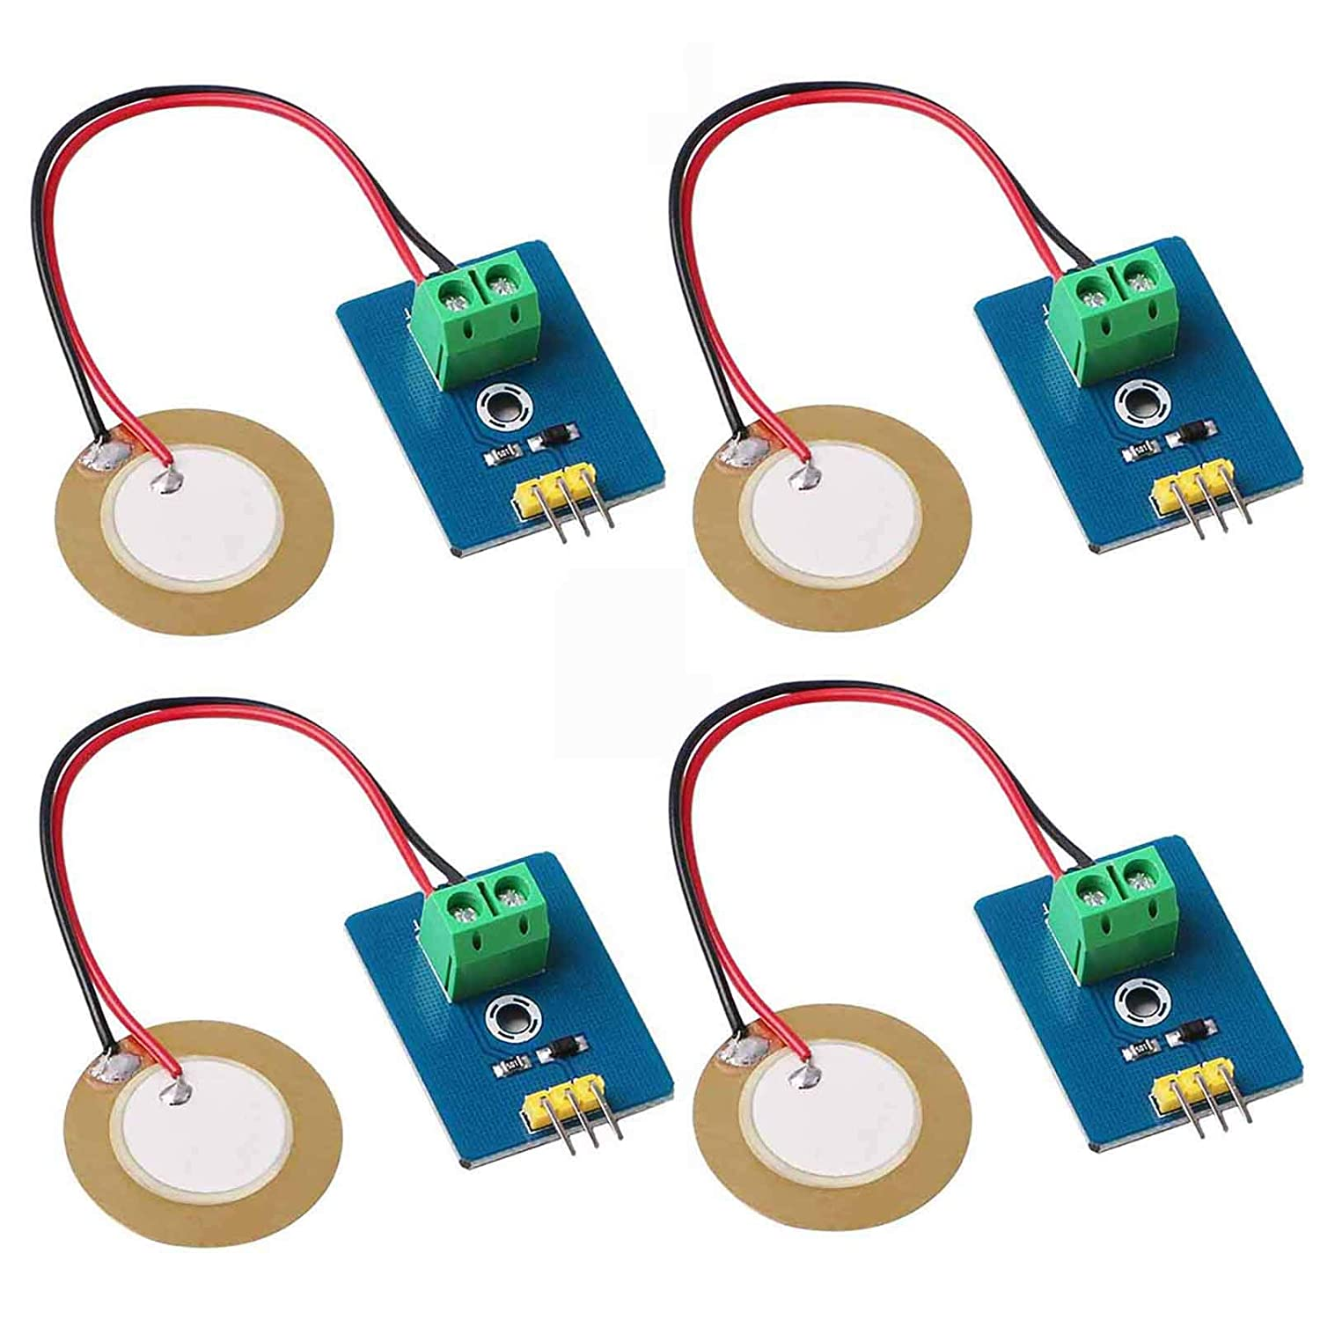
Sensor Decision
“MakerHawk Analog Ceramic Piezo Vibration Sensor Module 3.3V/5V for Arduino DIY Kit”
Few decisions to make for ways to capture the vibrations best
Essentially a better sensor for capturing vibrations of each plate
Will need wire extensions because of short wires
Piezo talks to Arduino then through USB to computer then plays that on the speaker

Slide 6

Construction
Made of a lot of items I already possess
Purchased sensors already
Building frame will not take long
Very practical to make because it won’t cost that much and will be very possible to assemble
Should not interfere with any other classes because I’ll have plenty of time on weekends
1) Assemble Frame
2) String up plates with rubber bands across them,
3) Attach Sensors to plates and configure with Arduino
4) Start setting up interface through Max to set Samples with pitch Accordingly with speakers attached

Slide 7

End

