Slide 1
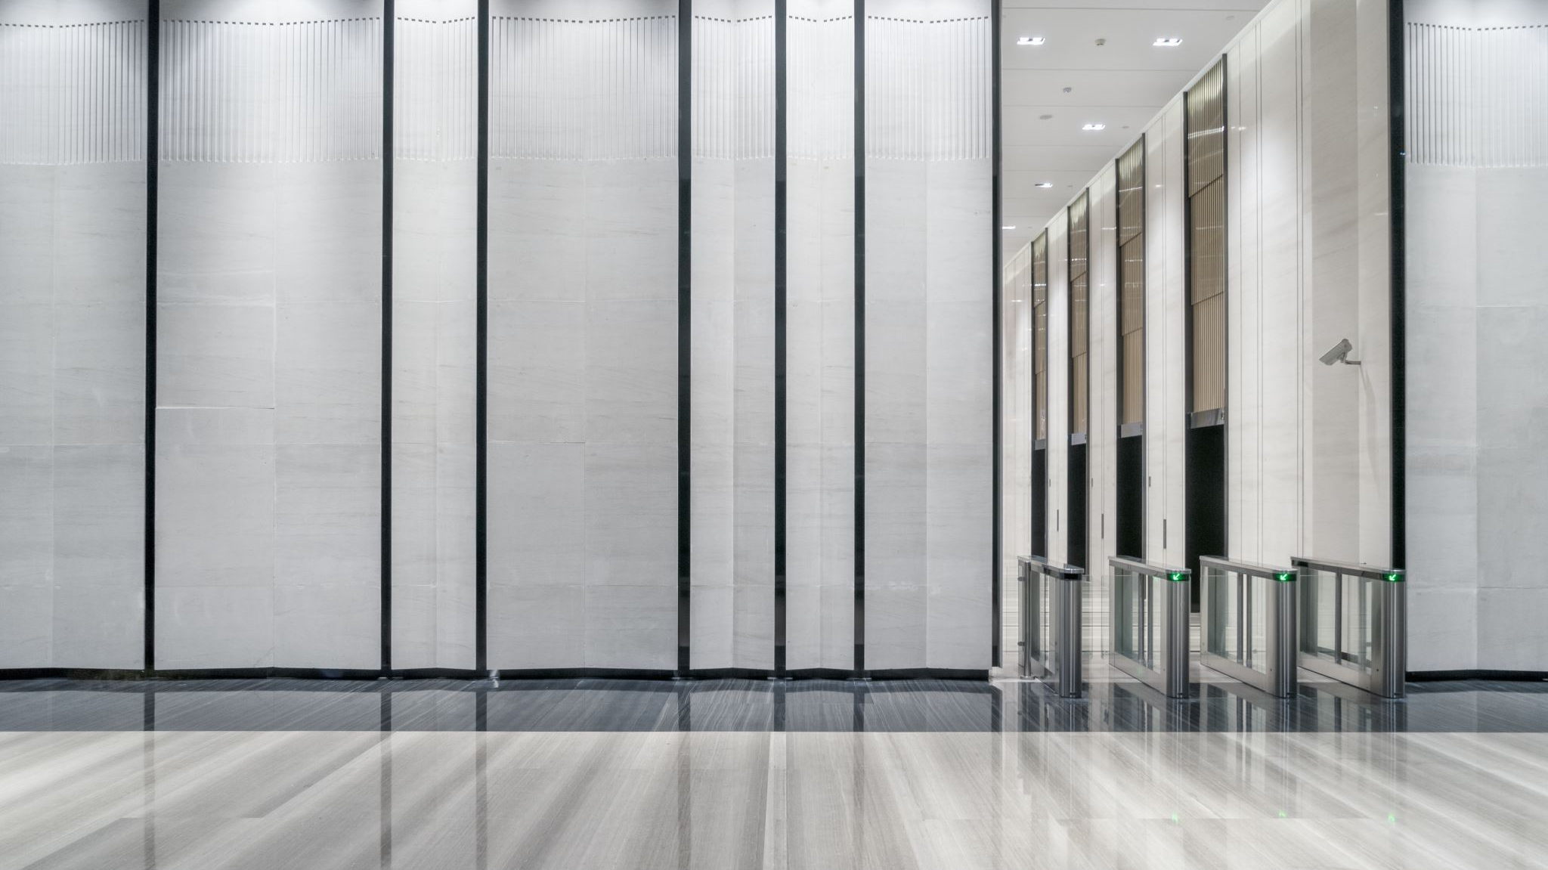
Troisième étage
Sam Coates

Slide 2
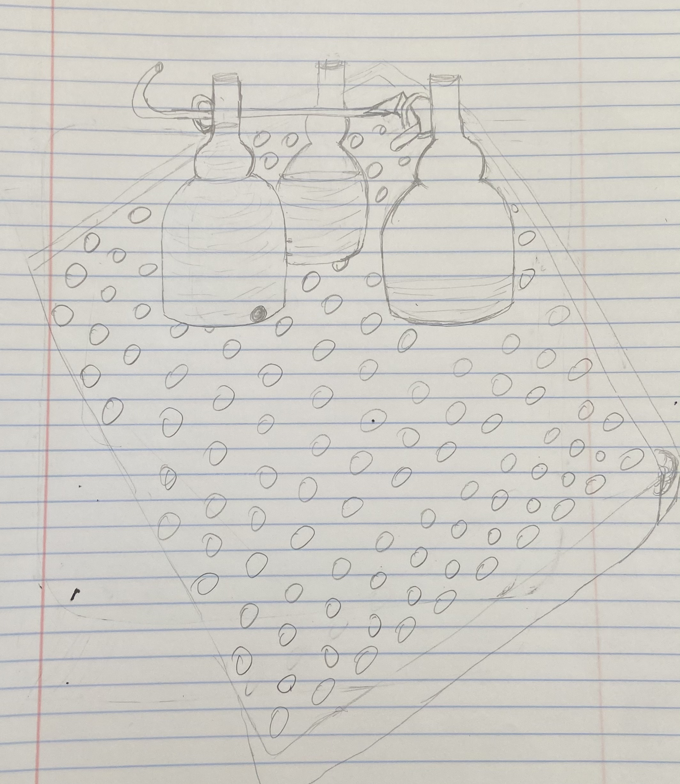
Concept

Slide 3
Understanding the Troisième étage
This NIME utilizes the glass and marbles to bring about different pitches of sounds depending on the water level in each container.
Marbles are necessary due to the type of material to bring about this sound.
This NIME is unique because of the style, display and usage of marbles and glass to produce a rhythm-based sound from the different glasses as well as metal in the middle to provide a little extra flare similar to what cymbals are to dumbs.

Slide 4
Technical description
I will need glass containers, marbles, and a piece of metal.
These parts will all synchronize by coming together as the marbles will be used to produce the musical expression.
The marbles are the pieces used to play the Troisième étage by tapping them on the instrument (similar to what drumsticks are to a drum).
The sound created is a sharp quick tone with varying fluctuations in pitch depending on where on the instrument is tapped.
I approached the creation of this NIME by using three glass containers, a piece of metal, and hard marbles together by experimenting different sounds, methods, and pitches to bring about my desired outcome

