Slide 1

Shree Ramswaroop Memorial University,Lucknow
SEMINAR PRESENTATION
On
BIG DATA ANALYSIS
Session: 2023-2024
Department of Computer Science & Engineering
Presented By:
Aditya Gond
B.Tech CSE 3rd Year Group-64 Roll No.-202110101110106
Under Supervision Of:
Mr. Neelesh Mishra

Slide 2
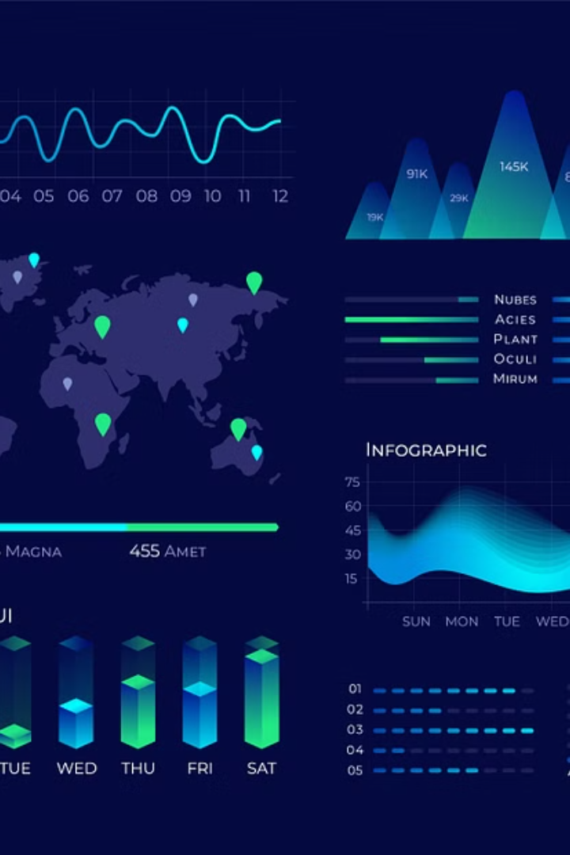
Introduction to Big Data
Big data refers to the massive and complex datasets that are difficult to process using traditional data management tools and techniques. It has become an essential part of modern business and technological advancements, offering valuable insights and opportunities for organizations.

Slide 3

What is Big Data?
1
Volume
2
Velocity
Big data deals with large volumes of data, often in the range of terabytes or petabytes, that are generated from various sources like social media, sensors, and transactional systems.
Big data is characterized by the high speed at which data is created, collected, and processed, often in real-time or near real-time.
3
Variety
Big data encompasses a wide range of data types, including structured, unstructured, and semi-structured data, such as text, images, videos, and sensor data.

Slide 4
Characteristics of Big Data
Volume
Velocity
Variety
The sheer amount of data generated from various sources, often in the range of terabytes or petabytes.
The speed at which data is created, collected, and processed, often in real-time or near real-time.
The wide range of data types, including structured, unstructured, and semi-structured data, such as text, images, videos, and sensor data.

Slide 5
Sources and Types of Big Data
Social Media
Internet of Things (IoT)
Data from platforms like Facebook, Twitter, and Instagram, including user-generated content, interactions, and metadata.
Data generated by connected devices, such as sensors, smart home appliances, and industrial equipment.
Transactional Data
Clickstream Data
Data from various business transactions, such as sales, purchases, and financial records.
Data that tracks user interactions and behaviors on websites and mobile applications.

Slide 6
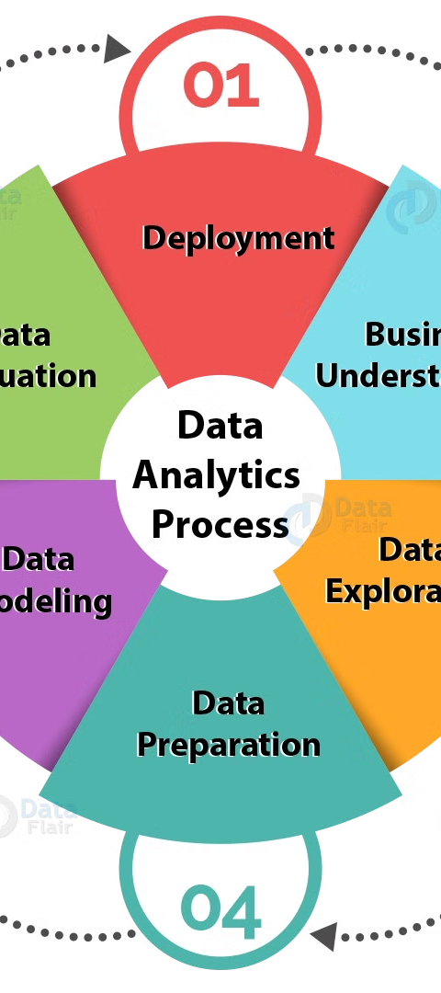
Big Data Analytics Techniques
1
Predictive Analytics
Leveraging statistical models and machine learning to forecast future trends and behaviors based on historical data.
2
Prescriptive Analytics
Providing recommendations and actions to optimize decision-making based on insights from data analysis.
3
Descriptive Analytics
Analyzing past and current data to understand what has happened and why, using techniques like reporting and data visualization.

Slide 7




Challenges in Big Data Analysis
Data Quality
Data Privacy
Data Storage
Data Processing
Ensuring the accuracy, completeness, and reliability of large, diverse datasets.
Protecting sensitive information and complying with data protection regulations.
Managing the massive volumes of data and finding cost-effective storage solutions.
Developing the computational power and software tools to analyze large, complex datasets in a timely manner.

Slide 8
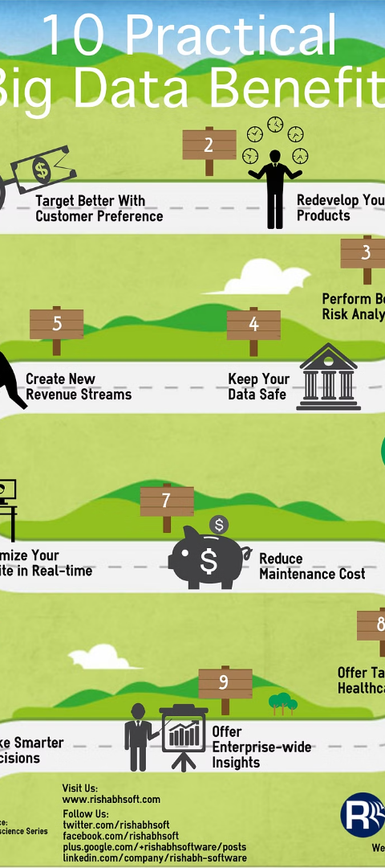



Benefits of Big Data Analysis
Improved Decision-Making
Big data analysis provides insights that enable more informed and data-driven decision-making.
Operational Efficiency
Big data can help organizations identify and address inefficiencies, optimizing processes and reducing costs.
New Revenue Streams
Big data analysis can uncover new business opportunities and lead to the development of innovative products and services.

Slide 9

Conclusion and Future Trends
As the volume, velocity, and variety of data continue to grow, the importance of big data analysis will only increase. Emerging technologies, such as artificial intelligence, machine learning, and edge computing, will further enhance the capabilities of big data analytics, leading to more powerful insights and transformative business opportunities.

