Slide 1

Apna IIT & Digital Manta Collaboration
Transforming Student Careers through Strategic Partnership
About Apna IIT
Empowering Students
Vision
Apna IIT is a premier institute offering specialized coding-related training to help students achieve high-paying packages and successful careers.
Empower students with the right skills to excel in the competitive tech industry.

Slide 2
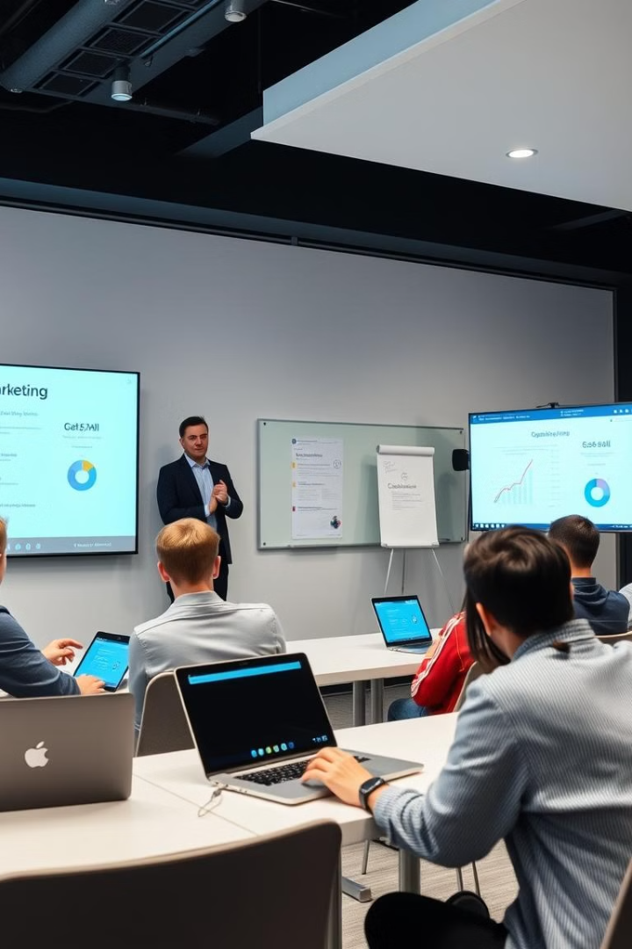
The Collaboration Vision
Attract more students through strategic marketing campaigns.
Foster business growth for both organizations by aligning technical education with marketing expertise

Slide 3



Collaboration Objectives
1
Enhance Employability
2
Bridge Skill Gap
3
Expand Opportunities

Slide 4





Key Collaboration Initiatives
Curriculum Co-Design
Hands-On Workshops
Internships
Placement Support
Developing a joint curriculum that integrates coding and digital marketing skills.
Providing practical workshops and training sessions led by Digital Manta experts.
Offering guaranteed internships with Digital Manta to gain real-world experience.
Providing guidance and assistance with job placement in the digital marketing field.

Slide 5
Benefits for Apna IIT Students
1
Industry-Relevant Training
2
Guaranteed Internships
3
Placement Assistance

Slide 6

Next Steps and Conclusion
Launching the Pilot
Formalizing the collaboration between Apna IIT and Digital Manta.
Implementing a pilot program to assess the effectiveness of the collaboration.
Scaling the Partnership
Expanding the program to a larger number of students and expanding the scope of collaboration.

