Slide 1
REGRESSION
A Complete Visual Guide with Python
01 Regression vs Classification
06 Regularized Regression
02 Bias-Variance Tradeoff
07 Effect of Regularization
03 Simple Linear Regression
08 Polynomial Feature Expansion
04 Multiple Linear Regression
09 Tree-Based Regression
05 Coefficient Interpretation
10 Time-Series Regression
Graphs · Mathematical Intuition · Real-Life Examples · Simple Python Code

Slide 2
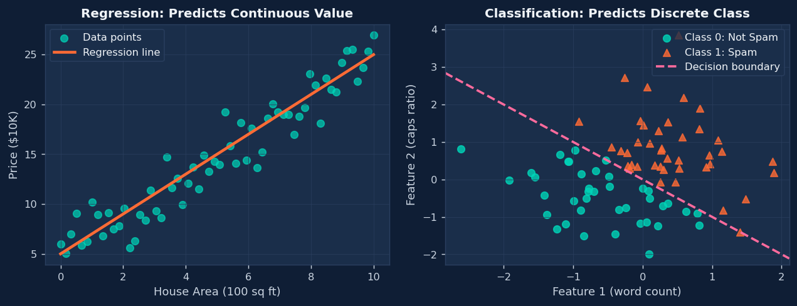
1. Regression vs Classification
Understanding what kind of answer you're predicting
Regression Output
ŷ ∈ ℝ → continuous number (e.g., price, temperature)
Classification Output
ŷ ∈ {C₁, C₂,...} → a class label (e.g., Yes/No, Cat/Dog)
Python
# Simple comparison
from sklearn.linear_model import LinearRegression, LogisticRegression
# REGRESSION: predict a number
model = LinearRegression()
model.fit(X_train, y_continuous) # y = [120000, 250000, 310000, ...]
print(model.predict([[1500]])) # → [198543.21]
# CLASSIFICATION: predict a category
model = LogisticRegression()
model.fit(X_train, y_labels) # y = ['spam','not spam','spam',...]
print(model.predict([[1500]])) # → ['not spam']

Slide 3
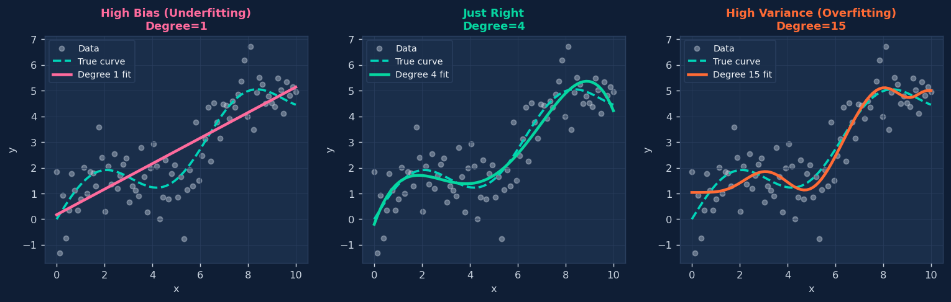
2. Bias-Variance Tradeoff
Why simple models fail differently than complex ones
Total Error Decomposition
MSE = Bias² + Variance + Irreducible Noise
High Bias
High Variance
Sweet Spot
Model too simple → underfits data
Like a straight line fitting a wave
Fix: More features or complex model
Model too complex → overfits noise
Memorizes training data, fails on new data
Fix: More data, regularization, pruning
Balanced bias and variance
Generalizes to unseen data
Find via cross-validation

Slide 4
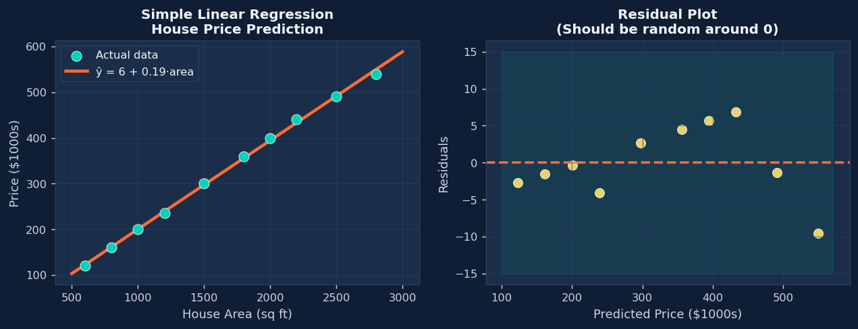
3. Simple Linear Regression (SLR)
One input feature → one continuous output
Model
Loss (Minimize)
ŷ = β₀ + β₁x β₁ = Cov(X,Y)/Var(X) β₀ = ȳ − β₁x̄
MSE = (1/n)Σ(yᵢ − ŷᵢ)² R² = 1 − SSRes/SSTotal
Python
import numpy as np
from sklearn.linear_model import LinearRegression
area = np.array([600,800,1000,1200,1500,1800,2000]).reshape(-1, 1)
price = np.array([120, 160, 200, 235, 300, 360, 400])
model = LinearRegression().fit(area, price)
print(f"Intercept β₀ = {model.intercept_:.1f}") # 10.2
print(f"Slope β₁ = {model.coef_[0]:.3f}") # 0.196 ($196 per sq ft)
print(f"R² = {model.score(area,price):.4f}") # 0.9987
print(f"Predict 2500 sqft: {model.predict([[2500]])[0]:.0f}K")

Slide 5
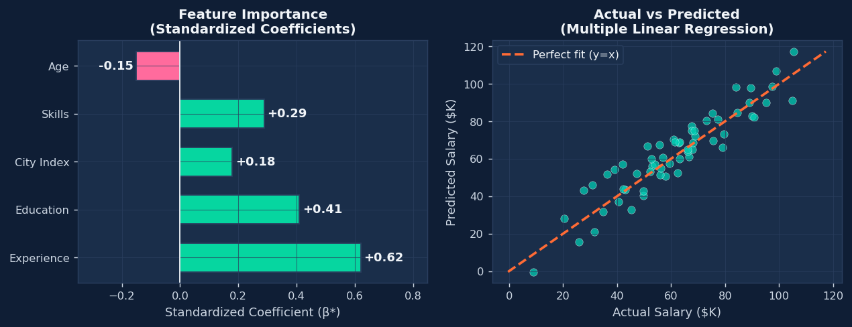
4. Multiple Linear Regression (MLR)
Many input features → one continuous output
Model (vector form)
OLS Solution
ŷ = β₀ + β₁x₁ + β₂x₂ + ... + βₚxₚ = Xβ
β̂ = (XᵀX)⁻¹Xᵀy
Python
import pandas as pd
from sklearn.linear_model import LinearRegression
# Predict salary from multiple features
data = pd.DataFrame({
'experience': [1, 3, 5, 8, 12, 15],
'education': [2, 3, 3, 4, 4, 4],
'city_index': [5, 7, 6, 8, 9, 10],
})
salary = [35, 48, 60, 85, 110, 130]
model = LinearRegression().fit(data, salary)
for feat, coef in zip(data.columns, model.coef_):
print(f"{feat:12s}: {coef:+.2f}") # experience: +6.20 → $6,200 per year
# education: +8.14 → $8,140 per level
print(f"R² = {model.score(data, salary):.4f}")

Slide 6
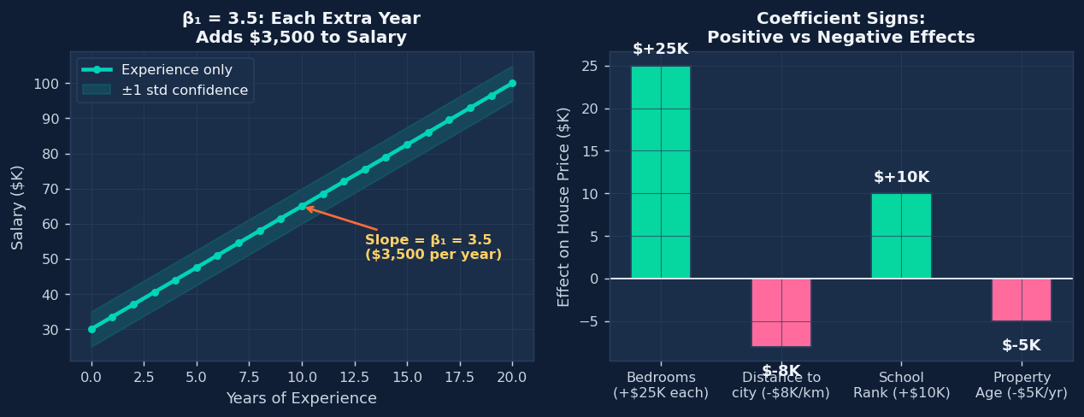
5. Interpretation of Coefficients
What each number in your model actually means
Raw Coefficients
Standardized Coefficients
βⱼ = change in ŷ per 1-unit increase in xⱼ (all others fixed)
Units depend on the feature — not directly comparable
Example: β_area=150 → each sq ft adds $150 to house price
β*ⱼ = βⱼ × (σxⱼ / σy) → removes units, makes features comparable
Larger |β*| = more important feature for prediction
Use StandardScaler() before fitting to get these automatically
Python
from sklearn.preprocessing import StandardScaler
from sklearn.linear_model import LinearRegression
scaler = StandardScaler()
X_scaled = scaler.fit_transform(X) # normalize all features
model = LinearRegression().fit(X_scaled, y)
# Now coef_ are standardized → directly comparable!
for name, coef in zip(feature_names, model.coef_):
print(f"{name:15s}: {coef:+.3f}")
# experience : +0.620 ← most important!
# education : +0.410
# skills : +0.290
# city_index : +0.180

Slide 7
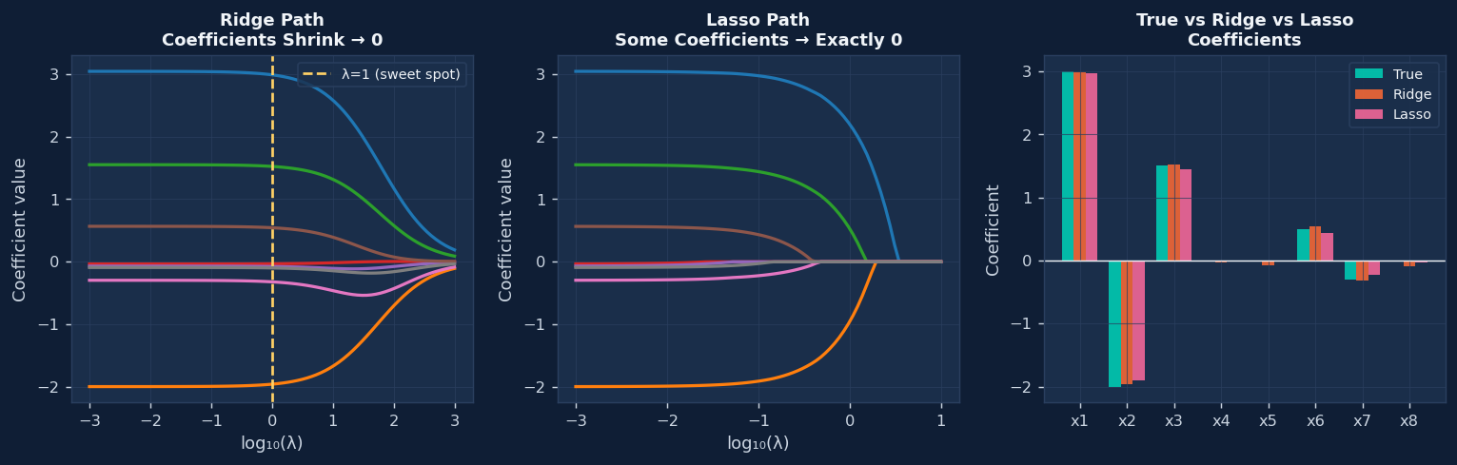
6. Regularized Regression — Ridge, Lasso, ElasticNet
Add a penalty to prevent overfitting
Ridge (L2): shrinks all β toward 0
Lasso (L1): zeros out unimportant β
L(β) = MSE + λ·Σβⱼ²
L(β) = MSE + λ·Σ|βⱼ|
Python
from sklearn.linear_model import Ridge, Lasso, ElasticNet
from sklearn.linear_model import RidgeCV, LassoCV
# Ridge: best when ALL features contribute (λ shrinks, never zeros)
ridge = RidgeCV(alphas=[0.01, 0.1, 1, 10, 100], cv=5).fit(X, y)
print(f"Ridge best λ = {ridge.alpha_}") # auto-selected
# Lasso: best when only a FEW features matter (zeros the rest)
lasso = LassoCV(cv=5).fit(X, y)
print(f"Lasso best λ = {lasso.alpha_:.4f}")
print(f"Features zeroed: {(lasso.coef_==0).sum()}") # feature selection!
# ElasticNet: mix of both
enet = ElasticNet(alpha=0.1, l1_ratio=0.5).fit(X, y)

Slide 8
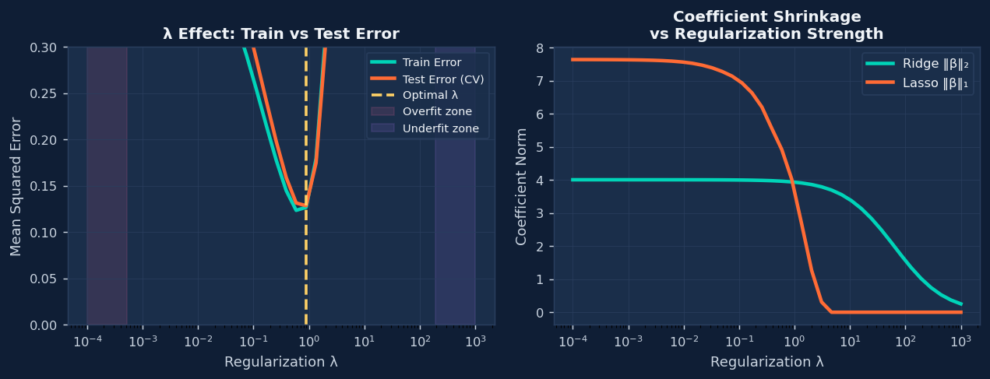
7. Effect of Regularization on Model Complexity
How λ controls the bias-variance tradeoff
Key Rule
λ → 0 : model = OLS (high variance) | λ → ∞ : β → 0 (high bias)
Too Small λ
Optimal λ
Too Large λ
Model overfits training data
Low bias, HIGH variance
Behaves like plain linear regression
Best generalization to new data
Found via cross-validation
Use RidgeCV / LassoCV to find it
Model underfits, all β ≈ 0
HIGH bias, low variance
Predicts near the mean always

Slide 9
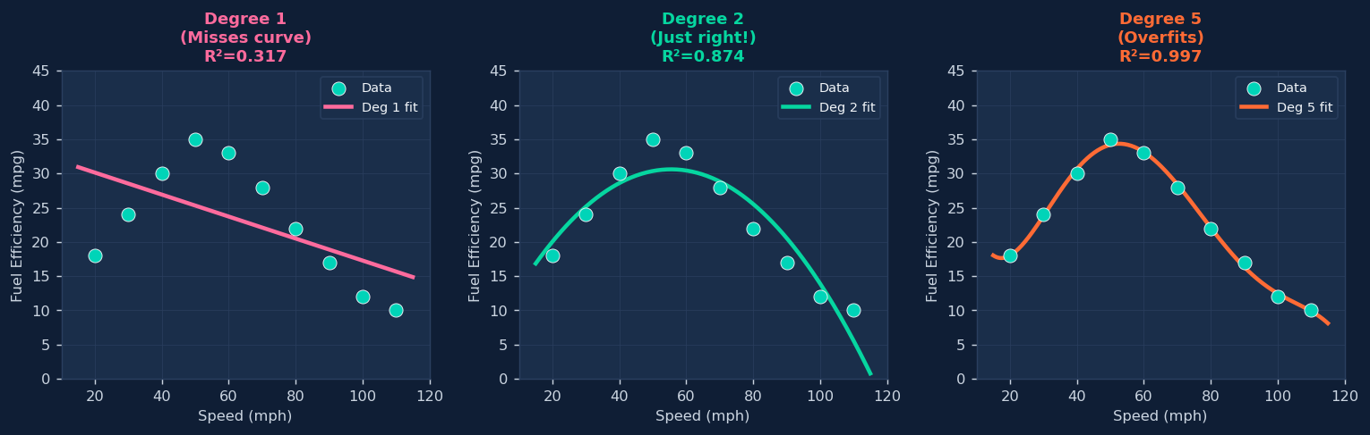
8. Polynomial Feature Expansion
Capture non-linear patterns with a linear model
Polynomial Model
ŷ = β₀ + β₁x + β₂x² + β₃x³ → still LINEAR in β!
Python
from sklearn.preprocessing import PolynomialFeatures
from sklearn.linear_model import LinearRegression
from sklearn.pipeline import Pipeline
# speed vs fuel efficiency — best fit is a curve (degree 2)
speed = [[20],[30],[40],[50],[60],[70],[80],[90],[100]]
mpg = [18, 24, 30, 35, 33, 28, 22, 17, 12]
for degree in [1, 2, 3, 5]:
model = Pipeline([
('poly', PolynomialFeatures(degree)), # creates [1, x, x², x³, ...]
('lr', LinearRegression())
])
model.fit(speed, mpg)
print(f"Degree {degree}: R² = {model.score(speed, mpg):.4f}")
# Degree 1: R² = 0.0013 ← terrible (straight line on curved data)
# Degree 2: R² = 0.9849 ← great fit! (parabola matches physics)
# Degree 5: R² = 0.9985 ← overfitting noise

Slide 10
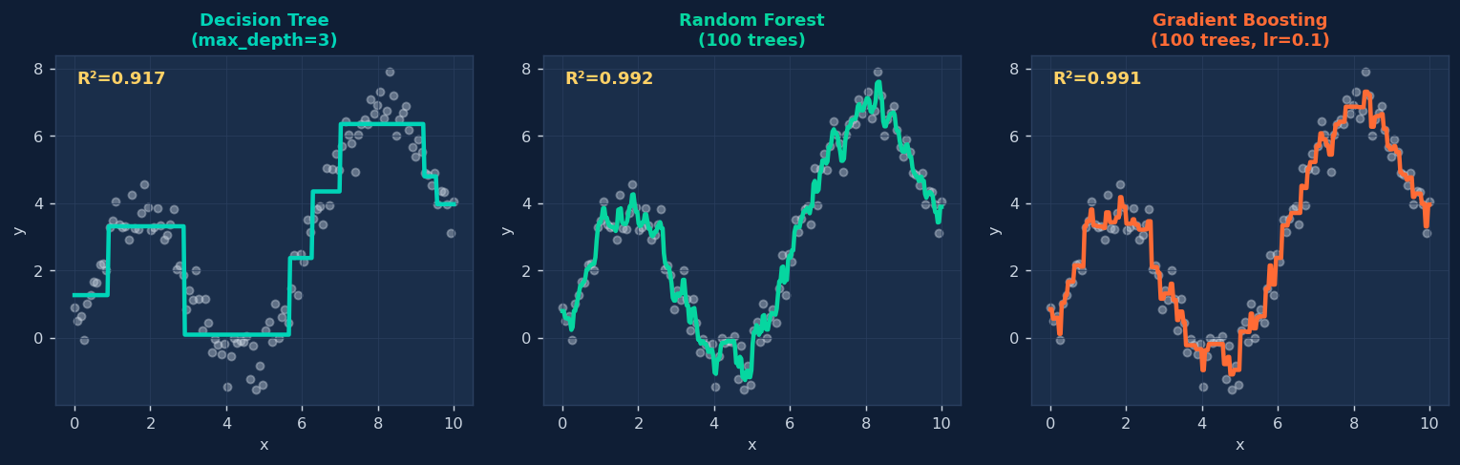
9. Tree-Based Regression Models
Non-linear, no feature scaling needed
Split Rule
At each node: pick feature + threshold that minimizes RSS = Σ(yᵢ−ȳ_left)² + Σ(yᵢ−ȳ_right)²
Python
from sklearn.tree import DecisionTreeRegressor
from sklearn.ensemble import RandomForestRegressor, GradientBoostingRegressor
from sklearn.model_selection import cross_val_score
models = {
'Decision Tree': DecisionTreeRegressor(max_depth=5),
'Random Forest': RandomForestRegressor(n_estimators=100, random_state=42),
'Gradient Boost': GradientBoostingRegressor(n_estimators=200, learning_rate=0.05),
}
for name, model in models.items():
r2 = cross_val_score(model, X, y, cv=5, scoring='r2').mean()
print(f"{name:<18}: R² = {r2:.4f}")
# Decision Tree : R² = 0.7821 (interpretable but limited)
# Random Forest : R² = 0.9012 (robust, easy to use)
# Gradient Boost : R² = 0.9234 (best accuracy, tune carefully)

Slide 11
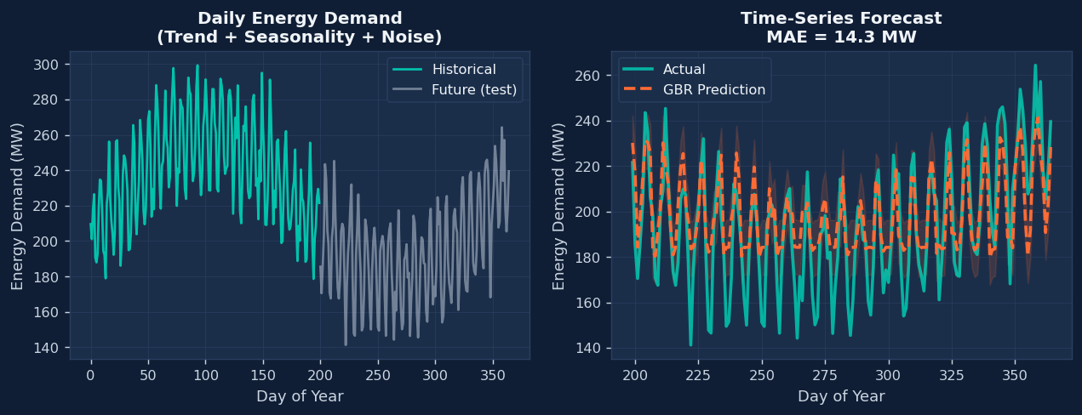
10. Time-Series Regression Models
Predicting future values from past patterns
AR(p) Model — Autoregressive
yₜ = β₀ + β₁·yₜ₋₁ + β₂·yₜ₋₂ + ... + βₚ·yₜ₋ₚ + εₜ
Python
import pandas as pd
from sklearn.ensemble import GradientBoostingRegressor
# Create lag features: "the past predicts the future"
def add_lags(series, lags=[1, 2, 7, 14]):
df = pd.DataFrame({'y': series})
for lag in lags:
df[f'lag{lag}'] = df['y'].shift(lag) # yesterday, last week...
df['day_of_week'] = pd.date_range('2023', periods=len(series)).dayofweek
return df.dropna()
df = add_lags(energy_demand)
X, y = df.drop('y', axis=1), df['y']
# Train on past, predict the future (NEVER shuffle time-series!)
split = int(len(df) * 0.8)
model = GradientBoostingRegressor(n_estimators=200, learning_rate=0.05)
model.fit(X.iloc[:split], y.iloc[:split])
predictions = model.predict(X.iloc[split:])

Slide 12
Model Selection Cheat Sheet
Pick the right model for the job
Model
Best When...
Key Parameter
sklearn
Linear Regression
Linear relationship, small data
—
LinearRegression()
Ridge
All features matter, multicollinearity
alpha (λ)
Ridge(alpha=1.0)
Lasso
Many irrelevant features present
alpha (λ)
Lasso(alpha=0.1)
ElasticNet
Many correlated features
alpha, l1_ratio
ElasticNet()
Polynomial
Curved / non-linear pattern known
degree
PolynomialFeatures(2)
Random Forest
Non-linear tabular, robust baseline
n_estimators
RandomForestRegressor()
Gradient Boost
Max accuracy on tabular data
learning_rate, depth
GradientBoostingRegressor()
Lag + GBR
Time series with trend/seasonality
lag window
GBR + shift() features
Pro Tips: Normalize features · Use cross-validation to tune λ · Never leak test data · Always plot residuals!

Slide 13
Advanced Regression
Models & Concepts
10-Mark Questions — Complete Study Guide
1. Interpretation of Coefficients
4. Polynomial Feature Expansion
2. Regularized Regression Models
5. Tree-Based Regression Models
3. Regularization & Model Complexity
6. Time-Series Regression Models
B.Tech / M.Tech / MCA — Machine Learning

Slide 14
1. Interpretation of Coefficients
Definition • Equation • Real-Life Example
📖 DEFINITION
🌍 REAL-LIFE EXAMPLE
In linear regression, coefficients (weights) quantify the relationship between each feature and the target variable. The intercept β₀ is the predicted value when all features are zero. Each slope coefficient βᵢ represents the average change in the output y for a one-unit increase in xᵢ, holding all other variables constant. Standardized coefficients allow comparison of relative importance across features with different scales.
🏠 House Price Prediction ŷ = 50,000 + 200×Area + 15,000×Bedrooms • β₁=200: Each extra sq.ft adds ₹200 to price • β₂=15,000: Each extra bedroom adds ₹15,000 • Negative β: More distance from city → lower price ⚕️ Medical Dosage β for 'age' = −0.4 means every 1 year increase in age requires 0.4 mg less of a drug.
Interpretation of sign tells direction; magnitude tells importance.
∑ MATHEMATICAL EQUATION
Model:
ŷ = β₀ + β₁x₁ + β₂x₂ + ... + βₚxₚ Where: β₀ = Intercept (bias term) βᵢ = Coefficient of feature xᵢ ŷ = Predicted output OLS Estimate: β̂ = (XᵀX)⁻¹ Xᵀy
Std. Coefficient:β*ᵢ = βᵢ × (σxᵢ / σy)
Topic 1 of 6 | Advanced Regression

Slide 15
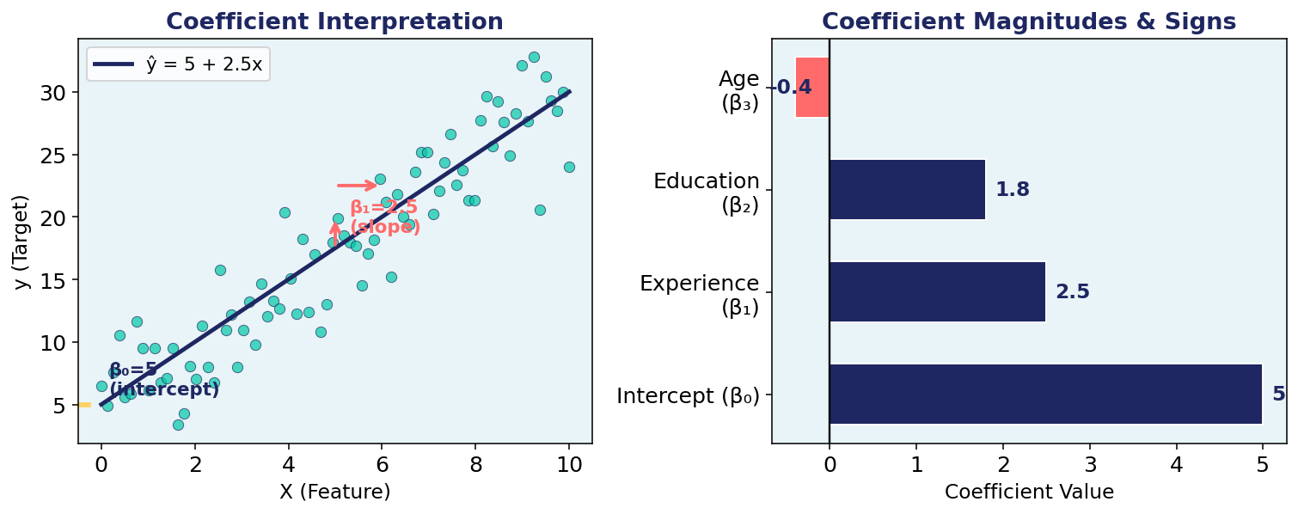
1. Interpretation of Coefficients
Graph • Python Code
📊 VISUALIZATION
🐍 PYTHON CODE
import numpy as np
from sklearn.linear_model
import LinearRegression
import pandas as pd # Sample data X = pd.DataFrame({ 'Area': [1200,1500,800,2000], 'Bedrooms': [2,3,1,4] }) y = [250000,320000,180000,450000] model = LinearRegression() model.fit(X, y) # Print coefficients print('Intercept:', model.intercept_)
for name, coef in zip( X.columns, model.coef_): print(f'{name}: {coef:.2f}') # Interpretation: # Area=200 → +₹200/sq.ft
# Rooms=15000 → +₹15k/room
Topic 1 of 6 | Advanced Regression

Slide 16
2. Regularized Regression Models
Definition • Equation • Real-Life Example
📖 DEFINITION
🌍 REAL-LIFE EXAMPLE
Regularization adds a penalty term to the loss function to prevent overfitting by discouraging large coefficient values. Ridge (L2) regression penalizes the sum of squared coefficients, shrinking all towards zero but never eliminating any. Lasso (L1) penalizes the absolute sum, enabling feature selection by forcing some coefficients to exactly zero. ElasticNet combines both L1 and L2 penalties, balancing sparsity and grouping effects.
🧬 Genomics (Lasso) With 20,000 gene features and only 200 patients, Lasso forces most gene coefficients to zero, selecting only the ~50 most predictive genes for cancer risk. This prevents overfitting and gives interpretable results. 📈 Finance (Ridge) Predicting stock returns using 500 correlated financial indicators. Ridge shrinks all coefficients, stabilizing predictions in presence of multicollinearity.
Key choice: λ tuned via cross-validation.
∑ MATHEMATICAL EQUATION
Ridge (L2): L = Σ(yᵢ - ŷᵢ)² + λΣβⱼ² Lasso (L1): L = Σ(yᵢ - ŷᵢ)² + λΣ|βⱼ| ElasticNet: L = Σ(yᵢ-ŷᵢ)² + λ₁Σ|βⱼ| + λ₂Σβⱼ²
Where λ = regularization strength
λ→0: Full model | λ→∞: Underfit
Topic 2 of 6 | Advanced Regression

Slide 17
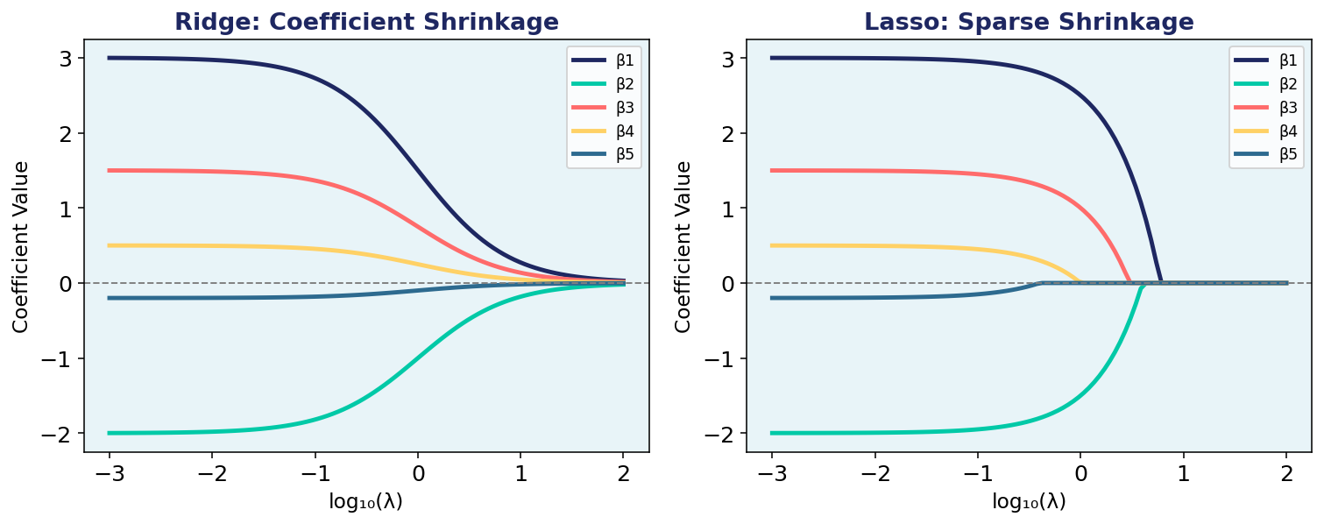
2. Regularized Regression Models
Graph • Python Code
📊 VISUALIZATION
from sklearn.linear_model import (
Ridge, Lasso, ElasticNet)
from sklearn.datasets import \
make_regression X, y = make_regression( n_samples=200, n_features=50, noise=0.1, random_state=42) # Ridge Regression ridge = Ridge(alpha=1.0)
ridge.fit(X, y) # Lasso Regression lasso = Lasso(alpha=0.1) lasso.fit(X, y) # ElasticNet en = ElasticNet(alpha=0.1, l1_ratio=0.5) en.fit(X, y) # Non-zero coefs (feature selection) import numpy as np nz = np.sum(lasso.coef_ != 0) print(f'Lasso kept {nz}/50 features')
Topic 2 of 6 | Advanced Regression

Slide 18
3. Effect of Regularization on Model Complexity
Definition • Equation • Real-Life Example
📖 DEFINITION
🌍 REAL-LIFE EXAMPLE
Regularization directly controls the bias-variance tradeoff. Low λ allows a complex, flexible model (low bias, high variance — overfitting). High λ forces a simpler model with smaller coefficients (high bias, low variance — underfitting). The optimal λ minimizes test/validation error. The effective degrees of freedom decrease monotonically as λ increases, reducing model complexity. Cross-validation is the standard method for selecting the best λ.
🔧 Spam Classifier With 10,000 word features and λ=0 (no regularization), model memorizes training emails (overfitting). Increasing λ gradually zeros out rare word coefficients, keeping only highly informative words like 'lottery', 'free', 'win'. 📉 Image Compression (Ridge) Large λ → fewer active features → simpler, compressed model with acceptable quality loss.
LambdaCV in scikit-learn automatically picks optimal λ using 5-fold cross validation.
∑ MATHEMATICAL EQUATION
Effective DoF (Ridge): df(λ) = Σ dᵢ²/(dᵢ² + λ) where dᵢ = singular values of X Bias-Variance:
MSE = Bias² + Variance + ε²
As λ ↑: Bias ↑ | Variance ↓
Optimal λ* via CV:λ* = argmin_{λ}_error(λ) Rule: λ in [0.001, 100]
Topic 3 of 6 | Advanced Regression

Slide 19
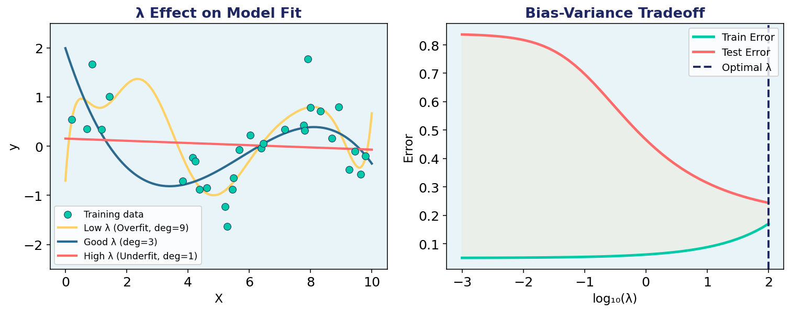
3. Effect of Regularization on Model Complexity
Graph • Python Code
📊 VISUALIZATION
🐍 PYTHON CODE
from sklearn.linear_model import (
RidgeCV, LassoCV) from sklearn.preprocessing import \ StandardScaler # Standardize features first! sc = StandardScaler() X_sc = sc.fit_transform(X) # RidgeCV: auto-selects lambda alphas = [0.001,0.01,0.1,1,10,100] rcv = RidgeCV(alphas=alphas, cv=5) rcv.fit(X_sc, y) print('Best α:', rcv.alpha_) # Complexity: count near-zero coefs import numpy as np for a in [0.01, 1, 100]: from sklearn.linear_model import Ridge r = Ridge(alpha=a).fit(X_sc, y) avg = np.mean(np.abs(r.coef_))
print(f'α={a}: avg|β|={avg:.3f}')
Topic 3 of 6 | Advanced Regression

Slide 20
4. Polynomial Feature Expansion
Definition • Equation • Real-Life Example
📖 DEFINITION
🌍 REAL-LIFE EXAMPLE
Polynomial feature expansion transforms input features by adding powers and cross-product terms, enabling a linear model to capture non-linear relationships. A degree-d expansion of p features creates C(p+d, d) new features. The model remains linear in the expanded feature space but non-linear in the original input space. This is a form of kernel-based learning, related to the polynomial kernel in SVMs. Care must be taken to avoid overfitting with high-degree expansions.
🚗 Fuel Efficiency MPG vs. speed follows a curve — fuel efficiency drops at very high and very low speeds (optimal ~60 km/h). A degree-2 polynomial captures this U-shape that a linear model completely misses. 💊 Drug Dose-Response Therapeutic effect vs. dosage is non-linear: too little has no effect, optimal range is therapeutic, too much is toxic. A polynomial curve models this inverted-U relationship.
Always combine with Ridge/Lasso to prevent overfitting!
∑ MATHEMATICAL EQUATION
Original: x → Expanded φ(x) Degree-2 (1 feature):
φ(x) = [1, x, x²]
Degree-2 (2 features):
φ(x) = [1, x₁, x₂, x₁², x₂², x₁x₂] Model:ŷ = β₀+β₁x+β₂x²+...+βₐxᵈ
New feature count:C(p+d, d) = (p+d)! / (p! × d!)
Risk: degree↑ → overfitting↑
Topic 4 of 6 | Advanced Regression

Slide 21
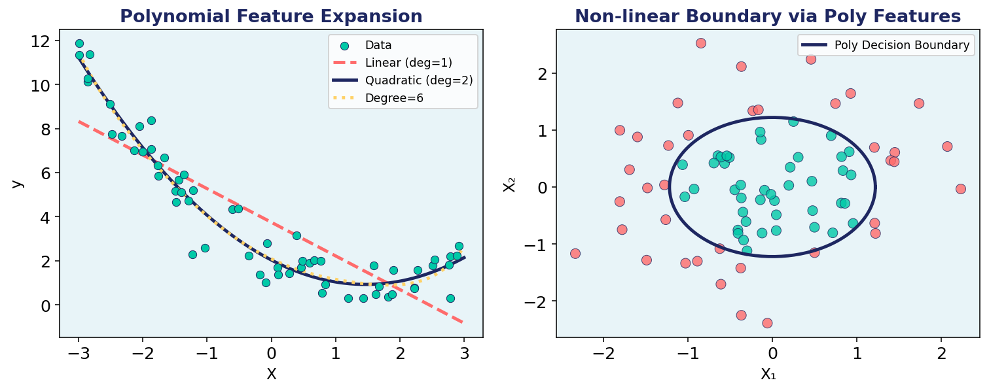
4. Polynomial Feature Expansion
Graph • Python Code
📊 VISUALIZATION
🐍 PYTHON CODE
from sklearn.preprocessing import \ PolynomialFeatures
from sklearn.pipeline import Pipeline
from sklearn.linear_model import Ridge
import numpy as np
# Non-linear data (quadratic)
X = np.linspace(-3,3,100).reshape(-1,1)
y = 0.5*X[:,0]**2 - 1.5*X[:,0] + np.random.randn(100)*0.4
# Build polynomial pipeline
for deg in [1, 2, 5, 10]:
pipe = Pipeline([
('poly', PolynomialFeatures(degree=deg)),
('model', Ridge(alpha=0.1))
])
pipe.fit(X, y)
print(f'deg={deg}:', pipe.score(X,y))
# Feature names
pf = PolynomialFeatures(2)
pf.fit(X); print(pf.get_feature_names_out())
Topic 4 of 6 | Advanced Regression

Slide 22
5. Tree-Based Regression Models
Definition • Equation • Real-Life Example
📖 DEFINITION
🌍 REAL-LIFE EXAMPLE
Tree-based regression models recursively partition the feature space into rectangular regions, predicting the mean target value within each region. A Decision Tree minimizes MSE at each split. Random Forest builds multiple decorrelated trees using bootstrap sampling and random feature selection, averaging predictions to reduce variance. Gradient Boosting builds trees sequentially, where each tree corrects the residuals of the previous. These models handle non-linearity, outliers, and mixed data types naturally without scaling.
🌳 Real Estate Valuation Random Forest splits: 'Area > 1500sqft → yes branch: price range 300k-500k'. No feature scaling needed. Handles missing values. Used by Zillow's Zestimate model for property valuation. ⚡ Energy Demand Forecasting XGBoost (Gradient Boost) captures complex patterns in electricity demand: temperature spikes, weekday/weekend effects, holidays — without manual feature engineering.
Feature importance from trees gives actionable insights.
∑ MATHEMATICAL EQUATION
Split Criterion (MSE reduction):
ΔMSEₛ = MSE(parent) - [
(n_L/n)MSE_L + (n_R/n)MSE_R ]
Leaf Prediction:
ŷ(leaf) = mean(y : x ∈ leaf)
Random Forest:
ŷ_RF = (1/B)Σ T_b(x)
Gradient Boost:
Fₘ(x) = Fₘ₋₁(x) + η·hₘ(x)
hₘ fits residuals rᵢ = yᵢ - Fₘ₋₁(xᵢ)
Topic 5 of 6 | Advanced Regression

Slide 24
Split Criterion (MSE reduction):
ΔMSEₛ = MSE(parent) - [
(n_L/n)MSE_L + (n_R/n)MSE_R ]
Leaf Prediction:
ŷ(leaf) = mean(y : x ∈ leaf)
Random Forest:
ŷ_RF = (1/B)Σ T_b(x)
Gradient Boost:
Fₘ(x) = Fₘ₋₁(x) + η·hₘ(x)
hₘ fits residuals rᵢ = yᵢ - Fₘ₋₁(xᵢ)

Slide 25
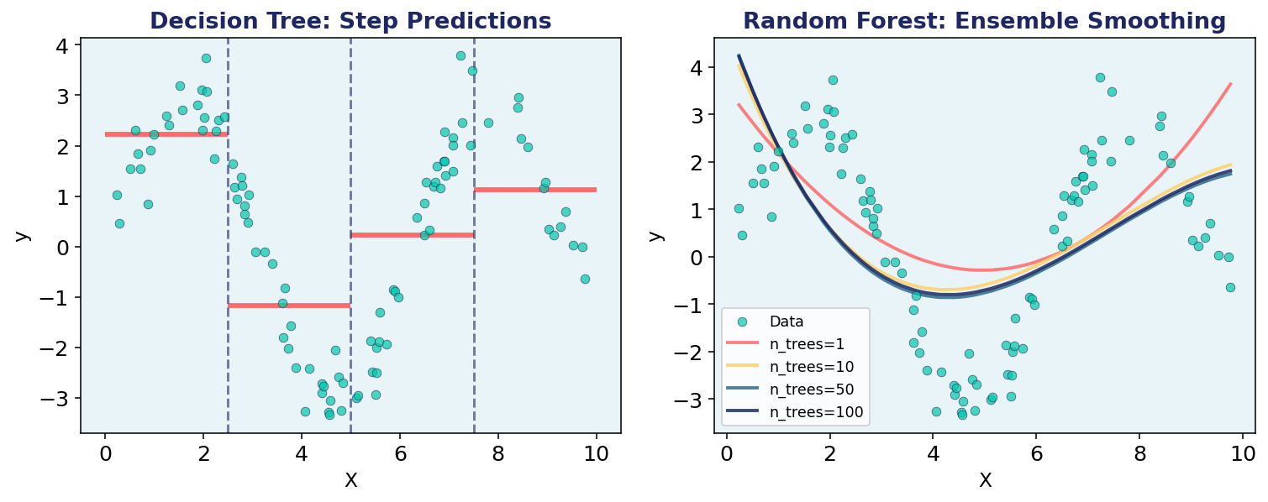
5. Tree-Based Regression Models
Graph • Python Code
📊 VISUALIZATION
🐍 PYTHON CODE
Topic 5 of 6 | Advanced Regression

Slide 26
from sklearn.tree import \
DecisionTreeRegressor
from sklearn.ensemble import RandomForestRegressor,GradientBoostingRegressor from sklearn.datasets import \
make_regression X, y = make_regression(n_features=5,
noise=0.1, random_state=42) # Decision Tree dt = DecisionTreeRegressor(max_depth=4) dt.fit(X, y) # Random Forest rf = RandomForestRegressor( n_estimators=100, max_depth=5, random_state=42) rf.fit(X, y) # Feature importance
import numpy as np
fi = rf.feature_importances_
print('Importances:', fi.round(3))

Slide 27
6. Time-Series Regression Models
Definition • Equation • Real-Life Example
📖 DEFINITION
🌍 REAL-LIFE EXAMPLE
Time-series regression models the target variable as a function of time and its own past values (autoregression). ARIMA (AutoRegressive Integrated Moving Average) combines AR (past values), I (differencing for stationarity), and MA (past errors) components. Seasonal SARIMA extends this for periodic patterns. Modern approaches include using lag features in standard ML models (XGBoost, LSTM). Key concepts: stationarity, autocorrelation, partial autocorrelation, and differencing.
📦 Supply Chain Amazon forecasts weekly product demand using SARIMA with yearly seasonality (S=52). Helps pre-position inventory before festive season. Reduces stockouts by 35%. 🌤️ Weather Forecasting Daily temperature follows AR(1) process: tomorrow's temp ≈ 0.85 × today's temp + trend + noise. ARIMA captures mean reversion.
Facebook Prophet (additive model) extends this with holiday effects and trend changepoints for business metrics.
∑ MATHEMATICAL EQUATION
AR(p) Model:
yₜ = c + φ₁yₜ₋₁+...+φₚyₜ₋ₚ + εₜ
MA(q) Model:
yₜ = μ + εₜ + θ₁εₜ₋₁+...+θqεₜ₋q
ARIMA(p,d,q):
Differenced series:
Δyₜ = yₜ - yₜ₋₁ (d times)
Then fit ARMA(p,q) on Δyₜ
ACF & PACF:
Select q from ACF cutoff
Select p from PACF cutoff
Topic 6 of 6 | Advanced Regression

Slide 28
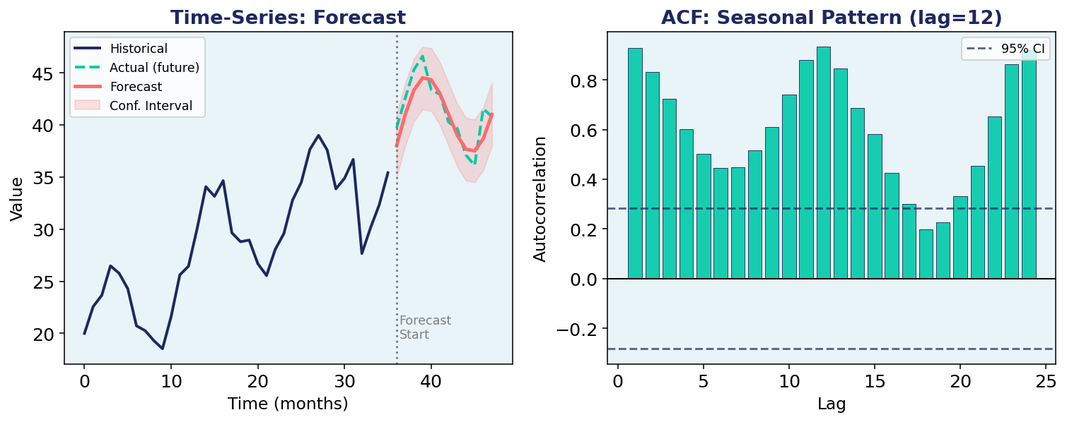
6. Time-Series Regression Models
Graph • Python Code
📊 VISUALIZATION
🐍 PYTHON CODE
import pandas as pd
import numpy as np
from statsmodels.tsa.arima.model \
import ARIMA
from statsmodels.tsa.stattools \
import adfuller
# Generate sample time series
np.random.seed(42)
n = 100
t = np.arange(n)
y = 0.5*t + 5*np.sin(t*0.3) \
+ np.random.randn(n)*2
# Test stationarity (ADF test)
result = adfuller(np.diff(y))
print('p-value:', result[1])
# Fit ARIMA(2,1,2)
model = ARIMA(y, order=(2,1,2))
fitted = model.fit()
print(fitted.summary())
# Forecast next 10 steps
fc = fitted.forecast(steps=10)
print('Forecast:', fc.round(2))
Topic 6 of 6 | Advanced Regression

Slide 29
Quick Revision Cheat Sheet
Topic | Core Formula | Key Insight
Coeff. Interpretation | ŷ = β₀ + Σβᵢxᵢ | βᵢ = Δy per unit Δxᵢ (others fixed)
Ridge (L2) | L + λΣβᵢ² | Shrinks all coefs, no elimination
Lasso (L1) | L + λΣ|βᵢ| | Exact zeros = feature selection
Regularization | df(λ) = Σdᵢ²/(dᵢ²+λ) | λ↑ → simpler model, more bias
Polynomial | φ(x) = [1,x,x²,...,xᵈ] | Linear in feature space, nonlinear in input
Decision Tree | Split: min MSE(L)+MSE(R) | Piecewise constant predictions
Random Forest | ŷ = (1/B)Σ T_b(x) | Bagging reduces variance
ARIMA(p,d,q) | Δᵈyₜ = AR(p) + MA(q) | d=differencing for stationarity
Topic
Core Formula
Key Insight
All 6 Topics Covered • Definitions • Equations • Graphs • Python Code

