Slide 1
Numerical Methods
I. Finding Roots
II. Integrating Functions

Slide 2
What computers can’t do
Solve (by reasoning) general mathematical problems → they can only repetitively apply arithmetic primitives to input.
Solve problems exactly.
Represent all numbers. Only a finite subset of the numbers between 0 and 1 can be represented.

Slide 3
Finding roots / solving equations
General solution exists for equations such as
ax² + bx + c = 0
The quadratic formula provides a quick answer to all quadratic equations.
However, no exact general solution (formula) exists for equations with exponents greater than 4.

Slide 4
Finding roots…
Even if “exact” procedures existed, we are stuck with the problem that a computer can only represent a finite number of values… thus, we cannot “validate” our answer because it will not come out exactly
However we can say how accurate our solution is as compared to the “exact” solution

Slide 5
Finding roots, continued
Transcendental equations: involving geometric functions (sin, cos), log, exp. These equations cannot be reduced to solution of a polynomial.
Convergence: we might imagine a “reasonable” procedure for finding solutions, but can we guarantee it terminates?

Slide 6
Problem-dependent decisions
Approximation: since we cannot have exactness, we specify our tolerance to error
Convergence: we also specify how long we are willing to wait for a solution
Method: we choose a method easy to implement and yet powerful enough and general
Put a human in the loop: since no general procedure can find roots of complex equations, we let a human specify a neighbourhood of a solution

Slide 7
Practical approach - hand calculations
Choose method and initial guess wisely
Good idea to start with a crude graph. If you are looking for a single root you only need one positive and one negative value
If even a crude graph is difficult, generate a table of values and plot graph from that.

Slide 8
Practical approach - example
Example
e^{-x} = sin(πx/2)
Solve for x.
Graph functions - the crossover points are solutions
This is equivalent to finding the roots of the difference function:
f(x)= e^{-x} - sin(πx/2)

Slide 9
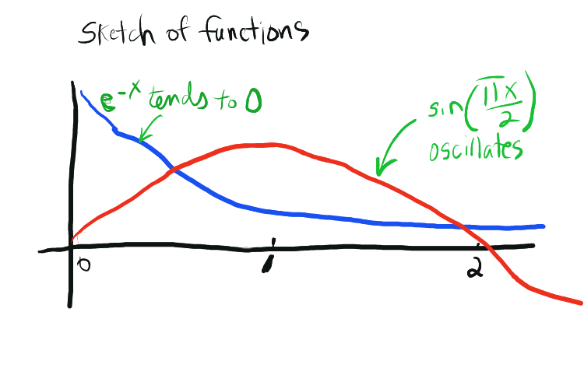
Graph

Slide 10
Solution, continued
One crossover point at about 0.5, another at about 2.0 (there are very many of them …)
Compute values of both functions at 0.5
Decrement/increment slightly – watch the sign of the difference-function!!
If there is an improvement continue, until you get closer.
Stop when you are “close enough”

Slide 11
Tabulating the function
Step | x | e^{-x} | sin(1/2πx) | f(x)= e^{-x} - sin(1/2πx)
0 | 0.3 | 0.741 | 0.454 | 0.297
1 | 0.4 | 0.670 | 0.588 | 0.082
2 | 0.5 | 0.606 | 0.707 | - 0.101
3 | 0.45 | 0.638 | 0.649 | - 0.012
4 | 0.425 | 0.654 | 0.619 | 0.0347
5 | 0.4375 | 0.6456 | 0.6344 | 0.01126
6 | 0.44365 | 0.6417 | 0.6418 | - 0.00014

Slide 12
Bisection Method
The Bisection Method slightly modifies “educated guess” approach of hand calculation method.
Suppose we know a function has a root between a and b. (…and the function is continuous, … and there is only one root)

Slide 13
Bisection Method
Keep in mind general approach in Computer Science: for complex problems we try to find a uniform simple systematic calculation
How can we express the hand calculation of the preceding in this way?
Hint: use an approach similar to the binary search…

Slide 14
Bisection method…
Check if solution lies between a and b…
F(a)*F(b) < 0 ?
Try the midpoint m: compute F(m)
If |F(m)| < tol select m as your approximate solution
Otherwise, if F(m) is of opposite sign to F(a) that is if
F(a)*F(m) < 0, then b = m.
Else a = m.

Slide 15
Bisection method…
This method converges to any pre-specified tolerance when a single root exists on a continuous function
Example Exercise: write a function that finds the square root of any positive number that does not require programmer to specify estimates

Slide 16
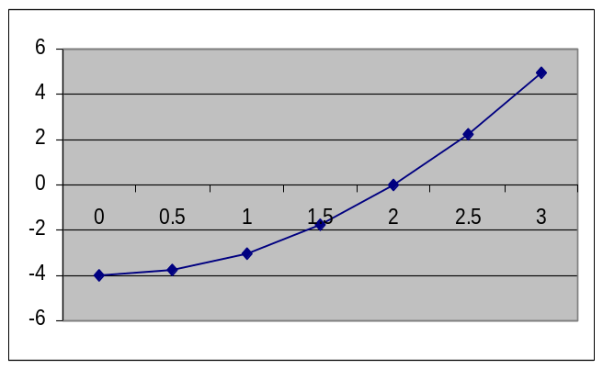
Square root program
If the input c < 1, the root lies between c and 1.
Else, the root lies between 1 and c.
The (positive) square root function is continuous and has a single solution.
c = x²
Example:
F(x) = x² - 4
F(x) = x² - c

Slide 17
double Sqrt(double c, double tol)
{
double a,b, mid, f;
// set initial boundaries of interval
if (c < 1) { a = c; b = 1}
else { a = 1; b = c}
do {
mid = ( a + b ) / 2.0;
f = mid * mid - c;
if ( f < 0 )
a = mid;
else
b = mid;
} while( fabs( f ) > tol );
return mid;
}

Slide 18
Program 13-1 (text; bisection)
Echos inputs
Computes values at endpoints
Checks whether a root exists
If root exists, employs bisection method
Convergence criterion: Root is found if size of current interval < ε (predefined tolerance)
Note difference with the algorithm on the previous slide!!!
If root found within number of iterations, prints results, else prints failure…

Slide 19
Problem with Bisection
Although it is guaranteed to converge under its assumptions,
Although we can predict in advance the number of iterations required for desired accuracy
(b - a)/2^{n} <ε −> n > log( (b - a ) / ε )
Too slow! Computer Graphics uses square roots to compute distances, can’t spend 15-30 iterations on every one!
We want more like 1 or 2, equivalent to ordinary math operation.

Slide 20
Improvement to Bisection
Regula Falsi, or Method of False Position.
Use the shape of the curve as a cue
Use a straight line between y values to select interior point
As curve segments become small, this closely approximates the root

Slide 21
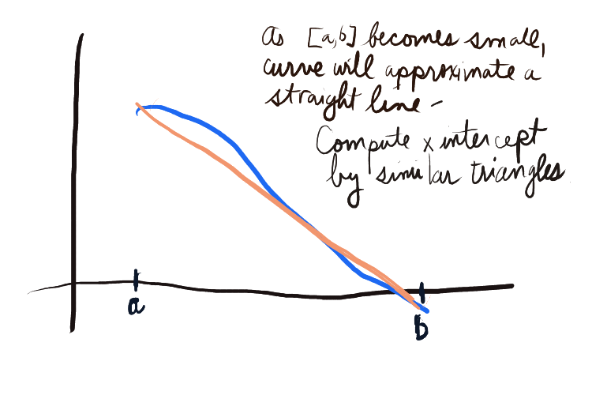
curve
approximation

Slide 22
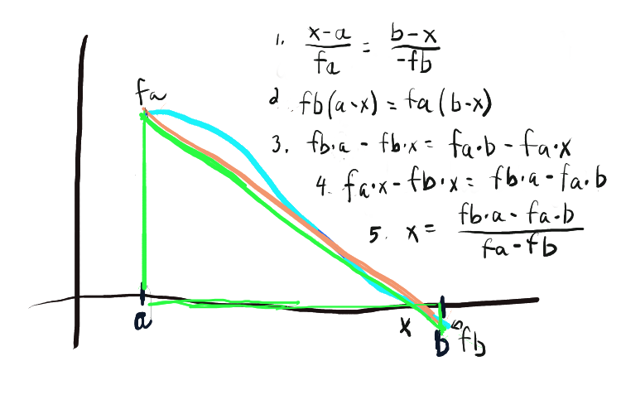
adjacent1
adjacent2
similar
triangles
fa*b-fb*a
fa*b – fb*a
The values needed for x are values already computed…
(Different triangles used from text, but same idea)

Slide 23
Method of false position
Pro: as the interval becomes small, the interior point generally becomes much closer to root
Con 1: if f_{a} and f_{b} become too close – overflow errors can occur
Con 2: can’t predict number of iterations to reach a give precision
Con 3: can be less precise than bisection – no strict precision guarantee

Slide 24
fa
a
b
fb
Problem with Regula Falsi -- if the graph is convex down, the interpolated point will repeatedly appear in the larger segment….

Slide 25
Therefore a problem arises if we use the size of the
current interval as a criterion that the root is found
fb
fx
a
x
b
fa
If we use the criterion abs(fx) < ε, this is not
a problem. But this criterion can’t be always
used (e.g. if function is very steep close to the
root…)

Slide 26
Another problem with Regular Falsi: if the function grows too fast
→ very slow convergence

Slide 27
Modified Regula Falsi
Because Regula Falsi can be fatally slow some of the time (which is too often)
Want to clip interval from both ends
Trick: drop the line from fa or fb to some fraction of its height, artificially change slope to cut off more of other side
The root will flip between left and right interval

Slide 28
Modified Regula Falsi
If the root is in the left segment [a, interior]
  Draw line between (a, f_{a}*0.5) and (interior, f_{interior})
Else (in the right segment [interior, b])
  -- Draw line between (interior, f_{interior}) and (b, f_{b}*0.5)
fb
interior₂
a
interior₃
interior₁
b
fa

Slide 29
Secant Method
Exactly like Regula Falsi, except:
No need to check for sign.
Begin with a, b, as usual
Compute interior point as usual
NEW: set a to b, and b to interior point
Loop until desired tolerance.

Slide 30
Secant method
No animation ready yet: Intuition
It automatically flips back and forth, solving problem with unmodified regula falsi
Sometimes, both fa and fb are positive, but it quickly tracks secant lines to root

Slide 31
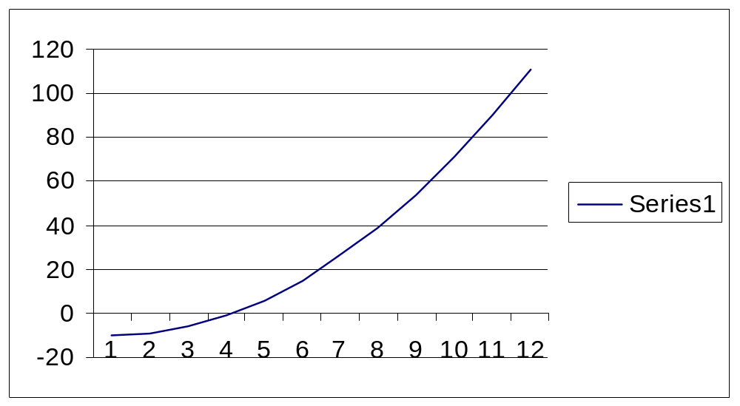
Secant Illustration
F(x) = x² - 10
1 (a=1, fa=-9) (b=10, fb=90)
→ int = 1.8, fint = -6.7
2 (a=10, fa=90) (b=1.8, fb= -6.7)
int = 0.88, fint = -9.22
3 (a=1.8, fa=-6.7) (b=0.88, fb=-9.22)
int = 4.25, fint = 8
4 (a=0.88, fa=-9.22) (b=4.25, fb=8)
Int =2.68, fint = -2.8
Etc…
1
2
3
4

Slide 32
Root finding algorithms
The algorithms have the following declarations:
double bisection(double c, int iterations, double tol);
double regula(double c, int iterations, double tol);
double regulaMod(double c, int iterations, double tol);
double secant(double c, int iterations, double tol);
i.e., they have the same kinds of inputs

Slide 33
Called function
All functions call this function: func(x, c) = x² - c
double func(double x, double c)
{
return x * x - c;
}
* Note that the root of this function is the square root of c.
The functions call it as follows:
func( current_x, square_of_x );

Slide 34
Initializations
All functions implementing the root-finding algorithm have the same initialization:
double a, b;
if ( c < 1 )
{ a = c ; b= 1;}
else
{ a = 1; b = c;};
double fa = func( a, c);
double fb = func( b, c);
The next slides illustrate the differences between algorithms.

Slide 35
Code
Earlier code gave “square root” example with logic of bisection method.
Following programs, to fit on a slide, have no debug output, and have the same initializations (as on the next slide)

Slide 36
double bisection(double c, int iterations, double tol) …
for ( int i = 0; i < iterations; i++)
{
double x = ( a + b ) / 2;
double fx = func( x, c );
if ( fabs( fx ) < tol )
return x;
if ( fa * fx < 0 ) {
b = x;
fb = fx; }
else {
a = x;
fa = fx; }
}
return -1;
BISECTION METHOD
This is the heart of the algorithm. Compute the midpoint and the value of the function there; iterate on half with root

Slide 37
double regula (double c, int iterations, double tol)…
for ( int i = 0; i < iterations; i++)
{
double x = ( fa*b - fb*a ) / ( fa - fb );
double fx = func( x, c );
if ( fabs( fx ) < tol )
return x;
if ( fa * fx < 0 ) {
b = x;
fb = fx; }
else {
a = x;
fa = fx; }
}
return -1;
REGULA FALSI
The main change from bisection is computing an interior point that more closely approximates the root….

Slide 38
double regulaMod (double c, int iterations, double tol)…
for ( int i = 0; i < iterations; i++)
{
double x = ( fa*b - fb*a ) / ( fa - fb );
double fx = func( x, c );
if ( fabs( fx ) < tol )
return x;
if ( fa * fx < 0 ) {
b = x;
fb = fx;
fa *= RELAX }
else {
a = x;
fa = fx;
fb *= RELAX }
}
return -1;
MODIFIED REGULA FALSI
The only change from ordinary regula is the
RELAXation factor

Slide 39
double secant(double c, int iterations, double tol)…
for ( int i = 0; i < iterations; i++)
{
double x = ( fa*b - fb*a ) / ( fa - fb );
double fx = func( x, c );
if ( fabs( fx ) < tol )
return x;
a = b;
fa = fb;
b = x;
fb = fx;
}
return -1;
SECANT METHOD
The change from ordinary
regula is that the sign check is dropped and points are just “shifted over”

Slide 40
Actual performance
Actual code includes other output commands
Used 4 methods to compute roots of 4, 100, 1000000, 0.25
Maximum allowable iterations 1000
Tolerance = 1e-15
RELAXation factor = 0.8

Slide 41
Actual performance (tol = 1e-15)
Method | Inputs | Answers | Iterations
Bisection | 4 100 1000000 0.25 | 2 10 1000 0.5 | 51 54 61 47
Regula | 4 100 1000000 0.25 | 2 -1 -1 0.5 | 32 1000 1000 30
Mod | 4 100 1000000 0.25 | 2 10 1000 0.5 | 21 28 46 19
Secant | 4 100 1000000 0.25 | 2 10 1000 0.5 | 7 10 20 6

Slide 42
Important differences from text
Assumed all methods would be used to find square root of k between [1, c] or [c,1] by finding root of x² – c.
All used closeness of fx to 0 as convergence criteria. Text uses different criteria for different algorithms

Slide 43
double bisection(double c, int iterations, double tol) …
for ( int i = 0; i < iterations; i++)
{
double x = ( a + b ) / 2;
double fx = func( x, c );
if ( fabs( fx ) < tol )
return x;
if ( fa * fx < 0 ) {
b = x;
fb = fx; }
else {
a = x;
fa = fx; }
}
return -1;
Example….
All four code examples used the closeness of fx to zero as convergence criterion.

Slide 44
Convergence criterion…
Closeness of fx to zero not always a good criterion, consider a very flat function may be close to zero a considerable distance before the root

Slide 45
Other convergence criteria
Width of the interval [a,b]. If this interval contains the root, guaranteed that the root is within this much accuracy
However, interval does not necessarily contain the root (secant method)
Text uses the width of the interval as the convergence criteria in the Bisection Method

Slide 46
Convergence criteria…
Fractional size of search interval:
(cur_a – cur_b) / ( a – b)
Used in modified falsi in text
Indicates that further search may not be productive. Does not guarantee small value of fx.

Slide 47
Numerical Integration
In NA, take visual view of integration as area under the curve
Many integrals that occur in science or engineering practice do not have a closed form solution – must be solved using numerical integration

Slide 48
Trapezoidal Rule
The area under the curve from
[a, fa] to [b, fb] is initially approximated by a trapezoid:
I₁ = ( b – a ) * ( fa + fb ) / 2

Slide 49
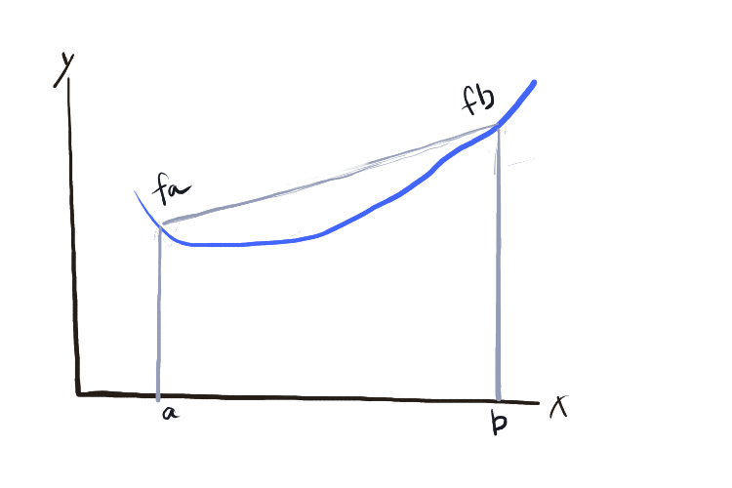
Simple trapezoid over large interval is prone to error.
Divide interval into halves…

Slide 50
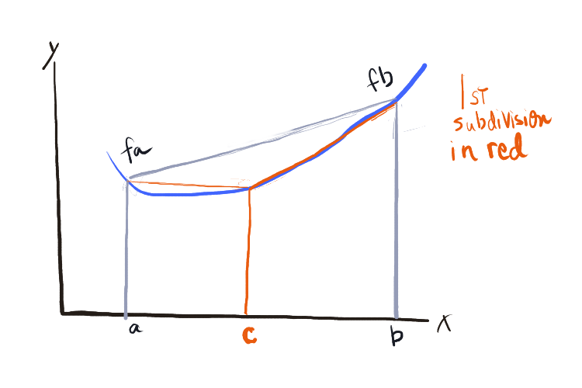
fc
I₂ = ( b – a )/2 * ( fa + 2*fc + fb ) / 2
(Note that interior sides count twice, since they belong to 2 traps.)

Slide 51
Further development…
I₂ = ( b – a ) / 2 * ( fa + 2*fc + fb ) / 2
= ( b – a ) /2 * ( f a + fb + 2* fc ) / 2
= ( b – a ) / 2* ( fa + fb ) /2 + (b – a) / 2* fc
= I₁ /2 + (b – a)/2 * fc
Notice that (b-a)/2 is the new interval width and fc is the value of the function at all new interior points. If we call d_{k} the new interval width at step k, and cut intervals by half:
I_{k} = I_{k-1}/2 + d_{k} Σ (all new interior f-values)

Slide 52
Trapezoidal algorithm
Compute first trapezoid: I = (fa + fb ) * (b – a) /2
New I = Old I / 2, length of interval by 2
Compute sum of function value at all new interior points, times new interval length
Add this to New I.
Continue until no significant difference

Slide 53
Simpson’s rule
.. Another approach
Rather than use straight line of best fit,
Use parabola of best fit (curves)
Converges more quickly

