Slide 1
FALSE POSITION METHOD
By SATYAJIT NAG-10.01.05.042
H.M. ZUBAER -10.01.05.028
MOSTOFA ZAMAN FAISAL-10.01.05.036

Slide 2
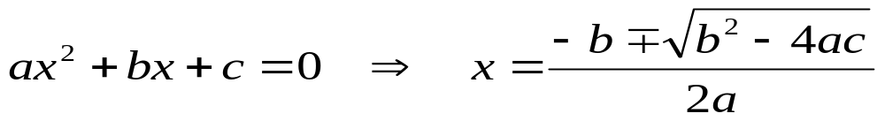
FINDING ROOTS / SOLVING EQUATIONS
The given quadratic formula provides a quick answer to all quadratic equations:
Easy
But, not easy
No exact general solution (formula) exists for equations with exponents greater than 4.

Slide 3
FINDING ROOTS…
For this reason, we have to find out the root to solve the equation.
However we can say how accurate our solution is as compared to the “exact” solution.
One of the method is FALSE POSITION.

Slide 4
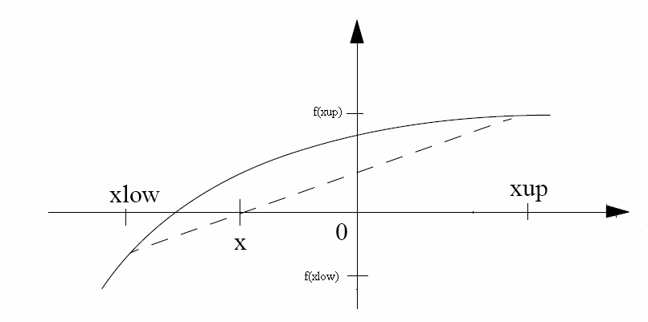
THE FALSE-POSITION METHOD (REGULA-FALSI)
  To refine the bisection method, we can choose a ‘false-position’ instead of the midpoint.
  The false-position is defined as the x position where a line connecting the two boundary points crosses the axis.

Slide 5
REGULA FALSI
  For example, if f(x_{low}) is much closer to zero than f(x_{up}), it is likely that the root is closer to x_{low} than to x_{up}.
False position method is an alternative approach where f(x_{low}) and f(x_{up}) are joined by a straight line; the intersection of which with the x-axis represents and improved estimate of the root.
The intersection of this line with the x axis represents an improved estimate of the root.

Slide 6
LINEAR INTERPOLATION METHOD
The fact that the replacement of the curve by a straight line gives the false position of the root is the origin of the name, method of false position, or in Latin, Regula Falsi.
It is also called the Linear Interpolation Method.

Slide 7
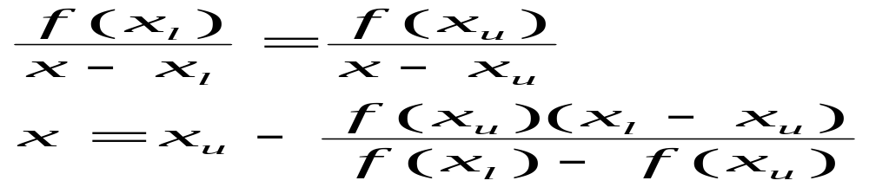
FALSE POSITION FORMULAE
Using similar triangles, the intersection of the straight line with the x axis can be estimated as
This is the False Position formulae. The value of x then replaces whichever of the two initial guesses, low x or up x , yields a function value with the same sign as f (x) .

Slide 8
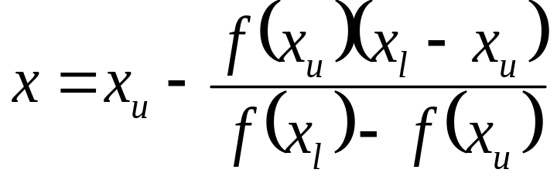
ALGORITHM
Given two guesses x_{low}, x_{up} that bracket the root,
Repeat
Set
If f(x_{up}) is of opposite sign to f(x_{low}) then
Set x_{low} = x_{up}
Else Set x_{low} = x
End If
Until y< tolerance value.

Slide 9
CODE
Find the real root of the equation d(x)=x5+x+1using Fasle Position Method. x_{low} = -1, x_{up} =0 and ε = selected x tolerance =10^-4 .
clear all;
close all;
clc;
xlow=-1;
xup=0;
xtol=10^-4;
f=@(x)(x^5+x+1);
x=xup-(f(xup)*(xlow-xup))/(f(xlow)-f(xup))
y=f(x);
iters=0;

Slide 10
CODE CONTINUED…..
while (((xup-x)/2>xtol)&& y>xtol)
if (f(xlow)*f(x)>0)
xlow=x;
else xup=x;
end
x=xup-(f(xup)*(xlow-xup))/(f(xlow)-f(xup));
y=f(x);
iters=iters+1;
end
x
y
iters

Slide 11
MERITS & DEMERITS
Merits
As the interval becomes small, the interior point generally becomes much closer to root.
Faster convergence than bisection.
Often superior to bisection.

Slide 12
Demerits
Problem with Regula Falsi -- if the graph is convex down, the interpolated point will repeatedly appear in the larger segment….
fa
a
b

Slide 13
DEMERITS
Demerits
It can’t predict number of iterations to reach a give precision.
It can be less precise than bisection – no strict precision guarantee.

Slide 14
Though the difference between Bisection and False Position Method is little but for some cases False Position Method is useful and for some problems Bisection method is effective….
In fact they both are necessary to solve any equation by ‘Bracketing method’.

Slide 15
THE END

Slide 16


