Slide 1
Inheritance & Polymorphism

Slide 2
Types of Inheritance
Single
Hierarchical
Multi Level
Multiple

Slide 3
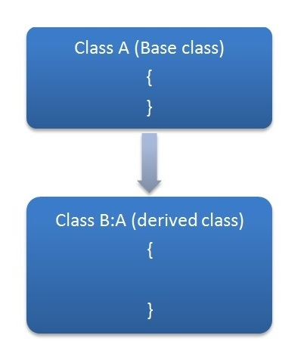
Single

Slide 4
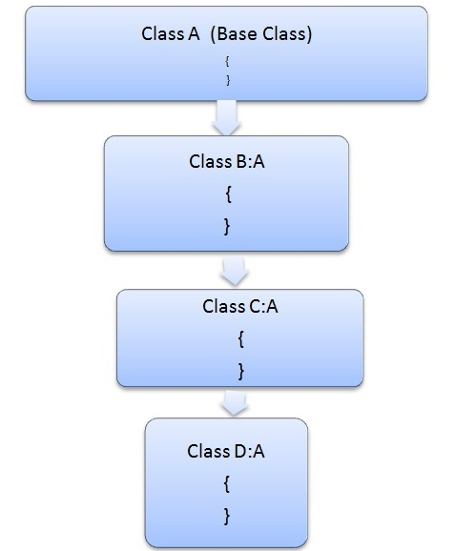
Hierarchical inheritance

Slide 5
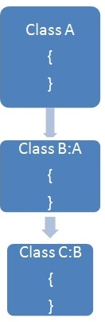
Multilevel inheritance

Slide 6
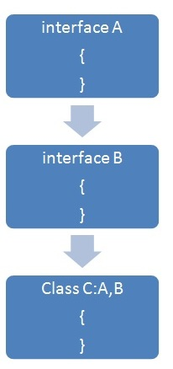
Multiple inheritance using Interfaces
C# does not support multiple inheritances of classes. To overcome this problem we can use interfaces,

Slide 7
Dynamic Polymorphism
C# allows you to create abstract classes that are used to provide partial class implementation of an interface. Implementation is completed when a derived class inherits from it.
Abstract classes contain abstract methods, which are implemented by the derived class.
The derived classes have more specialized functionality.

Slide 8
Rules about abstract classes
You cannot create an instance of an abstract class
You cannot declare an abstract method outside an abstract class
When a class is declared sealed, it cannot be inherited, abstract classes cannot be declared sealed.

Slide 9
Difference between virtual and abstract methods
Virtual methods have an implementation and provide the derived classes with the option of overriding it. Abstract methods do not provide an implementation and force the derived classes to override the method.
So, abstract methods have no actual code in them, and subclasses HAVE TO override the method. Virtual methods can have code, which is usually a default implementation of something, and any subclasses CAN override the method using the override modifier and provide a custom implementation

