Slide 1

Knowledge discovery & data mining
Tools, methods, and experiences

Slide 2
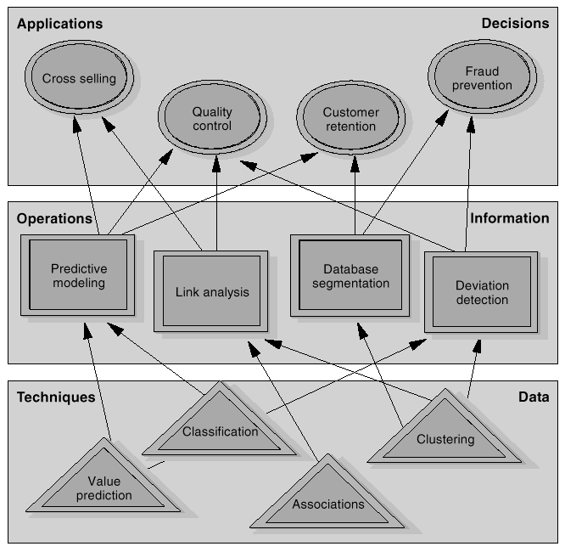
Applications, operations, techniques
EDBT2000 tutorial - Intro
Konstanz, 27-28.3.2000

Slide 3
Data mining and business intelligence
Increasing potential
to support
business decisions
Making
Decisions
End User
Data Presentation
Business
Analyst
Visualization Techniques
Data Mining
Data
Analyst
Information Discovery
Data Exploration
Statistical Analysis, Querying and Reporting
Data Warehouses / Data Marts
OLAP, MDA
DBA
Data Sources
Paper, Files, Information Providers, Database Systems, OLTP
EDBT2000 tutorial - Intro
Konstanz, 27-28.3.2000

Slide 4
Architecture of a KDD system
Graphical User Interface
Selection
and
Preprocessing
Data
Mining
Interpretation
and Evaluation
Data
Consolidation
Data Sources
Warehouse
Knowledge
EDBT2000 tutorial - Intro
Konstanz, 27-28.3.2000

Slide 5
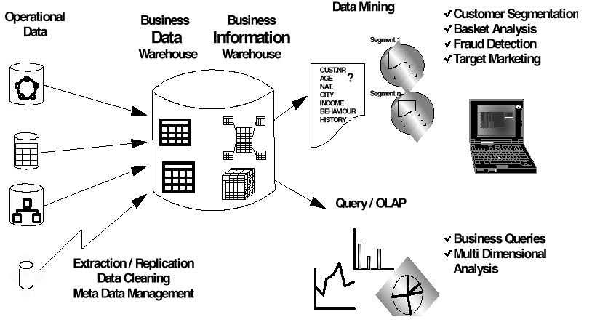
A business intelligence environment
EDBT2000 tutorial - Intro
Konstanz, 27-28.3.2000

