Slide 1

Chapter 11
Message Integrity
and
Message Authentication
Copyright © The McGraw-Hill Companies, Inc. Permission required for reproduction or display.
11.<number>

Slide 2
Chapter 11
Objectives
❏ To define message integrity
❏ To define message authentication
❏ To define criteria for a cryptographic hash function
❏ To define the Random Oracle Model and its role in
evaluating the security of cryptographic hash
functions
❏ To distinguish between an MDC and a MAC
❏ To discuss some common MACs
11.<number>

Slide 3
11-1 MESSAGE INTEGRITY
The cryptography systems that we have studied so far provide secrecy, or confidentiality, but not integrity. However, there are occasions where we may not even need secrecy but instead must have integrity.
Topics discussed in this section:
11.1 Document and Fingerprint
11.2 Message and Message Digest
11.3 Difference
11.4 Checking Integrity
11.5 Cryptographic Hash Function Criteria
11.<number>

Slide 4
11.1.1 Document and Fingerprint
One way to preserve the integrity of a document is through the use of a fingerprint. If Alice needs to be sure that the contents of her document will not be changed, she can put her fingerprint at the bottom of the document.
11.<number>

Slide 5
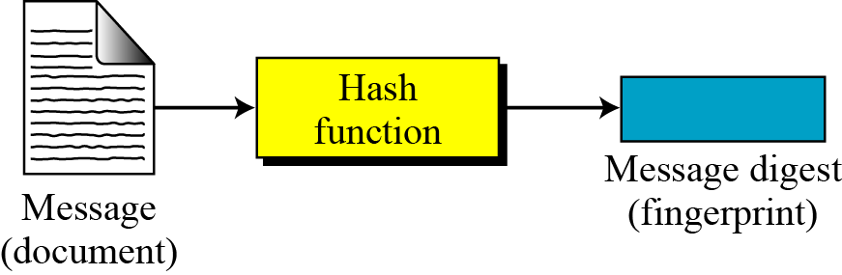
11.1.2 Message and Message Digest
The electronic equivalent of the document and fingerprint pair is the message and digest pair.
Figure 11.1 Message and digest
11.<number>

Slide 6

11.1.3 Difference
The two pairs (document / fingerprint) and (message / message digest) are similar, with some differences. The document and fingerprint are physically linked together. The message and message digest can be unlinked separately, and, most importantly, the message digest needs to be safe from change.
Note
The message digest needs to be safe from change.
11.<number>

Slide 7
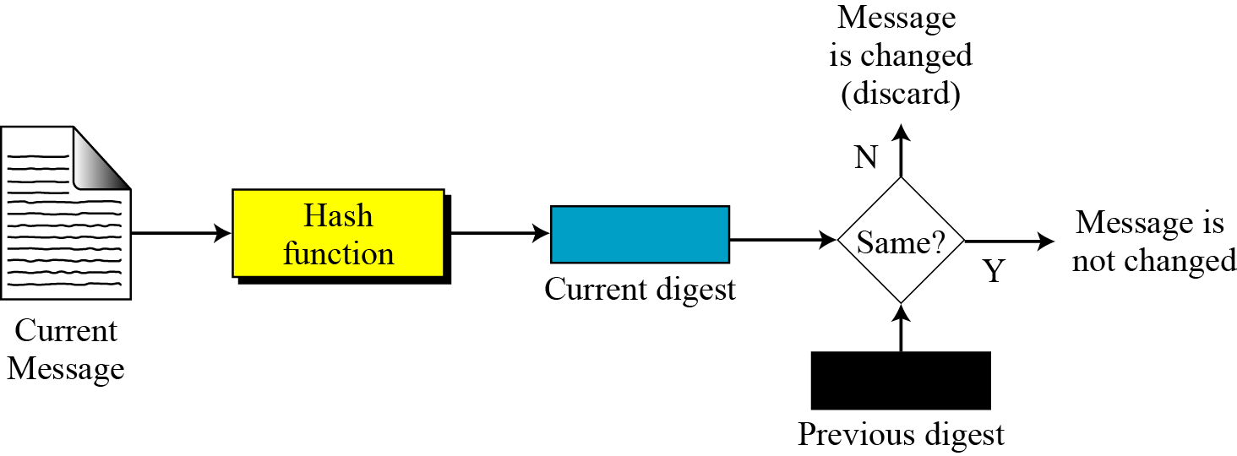
11.1.4 Checking Integrity
Figure 11.2 Checking integrity
11.<number>

Slide 8
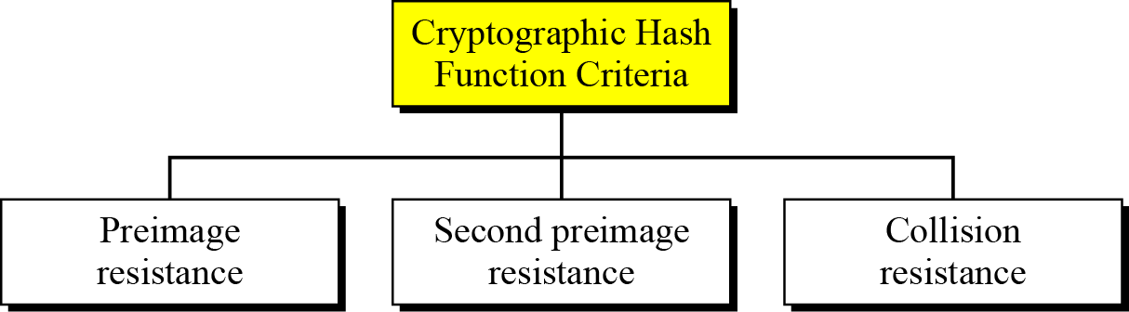
11.1.5 Cryptographic Hash Function Criteria
A cryptographic hash function must satisfy three criteria: preimage resistance, second preimage resistance, and collision resistance.
Figure 11.3 Criteria of a cryptographic hash function
11.<number>

Slide 9
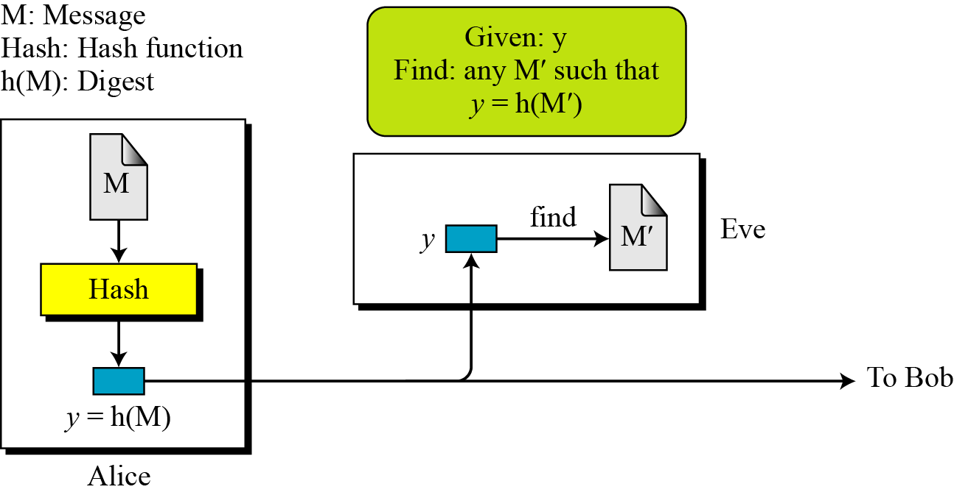
11.1.5 Continued
Preimage Resistance
Figure 11.4 Preimage
11.<number>

Slide 10
11.1.5 Continued
Example 11.1
Can we use a conventional lossless compression method such as StuffIt as a cryptographic hash function?
Solution
We cannot. A lossless compression method creates a compressed message that is reversible.
Example 11.2
Can we use a checksum function as a cryptographic hash function?
Solution
We cannot. A checksum function is not preimage resistant, Eve may find several messages whose checksum matches the given one.
11.<number>

Slide 11
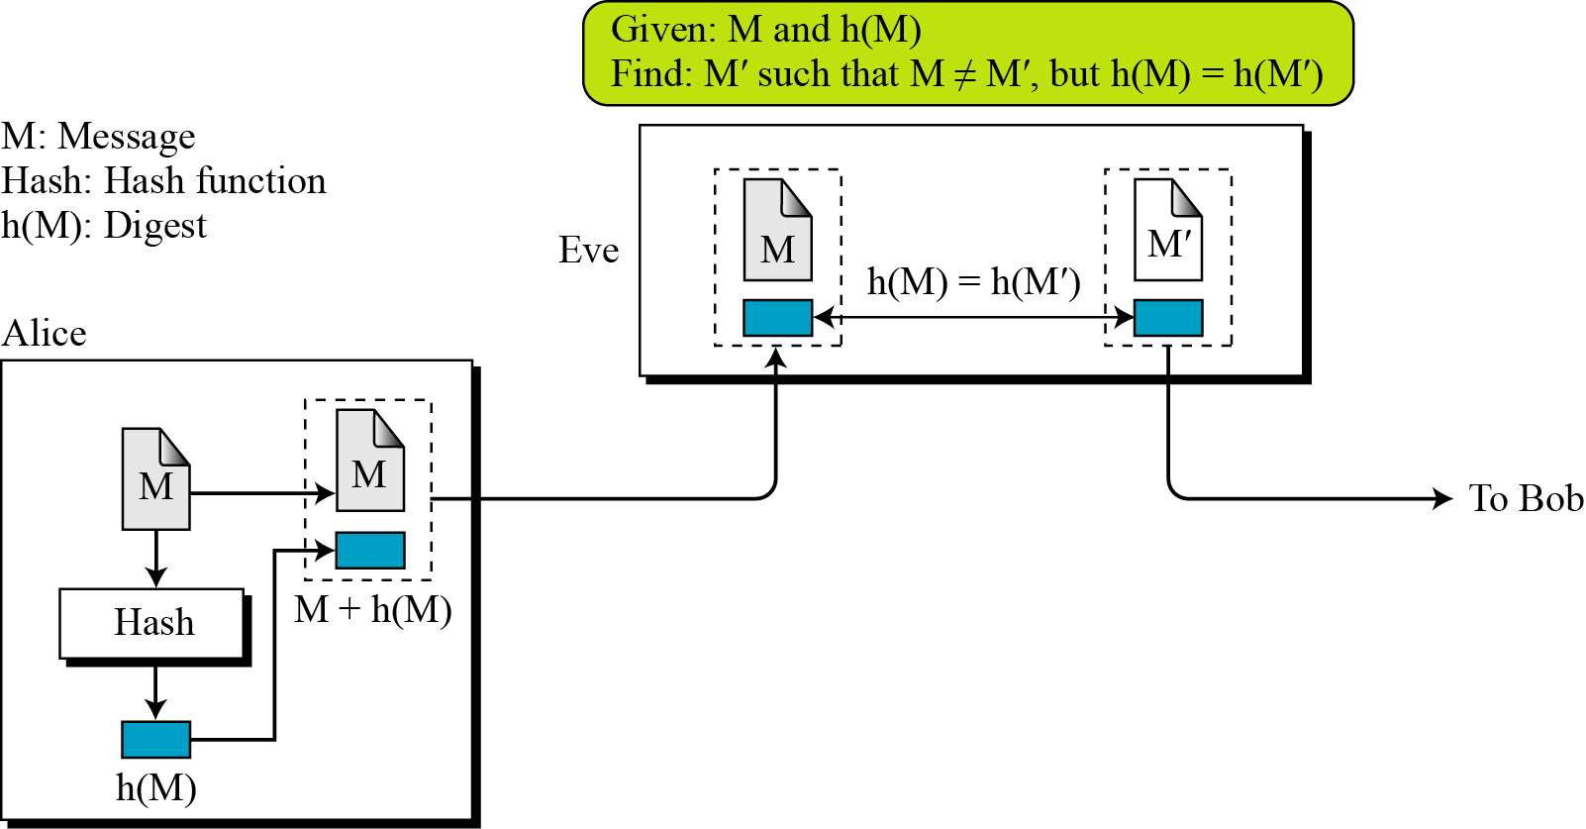
11.1.5 Continued
Second Preimage Resistance
Figure 11.5 Second preimage
11.<number>

Slide 12
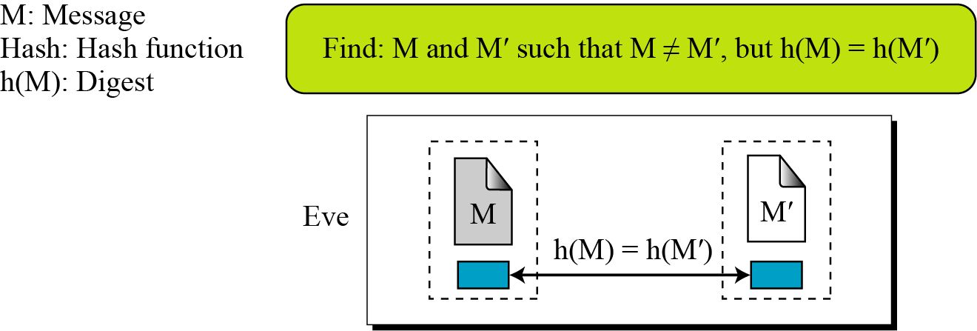
11.1.5 Continued
Collision Resistance
Figure 11.6 Collision
11.<number>

Slide 13
11-2 RANDOM ORACLE MODEL
The Random Oracle Model, which was introduced in 1993 by Bellare and Rogaway, is an ideal mathematical model for a hash function.
Topics discussed in this section:
11.2.1 Pigeonhole Principle
11.2.2 Birthday Problems
11.2.3 Attacks on Random Oracle Model
11.2.4 Attacks on the Structure
11.<number>

Slide 14
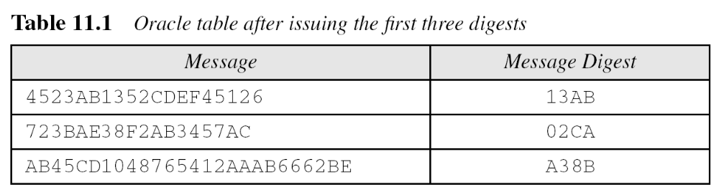
11-2 Continued
Example 11.3
Assume an oracle with a table and a fair coin. The table has two columns.
a. The message AB1234CD8765BDAD is given for digest calculation. The oracle checks its table.
11.<number>

Slide 15
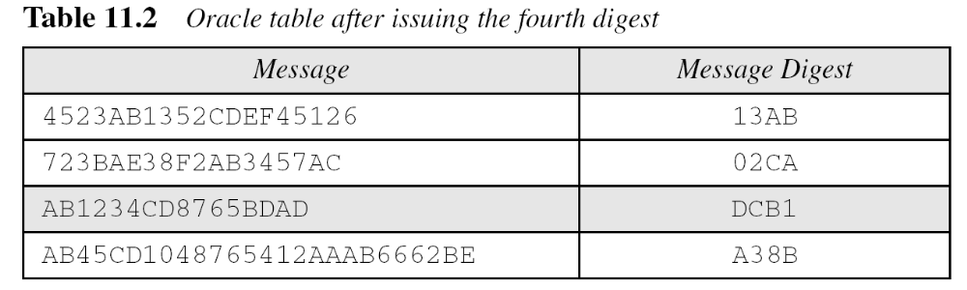
11-2 Continued
Example 11.3
Continued
b. The message 4523AB1352CDEF45126 is given for digest calculation. The oracle checks its table and finds that there is a digest for this message in the table (first row). The oracle simply gives the corresponding digest (13AB).
11.<number>

Slide 16
11-2 Continued
Example 11.4
The oracle in Example 11.3 cannot use a formula or algorithm to create the digest for a message. For example, imagine the oracle uses the formula h(M) = M mod n. Now suppose that the oracle has already given h(M1) and h(M2). If a new message is presented as M3 = M1 + M2, the oracle does not have to calculate the h(M3). The new digest is just [h(M1) + h(M2)] mod n since
This violates the third requirement that each digest must be randomly chosen based on the message given to the oracle.
11.<number>

Slide 17
11.2.1 Pigeonhole Principle
If n pigeonholes are occupied by n + 1 pigeons, then at least one pigeonhole is occupied by two pigeons. The generalized version of the pigeonhole principle is that if n pigeonholes are occupied by kn + 1 pigeons, then at least one pigeonhole is occupied by k + 1 pigeons.
11.<number>

Slide 18
11.2.1 Continued
Example 11.5
Assume that the messages in a hash function are 6 bits long and the digests are only 4 bits long. Then the possible number of digests (pigeonholes) is 24 = 16, and the possible number of messages (pigeons) is 26 = 64. This means n = 16 and kn + 1 = 64, so k is larger than 3. The conclusion is that at least one digest corresponds to four (k + 1) messages.
11.<number>

Slide 19
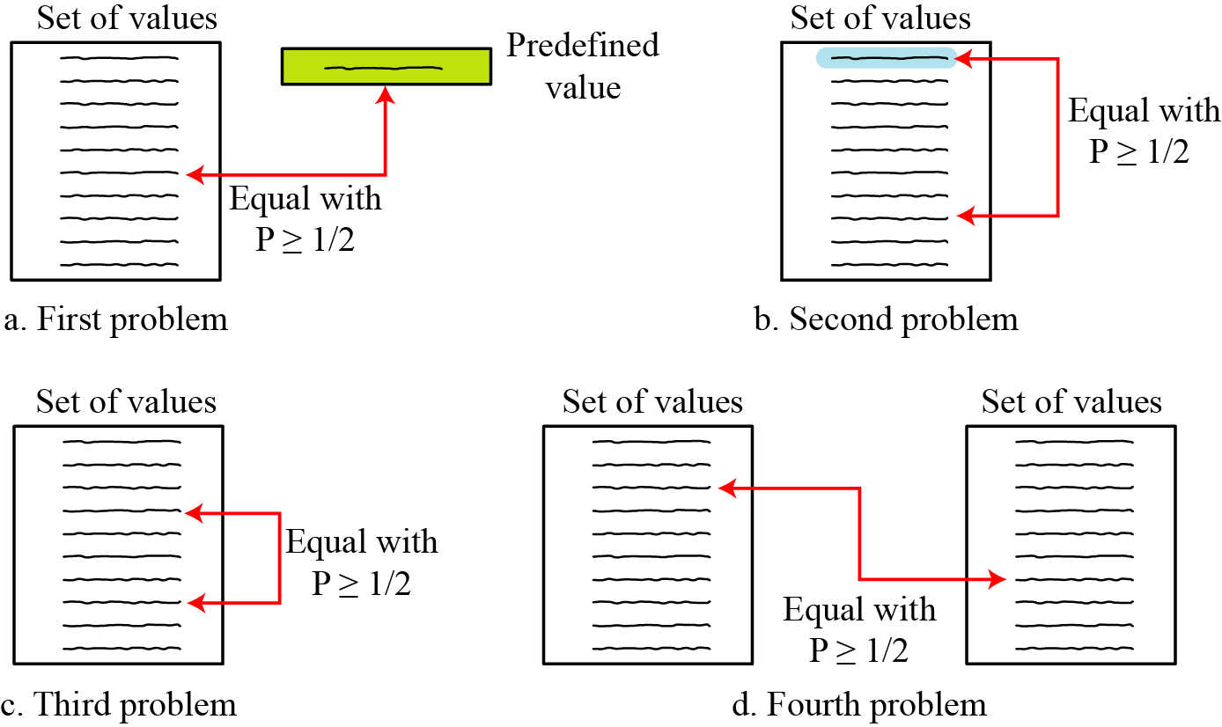
11.2.2 Birthday Problems
Figure 11.7 Four birthday problems
11.<number>

Slide 20
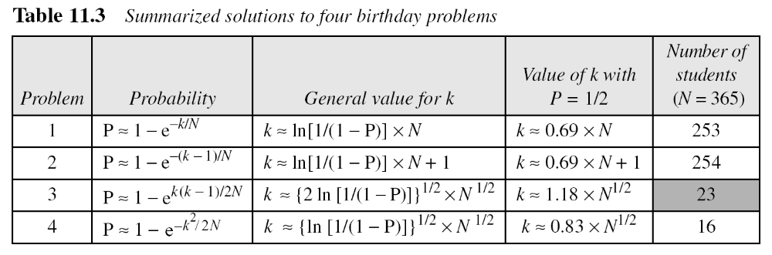
11.2.2 Continued
Summary of Solutions
Solutions to these problems are given in Appendix E for interested readers; The results are summarized in Table 11.3.
11.<number>

Slide 21
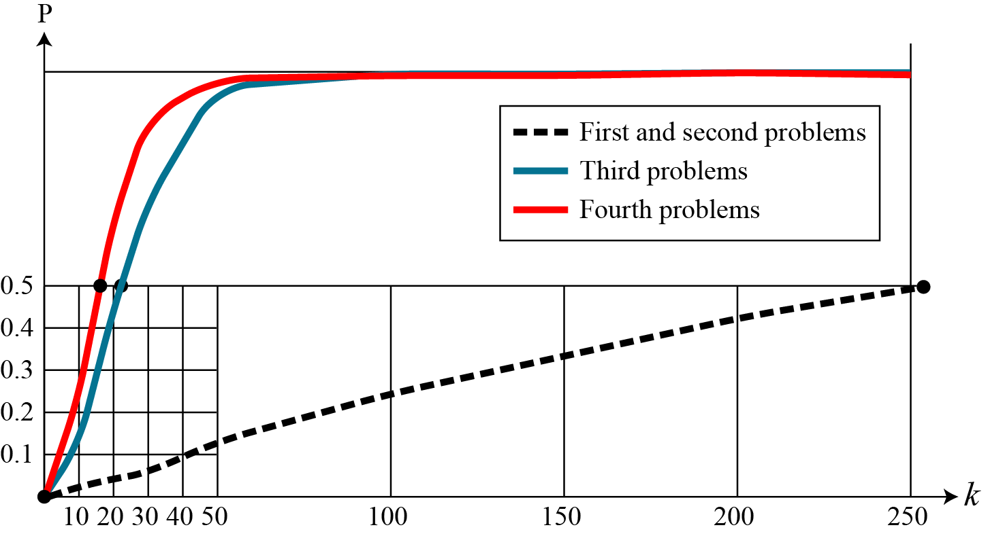
11.2.2 Continued
Comparison
Figure 11.8 Graph of four birthday problem
11.<number>

Slide 22
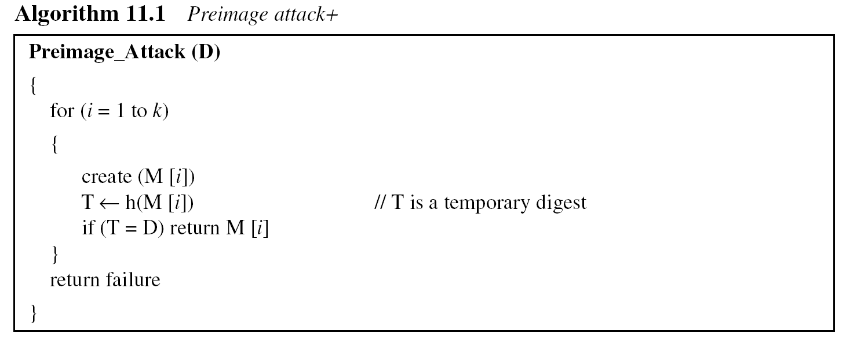
11.2.3 Attacks on Random Oracle Model
Preimage Attack
11.<number>

Slide 23
11.2.3 Continued
Example 11.6
A cryptographic hash function uses a digest of 64 bits. How many digests does Eve need to create to find the original message with the probability more than 0.5?
Solution
The number of digests to be created is k ≈ 0.69 × 2^{n} ≈ 0.69 × 2⁶⁴. This is a large number. Even if Eve can create 2³⁰ (almost one billion) messages per second, it takes 0.69 × 2³⁴ seconds or more than 500 years. This means that a message digest of size 64 bits is secure with respect to preimage attack, but, as we will see shortly, is not secured to collision attack.
11.<number>

Slide 24
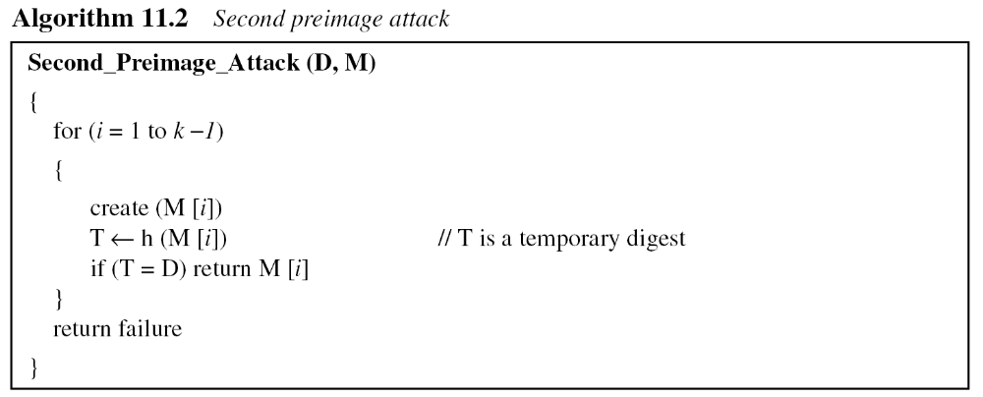
11.2.3 Continued
Second Preimage Attack.
11.<number>

Slide 25
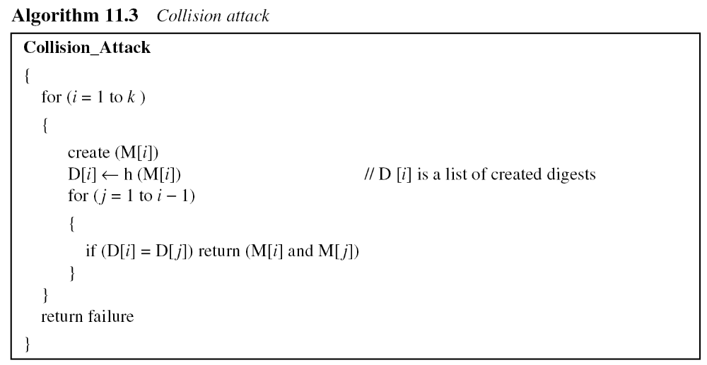
11.2.3 Continued
Collision Attack
11.<number>

Slide 26
11.2.3 Continued
Example 11.7
A cryptographic hash function uses a digest of 64 bits. How many digests does Eve need to create to find two messages with the same digest with the probability more than 0.5?
Solution
The number of digests to be created is k ≈ 1.18 × 2^{n/2} ≈ 1.18 × 232. If Eve can test 2²⁰ (almost one million) messages per second, it takes 1.18 × 2¹² seconds, or less than two hours. This means that a message digest of size 64 bits is not secure against the collision attack.
11.<number>

Slide 27
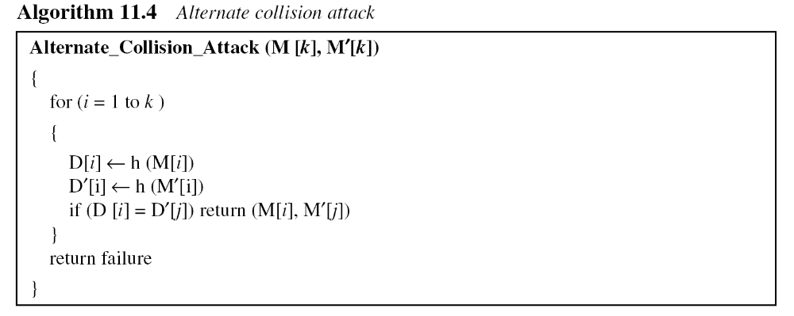
11.2.3 Continued
Alternate Collision Attack
11.<number>

Slide 28
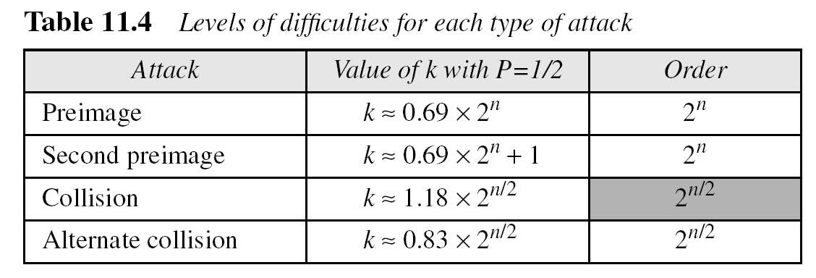
11.2.3 Continued
Summary of Attacks
Table 11.4 shows the level of difficulty for each attack if the digest is n bits.
11.<number>

Slide 29
11.2.3 Continued
Example 11.8
Originally hash functions with a 64-bit digest were believed to be immune to collision attacks. But with the increase in the processing speed, today everyone agrees that these hash functions are no longer secure. Eve needs only 2^{64/2} = 2³² tests to launch an attack with probability 1/2 or more. Assume she can perform 2²⁰ (one million) tests per second. She can launch an attack in
2³²/2²⁰ = 2¹² seconds (almost an hour).
11.<number>

Slide 30
11.2.3 Continued
Example 11.9
MD5 (see Chapter 12), which was one of the standard hash functions for a long time, creates digests of 128 bits. To launch a collision attack, the adversary needs to test 2⁶⁴ (2¹²⁸/2) tests in the collision algorithm. Even if the adversary can perform 2³⁰ (more than one billion) tests in a second, it takes 2³⁴ seconds (more than 500 years) to launch an attack. This type of attack is based on the Random Oracle Model. It has been proved that MD5 can be attacked on less than 2⁶⁴ tests because of the structure of the algorithm.
11.<number>

Slide 31
11.2.3 Continued
Example 11.10
SHA-1 (see Chapter 12), a standard hash function developed by NIST, creates digests of 160 bits. The function is attacks. To launch a collision attack, the adversary needs to test 2^{160/2} = 2⁸⁰ tests in the collision algorithm. Even if the adversary can perform 2³⁰ (more than one billion) tests in a second, it takes 2⁵⁰ seconds (more than ten thousand years) to launch an attack. However, researchers have discovered some features of the function that allow it to be attacked in less time than calculated above.
11.<number>

Slide 32
11.2.3 Continued
Example 11.11
The new hash function, that is likely to become NIST standard, is SHA-512 (see Chapter 12), which has a 512-bit digest. This function is definitely resistant to collision attacks based on the Random Oracle Model. It needs 2^{512/2} = 2²⁵⁶ tests to find a collision with the probability of 1/2.
11.<number>

Slide 33
11.2.4 Attacks on the Structure
The adversary may have other tools to attack hash function. One of these tools, for example, is the meet-in-the-middle attack that we discussed in Chapter 6 for double DES.
11.<number>

Slide 34
11-3 MESSAGE AUTHENTICATION
A message digest does not authenticate the sender of the message. To provide message authentication, Alice needs to provide proof that it is Alice sending the message and not an impostor. The digest created by a cryptographic hash function is normally called a modification detection code (MDC). What we need for message authentication is a message authentication code (MAC).
Topics discussed in this section:
11.3.1 Modification Detection Code (MDC)
11.3.2 Message Authentication Code (MAC)
11.<number>

Slide 35
11.3.1 Modification Detection Code (MDC)
A modification detection code (MDC) is a message digest that can prove the integrity of the message: that message has not been changed. If Alice needs to send a message to Bob and be sure that the message will not change during transmission, Alice can create a message digest, MDC, and send both the message and the MDC to Bob. Bob can create a new MDC from the message and compare the received MDC and the new MDC. If they are the same, the message has not been changed.
11.<number>

Slide 36
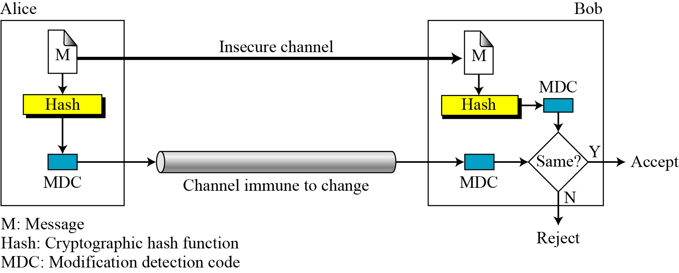
11.3.1 Continued
Figure 11.9 Modification detection code (MDC)
11.<number>

Slide 37
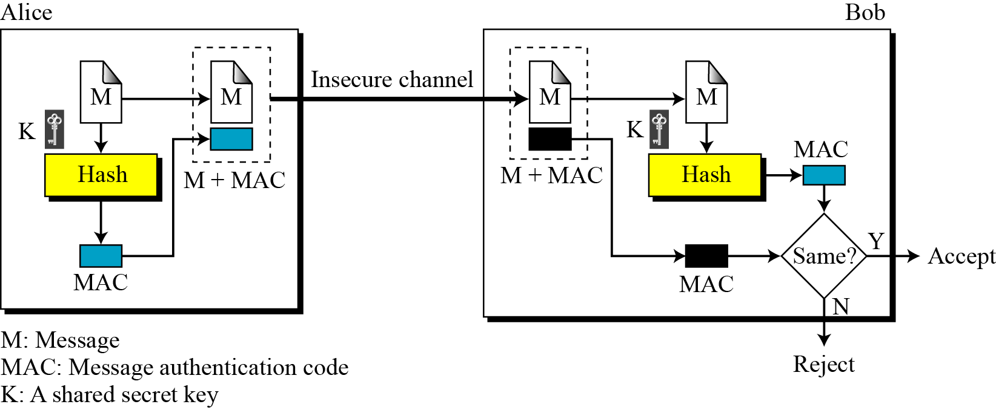
11.3.2 Message Authentication Code (MAC)
Figure 11.10 Message authentication code
11.<number>

Slide 38
11.3.2 Continued
Note
The security of a MAC depends on the security of the underlying hash algorithm.
11.<number>

Slide 39
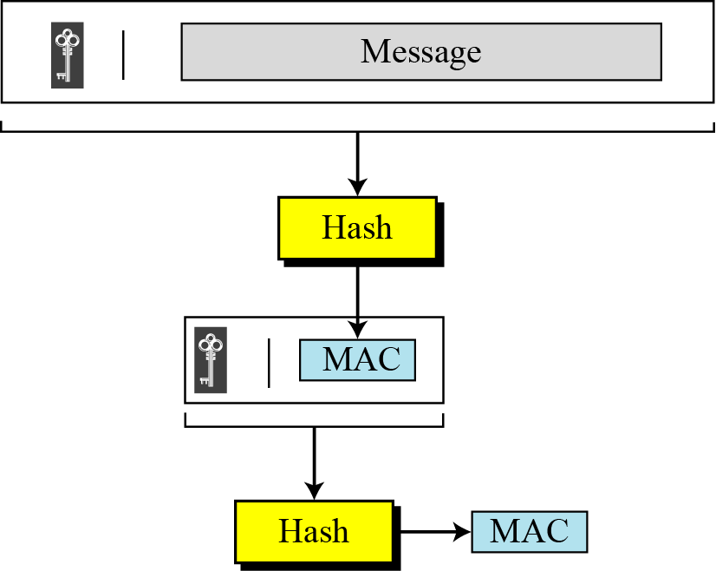
11.3.2 Continued
Nested MAC
Figure 11.11 Nested MAC
11.<number>

Slide 40
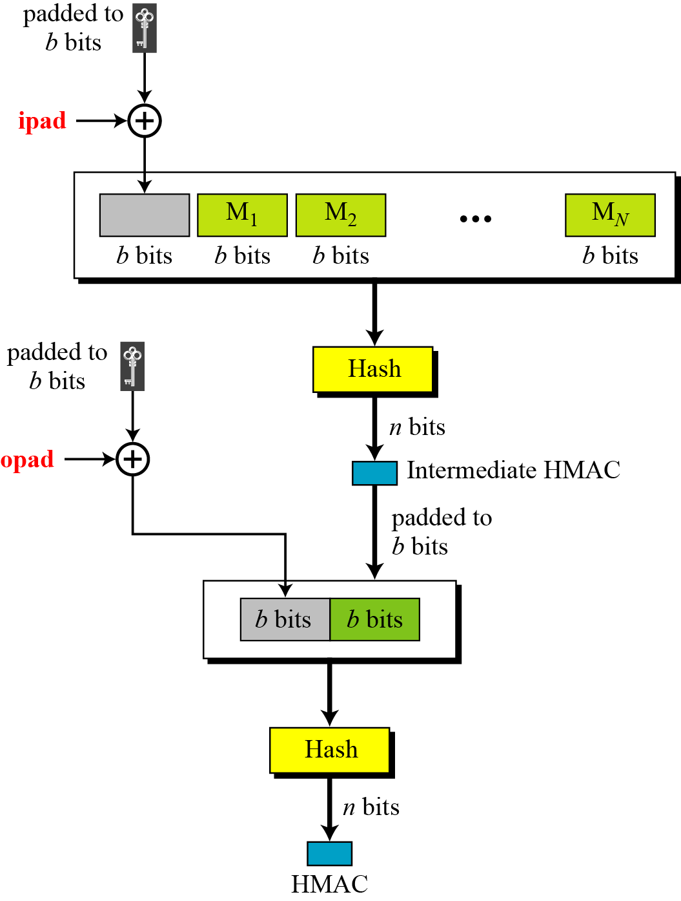
11.3.2 Continued
HMAC
Figure 11.12
Details of HMAC
11.<number>

Slide 41
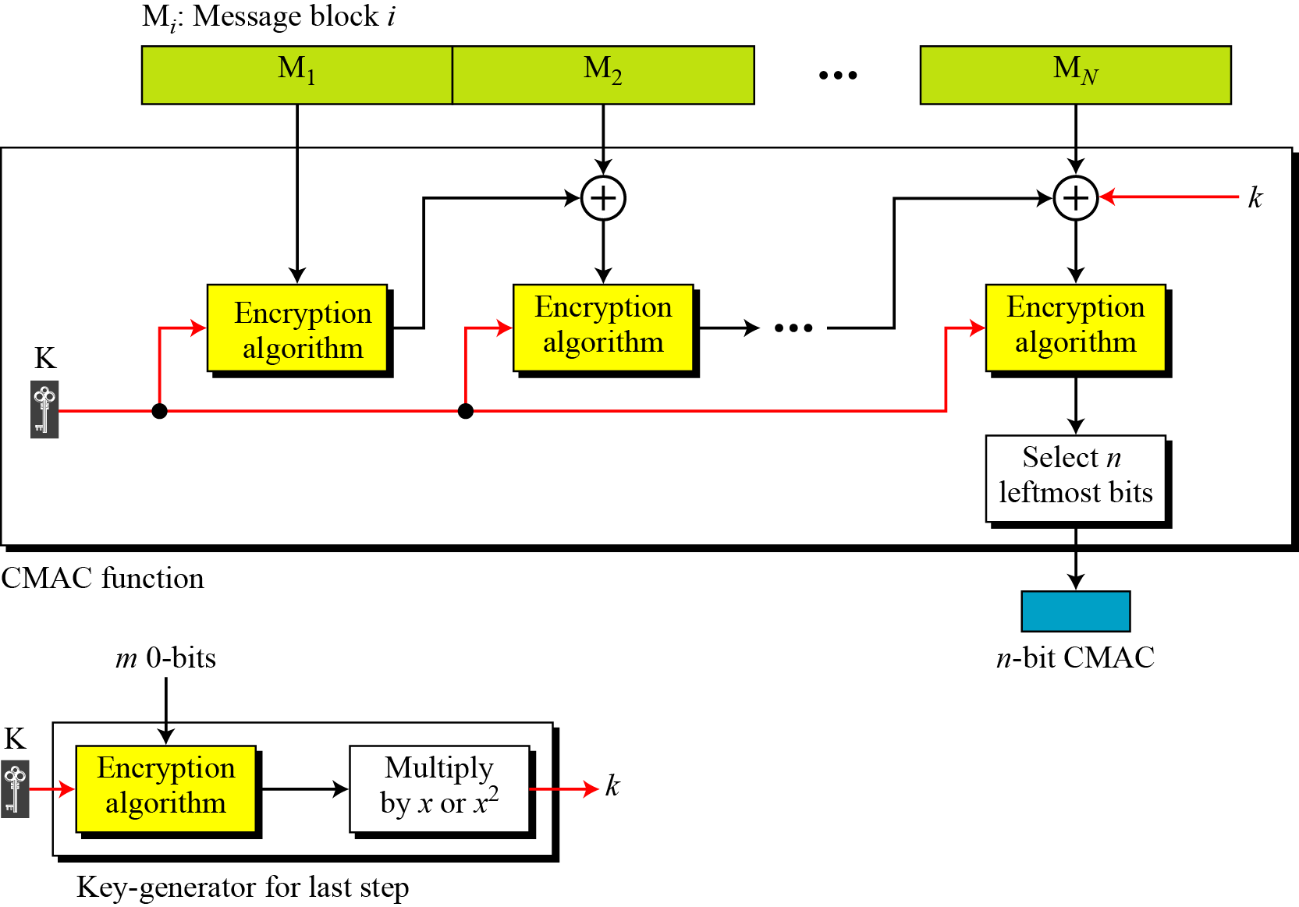
11.3.2 Continued
Figure 11.13 CMAC
11.<number>

