Slide 1

Instructor: Rehan Ahmad

Slide 2

Message authentication is a mechanism or service used to verify the integrity of a message. Message authentication assures that data received are exactly as sent by (i.e., contain no modification, insertion, deletion, or replay) and that the purported identity of the sender is valid.

Slide 3
The two most common cryptographic techniques for message authentication are a:
Message authentication code (MAC)
Secure hash function

Slide 4

In the context of communications across a network, the following attacks can be identified:
Disclosure: Release of message contents to any person or process not possessing the appropriate cryptographic key.
Traffic analysis: Discovery of the pattern of traffic between parties. In a connection-oriented application, the frequency and duration of connections could be determined. In either a connection-oriented or connectionless environment, the number and length of messages between parties could be determined.
Masquerade: Insertion of messages into the network from a fraudulent source. This includes the creation of messages by an opponent that are purported to come from an authorized entity. Also included are fraudulent acknowledgments of message receipt or nonreceipt by someone other than the message recipient.

Slide 5
Content modification: Changes to the contents of a message, including insertion, deletion, transposition, and modification.
Sequence modification: Any modification to a sequence of messages between parties, including insertion, deletion, and reordering.
Timing modification: Delay or replay of messages. In a connection-oriented application, an entire session or sequence of messages could be a replay of some previous valid session, or individual messages in the sequence could be delayed or replayed. In a connectionless application, an individual message (e.g., datagram) could be delayed or replayed.
Source repudiation: Denial of transmission of message by source.
Destination repudiation: Denial of receipt of message by destination.

Slide 6

Message encryption: The ciphertext of the entire message serves as its authenticator
Message authentication code (MAC): A function of the message and a secret key that produces a fixed-length value that serves as the authenticator
Hash function: A function that maps a message of any length into a fixed-length hash value, which serves as the authenticator

Slide 7

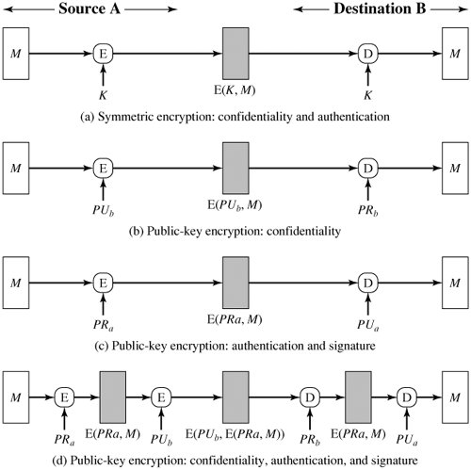

Slide 8

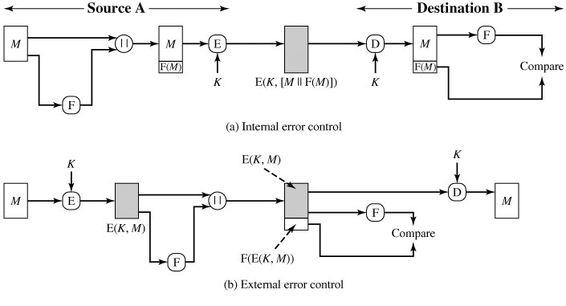

Slide 9

An alternative authentication technique involves the use of a secret key to generate a small fixed-size block of data, known as a cryptographic checksum or MAC that is appended to the message.

Slide 10

This technique assumes that two communicating parties, say A and B, share a common secret key K. When A has a message to send to B, it calculates the MAC as a function of the message and the key:
MAC = C(K, M), where
    M = input message
    C = MAC function
    K = shared secret key
    MAC = message authentication code

Slide 11

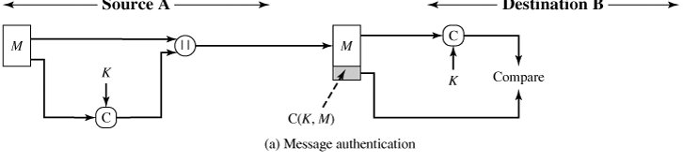
The receiver is assured that the message has not been altered. If an attacker alters the message but does not alter the MAC, then the receiver's calculation of the MAC will differ from the received MAC. Because the attacker is assumed not to know the secret key, the attacker cannot alter the MAC to correspond to the alterations in the message.

Slide 12
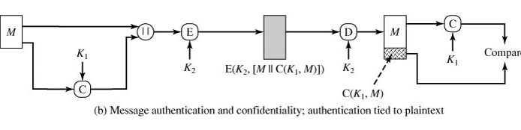
The receiver is assured that the message is from the alleged sender. Because no one else knows the secret key, no one else could prepare a message with a proper MAC.

Slide 13
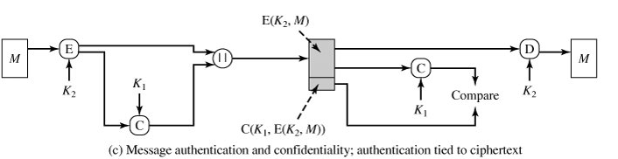
If the message includes a sequence number (such as is used with HDLC, X.25, and TCP), then the receiver can be assured of the proper sequence because an attacker cannot successfully alter the sequence number.

Slide 14
(a) Message authentication
A →B: M||C(K, M)
•Provides authentication
Only A and B share K
(b) Message authentication and confidentiality: authentication tied to plaintext
A → B:E(K₂, [M||C(K, M)])
• Provides authentication
Only A and B share K₁
• Provides confidentiality
Only A and B share K₂
(c) Message authentication and confidentiality: authentication tied to ciphertext
A → B:E(K₂, M)||C(K₁, E(K₂, M))
• Provides authentication
Using K₁
• Provides confidentiality
Using K₂

Slide 15

A variation on the message authentication code is the one-way hash function. As with the message authentication code, a hash function accepts a variable-size message M as input and produces a fixed-size output, referred to as a hash code H(M).
Unlike a MAC, a hash code does not use a key but is a function only of the input message. The hash code is also referred to as a message digest or hash value.

Slide 16

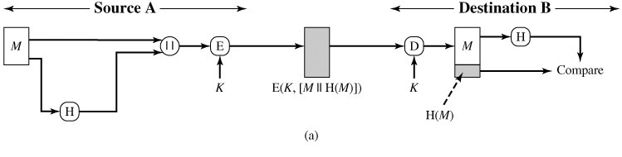
The message plus concatenated hash code is encrypted using symmetric encryption. This is identical in structure to the internal error control strategy.
The hash code provides the structure or redundancy required to achieve authentication

Slide 17
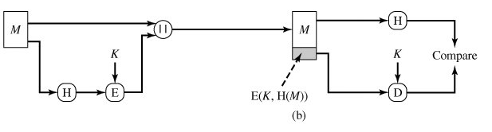
Only the hash code is encrypted, using symmetric encryption. This reduces the processing burden for those applications that do not require confidentiality.

Slide 18
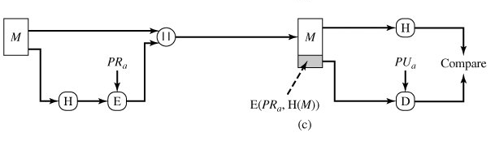
Only the hash code is encrypted, using public-key encryption and using the sender's private key. This provides authentication. It also provides a digital signature, because only the sender could have produced the encrypted hash code. In fact, this is the essence of the digital signature technique.

Slide 19
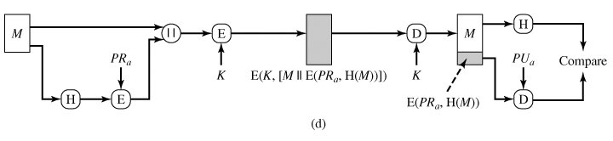
If confidentiality as well as a digital signature is desired, then the message plus the private-key-encrypted hash code can be encrypted using a symmetric secret key. This is a common technique.

Slide 20
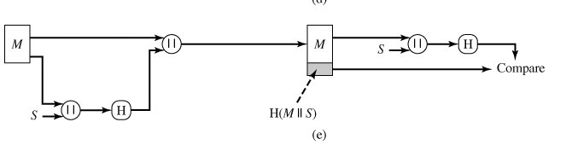
It is possible to use a hash function but no encryption for message authentication. The technique assumes that the two communicating parties share a common secret value S. A computes the hash value over the concatenation of M and S and appends the resulting hash value to M. Because B possesses S, it can recompute the hash value to verify. Because the secret value itself is not sent, an opponent cannot modify an intercepted message and cannot generate a false message.

Slide 21
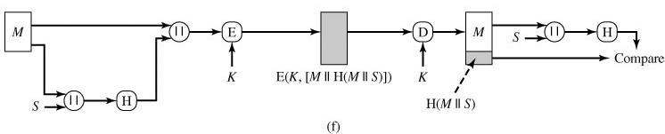
Confidentiality can be added to the approach of (e) by encrypting the entire message plus the hash code.

Slide 22

A MAC, also known as a cryptographic checksum, is generated by a function C of the form
MAC = C(K, M)
where M is a variable-length message, K is a secret key shared only by sender and receiver, and C(K, M) is the fixed-length authenticator. The MAC is appended to the message at the source at a time when the message is assumed or known to be correct. The receiver authenticates that message by recomputing the MAC.

Slide 23

The MAC function should satisfy the following requirements:
If an opponent observes M and C(K, M), it should be computationally infeasible for the opponent to construct a message M' such that C(K, M') = C(K, M).
( it should infeasible that opponent is able to construct a new message to match a given MAC )
C(K, M) should be uniformly distributed in the sense that for randomly chosen messages, M and M', the probability that C(K, M) = C(K, M') is 2^{n}, where n is the number of bits in the MAC.
Let M' be equal to some known transformation on M. That is, M' = f(M). For example, f may involve inverting one or more specific bits. In that case, Pr[C(K, M) = C(K, M')] = 2^{n}. (The final requirement dictates that the authentication algorithm should not be weaker )

Slide 24

The Data Authentication Algorithm, based on DES, has been one of the most widely used MACs for a number of years.
However security weaknesses in this algorithm have been discovered and it is being replaced by newer and stronger algorithms.
The algorithm can be defined as using the cipher block chaining (CBC) mode of operation of DES with an initialization vector of zero.

Slide 25

The data (e.g., message, record, file, or program) to be authenticated are grouped into contiguous 64-bit blocks: D₁, D₂,..., D_{N}. If necessary, the final block is padded on the right with zeroes to form a full 64-bit block. Using the DES encryption algorithm, E, and a secret key, K, a data authentication code (DAC) is calculated as shown in figure.

Slide 26

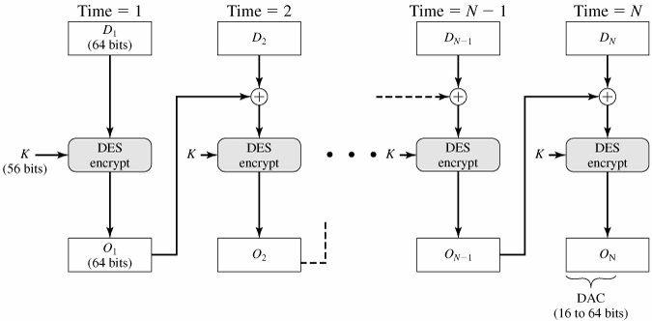

Slide 27

A hash value h is generated by a function H of the form
h = H(M)
where M is a variable-length message and H(M) is the fixed-length hash value. The hash value is appended to the message at the source at a time when the message is assumed or known to be correct. The receiver authenticates that message by recomputing the hash value. Because the hash function itself is not considered to be secret, some means is required to protect the hash value

Slide 28

The purpose of a hash function is to produce a "fingerprint" of a file, message, or other block of data. To be useful for message authentication, a hash function H must have the following properties:
H can be applied to a block of data of any size.
H produces a fixed-length output.
H(x) is relatively easy to compute for any given x, making both hardware and software implementations practical.

Slide 29
For any given value h, it is computationally infeasible to find x such that H(x) = h. This is sometimes referred to in the literature as the one-way property.
For any given block x, it is computationally infeasible to find y ≠x such that H(y) = H(x). This is sometimes referred to as weak collision resistance.
It is computationally infeasible to find any pair (x, y) such that H(x) = H(y). This is sometimes referred to as strong collision resistance

Slide 30

All hash functions operate using the following general principles. The input (message, file, etc.) is viewed as a sequence of n-bit blocks. The input is processed one block at a time in an iterative fashion to produce an n-bit hash function.
One of the simplest hash functions is the bit-by-bit exclusive-OR (XOR) of every block. This can be expressed as follows:
  C_{i} = b_{i1} + b_{i1} + ... + b_{im}
  where
  C_{i} = ith bit of the hash code, 1 i n
  M = number of n-bit blocks in the input
  B_{ij} = ith bit in jth block
  + = XOR operation

Slide 31
A simple way to improve matters is to perform a one-bit circular shift, or rotation, on the hash value after each block is processed. The procedure can be summarized as follows:
  Initially set the n-bit hash value to zero.
  Process each successive n-bit block of data as follows:
    Rotate the current hash value to the left by one bit.
    XOR the block into the hash value.

Slide 32
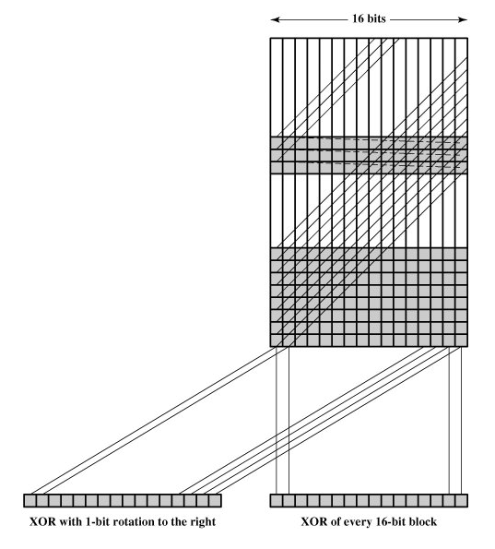

Slide 33

There are two types of attacks
1- Brute Force Attack
2- Cryptanalysis Attack

Slide 34

The nature of brute-force attacks differs somewhat for hash functions and MACs.

Slide 35

The strength of a hash function against brute-force attacks depends solely on the length of the hash code produced by the algorithm. there are three desirable properties:
One-way: For any given code h, it is computationally infeasible to find x such that H(x) = h.
Weak collision resistance: For any given block x, it is computationally infeasible to find y≠ x with H(y) = H(x).
Strong collision resistance: It is computationally infeasible to find any pair (x, y) such that H(x) = H(y).

Slide 36
For a hash code of length n, the level of effort required, as we have seen is proportional to the following:
One way 2^{n}
Weak collision resistance 2^{n}
Strong collision resistance 2^{n/2}

Slide 37

A brute-force attack on a MAC is a more difficult undertaking because it requires known message-MAC pairs.

Slide 38

As with encryption algorithms, cryptanalytic attacks on hash functions and MAC algorithms seek to exploit some property of the algorithm to perform some attack other than an exhaustive search. The way to measure the resistance of a hash or MAC algorithm to cryptanalysis is to compare its strength to the effort required for a brute-force attack. That is, an ideal hash or MAC algorithm will require a cryptanalytic effort greater than or equal to the brute-force effort.

Slide 39

The hash function takes an input message and partitions it into L fixed-sized blocks of b bits each. If necessary, the final block is padded to b bits. The final block also includes the value of the total length of the input to the hash function. The inclusion of the length makes the job of the opponent more difficult. Either the opponent must find two messages of equal length that hash to the same value or two messages of differing lengths that, together with their length values, hash to the same value.

Slide 40

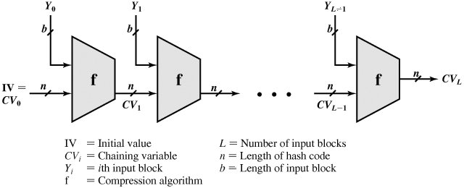

Slide 41
The motivation for this iterative structure stems from the observation by Merkle and Damgard that if the compression function is collision resistant, then so is the resultant iterated hash function. Therefore, the structure can be used to produce a secure hash function to operate on a message of any length. The problem of designing a secure hash function reduces to that of designing a collision-resistant compression function that operates on inputs of some fixed size.

Slide 42
Cryptanalysis of hash functions focuses on the internal structure of f and is based on attempts to find efficient techniques for producing collisions for a single execution of f. Once that is done, the attack must take into account the fixed value of IV. The attack on f depends on exploiting its internal structure. Typically, as with symmetric block ciphers, f consists of a series of rounds of processing, so that the attack involves analysis of the pattern of bit changes from round to round.
The attacks that have been mounted on hash functions are rather complex and beyond our scope here.

Slide 43

There is much more variety in the structure of MACs than in hash functions, so it is difficult to generalize about the cryptanalysis of MACs. Further, far less work has been done on developing such attacks

