Slide 1

Advanced Java Programming
Struts

Slide 2
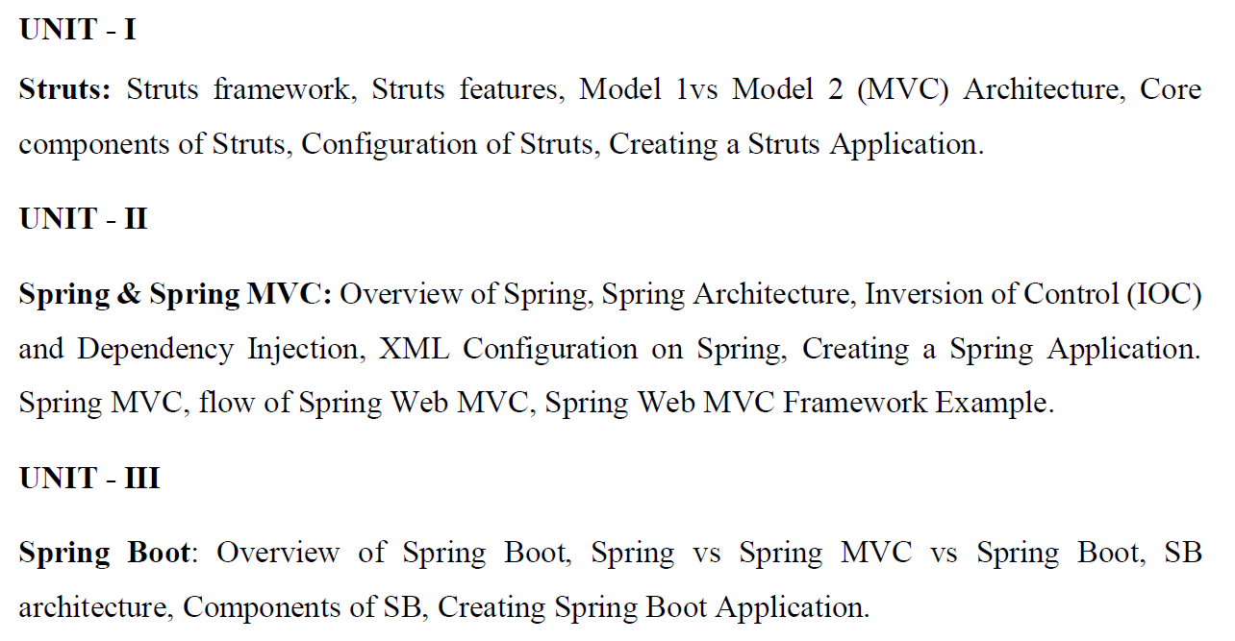
Syllabus

Slide 3
Struts
Struts is an open-source framework for developing Java web applications.
It was originally created by Craig R. McClanahan and donated to the Apache Software Foundation in 2000.
Struts is built on top of the Java Servlet API and the JavaServer Pages (JSP) technology and provides a structured framework for developing web applications.

Slide 4
Struts Architecture
There are two types of programming models (design models)
Model 1 Architecture
Model 2 (MVC) Architecture

Slide 5
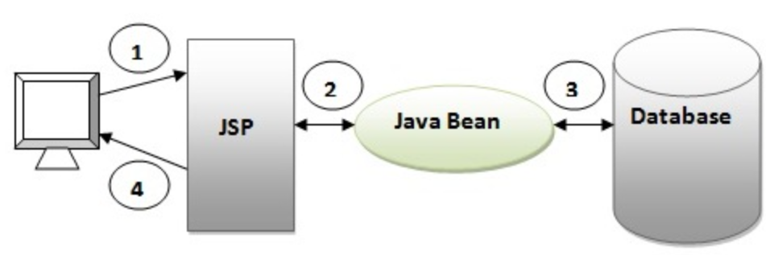
Struts Architecture
Model 1 architecture is an early and simple web application architecture that was used to build Java-based web applications.
Servlet and JSP are the main technologies to develop the web applications.
Browser sends request for the JSP page
JSP accesses Java Bean and invokes business logic
Java Bean connects to the database and get/save data
Response is sent to the browser which is generated by JSP

Slide 6
Struts Architecture
Model 2 (MVC) Architecture
Model 2 is based on the MVC (Model View Controller) design pattern. The MVC design pattern consists of three modules model, view and controller.
Model The model represents the state (data) and business logic of the application.
View The view module is responsible to display data i.e. it represents the presentation.
Controller The controller module acts as an interface between view and model. It intercepts all the requests i.e. receives input and commands to Model / View to change accordingly.

Slide 7
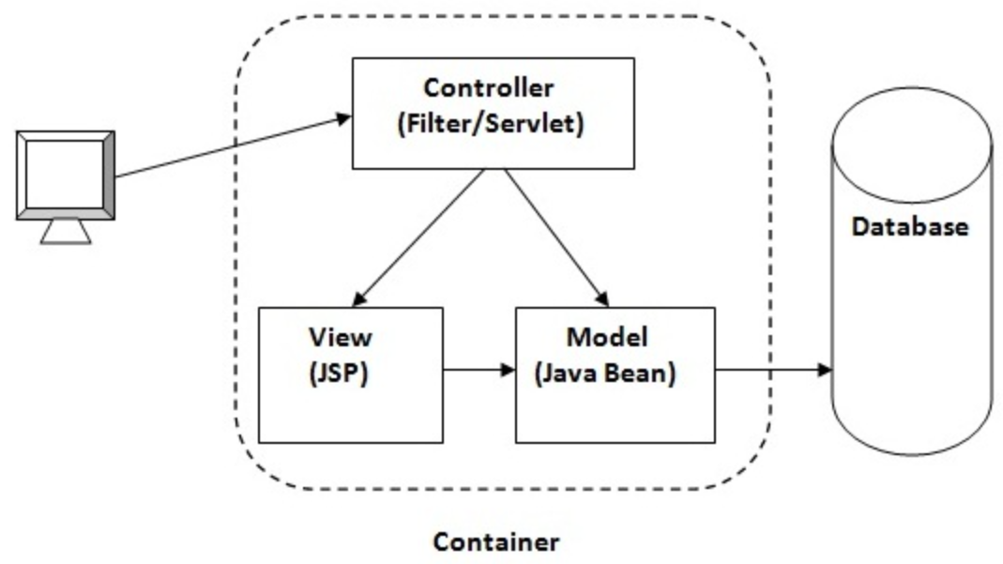
Struts Architecture
Model 2 (MVC) Architecture

Slide 8
Struts Features
It offers several features to simplify the development process and promote best practices. Here are some key features of Struts:
Model-View-Controller (MVC) Architecture: Struts follows the MVC design pattern, which helps in separating the application into three distinct components: Model (business logic and data), View (presentation layer), and Controller (request handling and routing).
This separation enhances code organization and maintainability.

Slide 9
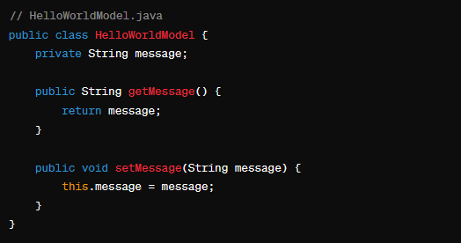
Struts Features
MVC (Model)

Slide 10
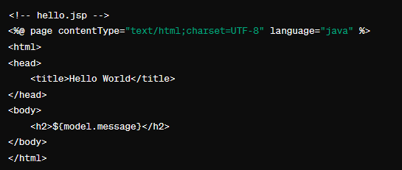
Struts Features
MVC (View)

Slide 11
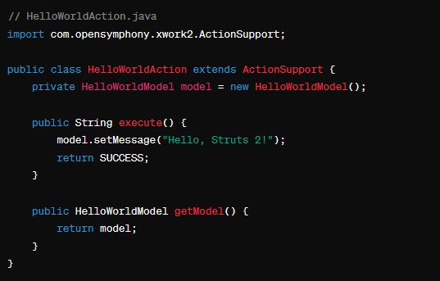
Struts Features
MVC (Controller)

Slide 12
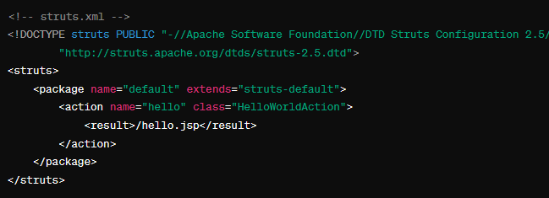
Struts Features
MVC (struts.xml)

Slide 13
Struts Features
Front Controller: In Struts 2, the Front Controller is responsible for managing the flow of a web application. The front controller is the entry point for all incoming requests and handles the request processing lifecycle.
In the case of Struts 2, the front controller is the FilterDispatcher (deprecated) or the more modern StrutsPrepareAndExecuteFilter.

Slide 14
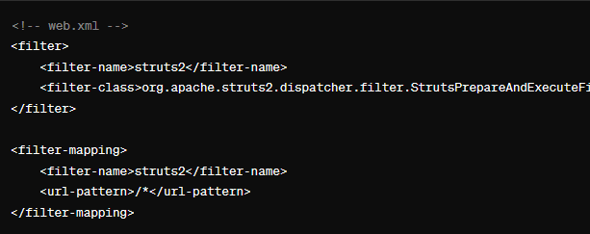
Struts Features
Front Controller:

Slide 15
Struts Features
Front Controller:
With this configuration, any incoming request to your web application, regardless of the URL path, will be intercepted by the StrutsPrepareAndExecuteFilter.
The filter will then delegate the processing to the appropriate Struts 2 action based on the URL and the mappings defined in the struts.xml file.

Slide 16
Struts Features
Struts.xml
The struts.xml file is a configuration file used in Struts 2 applications to define the mapping between URLs and the corresponding actions, as well as other configuration settings.
It plays a crucial role in configuring the behavior of your Struts 2 application.

Slide 17
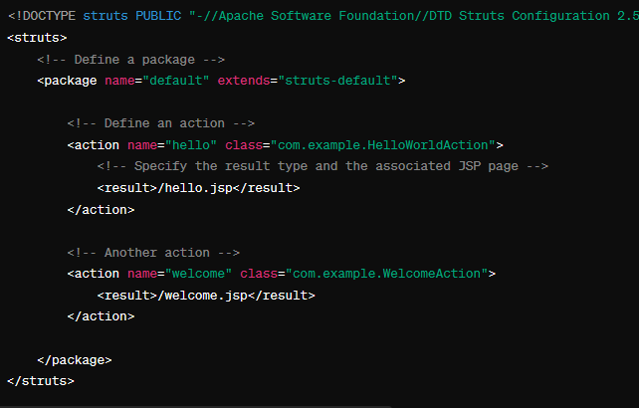
Struts Features
Struts.xml

Slide 18
Struts Features
Action Classes: Action classes are part of the controller layer and are responsible for handling specific user requests.
Each type of user action (such as submitting a form or clicking a link) is associated with a corresponding Action class.
Action classes in Struts typically extend the ActionSupport class provided by the framework and implement the execute method, where the actual processing for the user request takes place.

Slide 19
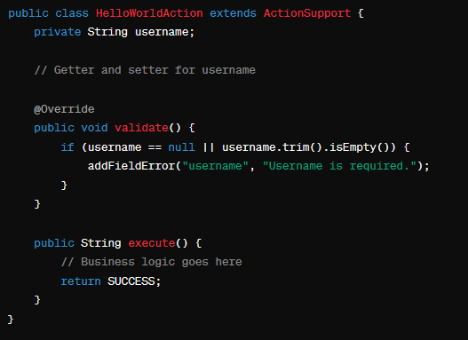
Struts Features
Action Classes:

Slide 20
Struts Features
Result Types:
In Struts 2, result types define what happens after an action has been executed. When an action returns a result, it is associated with a particular type, and Struts 2 uses this result type to determine the next step in the request processing.

Slide 21
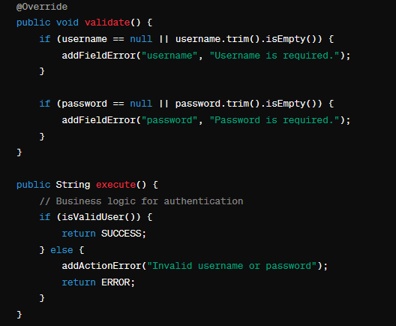
Struts Features
Various Result Types:

Slide 22
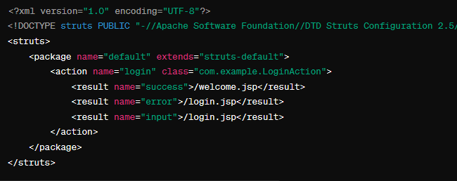
Struts Features
Various Result Types:

Slide 23
Struts Features
Tag Support: Tag libraries are sets of custom tags that you can use in JavaServer Pages (JSP) to simplify the creation of dynamic web pages.
These tags provide a convenient way to interact with Struts 2 components and features, helping you generate HTML forms, display data, and handle actions.
The tag library used in Struts 2 is known as the Struts Tags Library.

Slide 24
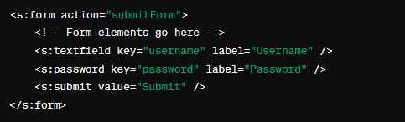

Struts Features
Tag Support:

Slide 25
Struts Features
Integration Support: When it comes to integration support in the context of Struts 2, it typically involves integrating Struts 2 with other technologies, frameworks, or tools to enhance the functionality and capabilities of your web application.
Integration support in struts 2 is provided for hibernate/JPA, Spring, JSON etc.

