Slide 1
Applicative Project-1
SECURE PASSWORD MANAGEMENT USING BLOCK CHAIN
Supervisor:
Dr. Patruni Muralidhar Rao
SOT-School of technology
Woxsen University
By:
1) Hemanth.B (22WU0106028)
2) Vishnu.J (22WU0101129)
3) Nishanth.M (22WU0106010)
4) Manideep.M (22WU0101135)

Slide 2
Applicative Project-1
Title:
Contents:
1. Abstract
2. Introduction
3. Literature survey
4. Proposed System
5. Work Flow
6. Software Requirements
7. Hardware Requirements
8. References

Slide 3
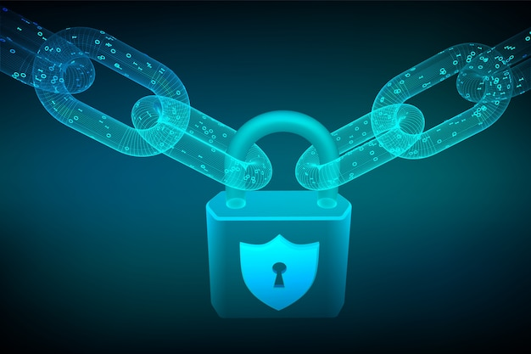
Applicative Project-1
Abstract
Objective : To build a decentralized, secure password management system using blockchain technology.
Problem Statement : Centralized password storage is vulnerable to breaches, necessitating a more secure solution.
Methodology : Passwords will be encrypted and stored on a blockchain with multi-factor authentication for enhanced security.
Results : The system will provide secure, transparent, and decentralized password management with reduced risk of breaches.

Slide 4
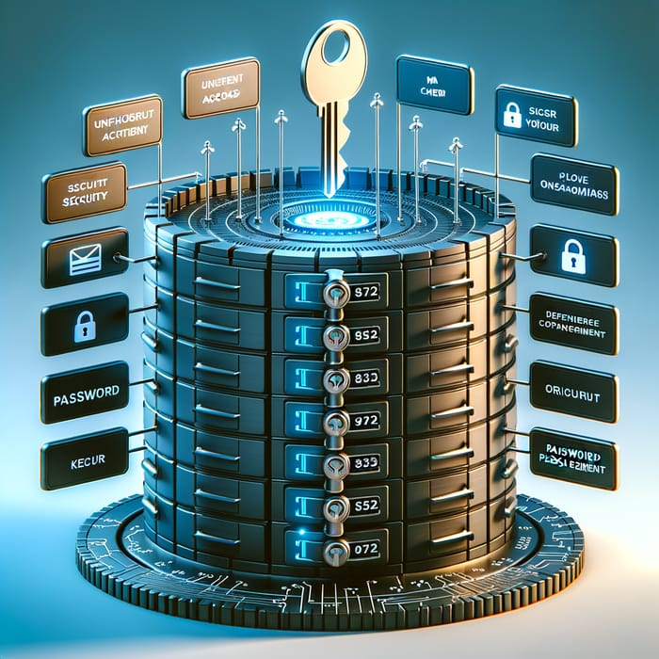
Applicative Project-1
Introduction
Password management is a critical aspect of cybersecurity. With the growing number of online platforms and the sensitive data they handle, secure password storage and management have become Essential.
Traditional methods often rely on centralized systems, which are vulnerable to breaches, data leaks, and cyberattacks. Blockchain technology offers a potential solution by decentralizing and securing password management systems.

Slide 5
Applicative Project-1
Literature Survey
A literature survey on secure password management using blockchain technology explores how researchers are using blockchain to improve password security. They are:
Blockchain-based identity management systems.
Improving Privacy and Security of Identity Management Systems Using Blockchain Technology.
A Systematic Literature Mapping On Secure Identity Management Using Blockchain Technology.
Blockchain-Based Identity Management System and Self-Sovereign Identity Ecosystem.
Blockchain-based multi-factor authentication.

Slide 6

Applicative Project-1
Proposed System
1. Decentralized Storage: Uses blockchain to store encrypted password hashes, reducing reliance on central databases.
2. Smart Contracts: Automates password management and enforces access control.
3. Enhanced Authentication: Multi-factor methods and zero-knowledge proofs protect user data.
4. Private Key Control: Users manage their own private keys for added security.
5. End-to-End Encryption: Protects data while being stored and transmitted.
6. Distributed Key Management: Security keys are spread across multiple locations.
8. Immutability: Blockchain ensures data can't be changed, aiding secure account recovery and audits.

Slide 7
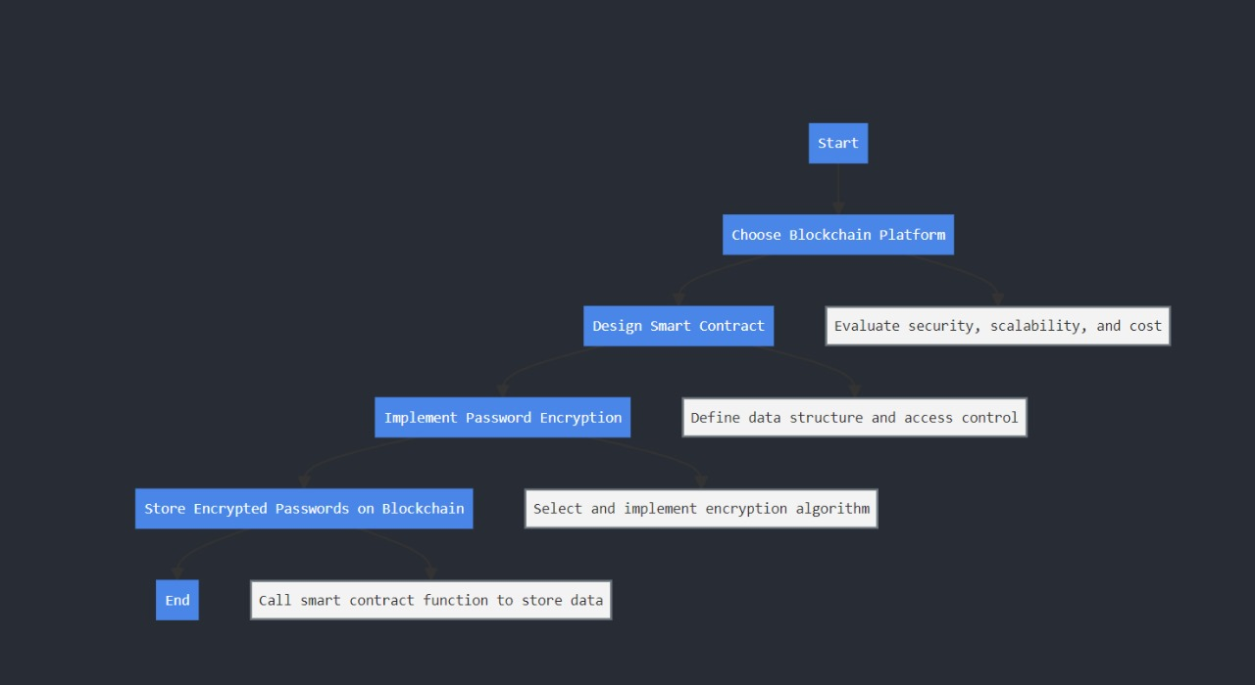
Applicative Project-1
Work Flow

Slide 8
Applicative Project-1
Software Requirements
1. Development Environment: Remix IDE
2. Blockchain Interaction Tools: MetaMask
3. Ethereum Test Network
4. Blockchain Explorers
5. Smart Contract Dependencies: Solidity Compiler
6. Operating System and Browser
7. Additional Tools
8. Security and Encryption: Cryptographic Libraries

Slide 9
Applicative Project-1
Hardware Requirements
General Hardware Requirements
Specific Hardware for Blockchain Interaction
MetaMask Setup
Remix IDE (Web-Based)
Ethereum Node Setup
Backup and Storage

Slide 10
Applicative Project-1
References
https://www.dappuniversity.com/
https://www.irjmets.com/uploadedfiles/paper/issue_6_june_2022/26519/final/fin_irjmets1655735566.pdf
https://www.irjet.net/archives/V7/i3/IRJET-V7I3250.pdf

Slide 11
Applicative Project-1
Thank You

