Slide 1




ThoughtALoud Mental Health Clinic
By Code Crew

Slide 2










Table of contents
01
03
02
04
The Website
Problems & Audience we Target
Our Objective
Conclusion

Slide 3


01
Problems & Audience we Target

Slide 4
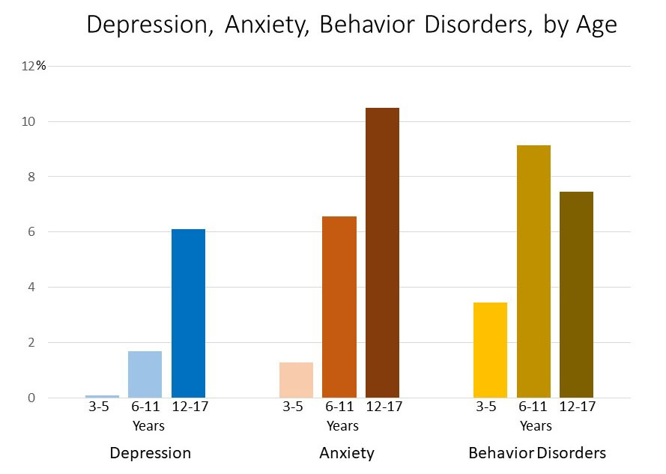
This is a graph showing Depression, Anxiety, Behaviour Disorders by Age
Behavioural disorders are most observed for 6-11 years of age group.
12-17 years of age group account for most of the depression problems
Diagnoses of ADHD, anxiety, and depression become are more common with increased age

Slide 5
Some more Statistics
For adolescents, depression, substance use and suicide are important concerns. Among adolescents aged 12-17 years in 2018-2019 reporting on the past year:
15.1% had a major depressive episode.
36.7% had persistent feelings of sadness or hopelessness.
4.1% had a substance use disorder.
1.6% had an alcohol use disorder.
3.2% had an illicit drug use disorder.
18.8% seriously considered attempting suicide.
15.7% made a suicide plan.
8.9% attempted suicide.
2.5% made a suicide attempt requiring medical treatment.

Slide 6
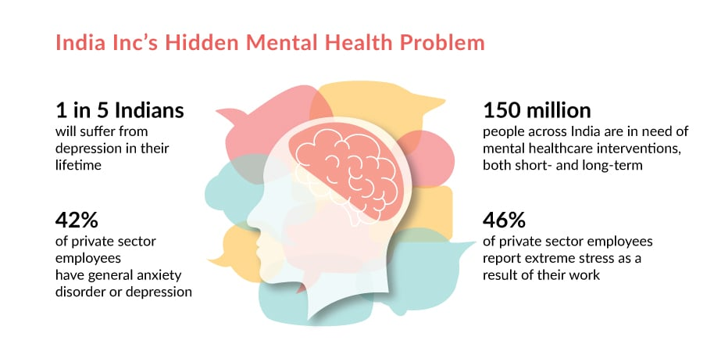

Slide 7
Our Objective
02

Slide 8
Mission and vision
Mission
Vision
To instill self-love, openness, and a carefree mindset in every adolescent.
To create a kid-friendly, secure, and private website in order to reach a growing number of youngsters and enable them get in touch with experts.

Slide 9

The Website
03

Slide 10

ThoughtsALoud
‘A Listening Ear for Every Challenge’
ThoughtsALoud works with your specific situation and thought patterns. .Our website offers a range of proven, evidence-based therapeutic approaches to address your mental health needs.

Slide 11
Introduction
Our extensive psychological website is intended to give you the tools and assistance you need to deal with the challenges associated with mental health. Designed to empower you on your road to Wellness, this area offers you access to emergency services, practical activities, and expert guidance.

Slide 12
Key Features of our Website
Crisis Support: Immediate access to crisis hotlines, emergency contacts, and intervention resources for users in acute distress, with our unique, SOS feature.
Privacy Protection: Stringent privacy measures to safeguard user data and ensure confidentiality in all interactions.
Access to licensed therapists and counselors for one-on-one sessions via text Chatbots.
We are able to locate and obtain information on the different psychologists and counsellors in our area.

Slide 13
SOS Click
The instillation in the website for anyone who feels uneasy or see panic attack or any kind of mishaps like suicide can click the SOS for the helpline to get active and ambulance to know the location to reach on. With an assistance on call for the duration till which the ambulance or any other kind of help reaches the location.

Slide 14
Exercises
A temporary aid for basic level of anxiety, panic, scare, uneasiness, breathlessness and several other issues with a constant reminder to the user to keep practicing them daily.

Slide 15
Survey
A survey for the people who are unaware of their uneasiness and for our specialist to know their patient’s problems at a better and deeper level.
*Appendix shared at the end of the ppt

Slide 16
Professionals
Gathering up many professionals who are in the field to help children for free or at a low price. Selection of the professionals on the basis of their experience. Professionals page is represented to the kids for choosing who to contact on basis of their accessibility, field in which they are facing problems and on charges.

Slide 17
Cognitive Behavioral Therapy (CBT) Exercises
Thought Records
Identify and challenge negative thought patterns by writing down your thoughts, feelings, and evidence for and against those thoughts.
Behavioral Experiments
Test out your beliefs and assumptions through small, manageable experiments to see if they hold true in real life.
Mindfulness Exercises
Practice being present and non-judgmental through breathing exercises,
body scans, and other mindfulness techniques.

Slide 18
Mindfulness and Relaxation Techniques
Discover the transformative power of mindfulness and relaxation practices. From deep breathing exercises to gentle yoga, these techniques can help alleviate symptoms of depression and promote overall emotional well-being.
By cultivating present-moment awareness and engaging in soothing, restorative activities, you can find greater inner peace and clarity to navigate life's challenges.

Slide 19
Journaling and Self-Reflection Activities
Therapeutic Journaling
Engaging in regular journaling allows you to process emotions, gain self-awareness, and
track your progress on your mental health journey.
Goal-Setting and Planning
Journaling provides a space to set achievable goals, map out actionable steps, and
celebrate your accomplishments along the way.
Self-Acceptance Exercises
Engaging in reflective writing can foster self-compassion, uncover your
inner strengths, and help you embrace all aspects of who you are.

Slide 20
Support Groups and Community Resources
Local Support Groups
Connect with others facing similar challenges in your community. Share experiences, coping strategies, and find mutual understanding and encouragement.
Online Forums
Participate in online discussion forums to access 24/7 support from a broader network of individuals dealing with depression.
Community Outreach Programs
Explore local programs that offer counseling, wellness workshops,
and social activities to promote mental health and well-being.

Slide 21
Medication Management and Referrals
Personalized Medication Plans
Our team of mental health professionals will work closely with you to develop a
personalized medication plan tailored to your specific needs and symptoms.
Medication Monitoring
We'll closely monitor the effectiveness of your medications and make adjustments as
needed to ensure you're getting the best possible treatment.
Referrals to Specialists
If your case requires additional support, we'll provide referrals to trusted
psychiatrists, therapists, and other mental health specialists in your local area.
Ongoing Support
Our team will be with you every step of the way, providing guidance
and support throughout your medication management journey.

Slide 22
Emergency Hotline and Ambulance Services
24/7 Crisis Hotline
Our dedicated crisis hotline is available 24 hours a day, 7 days a week to provide immediate support and guidance during emergencies.
Rapid Ambulance Response
With our network of emergency vehicles strategically positioned, we can dispatch an ambulance to your location within minutes to provide critical medical assistance.
Compassionate Care
Our highly trained EMTs and paramedics are committed to delivering
compassionate, patient-centered care to help stabilize and transport
individuals in crisis.
Coordination with Local Hospitals
We work closely with local hospitals to ensure a seamless transfer
of care and to provide the best possible treatment options for our clients.

Slide 23
04
Conclusion

Slide 24
Our website is a secure platform for any teenager to reach out and get help from several professionals with a member on board also tracking their progress. We intend to bring a website to people with several aspects like survey, contacting professionals, exercises with notifications and SOS react.

Slide 25
Thanks!

Slide 26
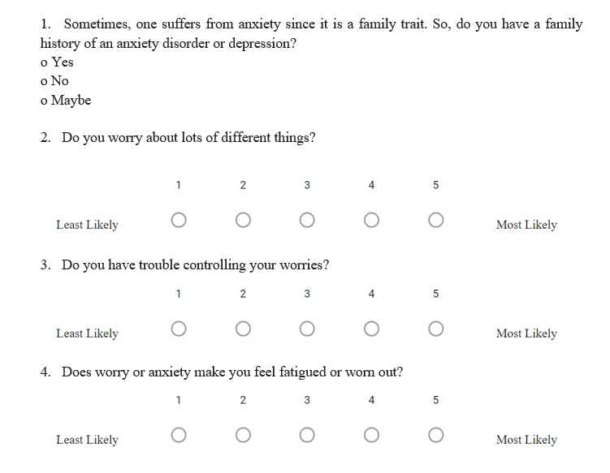

Slide 27
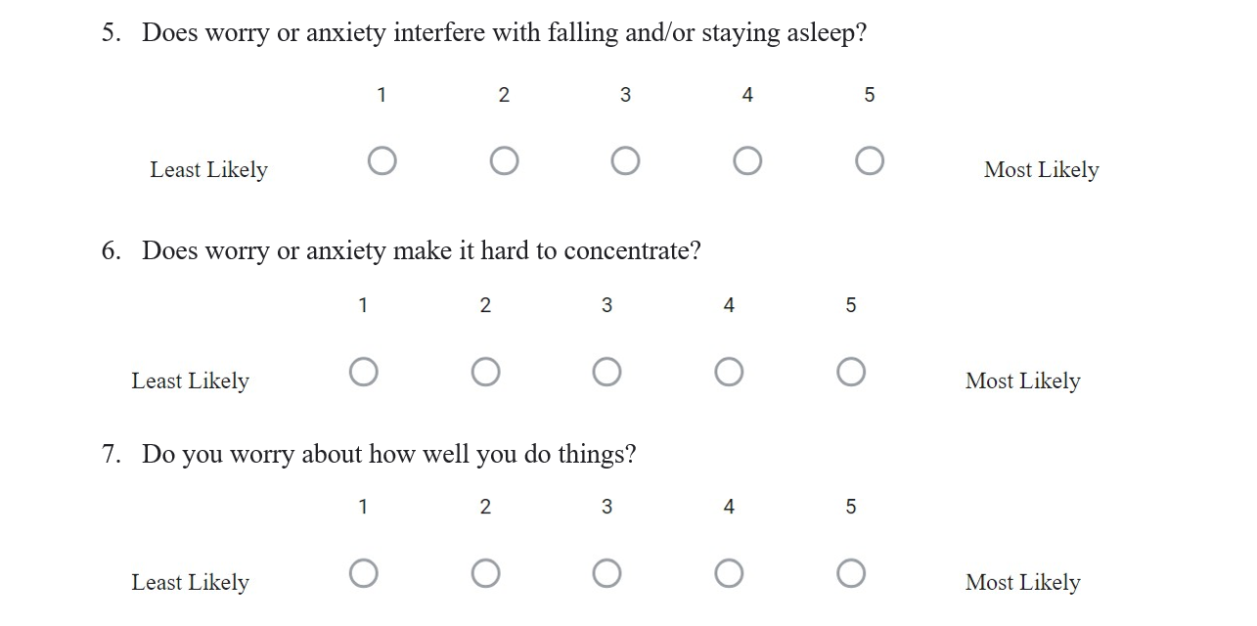

Slide 28
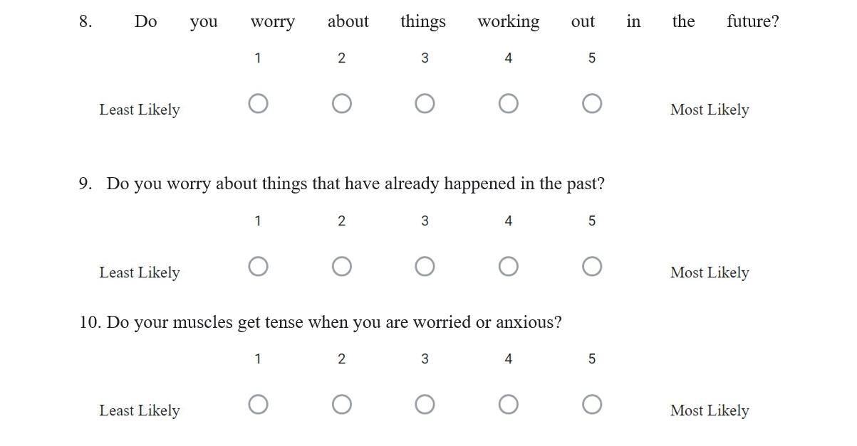

Slide 29
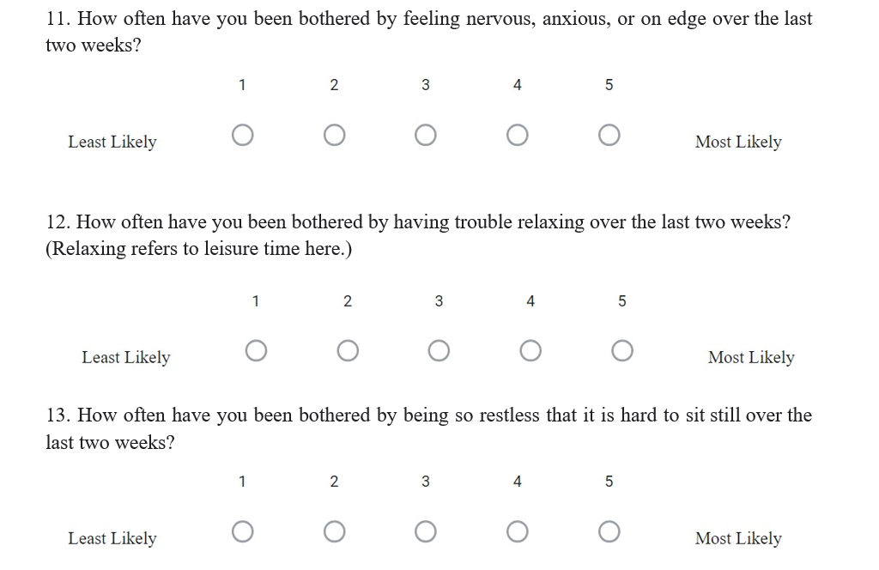

Slide 30
