Slide 1
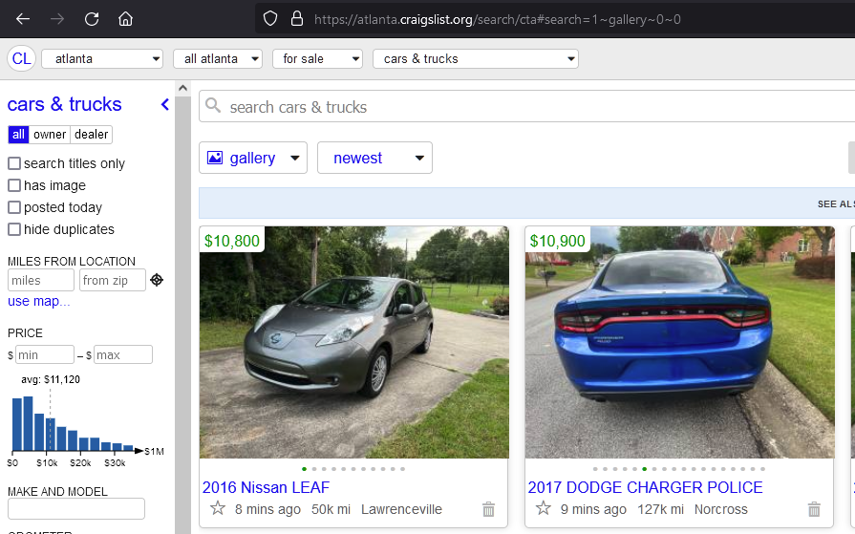
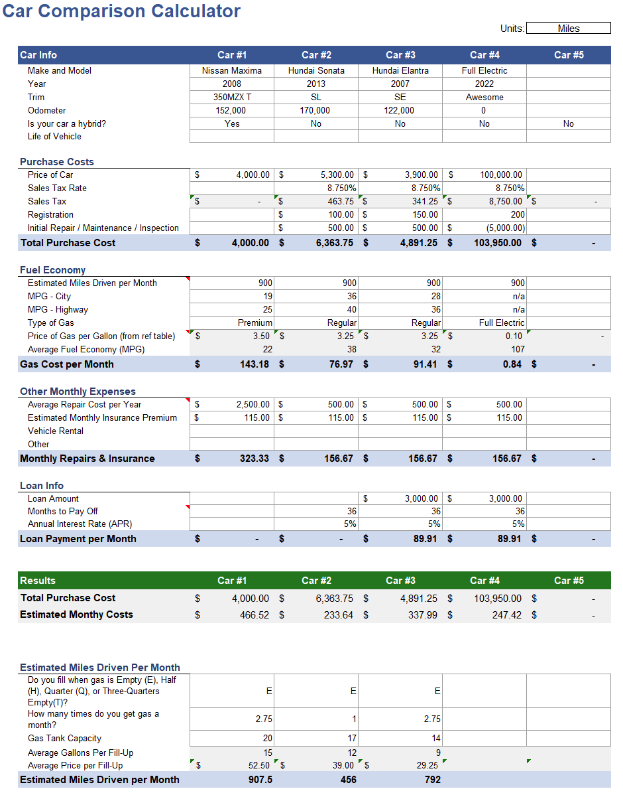

Craigslist Webscraper
Runs a query and exports the results to Excel
By Matthew Wetzel

