Slide 1
Once upon a time,
there was a living room.
A television set.
A Commodore 64 on the floor.

Slide 2
A young boy.
An older man.
A thick book of code.
Typing.

Slide 3
Line by line,
a game took shape.
Hangman.
Character-based gallows.
A little man hanging.

Slide 4
To that boy,
it was magic.

Slide 5
That magic
sparked a dream.
A dream of
making games.

Slide 6
The boy grew up.
Became a software engineer.
But the dream?
Never faded.

Slide 7
Now it's time
to make it real.

Slide 8


Slide 10
71 vintage systems.
8-bit to 16-bit.
Computers and consoles.
1977-1995.
Original + modern hardware.

Slide 11
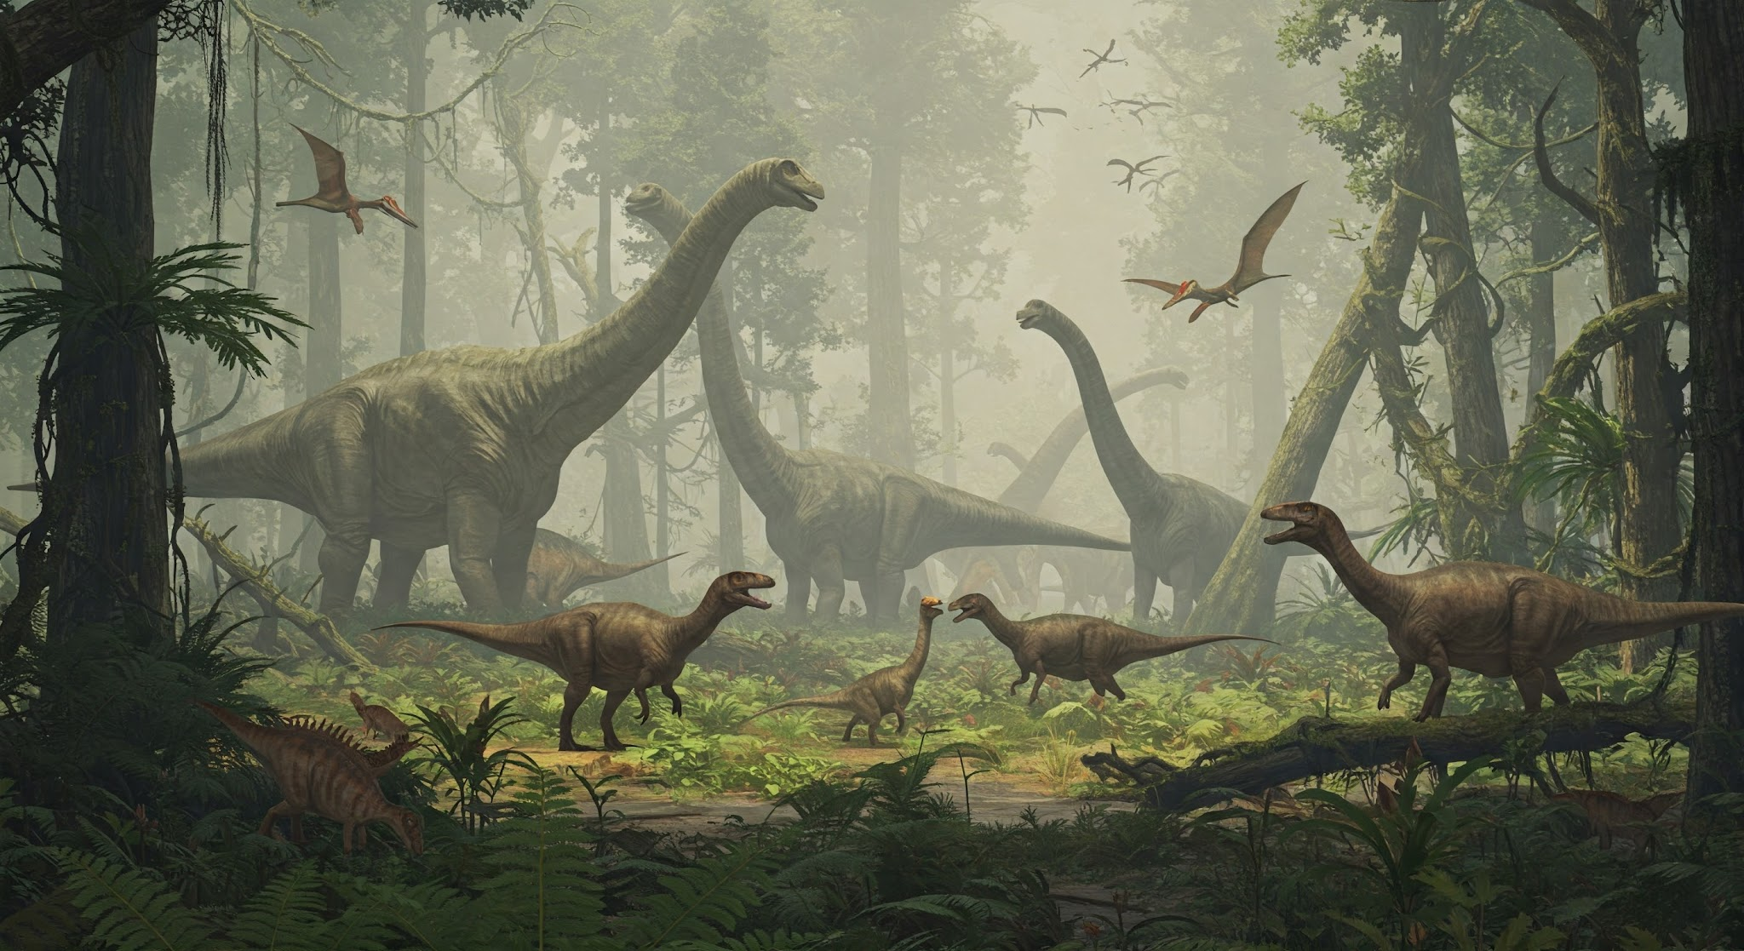
Commodore 64:
8,256 lessons,
100+ complete games.

Slide 12
Home computers:
BASIC → Assembly.
Consoles:
Straight to the metal.
Build games from lesson 1.

Slide 13
Home computers
had BASIC.
Let's use that.

Slide 14
64 BASIC lessons =
16 complete games.
Build. Improve.
Hit the ceiling.

Slide 15

Lessons 49-64:
Try professional techniques.
Watch BASIC fail.
6-8 fps. Raster jitter.

Slide 16
You've built 16 games.
You know what's possible.
You've hit the limits.
Now you WANT assembly.

Slide 17
8,192 assembly lessons.
100+ games.
Pong → Platformers →
RPGs → Shoot-em-ups.

Slide 18
Beyond 1980s games.
Demoscene tricks.
Modern techniques.
State-of-the-art retro.

Slide 19
MEGA65.
ZX Spectrum Next.
Amiga Vampire.
Original + expanded hardware.
Push the limits further.

Slide 20
NES, Master System, Genesis:
No BASIC.
Jump straight to assembly.
Same goals:
Beyond commercial.

Slide 21
No instructor.
No bootcamp fees.
No waiting for cohorts.
Start today.
Learn at your pace.

Slide 22
Prerequisites:
None.
Absolute beginners welcome.
Kids can start.
Experienced devs can jump ahead.

Slide 23
Portfolio of
100+ complete games.
Deep hardware mastery.
Assembly expertise.
Real systems programming skills.

Slide 24
Game-first learning.
Discover concepts
through necessity,
not lectures.

Slide 25
Every byte counts.
Every clock cycle matters.
Think like
a systems engineer.

Slide 27
100% free.
100% open source.
Always.
GitHub: MIT licensed.
Content: Creative Commons.

Slide 28
Like it?
GitHub Sponsors. Patreon.
Keep it sustainable.

Slide 29
Discord for chat.
GitHub Discussions for Q&A.
Share your games.
Learn together.

Slide 30
Lessons 1-16 live.
More weekly.
code198x.stevehill.xyz
Start lesson 1 today.

Slide 31
Test lessons. Report bugs.
Tell me your childhood machine.
Help build the next 70 systems.

Slide 32
From lesson 1
to beyond commercial.
From 1980s limits
to 2025 techniques.
From magic to mastery.

