Slide 1
Code Like It's 198x

Slide 2
I'm going to tell
you a story…

Slide 3
About a kid who once
watched his dad
code a version of
Hangman…

Slide 4
That sparked a dream
to make games.
Didn't quite happen.
But close enough.

Slide 5
Lately, programming feels
more mystical than ever.
Can you truly understand
everything your code does?

Slide 6
So I'm going back to when
computers had <0.1%
of today's RAM.
When every byte counted.

Slide 7


Slide 8
71 vintage systems.
8-bit to 16-bit.
Computers and consoles.
1977-1995.
Original + modern hardware.

Slide 9
Commodore 64:
8,256 lessons,
100+ complete games.

Slide 10
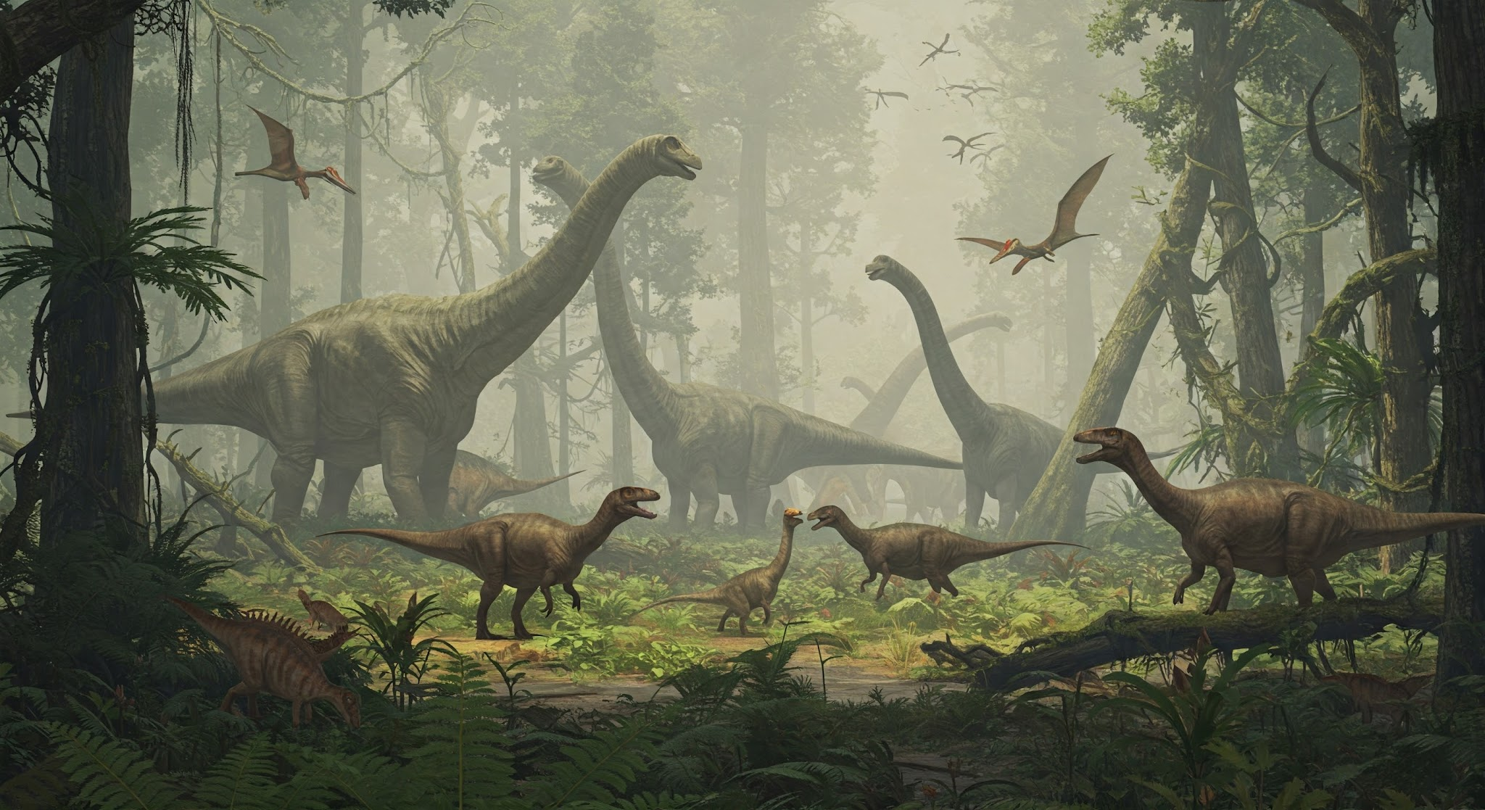
Home computers:
BASIC → Assembly.
Consoles:
Straight to the metal.
Build games from lesson 1.

Slide 11
Home computers
had BASIC.
Let's use that.

Slide 12
64 BASIC lessons =
16 complete games.
Build. Improve.
Hit the ceiling.

Slide 13
Lessons 49-64:
Try professional techniques.
Watch BASIC fail.
6-8 fps. Raster jitter.

Slide 14

You've built 16 games.
You know what's possible.
You've hit the limits.
Now you WANT assembly.

Slide 15
8,192 assembly lessons.
100+ games.
Pong → Platformers →
RPGs → Shoot-em-ups.

Slide 16
Beyond 1980s games.
Demoscene tricks.
Modern techniques.
State-of-the-art retro.

Slide 17
MEGA65.
ZX Spectrum Next.
Amiga Vampire.
Original + expanded hardware.
Push the limits further.

Slide 18
NES, Master System, Genesis:
No BASIC.
Jump straight to assembly.
Same goals:
Beyond commercial.

Slide 19
No instructor.
No bootcamp fees.
No waiting for cohorts.
Start today.
Learn at your pace.

Slide 20
Prerequisites:
None.
Absolute beginners welcome.
Kids can start.
Experienced devs can jump ahead.

Slide 21
Portfolio of
100+ complete games.
Deep hardware mastery.
Assembly expertise.
Real systems programming skills.

Slide 22
Game-first learning.
Discover concepts
through necessity,
not lectures.

Slide 23
Every byte counts.
Every clock cycle matters.
Think like
a systems engineer.

Slide 25
100% free.
100% open source.
Always.
GitHub: MIT licensed.
Content: Creative Commons.

Slide 26
Like it?
GitHub Sponsors. Patreon.
Keep it sustainable.

Slide 27
Discord for chat.
GitHub Discussions for Q&A.
Share your games.
Learn together.

Slide 28
Lessons 1-16 live.
More weekly.
code198x.stevehill.xyz
Start lesson 1 today.

Slide 29
Test lessons. Report bugs.
Tell me your childhood machine.
Help build the next 70 systems.

Slide 30
From lesson 1
to beyond commercial.
From 1980s limits
to 2025 techniques.
From magic to mastery.

Slide 31
Thanks!

