Slide 1
I’m going to tell
you a story…

Slide 2
I’m going to tell
you a story…

Slide 3
I’m going to tell
you a story…

Slide 4
I’m going to tell
you a story…

Slide 5
I’m going to tell
you a story…

Slide 6
I’m going to tell
you a story…

Slide 7
I’m going to tell
you a story…

Slide 8


Slide 9
Are you sure?
What about all
your dependencies?
Do you understand
those too?

Slide 10
It got me thinking
about simpler times.

Slide 11
I’m going to tell
you a story…

Slide 12
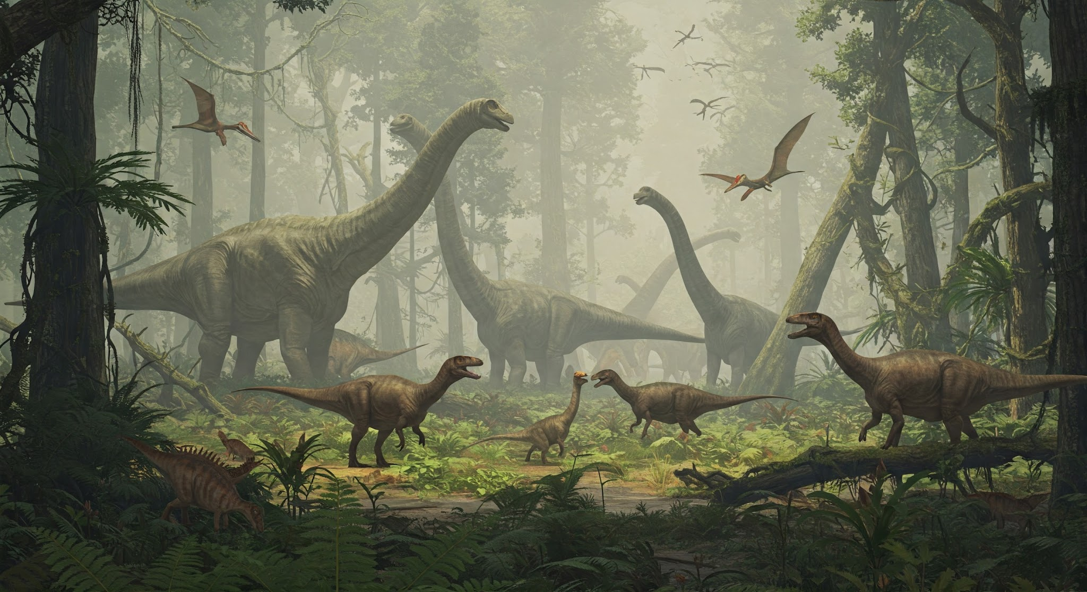
Before GitHub.
Before CI/CD.
Before ChatGPT.

Slide 13
When computers had
less than 0.1% of the
RAM that they
have today.

Slide 14
When every byte counted.
When every clock cycle
mattered.

Slide 15
I thought it might be fun
to go back to those times.

Slide 16

But I don’t have a time
machine.

Slide 17
So, I did the
next best thing…

Slide 18
So, what is it?

Slide 19
It’s a long-term
side project.
Like, multiple years.

Slide 20
I’m aiming to recreate
the experience of
programming on vintage
8-bit and 16-bit
computers and consoles.

Slide 21
I’m starting with
8-bit computers,
like the ZX Spectrum,
the Commodore 64
and the BBC Micro.

Slide 22
From there, I’ll move on
to consoles, and the
16-bit computers like the
Amiga and the Atari ST.

Slide 23
Why am I
doing this?

Slide 24
I want to rediscover
the wonder of
programming.

Slide 25
I want to explore how
people created
incredible software
on limited hardware.

Slide 26
I want to demystify
low-level development
using modern tools, like
Docker, cross-compilers
and emulators.

Slide 27
I want to highlight
the craft of code
in a constrained world.

Slide 28
I want to learn,
and I want to teach.

Slide 29
Also, I’m a massive
nerd.

Slide 30
How will
it work?

Slide 31
I’m going to tell
you a story…

Slide 32
Choose a system.

Slide 33
What will
it cover?

Slide 34
All the common
computers and
consoles from
the 1980s
and 1990s.

