Slide 1
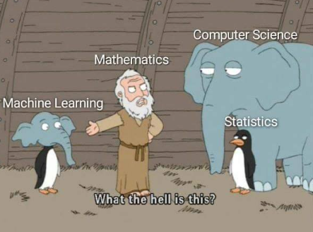
Regression

Slide 2
What Is Regression?
3
Regression analysis is a statistical method to model the relationship between a dependent (target) and independent (predictor) variables with one or more independent variables.
In Regression, we plot a graph between the variables which best fits the given datapoints, using this plot, the machine learning model can make predictions about the data.
Let’s say you’ve developed an algorithm which predicts next week’s temperature. The temperature to be predicted depends on different properties such as humidity, atmospheric pressure, air temperature and wind speed. But how accurate are your predictions? How good is your algorithm?

Slide 3
Some Important Keywords
Independent Variable: Also known as input features or predictors, these are the variables you use to make predictions or decisions. In a machine learning context, these are the features used to train the model.
Dependent Variable: Also known as the target variable, this is what you are trying to predict or explain based on the independent variables. It's the outcome or result variable
For example, if you're building a model to predict house prices, the independent variables might include features like square footage, number of bedrooms, and neighborhood, while the dependent variable would be the actual price of the house.

Slide 4
Training Data: This is a subset of your data used to train your machine learning model. It consists of input features (independent variables) and their corresponding target values (dependent variables). The model learns patterns, relationships, and rules from this data.
Test Data: This is another subset of your data that is kept separate from the training data. It is used to evaluate the model's performance and assess how well it generalizes to new, unseen data.
If you used the same data for training and testing, your model might simply memorize the data (overfitting) and perform poorly on new data. By keeping a separate test set, you can gauge your model's ability to generalize to unseen examples.

Slide 5
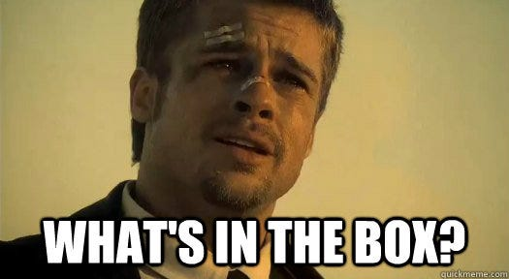
Types of Regression
Linear
Regression
Decision Tree Regression
Support Vector Regression
Random Forest Regression
Polynomial
Regression
Logisitic Regression

Slide 6
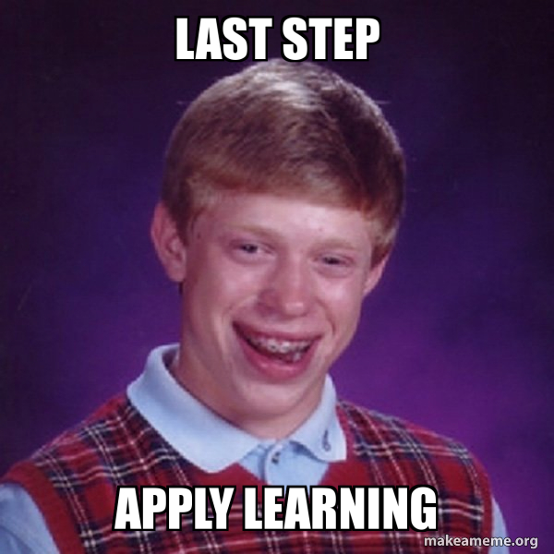
Steps of applying a model
Importing dataset and necessary libraries
Data Preprocessing
Feature Engineering
Split dataset in train-test
Model Selection
Model training
Model Evaluation
Fine tune the model
Make Predictions

Slide 7
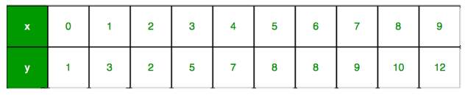
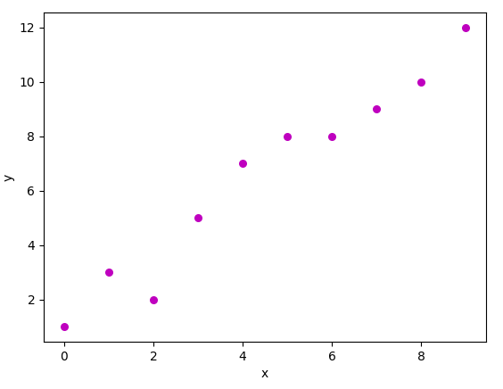
Linear Regression
After scatter plotting these points we get this graph
We need to find such a line that covers all these points
The best line which covers all the points is the yellow line. Such a line is called regressor line.

Slide 8

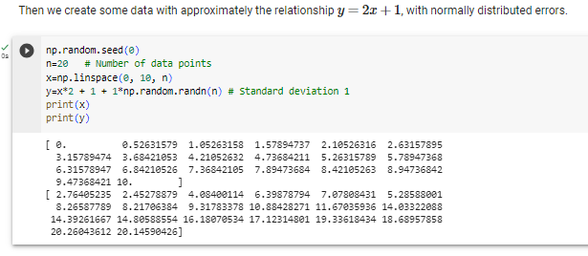

Applying Linear Regression
Importing necessary libraries
Creating some random data
Assuming a line
y = x^2 + 1
and applying it into
the model

Slide 9
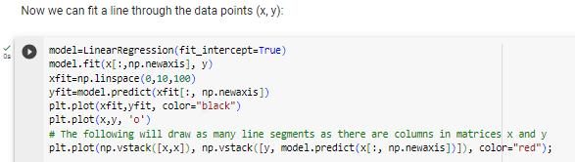
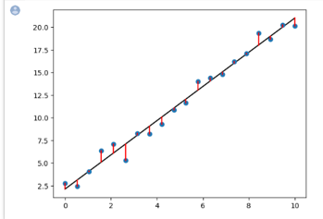
Applying the model and using model.fit to fit the parameters
Plotting the model using those parameters
Using vstack and hstack function to understand the closeness of these points to the line.

Slide 10
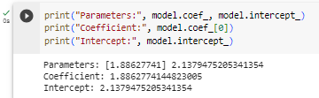
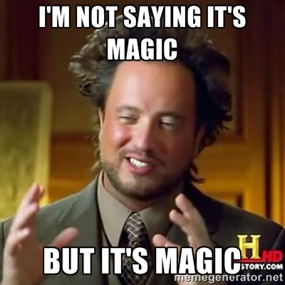
We see that the Intercept and Coefficient are coming very close to the values that we took
Hence our model was apt for this dataset

Slide 11

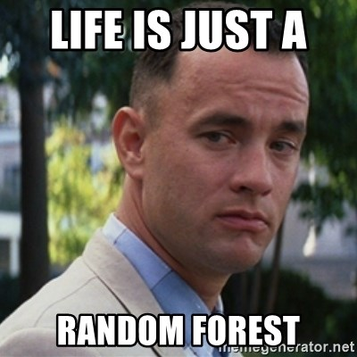

Random Forest Classification
Importing the dataset
Importing the necessary libraries

Slide 12
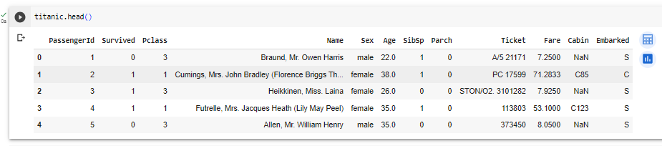
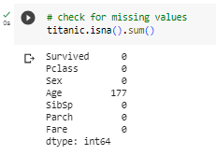
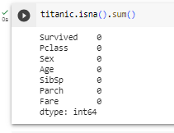
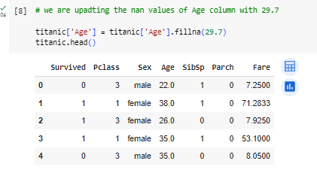

Slide 13

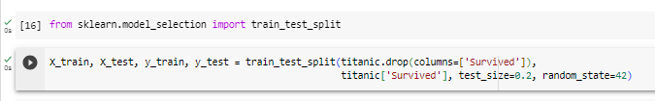
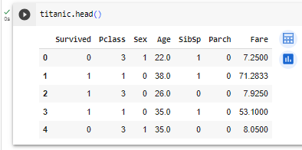
We have imported function Label encoder to label our data
Here we are splitting the data into train and test in 80:20 ratio
Data is ready to be integrated into a machine learning model

Slide 14
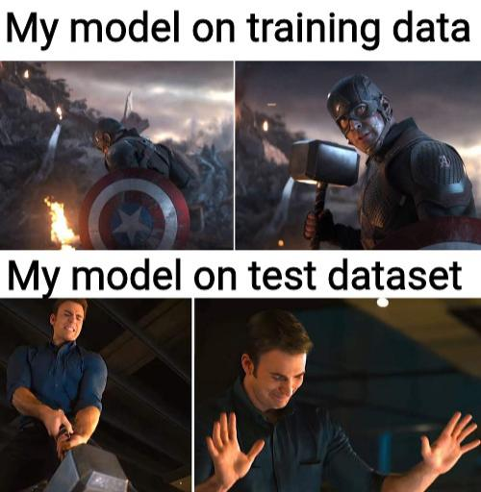
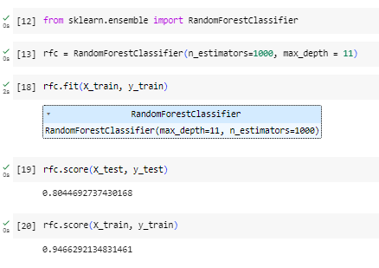
Testing and Training data accuracy should have less difference in terms of their accuracy
Here accuracy of training data is good but comparatively less than test data
So we’ll choose a better model

Slide 15
Thank you

