Slide 1
Zelalem Gebremariam ID: 612353
Twitter Streaming and Analysis

Slide 2
Contents
Introduction
Architecture
Tools I use
Development environment setup
Code explanation

Slide 3
Introduction
Data source
Twitter: system that allows to send and receive short posts called tweets.
Analysis: #nomore

Slide 4
Tools I use
Cloudera
Spark Streaming
HIVE (HQL)
Twitter API
Zookeeper
Kafka

Slide 5
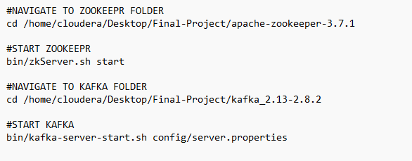
Development environment setup
I use Cloudera due to license constraint I setup zookeepr and Apache Kafka separately.
Commands used to start and stop zookeeper and apache kafka

Slide 6
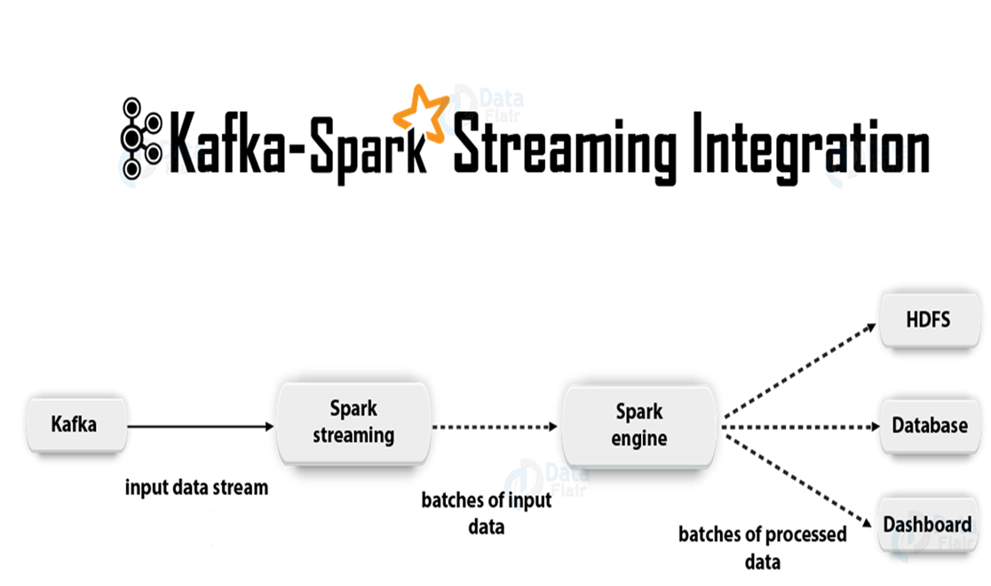
Architecture

Slide 7
Kafka Stream as Ingestion
Kafka: it is one of open-source streaming system
Spark Streaming: Accepting real-time data and apply some operation and produce output as batch
Once Spark streaming processing finish, the output can be stored or presented for user in different ways.

Slide 8
Code explanation
Kafka Producer
Spark Stream
Using Hive to query stored data

Slide 9
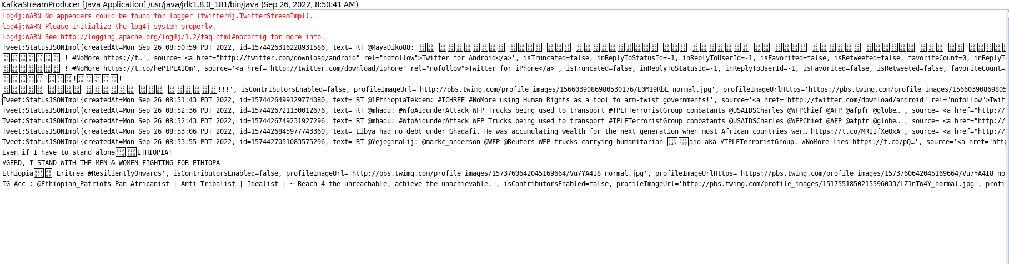
Input Screenshot

Slide 10
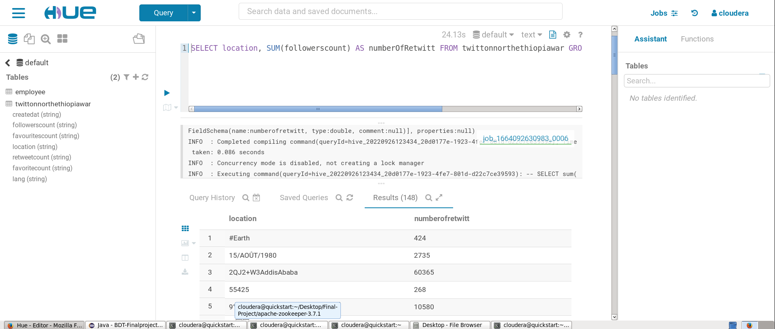
Output Screenshot

Slide 11
THANK YOU

