Slide 1
Zelalem Gebremariam ID: 612353
Twitter Streaming and Analysis

Slide 2
Contents
Introduction
Architecture (Kafka Stream as Ingestion)
Tools I use
Development environment setup
Strong data permanently on HDFS
Using Hive to query stored data

Slide 3
Introduction
Twitter: system that allows to send and receive short posts called tweets.
Why: almost all the phenomenon happening in our world twitted on twitter including war, love and peace.
Goal: create a small project that consume Twitter API in a real-time fashion and process using Spark Stream and store permanently on hdfs and write some queries on stored result.

Slide 4
Tools I use
Twitter API
Kafka
Spark Streaming
HIVE (HQL)

Slide 5
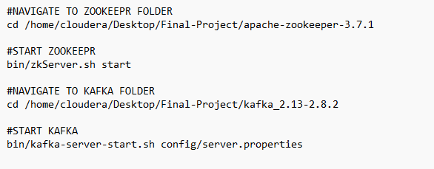
Development environment setup
I use Cloudera due to license constraint I setup zookeepr and Apache Kafka separately.
Commands used to start and stop zookeeper and apache kafka

Slide 6
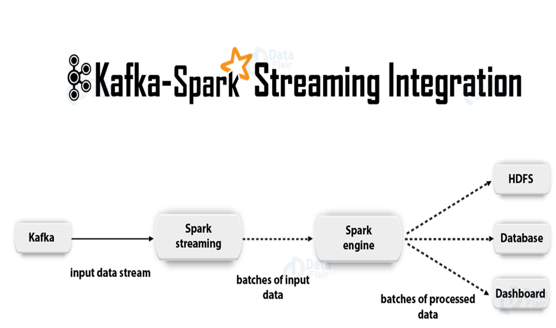
Spark Streaming with Kafka

Slide 7
Kafka Stream as Ingestion
Kafka: it is one of open-source streaming system
Spark Streaming: Accepting real-time data and apply some operation and produce output as batch
Once Spark streaming processing finish, the output can be stored or presented for user in different ways.

Slide 8
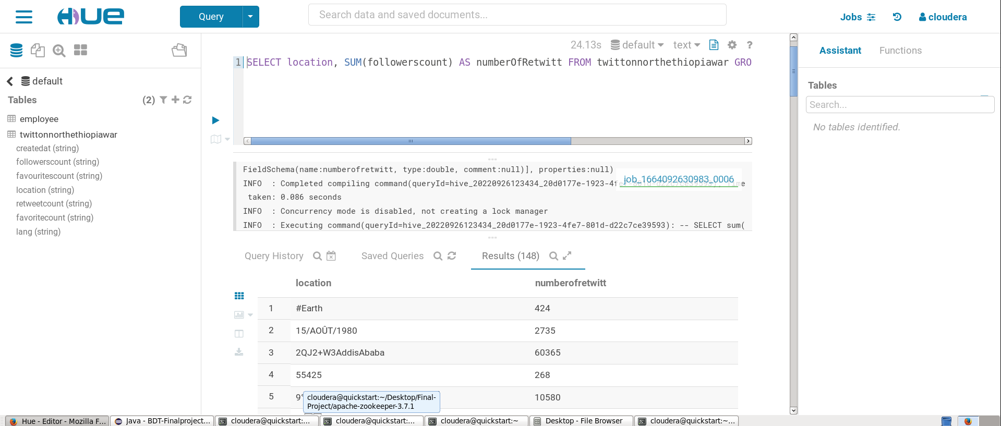
Using Hive to query stored data

Slide 9
THANK YOU

