Slide 1
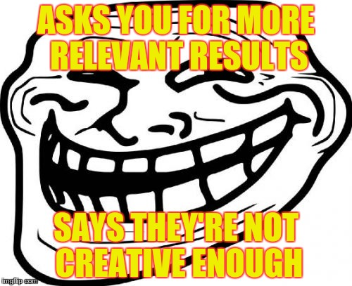
Beyond the Keyword:
Creative Search and Query Expansions Using Dbpedia
Github.com/minervax
Twitter: @maryasawaf @brainforks

Slide 2
What’s this all about?
Semantic search
…taking semantic search one step further
Case studies
Code I have written to implement these ideas
User experience / User Interface

Slide 3
Semantic search
Search performed on semantically related queries
Synonyms
  School
    academic institutions, educational institutions, educational organization…
Semantic keywords
  School
    Schoolteacher, school districts, school bus, students, exams…
Where do these come from?

Slide 4
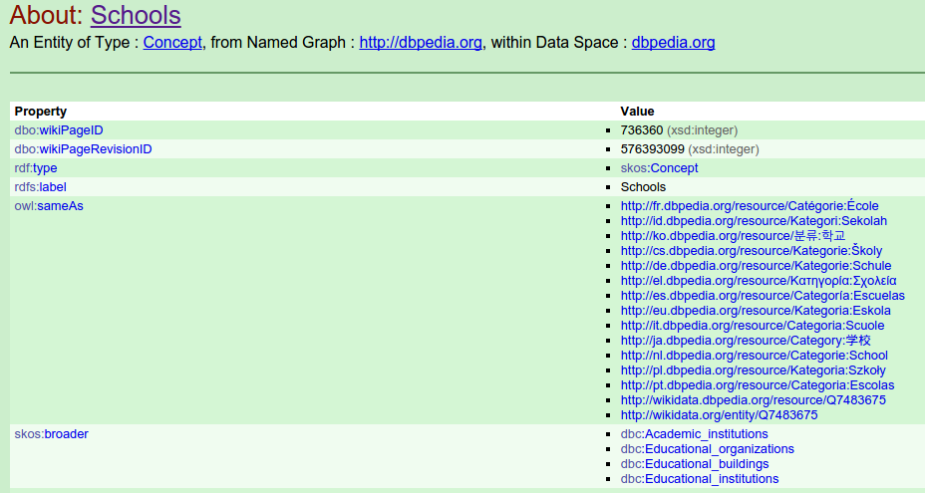
http://dbpedia.org/Page/Schools

Slide 5
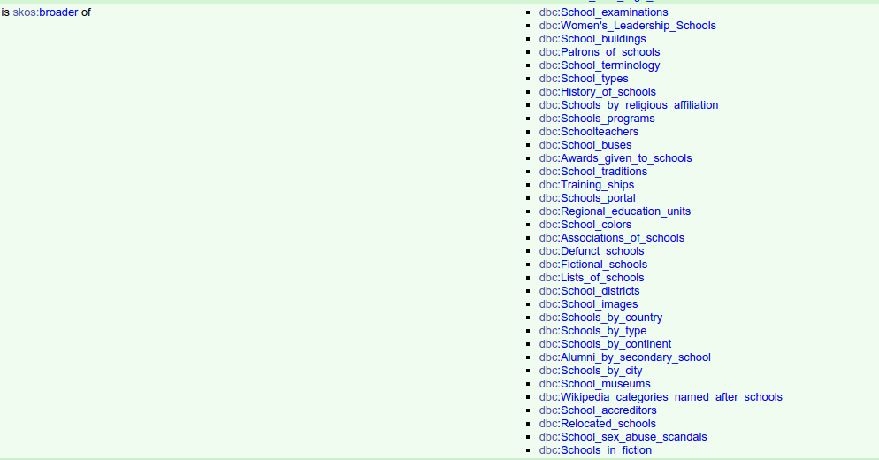
http://dbpedia.org/Page/Schools

Slide 6
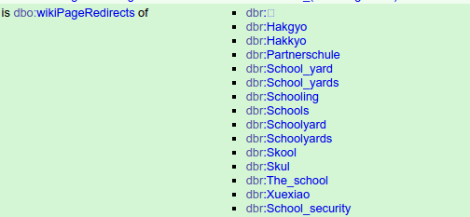

http://dbpedia.org/Page/School
http://dbpedia.org/Page/Animal_control_officer

Slide 7
Creative search
Semantic Search - closely related concepts
Query + word variations + synonyms + Wikipedia redirects

Slide 8
What is Creative search?
Semantic search is restricted within the same knowledge space as the original query
Creative search = recursive semantic search to share ideas across disciplines
Example: Photography
Issues: Filtering? Fault Tolerance? Automation?
http://dbpedia.org/Page/Category:Photography

Slide 9
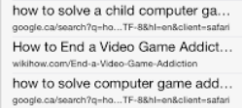
APPLICATIONS for creative search
Creative Book Search
  http://brainforks:8080/creativebook/query
Cross Disciplinary Academic Search
    http://brainforks:8080/creativesearch/query
Creative Project Search
  http://brainforks:8080/creativesearch/query
Children
Non-Native Speakers
  (howto solve a child computer game addiction)
  http://brainforks:8080/nonnative/query
Everyone? Noobs, Lazy Search, Unskilled search, Search is Hard!

Slide 10
http://brainforks:8080/creativesearch/creativity
'intelligence‘
‘arts',
'imagination',
'fiction‘
'discrimination‘
'reasoning‘
‘listening',
‘mathematics’
'emotion‘
'complexity‘
'ritual‘
'humans‘
'dialogue‘
'uncertainty'
'insight‘
'lecture‘
'motivation‘
'grammar‘
'invention‘
'innovation‘
'simplicity‘
'certainty‘
'curiosity‘
'studio‘
'intellect‘
'quest‘
'metaphor‘
‘chaos‘
'creativity‘
'nonsense‘
‘abstraction’
‘cognition’
‘inventors’
‘serendipity’

Slide 11
Case study #1: creative book search!
A good example of using query expansions
You do risk there being some irrelevant results
Feels more like a human curated bookshelf than regular keyword booksearch
UX tips: Add tooltips or a conceptual breadcrumb to explain why this book is being recommended

Slide 12
Distance = 3, freq = 5
http://brainforks:8080/creativebook/Fashion_design
[["clothing", "cleaning", "sculpture", "luxury", "boots", "photography", "torture", "buttons", "hygiene", "ornaments", "hats", "designers", "weaving", "gloves", "odor", "sewing", "crafts", "textiles", "masks", "watches", "fabrics", "knots", "laundry", "aesthetics", "brands", "crowns", "retailers", "dyes", "incense", "socks"],
"distance 1": ["cultural_trends", "body_modification", "perfumery", "fashion_accessories", "body_art", "footwear", "hairstyles", "hairdressing", "clothing", "fashion_design“, “Islamic dress”, “uniforms”]}]
"distance 2": ["tattooing", "subcultures", "fragrances", "jewellery", "luxury_brands", "implants", "costume_design", "socks", "garment_industry", "human_hair", "emerging_trends", "hosiery", "hairdressers", "sports_footwear", "fads", "facial_hair", "art_media", "perfumers", "watches", "clothing_retailers", "fashion_schools", "braids", "buttons", "aromatherapy", "haute_couture", "textiles", "plastic_surgery", "beauty_salons", "cosmetic_surgery", "cosmetics", "laundry", "human_appearance", "sewing", "versace", "fashion_designers", "boots", "headgear", "badges", "sandals", "chanel", "incense", "mutilation", "gloves", "design_writers", "shaving“, “dress codes”]
"distance 3": ["textile_designers", "watchmakers", "hats", "haberdashers", "hair_color", "clocks", "clothing_companies", "portable_tools", "skin_care", "bearded_women", "milliners", "perfumery", "facial_features", "nail_polish", "regalia", "seams", "textile_arts", "torture", "photography", "horology", "designers", "fabrics", "hippie_movement", "dry_cleaning", "visual_arts", "body_modification", "lingerie", "retailers", "cosmetics_companies", "critical_design", "tattoo_artists", "fashion_design", "neuroprosthetics", "cultural_trends", "plastic_surgeons", "military_boots", "shoe_business", "ornaments", "magic_substances", "medical_technology", "geometric_topology", "linens", "memes", "odor", "helmets", "essential_oils", "body_art", "surgical_specialties", "luxottica", "surgical_procedures", "youth_culture", "sewing_stitches", "underwear", "depilation", "luxury_vehicles", "motorcycle_boots", "ice_skates", "footwear", "hairdressing", "knots", "theatrical_professions", "industrial_design", "hair_transplantation", "fashion_accessories", "hygiene", "hairstyles", "polynesian_tattooing", "graphic_design", "weaving", "integumentary_system", "sports_clothing", "laundry_detergents", "counterculture", "roller_skates", "sewing_equipment", "film_production", "domestic_life", "violent_crime", "animal_hair", "cultural_appropriation", "amputations", "heraldic_badges", "sculpture", "costume_designers", "barbers", "aesthetics", "body_shape", "athletic_shoes", "permutations", "hosiery_brands", "incense_material", "stagecraft", "textile_machinery", "crowns", "luxury", "breast_surgery", "product_design", "masks", "physical_attractiveness", "cleaning", "brands", "crafts", "dyes", "veils“, “Islamic dress”]
http://dbpedia.org/Page/Category:Photography

Slide 13



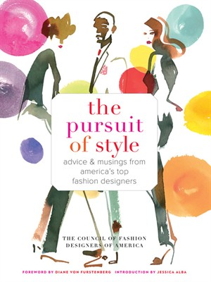


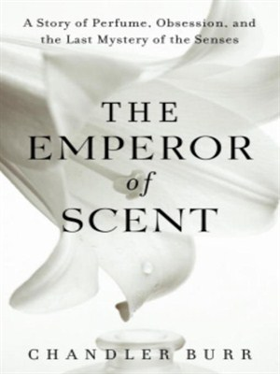
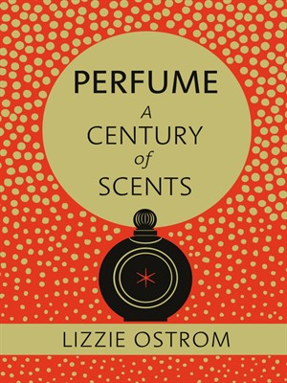
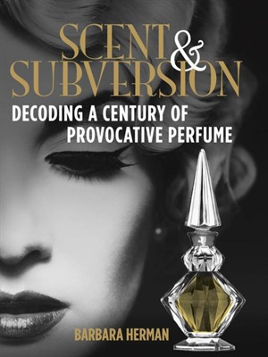
Results:
Fashion Design
Perfumery

Slide 14
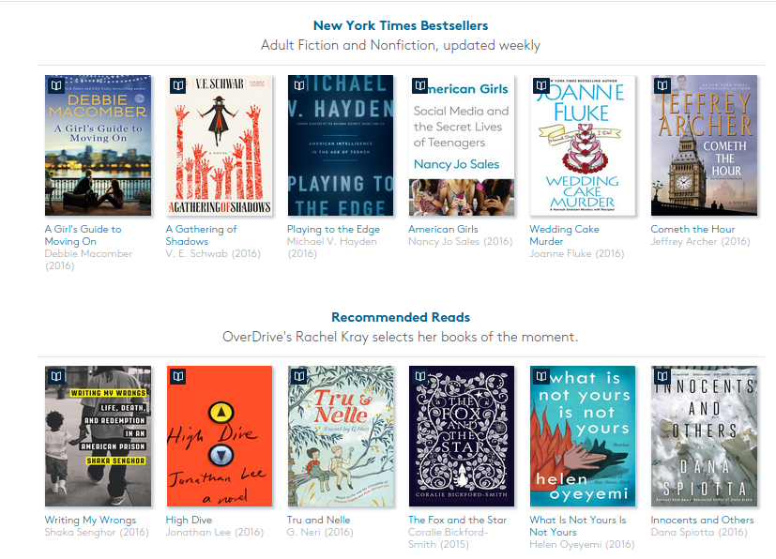
Body Art
Photography

Slide 15
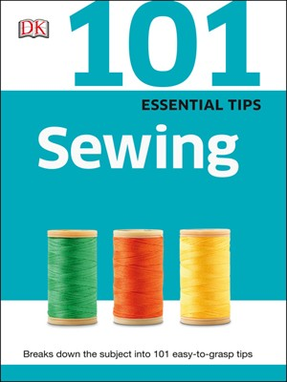


Not everything will be relevant…

Slide 16



UI: Idea exchange heading and breadcrumbs

Slide 17
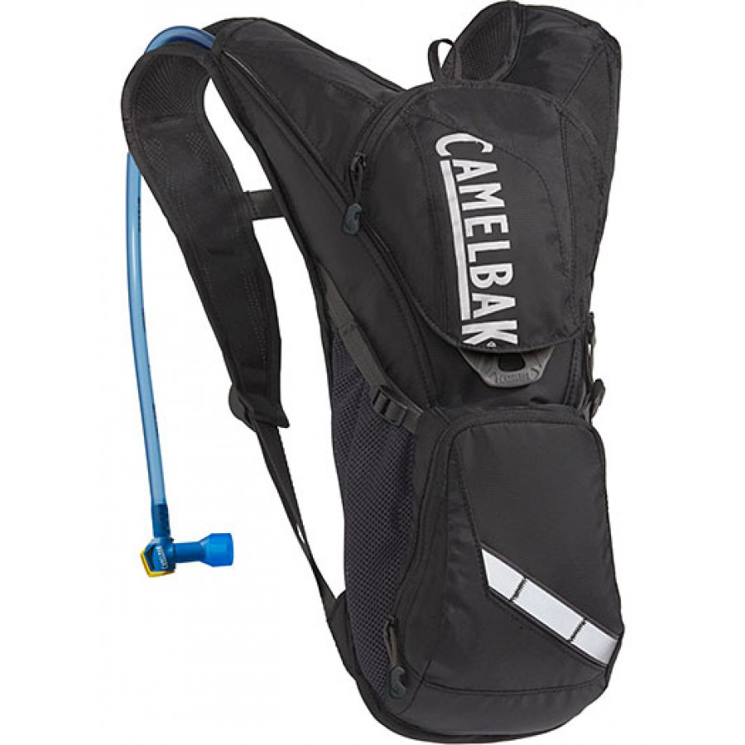
Case study #2: Creative Project search/children
www.yureeka.com
Let teenagers explore ideas for maker projects and combine them in interesting ways

Slide 18
UX/UI Notes:
Subject navigation panels are useful in this case: Making the user aware of their selection and it’s creative effect
Too many selections makes the whole thing pointless; frequency restrictions are a good way to filter this
Filtered selections and a separate section for more “creative” selections showed increased user engagement

Slide 19
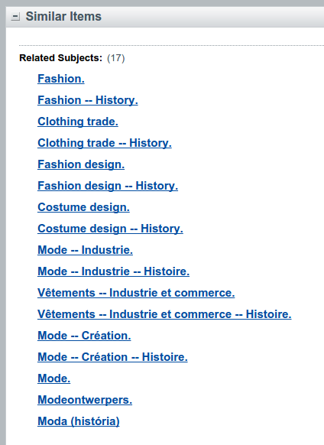
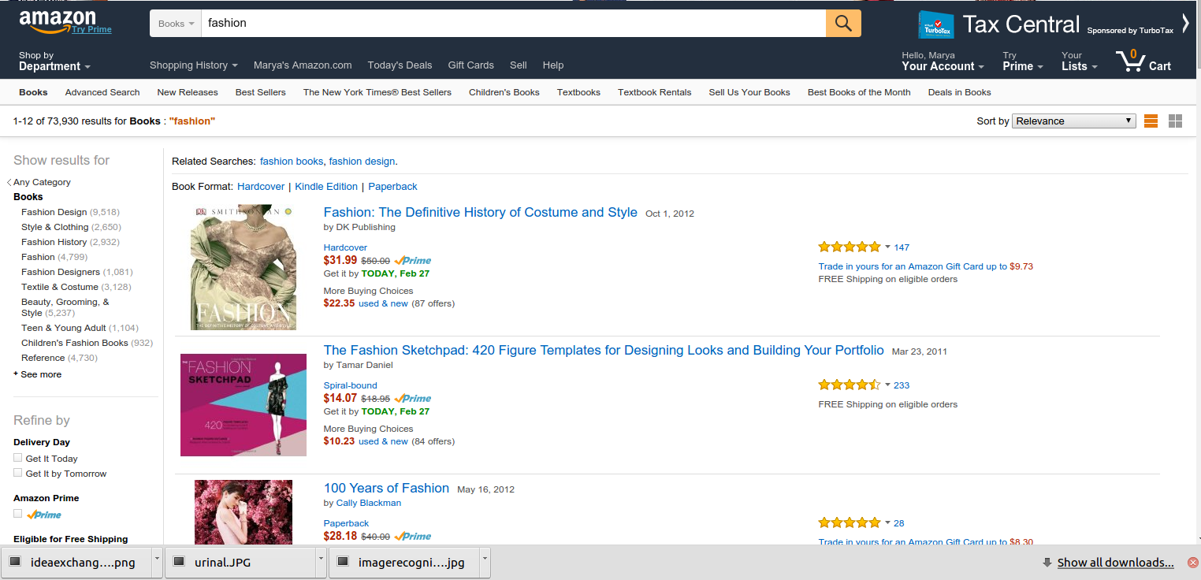
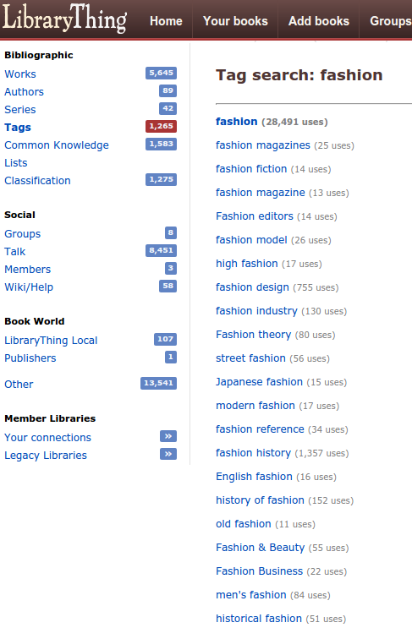
How many is too many?
WorldCat

Slide 20
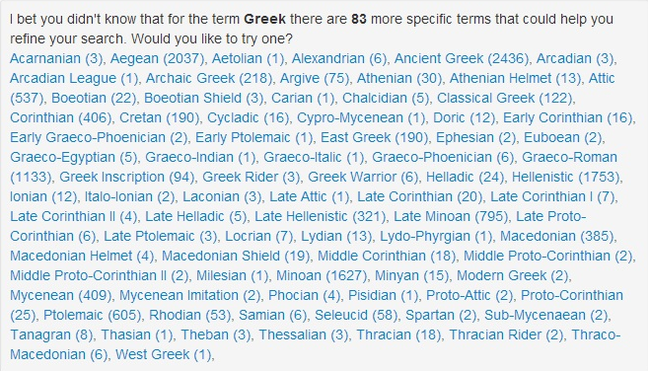
Better Search Through Query Expansion Using Controlled Vocabularies and Apache Solr – Scott Williams, University of Pennsylvania

Slide 21
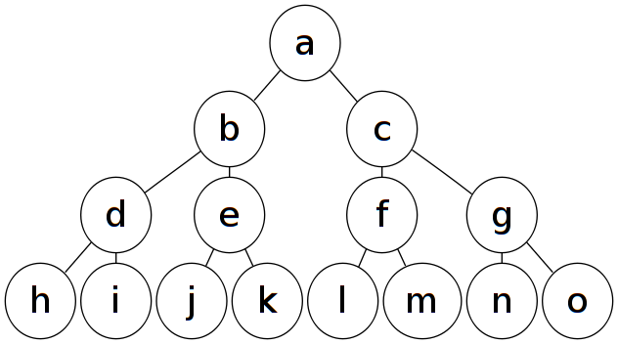
iMPLEMENTATION
Filtering – Exponential growth!→
  Need to keep only the most relevant results
  Google Ngrams used to filter uncommon expressions
Automation
  Python
  Restful API
Fault Tolerance – DBPedia is human curated – not machine friendly
  Handling pages and category pages with the same name
  Lemmas
  Capitalized terms for NER
  Weird dbpedia words (Categories_by_type, terminology, list of)
  Singplu
  If list is too short, expand another round

Slide 22
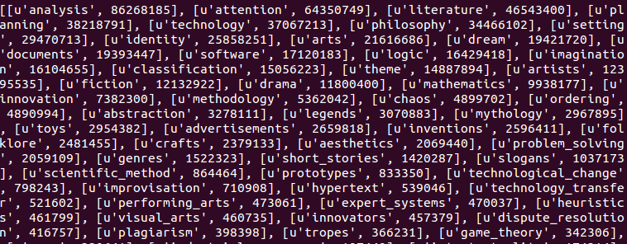
Google ngrams
I used Google Ngrams to filter out strange words. Tweak the frequency thresholds for exploratory search, creative search or non-native speakers.
  http://brainforks:8080/getfreq/[[“1gram”], [“2”,”gram”],[“hello”],[“gender”,”studies”]]
  Frequent words can be too vague
  More 2grams, each less frequent (1 gram is 11.45 times more likely to occur)
  New words underrepresented (email); scientific terms.

Slide 23
Conclusions
Useful for many applications (by tweaking parameters accordingly)
  Creative book search
  Interdisciplinary search
  Foreign language assistance
User experience decisions
  Whether to use automated query expansions vs. user selections
  Present results in a regular result list (weighted by relevance) or have a separate section for creative options

Slide 24
Resources
My github account: Minervax
Sparql queries: Knowledge engineering with semantic web technologies (openHIP course)
NLTK (Natural Language Processing ToolKit)
Dbpedia
Brainforks.com
Wordnet
Building navigation from a solr Index or an authority file:
http://blog.florian-hopf.de/2014/03/building-navigation-from-search-index.html
Implementing Query Expansions in Solr (using Request Handler) and Blacklight:
Query expansions in Solr: http://nolanlawson.com/2012/10/31/better-synonym-handling-in-solr/

