Slide 1
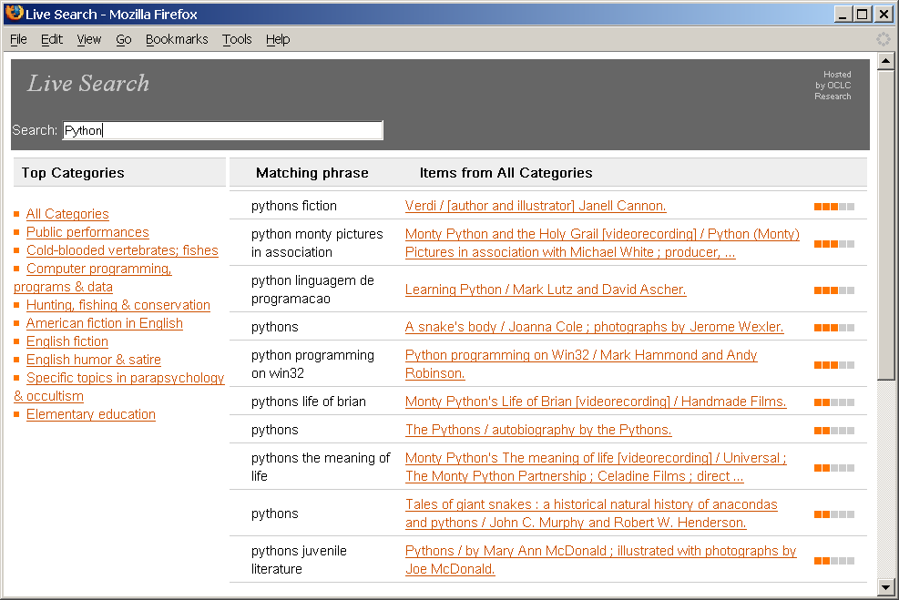
1,000 Lines of Code
T. Hickey
http://errol.oclc.org/laf/n82-54463.html
Code4Lib Conference
2006 February
Notes:
What I really needed was a picture of a card catalog in pieces.
We’re talking about taking the catalog apart an putting it back together.

Slide 2
Programs don’t have to be huge
“Anybody who thinks a little 9,000-line program that's distributed free and can be cloned by anyone is going to affect anything we do at Microsoft has his head screwed on wrong.”
-- Bill Gates

Slide 3
OAI Harvester in 50 lines?
import sys, urllib2, zlib, time, re, xml.dom.pulldom, operator, codecs
nDataBytes, nRawBytes, nRecoveries, maxRecoveries = 0, 0, 0, 3
def getFile(serverString, command, verbose=1, sleepTime=0):
global nRecoveries, nDataBytes, nRawBytes
if sleepTime: time.sleep(sleepTime)
remoteAddr = serverString+'?verb=%s'%command
if verbose: print "\r", "getFile ...'%s'"%remoteAddr[-90:],
headers = {'User-Agent': 'OAIHarvester/2.0', 'Accept': 'text/html',
'Accept-Encoding': 'compress, deflate'}
try:remoteData=urllib2.urlopen(urllib2.Request(remoteAddr, None, headers)).read()
except urllib2.HTTPError, exValue:
if exValue.code==503:
retryWait = int(exValue.hdrs.get("Retry-After", "-1"))
if retryWait<0: return None
print 'Waiting %d seconds'%retryWait
return getFile(serverString, command, 0, retryWait)
print exValue
if nRecoveries<maxRecoveries:
nRecoveries += 1
return getFile(serverString, command, 1, 60)
return
nRawBytes += len(remoteData)
try: remoteData = zlib.decompressobj().decompress(remoteData)
except: pass
nDataBytes += len(remoteData)
mo = re.search('<error *code=\"([^"]*)">(.*)</error>', remoteData)
if mo: print "OAIERROR: code=%s '%s'"%(mo.group(1), mo.group(2))
else: return remoteData
try: serverString, outFileName=sys.argv[1:]
except:serverString, outFileName='alcme.oclc.org/ndltd/servlet/OAIHandler', 'repository.xml'
if serverString.find('http://')!=0: serverString = 'http://'+serverString
print "Writing records to %s from archive %s"%(outFileName, serverString)
ofile = codecs.lookup('utf-8')[-1](file(outFileName, 'wb'))
ofile.write('<repository>\n') # wrap list of records with this
data = getFile(serverString, 'ListRecords&metadataPrefix=%s'%'oai_dc')
recordCount = 0
while data:
events = xml.dom.pulldom.parseString(data)
for (event, node) in events:
if event=="START_ELEMENT" and node.tagName=='record':
events.expandNode(node)
node.writexml(ofile)
recordCount += 1
mo = re.search('<resumptionToken[^>]*>(.*)</resumptionToken>', data)
if not mo: break
data = getFile(serverString, "ListRecords&resumptionToken=%s"%mo.group(1))
ofile.write('\n</repository>\n'), ofile.close()
print "\nRead %d bytes (%.2f compression)"%(nDataBytes, float(nDataBytes)/nRawBytes)
print "Wrote out %d records"%recordCount

Slide 4
"If you want to increase your success rate, double your failure rate."
-- Thomas J. Watson, Sr.

Slide 5
The Idea
Google suggest
  As you type
    a list of possible search phrases appears
    Ranked by how often used
Showed
  Real-time (~0.1 second) interaction over HTTP
  Limited number of common phrases

Slide 6
First try
Extracted phrases from subject headings in WorldCat
Created in-memory tables
Simple HTML interface copied from Google Suggest

Slide 7
More tries
Author names
All controlled fields
All controlled fields with MARC tags
Virtual International Authority File
  XSLT interface
  SRU retrievals
VIAF suggestions
All 3-word phrases from author, title subjects from the Phoenix Public Library records
All 5-word phrases from Phoenix [6 different ways]
All 5-word phrases from LCSH [3 ways]
DDC categorization [6 ways]
Move phrases to Pears DB
Move citations to Pears DB

Slide 8
What were the problems?
Speed => in-memory tables
In-memory => not scalable
Tried compressing tables
  Eliminate redundancy
  Lots of indirection
  Still taking 800 megabytes for 800,000 records
XML
  HTML is simpler
  Moved to XML with Pears SRU database
  XSLT/CSS/JS
  External server => more record parsing, manipulation

Slide 9
Where does the code go?
Language | Lines
Python run-time | 200
Python build-time | 400
JavaScript | 50
CSS | 50
XSLT | 200
DB Config | 100
Total | ~1,000

Slide 10
Data Structure
Partial phrase -> attributes
Partial phrase -> full phrase + citation IDs
Attribute+Partial phrase -> full phrase + citation IDs
Citation ID -> citation
Manifestation for phrase picked by:
  Most commonly held manifestation
    In the most widely held work-set

Slide 11
‘3-Level’ Server
Standard HTTP Server
  Handles files
  Passes SRU commands through
SRU Munger
  Mines SRU responses
  Modifies and repeats searches
  Combines/cascades searches
  Generates valid SRU responses
SRU database

Slide 12
From Phrase to Display
Display
Input Phrase
Attributes
Phrase/
Citation
List
Phrases
Citations

Slide 13
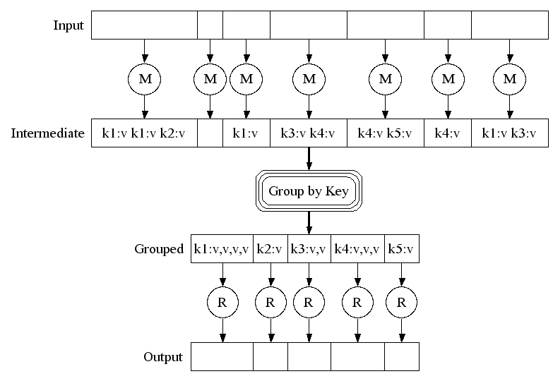
Overview of MapReduce
Source: Dean & Ghemawat (Google)

Slide 14
Build Code
Map 767,000 bibliographic records to 18 million
    phrase+workset holdings+manifestation holdings+recordnumber+wsid+[DDC]
    computer program language 1586 329 41466161 sw41466161 005
  Reduced to 6.5 million:
    Pharse+[ws holds+man holds+rn+wsid+[DDC]]
    <dterm>005_com</dterm> <citation id="41466161">computer program language</citation>

Slide 15
Build Code (cont.)
Map that to 1-5 character keys + input record (33 million)
  Reduce to
    Phrases+Attributes + citations
    Phrases citations
    Attributes
    Citation id + citation
  <record><dterm>005_langu</dterm>…<term>_lang</term><citation id="41466161">language</citation></record>

Slide 16
Build Code (cont.)
Map phrase-record to record-phrase
  Group all keys with identical records
Reduce by wrapping keys into record tag (17 million)
Map bibliographic records
Reduce to XML citations
Finally merge citations and wrapped keys into single XML file for indexing
Total time ~50 minutes (~40 processor hours)

Slide 17
Cluster
24 nodes
  1 head node
    External communications
    400 Gb disk
    4 Gb RAM
    2x2GHz cpu’s
  23 compute nodes
    80 Gb local disk
    NFS mount head node files
    4 Gb RAM
    2x2GHz cpu’s
Total
  96 g RAM, 1 Tb disk, 46 cpu’s

Slide 18
Why is it short?
Things like xpath:
select="document('DDC22eng.xml')/*/caption[@ddc=$ddc]"
HTML, CSS, XSLT, JavaScript, Python, MapReduce, Unicode, XML, HTTP, SRU, iFrames
No browser-specific code
Downside
  Balancing where to put what
  Different syntaxes
  Different skills
  Wrote it all ourselves
  Doesn’t work in Opera

Slide 19
Guidelines
No ‘broken windows’
  Constant refactoring
  Read your code
No hooks
Small team
Write it yourself (first)
Always running
  Most changes <15 minutes
  No changes longer than a day
  Evolution guided by intelligent design

Slide 20
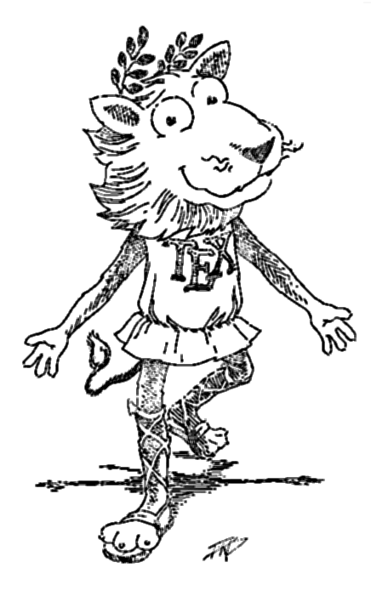

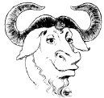
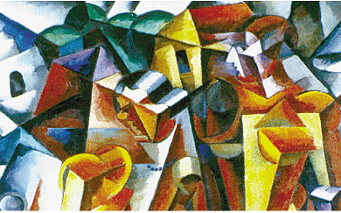

OCLC Research Software License

Slide 21

Software Licenses
Original license
  Not OSI approved
OR License 2.0
  Confusing
  Specific to OCLC
  Vetted by Open Software Initiative
  Everyone using it had questions

Slide 22
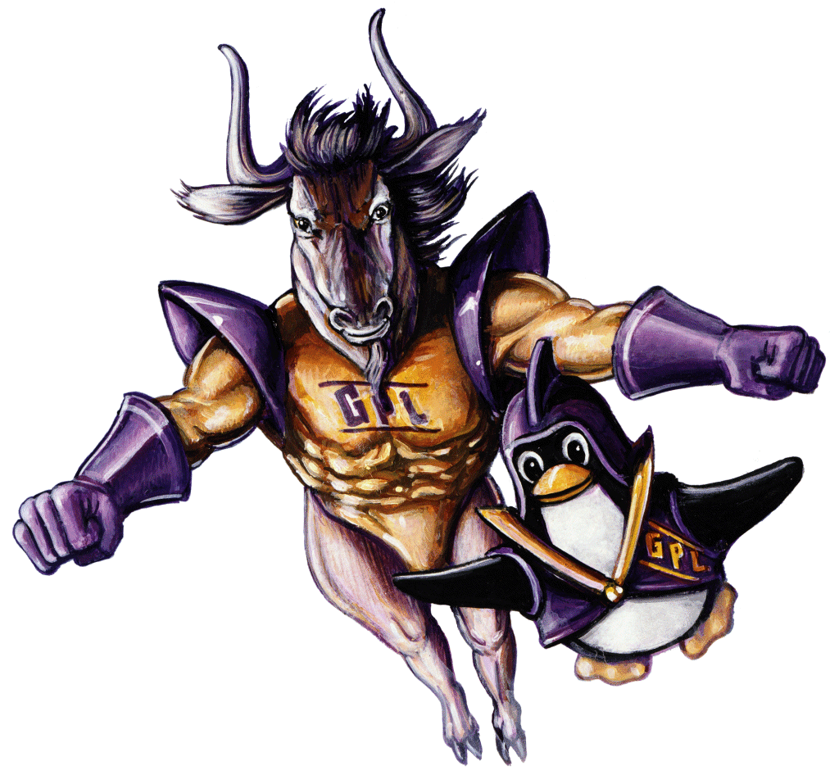
Approach
Goals
  Promote use
  Protect OCLC
  Understandable
Questions
  How many restrictions?
  What could our lawyers live with?

Slide 23

Alternatives
MIT
BSD
GNU GPL
GNU Lesser GPL
Apache
  Covers standard problems (patents, etc.)
  Understandable
  Few restrictions
Persuaded that open source works

Slide 24
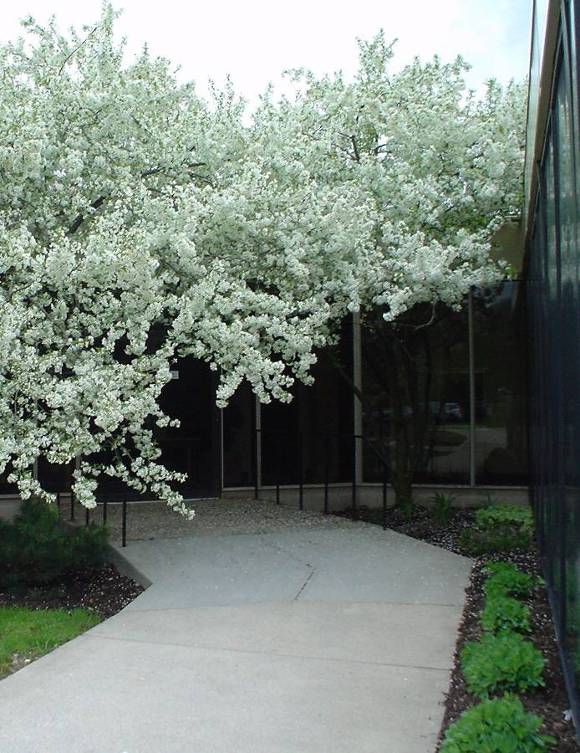
Thank you
T. Hickey
http://errol.oclc.org/laf/n82-54463.html
Code4Lib
2006 February

