Slide 1
Becoming Truly Innovative:
Migrating from Millennium to Koha
Ian Walls
code4lib 2010
Asheville, NC
2010-02-24 10:55:00

Slide 2
Variable Declaration
$NYUHSL = New York University Health Sciences Libraries;
$III = Innovative Interfaces, Inc.;
$NetSec = Network Security (at NYU Med Center);

Slide 3
Some Context
NYUHSL had been using Millennium for over a decade and a half
Used to have root access, but no longer
Set up a bastion host in 2002 to III allow access
Outside the library, IT departments in the Med Center are merging…

Slide 4

Connection Method
MEDCat
III
Firewall
1
2

Slide 5
WTF?!
When NetSec consolidated, policies were brought into focus
YOU MAY NOT CIRCUMVENT THE FIREWALL!
As Server 2 neared end of life, it was just dismantled and “put on the side of the road”
Only discovered this because our ILS was down…

Slide 6
Stalemate
NetSec required all vendors to connect using the Juniper VPN
III only uses the Cisco VPN
NYUHSL just wants their ILS to work

Slide 7

When Titans collide…

Slide 8
Meanwhile, Koha!
Switching to an open source ILS had long been in mind
Did a test install on an old desktop machine
Just needed to get the pesky data migrated…

Slide 9
What Info to Migrate?
Bibliographic/Authority
Patron
Checkouts
Holds
Serials issues
Acquisitions

Slide 10
Only Migrate “Active” Patrons
Where “Active” means:
Has an item out OR
Owes us money OR
Circ Active since 2008 OR
Created since 2008
AND
Is ‘active’ according to HR

Slide 11
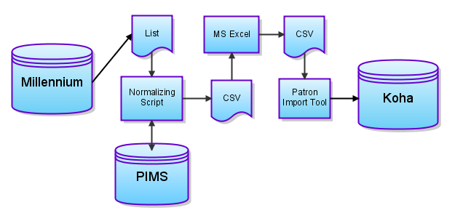
Patron Data Migration

Slide 12
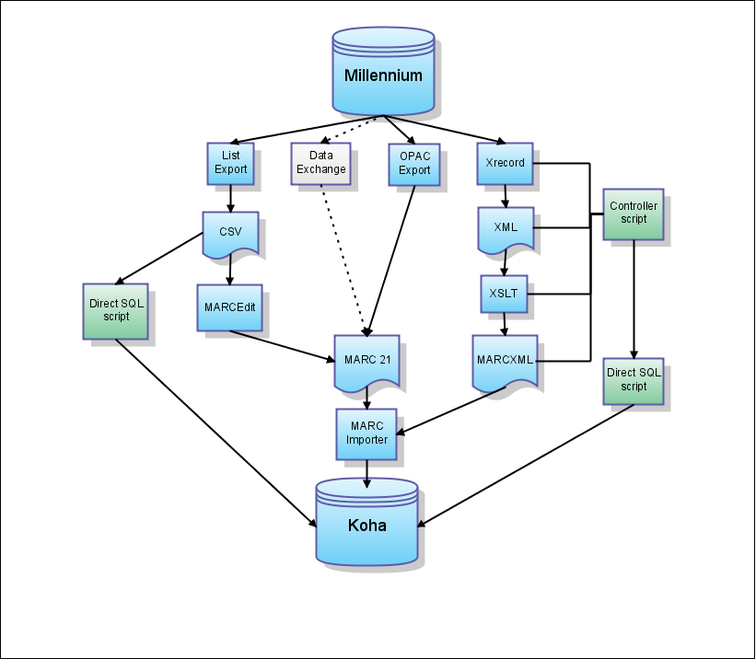
Bibliographic Migration

Slide 13
Why not CSV?
Millennium tags to MARC fields not 1-1
Also not comprehensive
Would have had to manually enter in every MARC subfield in our data not covered by Millennium tags
What about multiple subfields?

Slide 14
Bibliographic Migration

Slide 15
Why not Data Exchange?
Not set up
III couldn’t connect to set it up
May well work for anyone in different circumstances

Slide 16
Bibliographic Migration

Slide 17
Why not OPAC export?
No ‘backend’ codes
No transactional data
OPAC MARC export can only be done in batches on some kind of search (subjects, titles, etc.)

Slide 18

Why not Shrew?
Looked at it, couldn’t really get it to work
Maybe another library would have more luck

Slide 19
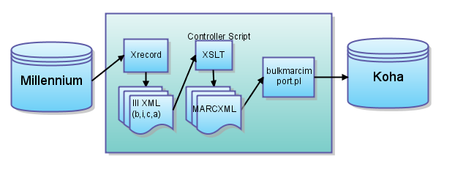
Chosen Method: Xrecords

Slide 20
Overview of Code
Supply list of record numbers (bibs and associated items on one line)
Pulls IIIXML in batches
Converts IIIXML into MARCXML with user-configured XSLT (xalan)
Imports MARCXML into Koha
Can handle bib, item & checkin records, or authorities

Slide 21
XSLT!
Each XSLT will need to be customized for the institutions particular coding structure
Millennium codes didn’t map directly to Koha codes; had to use a lot of conditionals
Certain patterns are common, and make good starting points
No

Slide 22
Circ Transactions
Quick List export of which patron barcodes have which item barcodes out on which dates
Can also transport in-house use counts for the year and previous
Holds would be handled manually

Slide 23
Decision time
In May, III and NetSec finally come to an agreement to use Juniper VPN
This is, of course, $$$
NYUHSL’s contract ended on Aug 31, with 90 days notice required…

Slide 24

Let’s Do This!

Slide 25
Migration Schedule
Aug 6: Freeze cataloging in Millennium
Aug 7: Initial data load into production system
Aug 24-26: Training from ByWater Solutions
Aug 27: Serials and Acquisitions frozen in Millennium
Aug 29: Circ frozen in Millennium
Aug 30: Koha migration day
Aug 31: Koha is live!

Slide 26
What Info to Migrate?
Bibliographic/Authority (80k/5k)
Patron (11k)
Checkouts (few hundred)
Holds
Serials issues
Acquisitions

Slide 27
Serials Issues
MFHD support was originally slated for Koha 3.2
Um, yeah
NYUHSL was only keeping a couple hundred print titles, anyway
Manual checkin of new issues, old ones will just get bound and added as items

Slide 28

The Outcome?

Slide 29
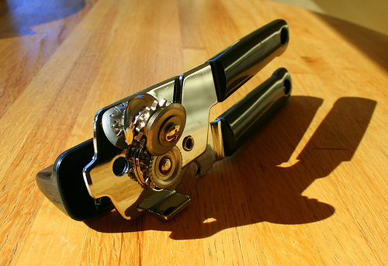
Further Outcome?

Slide 30
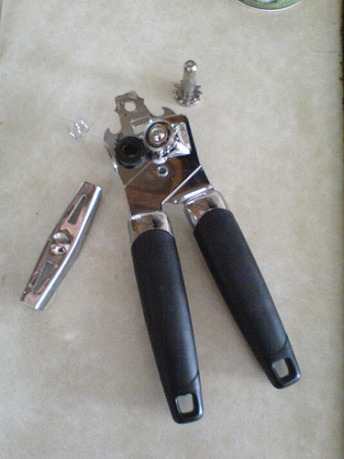
Well, maybe more like:

Slide 31
Caveats/Warnings
No MFHD support yet
Diacritics: Bracecodes vs. UTF-8
Cross linked items
Multiple barcodes/call numbers
Keeping track of old record numbers can be tricky
Be sure you pull your patron data on migration day, not a week before

Slide 32
Thanks!
Download full package at contribs.koha.org as early as next week
Thanks to Cody Hennesy for beta testing

