Slide 1
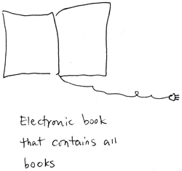
Self-replicating networkable hyperlocal participatory read/write SEO-friendly library…
Notes:
Chicago Underground Library (CUL) is a replicable model for community collections. It uses the lens of an archive to examine the creative, political, and intellectual interdependencies of a city, tracing how people have worked together, who influenced whom, where ideas first developed, and how they spread from one publication to another through individuals.

Slide 2
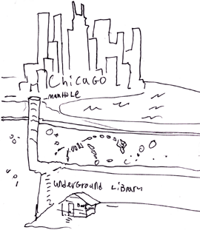
…of physical media. In a physical space.
Notes:
Our collection is Chicago-specific, incorporating everything from well-established publications like Poetry magazine and University of Chicago Press to zines made by students at a social justice high school to limited-edition handmade artist’s books. “Published” is defined broadly as anything intended for public consumption; likewise, we have no political ideology or agenda: a library that excludes material based on narrow definitions of “small” or “independent” is just as problematic as libraries that ignore it. When you create a false binary between independent and mainstream media, you lose out on 90% of what’s actually contributing to the growth of culture.
The collection is 100% inclusive, without making quality or importance judgments, which is very different from traditional curatorial roles. By actively reaching out to collect material from underrepresented communities including immigrants, youth, and work published in educational settings like Young Chicago Authors or Neighborhood Writing Alliance, we are also able to place typically marginalized voices into the wider creative context of Chicago.
CUL’s collecting system privileges connections between people and publications over strict regional boundaries.

Slide 3
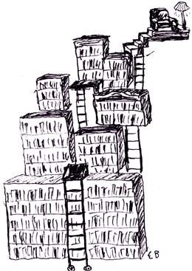
Whoa, TMI
Notes:
So how do we organize it?
We catalog by every single contributor (authors, editors, typesetters, illustrators, etc.) and compile exhaustive lists of subjects so that users can see how publications are linked by threads of influence and how ideas and movements have developed, creating a network of interdependent primary sources. Because the catalogers focus on all contributors and use non-hierarchical combinations of subjects and keywords, our catalog interfaces extremely well with search engines rather than relying on traditional library catalogs alone.
This allows the unique data in our index to display alongside the historical record one might find in search results dominated by publishers with the means to digitize their content, providing a hyperlocal or alternative perspective
-Keyword based
-Reflects the way people seek info now

Slide 4
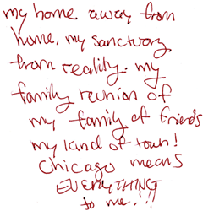
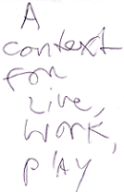
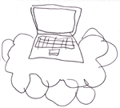
Catalog + Community = Context
(with a pretty big margin of error)
+
=
Notes:
Users are able to search all of the individuals and subjects, click on contributors’ names and find everything else they’ve worked on throughout their careers, look on a map at where each publication came from and see what’s been published in your their neighborhood, and also provide their own historical notes and additions to any catalog entry.
CUL is entirely volunteer-run. The catalogers meet once a week and most are librarians, but many others are untrained and they are able to learn our system very quickly. Even when they are well-trained, our cataloging system is still subjective so we’ll use the notes not just to provide context, but also for correction and to fill in the gaps.
Many of the publications in our collection have incomplete data sets because the people who made them never expected them to wind up in a library. We will be proactively reaching out to people in the community to share their knowledge of different publications in the catalog; tell us stories about where that magazine might have been distributed, who we’re missing from the masthead, where the publisher’s office might have moved to, which publications hosted readings together, etc. Our catalogers will use these contextual comments to glean more metadata for the catalog entry, but will leave up all the comments and anecdotes as part of the record. We want the catalog to further demonstrate the connections between everyone as much as it helps users navigate to their interests.

Slide 5

Open-sourcing the dream
View Site
Notes:
Two assumptions: very few of our items would come with any sort of formal metadata, and very few of our catalogers would have any idea what to do with metadata when they saw it.
The first instincts we had were for an open source ILS, archival information system, or digital collection exhibit platform.
For our purposes when we started developing this catalog, none of these were quite right. (which is not to say they couldn’t be in the future). We don’t have the resources to use any of those systems to their fullest potential, and while we have dedicated volunteers, we do our cataloging training in 20 minutes, not two semesters.
We liked the idea of Drupal because it was flexible and easily allowed social features.
Development started with a large open meeting where volunteers (many non-librarians) described what they wanted to see in a catalog. The report of that meeting is in the handout. We have very slowly been working our way through that list. My personal favorite, the Obscurity Meter is set up already. We do ask that tagging is done by people who have attended a cataloging session for brief training rather than a completely open tagging system, but this may change.
Current setup is Drupal 6, with an eye to moving to Drupal 7 for many reasons. It is extremely simple—perhaps too simple! The key modules we use are on the handout.

Slide 6
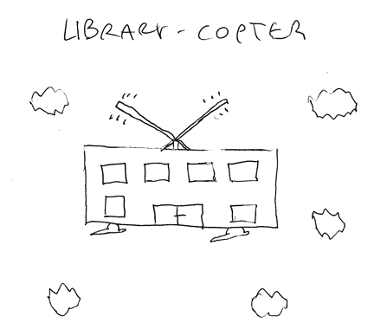
Road conditions
Notes:
Challenges, and the road ahead
As of just about a week ago, the catalog/site is functioning more or less how we want it to. The next step is addressing our challenges and figuring out where we go from here.
Bad data: We love our catalogers, but there are no professional catalogers among us (as far as I know…)
The system has certain controlled vocabularies and required fields, but we leave it fairly open.
We see problems with people not being thorough enough (they want to catalog a lot in a short time), or putting in data incorrectly (though this seems to have improved with better instructions)
However, the catalog is meant to be self-correcting as people go back in and make improvements over time.
Extensibility: This has two major problems.
Right now this only really works in Drupal, and only in Drupal 6. While we think that Drupal works for us, it may not work for everyone. We have constructed a technical implementation of our theoretical model, and we believe that the model is ultimately extensible into many other systems.
The larger problem is that while the model is extensible, the data we currently have collected isn’t quite there yet. Because our metadata isn’t mapped to any other widely used standards, other systems can’t work with it easily. Our next step is to determine how we want to make our data available--whether for study, experimental visualizations, or the theme parties imagined at our first catalog development meeting.

Slide 7
Margaret Heller
margaret@underground-library.org
@margaret_heller
Nell Taylor
nell@underground-library.org
@nelltaylor
www.underground-library.org
@TheChibrary

