Slide 1
Title
David K. Uspal
Falvey Library, Villanova University
code4lib 2012 Feb 9, 2012
david.uspal@villanova.edu

Slide 2
Random Stuff I Talked to People about at the Conference that I Thought Might Be Interesting, so I'm Bringing Up Now, since I have a Podium in Front of Me. Plus, I'm Getting on a Plane in Two Hours so if its Bad, I Don't have to Stick around to Deal with the Fallout
(In Glorious Trebuchet MS)

Slide 3
I just spent 30 seconds talking about talking about things I want to talk about

Slide 4
Interactive Map
Javascript based (for accessibility)
Data stored in JSON file
SVG graphics
Uses the Raphaël.js library (http://raphaeljs.com)
Search by: location, person, call number
http://library.villanova.edu/about/information/interactive-map/

Slide 5
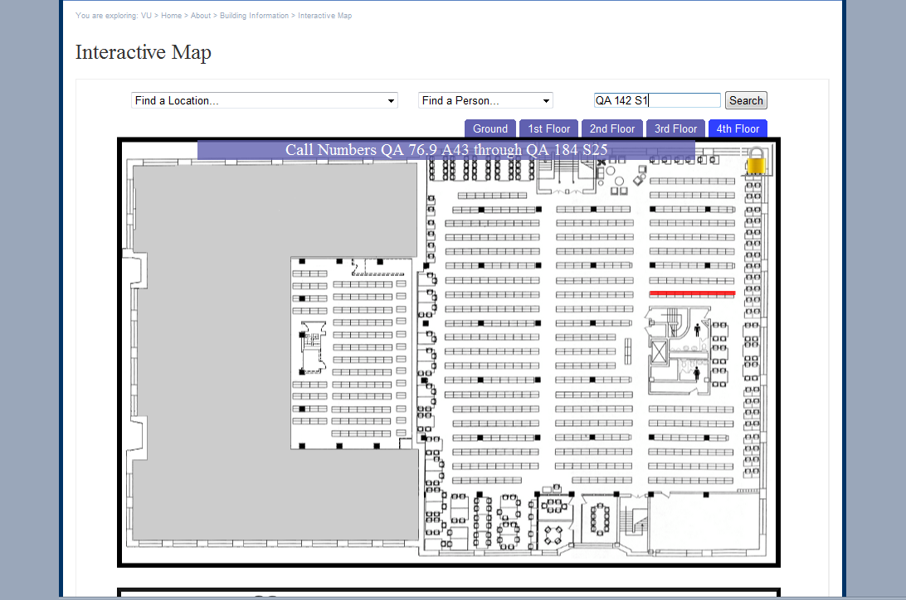
http://library.villanova.edu/about/information/interactive-map/

Slide 6
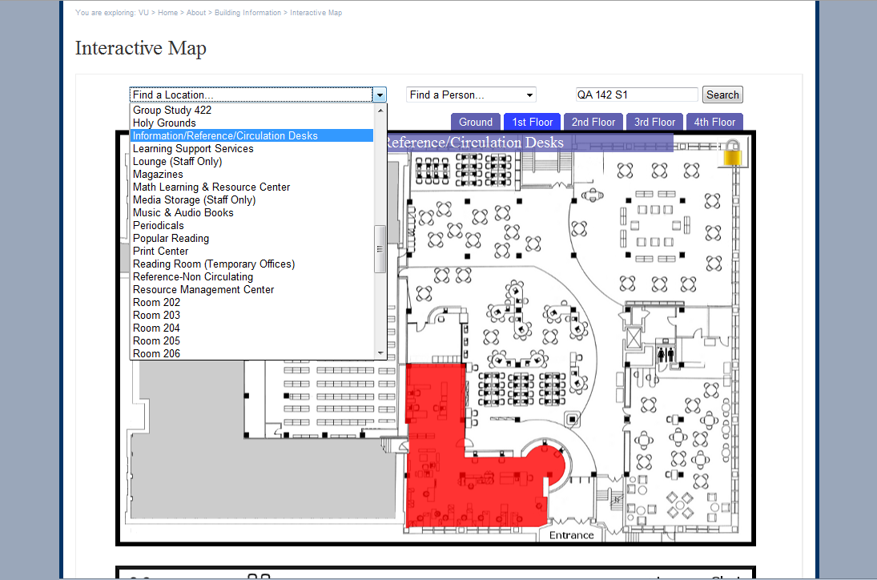
http://library.villanova.edu/about/information/interactive-map/

Slide 7
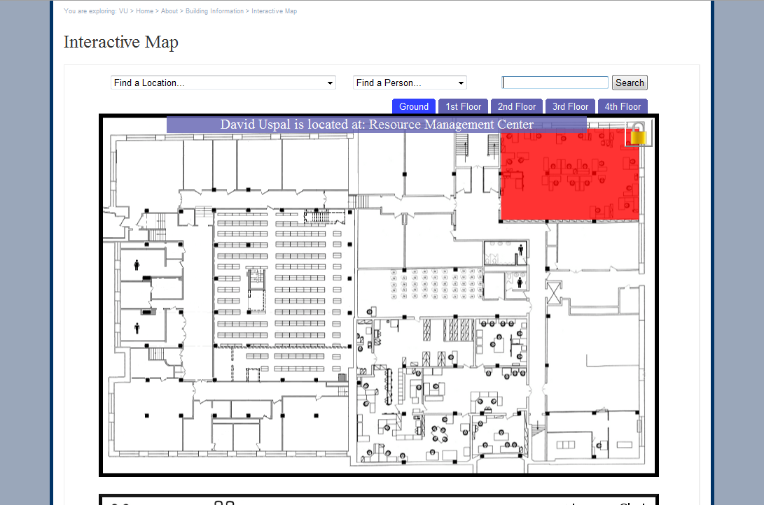
http://library.villanova.edu/about/information/interactive-map/

Slide 8
Interactive Map
85%
http://library.villanova.edu/about/information/interactive-map/

Slide 9
Interactive Map
To do:
  Decouple from CMS (Concrete5)
  SVG path generation as a web application
  Add more configurable options (colors, etc)
http://library.villanova.edu/about/information/interactive-map/

Slide 10
Tap Tour
Started at the Indianapolis Museum of Art
Easy to create a Mobile Tour Application
Currently iPhone/IPod, plans to expand
Drupal CMS back-end (new version released 1/25/2012)
Tours stored in TourML format
http://www.tapintomuseums.org/

Slide 11
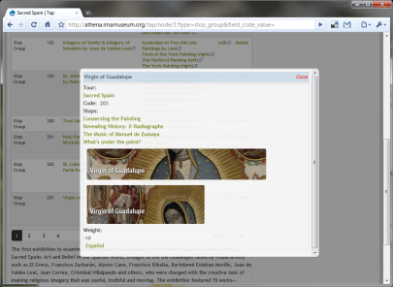
TAP Tour
http://www.tapintomuseums.org/

Slide 12
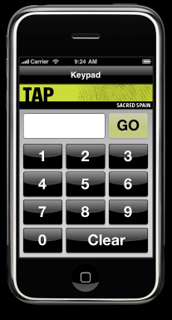
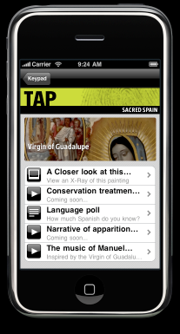
TAP Tour
http://www.tapintomuseums.org/

Slide 13
TAP Tour
85%
http://www.tapintomuseums.org/

Slide 14
URL Manager
Our replacement for LibGuides
Combines Concrete5 CMS with a custom C5 package
Change once, change everywhere URLs
Easy EZ Proxy updates
Concrete5 page building tools allows
http://library.villanova.edu/research/subject-guides

Slide 15
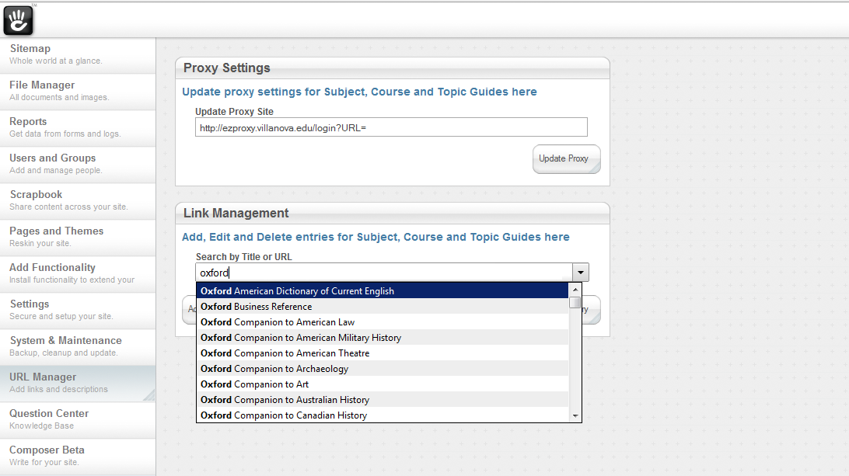
http://library.villanova.edu/research/subject-guides

Slide 16
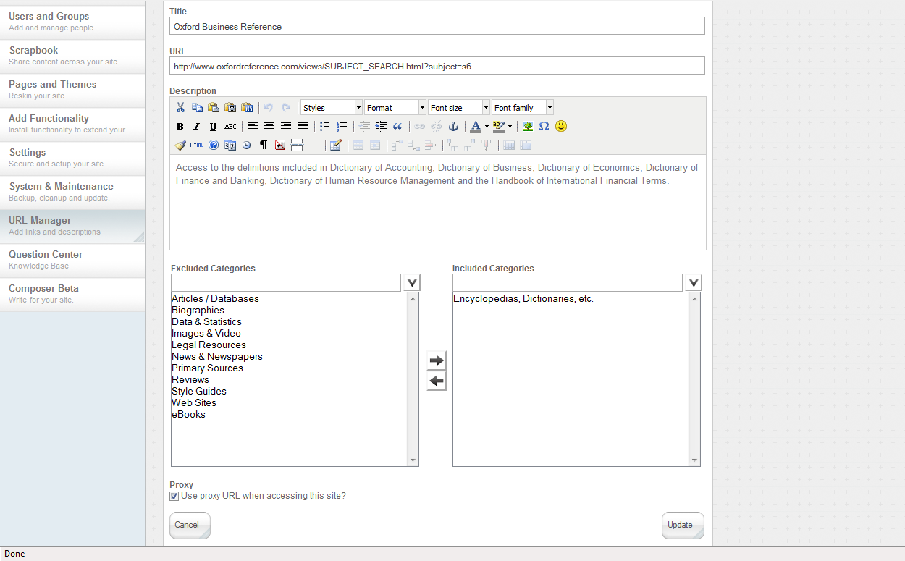
http://library.villanova.edu/research/subject-guides

Slide 17
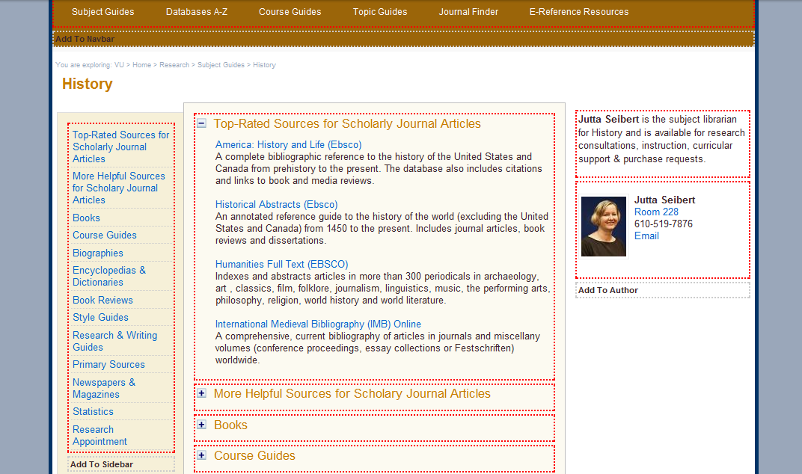
http://library.villanova.edu/research/subject-guides

Slide 18
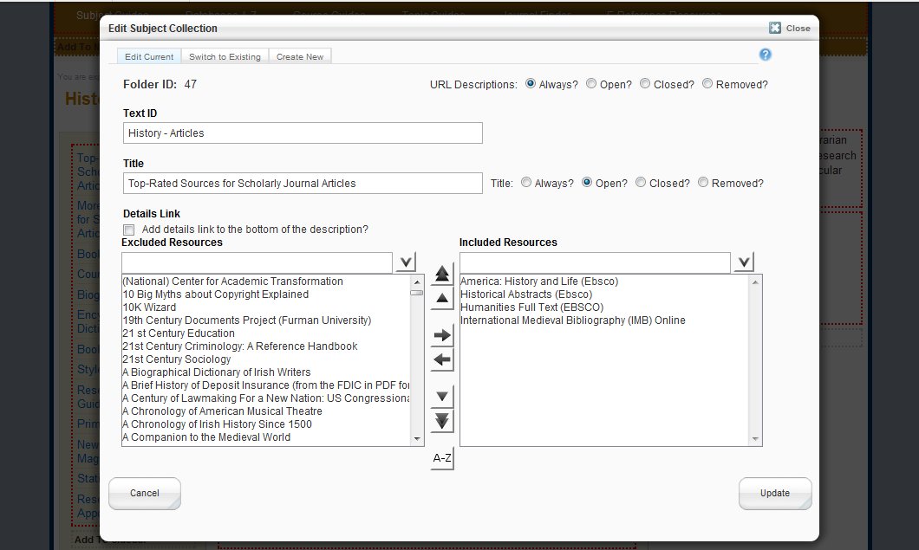
http://library.villanova.edu/research/subject-guides

Slide 19
URL Manager
85%
http://library.villanova.edu/research/subject-guides

Slide 20
URL Manager
To do:
  Package for general release
  Make back-end compatible with Chrome
  TinyMCE Plug-In for in-line links
http://library.villanova.edu/research/subject-guides

Slide 21
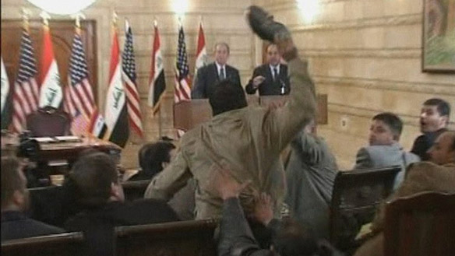
david.uspal@villanova.edu

