Slide 1
The Intellectual Property Disclosure Process
Releasing Open Source Software in Academia
Michael Doran, Systems Librarian
University of Texas at Arlington
doran@uta.edu
Prepared Talk - Code4Lib 2007 - Athens, GA

Slide 2


A typical path to open source
Your library had a need
You wrote some software
You think the software would be useful to other libraries, so you decide to make it available as free software
You slap on a GNU General Public License (or maybe no license at all) and put the source code up on the web
GNU
GPL

Slide 3

What this presentation is about
You slap on a GNU General Public License (or maybe no license at all) and put the source code up on the web
You seek permission from your University to release the application as open source (free) software and if approved, you distribute it
  Intellectual property disclosure process

Slide 4
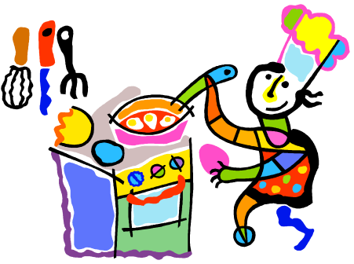
The sad, old truth...
You may be the sole author(s) and:
  written every single ‘bit’ of the code
  slaved for hours over a hot stove computer
  done a lot of the programming on your own time, on evenings and weekends
  been brilliantly creative (or at least clever)
But you likely don’t own the copyright and can’t decide (on your own) to release the software as open source

Slide 5




...the dirty lowdown
If you used any university resources in the creation of your software:
  work time
  university funds
  a university computer
  collaborated with other university staff
Then the university probably owns the copyright and you must petition them for permission to release what you have created

Slide 6
Who owns intellectual property?*
* From the University of Texas at Arlington Intellectual Property Handbook
Intellectual property that is related to an individual's employment responsibility, or has resulted either from activities performed by an individual while employed by The University of Texas System, or supported by State funds, or while using The University of Texas System facilities belongs to The University of Texas (Part Two, Chapter XII, Section 5.2, Rules and Regulations of the Board of Regents of The University of Texas System). These Rules and Regulations govern all U.T. Arlington employees, candidates for masters and doctoral degrees, and predoctoral and postdoctoral fellows.
The University's right to intellectual property is not dependent on the source of funding for research. Intellectual property that results from research supported by a grant or contract with a federal agency or with a profit or non-profit entity, or by a private gift or grant to The University of Texas most often will also belong to the University (Section 5.3). The Intellectual Property Policy requires assignment of the intellectual property by the inventor to the Board of Regents or other appropriate entity. This provision is necessary since the assignment legally designates the owner of the intellectual property.

Slide 7
Intellectual property simplified
Intellectual property that is related to an individual's employment responsibility, or has resulted either from activities performed by an individual while employed by The University of Texas System, or supported by State funds, or while using The University of Texas System facilities belongs to The University of Texas (Part Two, Chapter XII, Section 5.2, Rules and Regulations of the Board of Regents of The University of Texas System). These Rules and Regulations govern all U.T. Arlington employees, candidates for masters and doctoral degrees, and predoctoral and postdoctoral fellows.
The University's right to intellectual property is not dependent on the source of funding for research. Intellectual property that results from research supported by a grant or contract with a federal agency or with a profit or non-profit entity, or by a private gift or grant to The University of Texas most often will also belong to the University (Section 5.3). The Intellectual Property Policy requires assignment of the intellectual property by the inventor to the Board of Regents or other appropriate entity. This provision is necessary since the assignment legally designates the owner of the intellectual property.
Intellectual property...
...blah, blah, blah...
...belongs to The University

Slide 8

Intellectual property disclosure
Your university (almost assuredly) has:
  an office/department that handles intellectual property (IP) issues
  intellectual property policies and procedures
  an intellectual property disclosure process
University of Texas at Arlington
  Vice President for Research
    Office of Technology Management
      Intellectual Property Handbook
      Intellectual Property Disclosure Form (DOC)
  Intellectual Property Committee

Slide 9


Intellectual property disclosure
Other examples
  University of Georgia
    Office of the Vice President for Research
      Intellectual Property Policy
      Copyright Disclosure Form (DOC)
  Georgia Tech
    Office of Technology Licensing
      Copyright Disclosure Form (DOC)
      Software Disclosure Form (DOC)
    Intellectual Property Policy

Slide 10
Does this IP stuff apply to me?
Very likely “yes” – ask if you’re not sure
Does it apply to this particular software?
  Use common sense and/or ask
    Size/complexity/originality of program
    Likelihood of notoriety/popularity/success
The “Sorry, I didn’t know any better” excuse and/or the “I figured it’s easier to ask for forgiveness than permission” strategy may only work one time (or not)

Slide 11
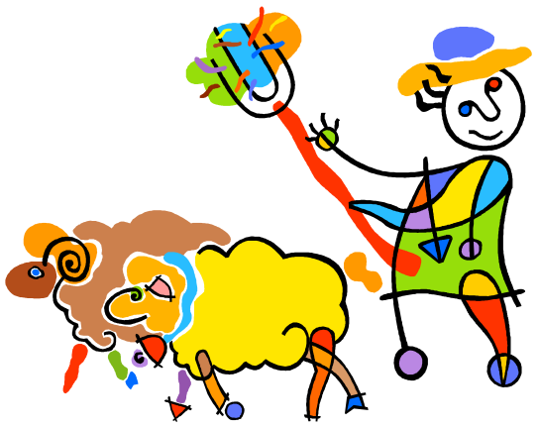
My stories, or, why listen to me?
Successfully shepherded two software applications through our university’s intellectual property (IP) disclosure process in order to (legitimately) release them as open source / free software:
  New Books List
  ShelfLister
And... I’ve also done IP things the wrong way

Slide 12
Story #1 – beginner’s luck
Very unpolished programming – was intended to be an example rather than a product
Source code “illicitly” published on web
App downloaded and used by other libraries
No IP disclosure had been done
Comes to the attention of Library director, who instructs me to contact University’s Intellectual Property Committee
A belated IP disclosure process...

Slide 13
The IP disclosure process at UTA*
* The University of Texas at Arlington
Decide if software is “license worthy”
Obtain, fill out, and submit IP disclosure form (and copy of source code)
Get on schedule for IP Committee meeting
Make “pitch” to Committee
Committee sends recommendation to Provost
Provost makes final decision
Petitioner is notified
Takes about six weeks (if all goes well)

Slide 14
UTA “open source” license
Copyright 2000-2007, The University of Texas at Arlington ("UTA"). All rights reserved.
By using this software the USER indicates that he or she has read, understood and will comply with the following:
UTA hereby grants USER permission to use, copy, modify, and distribute this software and its documentation for any purpose and without fee, provided that:
1. the above copyright notice appears in all copies of the software and its documentation, or portions thereof, and
2. a full copy of this notice is included with the software and its documentation, or portions thereof, and
3. neither the software nor its documentation, nor portions thereof, is sold for profit. Any commercial sale or license of this software, copies of the software, its associated documentation and/or modifications of either is strictly prohibited without the prior consent of UTA.
Title to copyright to this software and its associated documentation shall at all times remain with UTA. No right is granted to use in advertising, publicity or otherwise any trademark, service mark, or the name of UTA.
This software and any associated documentation are provided "as is," and UTA MAKES NO REPRESENTATIONS OR WARRANTIES, EXPRESSED OR IMPLIED, INCLUDING THOSE OF MERCHANTABILITY OR FITNESS FOR A PARTICULAR PURPOSE, OR THAT USE OF THE SOFTWARE, MODIFICATIONS, OR ASSOCIATED DOCUMENTATION WILL NOT INFRINGE ANY PATENTS, COPYRIGHTS, TRADEMARKS OR OTHER INTELLECTUAL PROPERTY RIGHTS OF A THIRD PARTY. UTA, The University of Texas System, its Regents, officers, and employees shall not be liable under any circumstances for any direct, indirect, special, incidental, or consequential damages with respect to any claim by USER or any third party on account of or arising from the use, or inability to use, this software or its associated documentation, even if UTA has been advised of the possibility of those damages.
Submit commercialization requests to: The University of Texas at Arlington, Office of Grant and Contract Services, 701 South Nedderman Drive, Box 19145, Arlington, Texas 76019-0145, ATTN: Director of Technology Transfer.

Slide 15
UTA “open source” license
[...] provided that:
Copyright 2000-2007, The University of Texas at Arlington ("UTA"). All rights reserved.
By using this software the USER indicates that he or she has read, understood and will comply with the following:
UTA hereby grants USER permission to use, copy, modify, and distribute this software and its documentation for any purpose and without fee, provided that:
1. the above copyright notice appears in all copies of the software and its documentation, or portions thereof, and
2. a full copy of this notice is included with the software and its documentation, or portions thereof, and
3. neither the software nor its documentation, nor portions thereof, is sold for profit. Any commercial sale or license of this software, copies of the software, its associated documentation and/or modifications of either is strictly prohibited without the prior consent of UTA.
Title to copyright to this software and its associated documentation shall at all times remain with UTA. No right is granted to use in advertising, publicity or otherwise any trademark, service mark, or the name of UTA.
This software and any associated documentation are provided "as is," and UTA MAKES NO REPRESENTATIONS OR WARRANTIES, EXPRESSED OR IMPLIED, INCLUDING THOSE OF MERCHANTABILITY OR FITNESS FOR A PARTICULAR PURPOSE, OR THAT USE OF THE SOFTWARE, MODIFICATIONS, OR ASSOCIATED DOCUMENTATION WILL NOT INFRINGE ANY PATENTS, COPYRIGHTS, TRADEMARKS OR OTHER INTELLECTUAL PROPERTY RIGHTS OF A THIRD PARTY. UTA, The University of Texas System, its Regents, officers, and employees shall not be liable under any circumstances for any direct, indirect, special, incidental, or consequential damages with respect to any claim by USER or any third party on account of or arising from the use, or inability to use, this software or its associated documentation, even if UTA has been advised of the possibility of those damages.
Submit commercialization requests to: The University of Texas at Arlington, Office of Grant and Contract Services, 701 South Nedderman Drive, Box 19145, Arlington, Texas 76019-0145, ATTN: Director of Technology Transfer.
UTA hereby grants USER permission to use, copy, modify, and distribute this software and its documentation for any purpose and without fee [...]

Slide 16
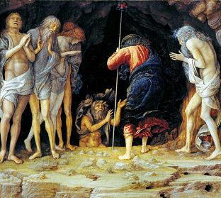
A year in intellectual property limbo
Notes:
Mantegna's “Descent into Limbo”. Painted circa 1492

Slide 17
Story #2, a cautionary tale
This time, I submit an IP disclosure prior to release
Intellectual Property Committee recommends that the university not allow the free release of this software (and the Provost concurs)
The Technology Transfer Office attempts to license the application to the ILS vendor
When that fails, the Technology Transfer Office devises a plan to charge a fee to individual libraries who want to use the application
After a year of this, I send letter to the Vice President for Research, asking for another opportunity to meet with the Intellectual Property Committee
I make a better case for free release -- happy ending

Slide 18

Have a plan
Find out about process beforehand
Understand the committee’s viewpoint
  represent the university’s interests
  conservative/cautious
Work out a strategy
Be clear about what you want and why
Add context (especially regarding open source) if necessary

Slide 19
References
Open source and/or free software
  Definitions
    Open Source Initiative (OSI) http://www.opensource.org/docs/definition.php
    GNU Project
    http://www.gnu.org/philosophy/free-sw.html
    Wikipedia
    http://en.wikipedia.org/wiki/Open_source
  Licenses
    GNU General Public License http://www.gnu.org/copyleft/gpl.html
    Other
    http://www.gnu.org/philosophy/license-list.html

Slide 20
Q & A

