Slide 1

LibX 2.0 - an Open Source, Community Platform for Delivering Library Services
Code4Lib 2009
Godmar Back
University Libraries and Dep. Of Computer Science
Virginia Tech

Slide 2
LibX 1.0
Toolbar and right-click context menu
Adaptive and user-configurable context menus
OpenURL support
Magic Button (Google Scholar support)
Web Localization via Embedded Cues
Autolinking
Off-campus access via EZProxy or WAM
Support for CiteULike
Support for COinS
Support for xISBN
Show/Hide Hotkey
Code4Lib 2009

Slide 3
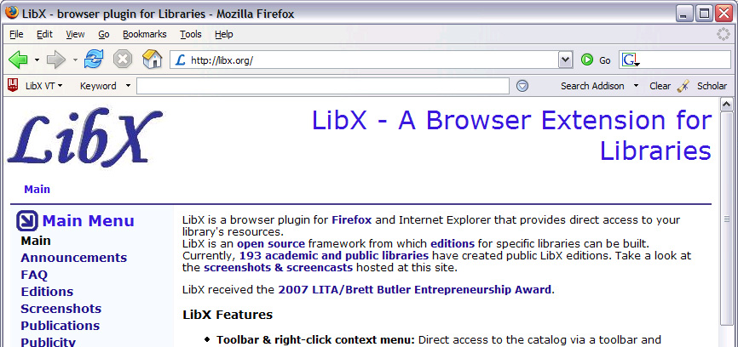
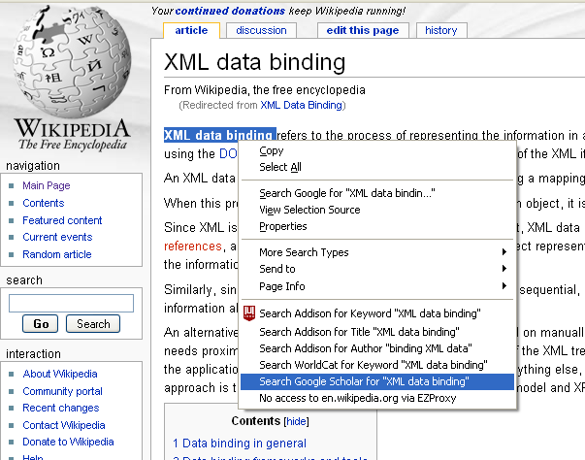
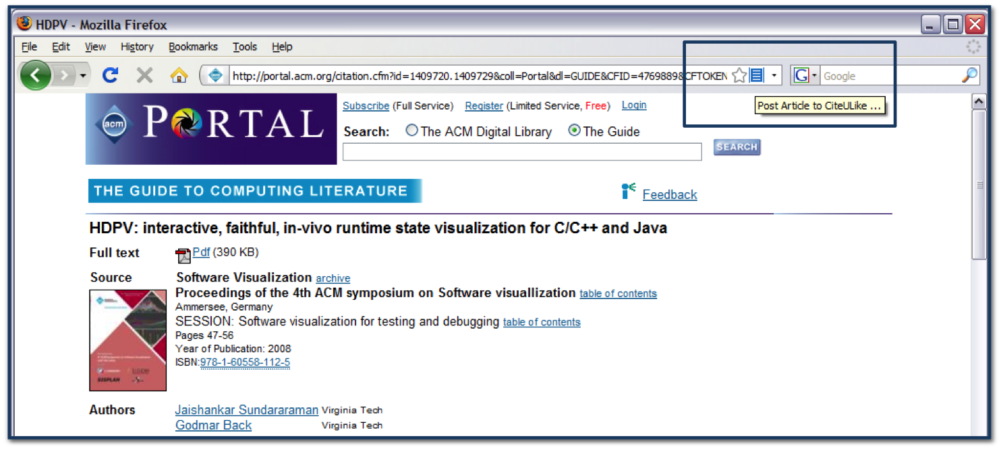
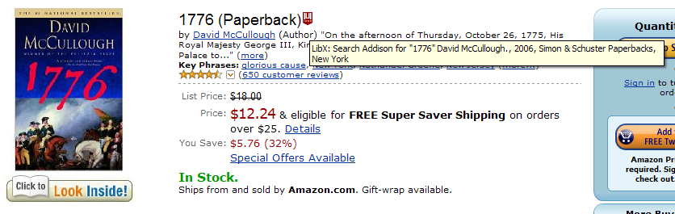
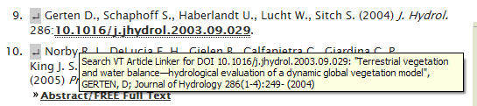
LibX 1.0
Toolbar and right-click context menu
Adaptive and user-configurable context menus
OpenURL support
Magic Button (Google Scholar support)
Web Localization via Embedded Cues
Autolinking
Off-campus access via EZProxy or WAM
Support for CiteULike
Support for COinS
Support for xISBN
Show/Hide Hotkey
Code4Lib 2009

Slide 4
The LibX Edition Builder
A configuration management tool for creating customized versions of LibX
  Customized version of LibX = LibX edition
Edition configuration includes descriptions of community-local resources:
  OPACs, OpenURL, Proxy, Databases, Links, Branding, …
Edition Builder is easy to use
  Makes heavy use of OCLC registries
  Uses sophisticated auto-detection techniques
  Usable by librarians, not just programmers
Anybody can create, share, and manage editions
Over 550 edition as of now, new ones created at a pace of 20/month
  Huge human investment
  10’s of thousands of end users
Code4Lib 2009

Slide 5
Where to go from here?
A toolbar is great, but…
Emerging technology trends
  Service-oriented architectures, web services interfaces – soon even to ILS!
  Data mash-ups; HTML widgets
Educational trends: librarians, educators, and users create
  Online tutorials, subject guides, visualizations
  Social OPACs: tagging, reviews, recommender services
Code4Lib 2009

Slide 6




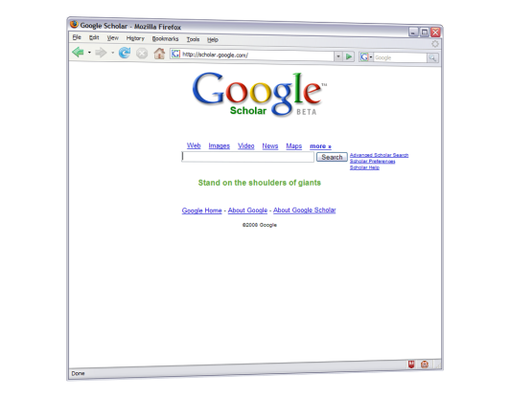
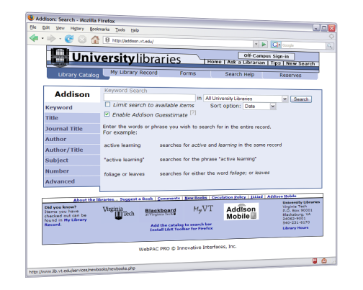
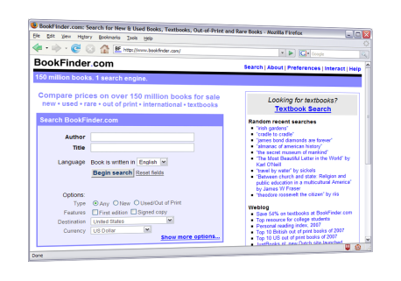
World Wide Web
But who will create those modules?
Library Resources and
Web Services
LibX 2.0 plugin: executes Libapps, merging library information into pages.
LibX 2.0
Users:
decide to which library services to subscribe, see expanded view of the web
Librarians: create or adapt Libapps from reusable, shareable modules
Code4Lib 2009

Slide 7
The LibApp Model
How can the interaction of LibX with web content be modeled?
Typical tasks involve
  Examination of the page and extraction of information
  Processing of information
  Modification of the page
A Module is a small piece of JavaScript code along with a metadata description of its input and/or output
A Libapp is a group of modules
A Package is a folder of libapps and packages
Code4Lib 2009

Slide 8
Modules
Modules are named using a URL and published via REST/AtomPub
Modules can reference JavaScript libraries (e.g., jQuery) and CSS stylesheets
  Execute in a parallel environment to the client page
Modules are trusted, with full access to LibX API, including edition configuration and user preferences
Modules communicate with each other via tuple space
Code4Lib 2009

Slide 9
LibX Tuple Spaces
tuple = TAKE(template)
WRITE (tuple)
If a tuple matching template exists in the tuple space, remove it and return it
If no tuple exists, wait until a matching tuple is written, remove it and return it
Write a tuple into the space
If a TAKE is pending with a matching template, complete the TAKE
Tuples and Templates are JavaScript objects in JSON notation.
Tuple example: { isbn: “0743226720” }
Template example: { isbn : * } // any tuple with ‘isbn’ field
Code4Lib 2009

Slide 10

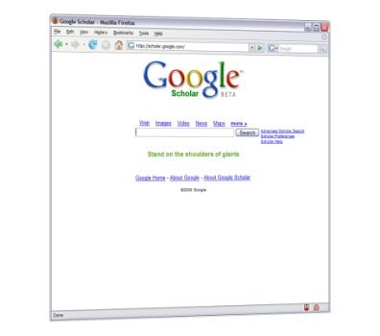


Jangle
ISBN Lookup
Display Result
{ display:
“ISBN 223.. is on the shelf”
}
ISBN Scraper
{ isbn: 2234532134 }
Guarded-By:
{ isbn: *}
Guarded-By:
{ display: * }
Tuple Space
Code4Lib 2009

Slide 11
Rationale for Tuple Spaces
Software Engineering
Handling Asynchrony
Low coupling between modules
Independent composition
Simplicity
Suitable for meta-programming
User actions happen asynchronously
Information arrives asynchronously from external sources
Execution order independence
Code4Lib 2009

Slide 12
LIBAPP DEMO 1
CREATE A PRESENCE FOR THE LIBRARY
Code4Lib 2009

Slide 13
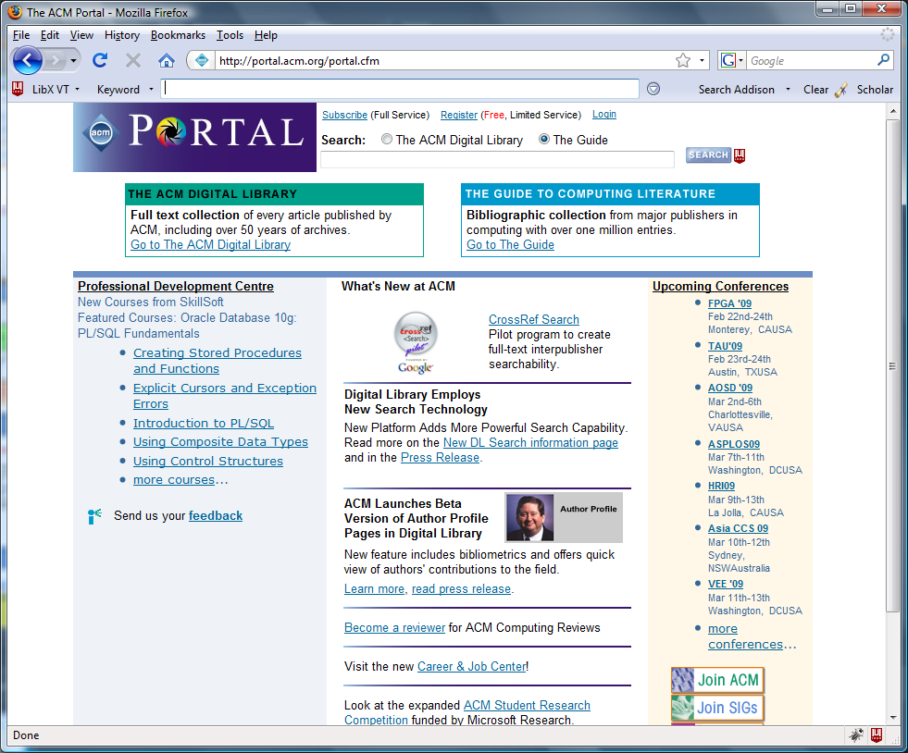

Code4Lib 2009

Slide 14

Code4Lib 2009

Slide 15
Step 1: Arrangement
Description: Display a Help icon on the ACM page that plays a video when clicked.
Include: /portal\.acm\.org.*/
Require: jquery
// Place the current edition's icon into the ACM portal page, next to the
// current search button.
libx.space.write ( {
needsuserbutton: $('input[src="http://portal.acm.org/images/search_small.jpg"]'),
image: libx.edition.options.icon,
text: "Click for a short tutorial",
action: function () {
// When user clicks, offer to show a YouTube clip
libx.space.write ( { youtube: "ehkfEcQ5YnQ"} );
}
} );
Code4Lib 2009

Slide 16
Step 2: Place UI Button
Description: Place a clickable image into a page
Include: /.*/
Guarded-By: { needsuserbutton: libx.space.WILDCARD, action: libx.space.WILDCARD }
Require: jquery
// Create a link with an embedded image
var a = $("<a href='javascript:void(0);'/>");
a.append('<img border="0" src="' + tuple.image + '"/>');
a.attr( 'title', tuple.text || "");
// Insert link after element where a 'user button' is wanted
$(tuple.needsuserbutton).after(a);
// Associate onclick handler and animate
$(a).click(tuple.action).fadeOut("slow").fadeIn("slow");
Code4Lib 2009

Slide 17
Step 3: Create Youtube Clip
Description: Create a notification to play a YouTube video, based on Video ID
Include: /.*/
Guarded-By: { youtube: libx.space.WILDCARD }
// Create HTML based on tuple.youtube
libx.space.write ( {
notify : '<object width="425" height="344"><param name="movie" value="http://www.youtube.com/v/'+tuple.youtube+'&hl=en&fs=1"></param><param name="allowFullScreen" value="true"></param><param name="allowscriptaccess" value="always"></param><embed src="http://www.youtube.com/v/'+tuple.youtube+'&hl=en&fs=1" type="application/x-shockwave-flash" allowscriptaccess="always" allowfullscreen="true" width="425" height="344"></embed></object>',
options: { width: '450px' }
} );
Code4Lib 2009

Slide 18
Step 4: Display HTML Notification
Description: Display HTML notifications via an embedded panel using jGrowl
Include: /.*/
Guarded-By: { notify: libx.space.WILDCARD }
Require: jquery
Require: jgrowl
Require: jgrowl.css
// Set sticky:true unless provided in tuple.options
var jGrowlOptions = $.extend({}, {sticky:true}, tuple.options);
// Display notification
$.jGrowl( tuple.notify, jGrowlOptions );
Code4Lib 2009

Slide 19
LIBAPP DEMO 2
“GET FULL TEXT LINKS FOR COINS”
Code4Lib 2009

Slide 20
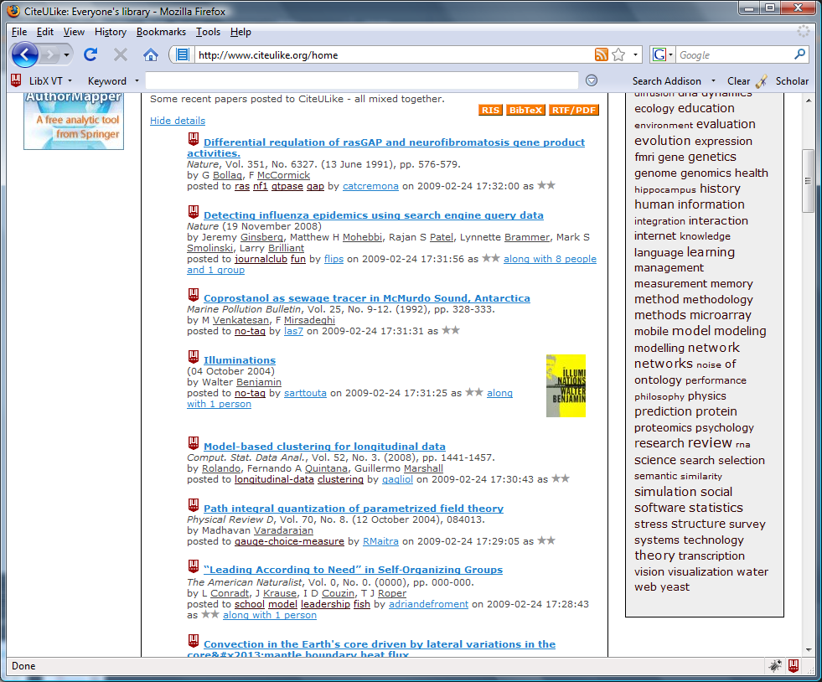
Code4Lib 2009

Slide 21
COinS, the LibX 2.0 way
<span class="Z3988" title="ctx_ver=Z39.88-2004&rft_val_fmt=info:ofi/fmt:kev:mtx:journal&rft_id=info:pmid/16646082&rft.genre=article">
Include: /.*/
Description: Find COinS
Require: jquery
$(“span.Z3988").each(function () {
libx.space.write({
coins: this,
contextobj: this.getAttribute('title')
});
});
Code4Lib 2009

Slide 22
COinS, the LibX 2.0 way
Include: /.*/
Description: Link COinS
Guarded-By: { coins: libx.space.WILDCARD }
Require: legacy-cues
var cue = new libx.cues.StandardCoins(tuple.contextobj);
cue.insertBefore(tuple.coins);
Code4Lib 2009

Slide 23
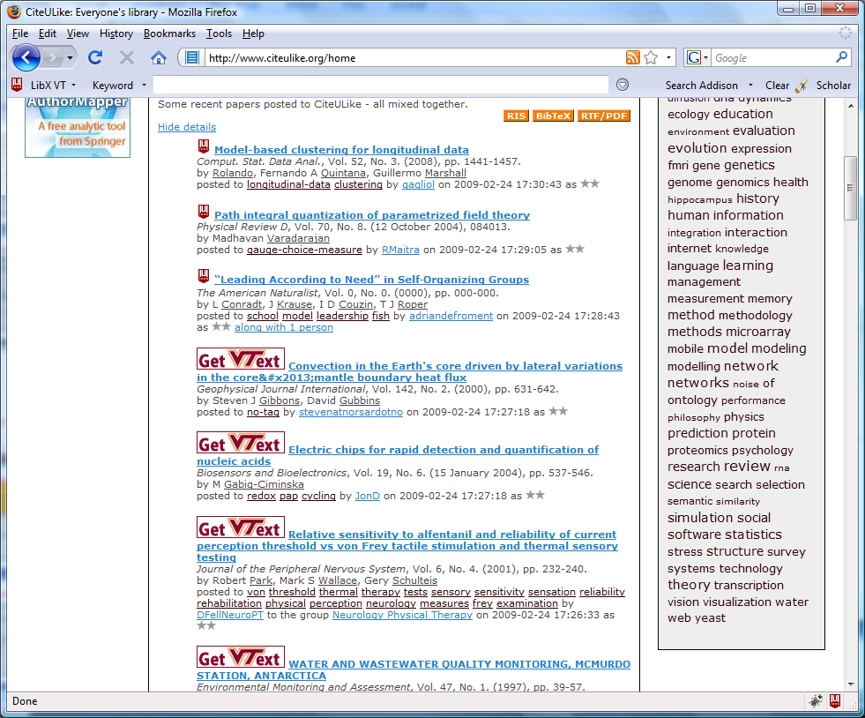
Code4Lib 2009

Slide 24
Add Link/360 direct link
var link360 = libx.services.link360.getLink360(libx.edition);
if (link360)
link360.getMetadata({
query: tuple.contextobj,
type: 'article',
hasFullText: function (xmlDoc, url, databaseName) {
cue.setAttribute('href', url);
cue.setAttribute('title', "Users of " + libx.edition.links.primary.label
+ " click here for full text via " + databaseName);
cue.setImageAttribute('src', 'http://www.lib.vt.edu/images/getvtext.gif');
cue.animate();
},
});
Code4Lib 2009

Slide 25
Transitioning from LibX 1.0 to 2.0
Complete redesign of LibX client code
Browser-independent, strictly object-oriented JavaScript code with proper namespacing and encapsulation
Provide full documentation (via jsdoc, accessible in about:libx)
Provide built-in interactive reflection of data structures
Include unit tests (run via Rhino)
Hot updatable
Code4Lib 2009

Slide 26
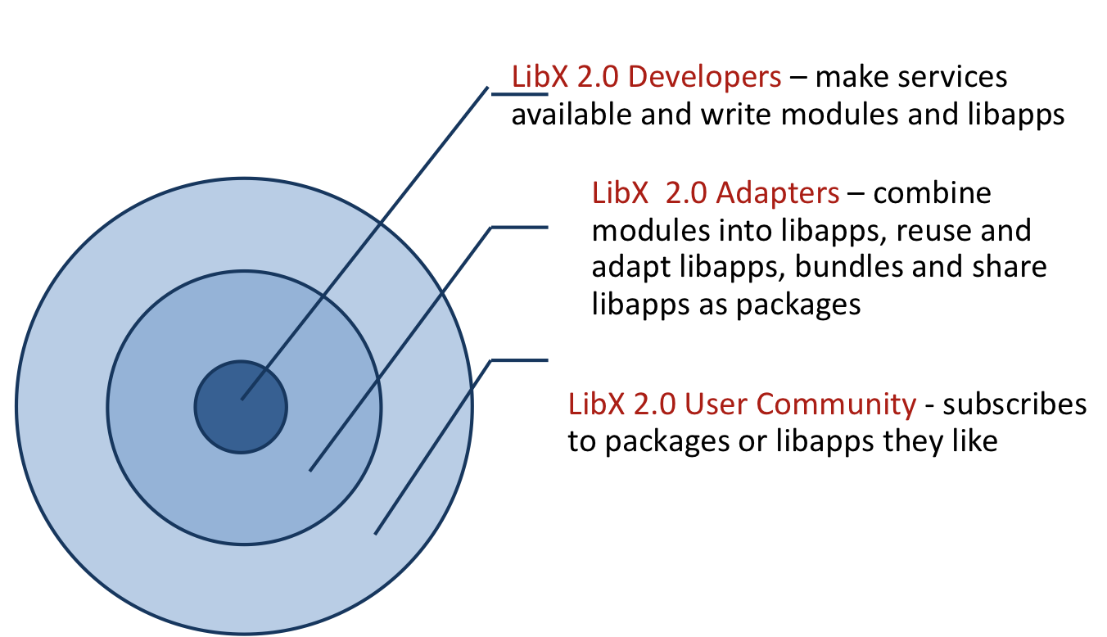
LibX 2.0 – Roles
Code4Lib 2009

Slide 27
LibX 2.0 Community Repository
Based on tuple space model, create metadata descriptions for modules
Create a repository of modules, libapps, and packages
Editable like a Wiki
Integrate repository into Edition Builder
  Include consistency checking
This will be done during the next 2 years (but libapps can already be created now)
Code4Lib 2009

Slide 28
Call for Developers
Launched Developer Website
  http://developers.libx.org
Launched mailing list
  libx-dev@googlegroups.com
Transition path: update from LibX 1.5
Agile roll-out, no “releases”
We invite you to try and play with it!
Code4Lib 2009

Slide 29
LibX Team
Annette Bailey
Godmar Back
Kyrille Goldbeck
Mike Doyle
Arif Khokar
Travis Webb
Alumni
  Nathan Baker
  Tilottama Gaat
  Tobias Wieschnowsky
Code4Lib 2009

