Slide 1
About the WorldCat API
Bruce Washburn
Consulting Software Engineer, OCLC

Slide 2
The Basics
OpenSearch and SRU searches
XML responses
RSS, Atom, MARC21 XML, Dublin Core

Slide 3
The Basics
Lots of indexes for authenticated users
Limit results by holding library
Other users search a subset of indexes, like those in WorldCat.org

Slide 4
The Basics
Sort by relevance, author, title, date, and more
List libraries that hold a title
Sort holding libraries geographically
Get standard citations … APA, Chicago, Harvard, MLA, and Turabian

Slide 5
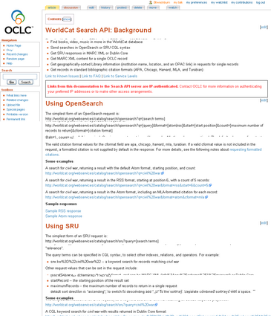
Implementers’ Overview
The Search API overview describes all of its features with working examples, links to other resources, and more.
Find the overview on the OCLC Developer’s Network site at http://www.worldcat.org/devnet/.

Slide 6
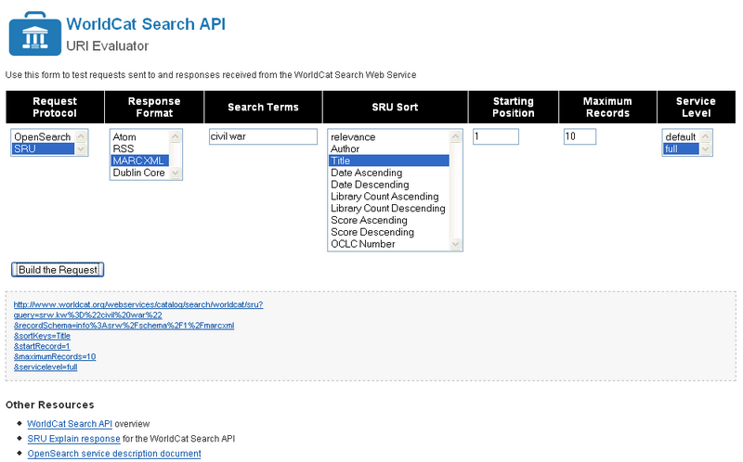
Test Requests and Responses
The URI Evaluator offers an easy way to test API requests and evaluate their responses.

Slide 7
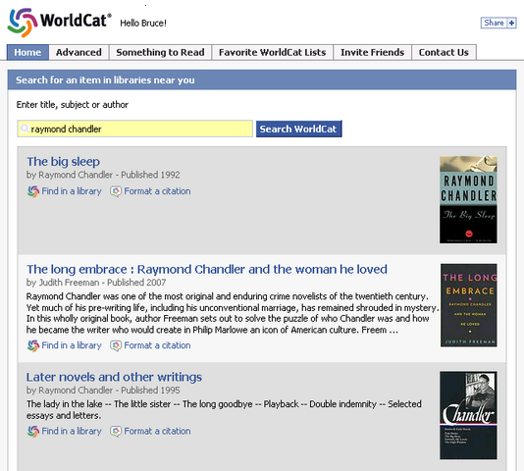
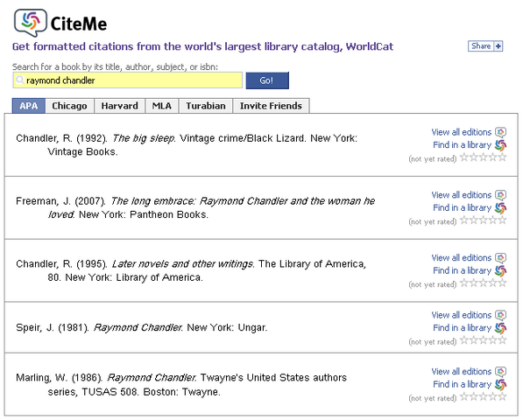
WorldCat API and Facebook
Notes:
The WorldCat Facebook application uses Dublin Core search results. Using the user’s zip code, available in the Facebook Platform user profile, it provides links to WorldCat.org to find each title in a nearby library.
The CiteMe application uses OpenSearch results, with each item automatically formatted based on the user’s preference.

Slide 8
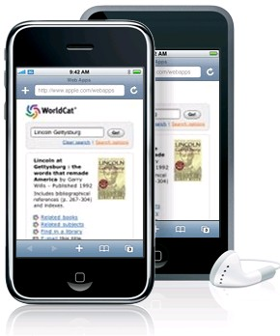
Mobile web apps
Notes:
Recently, as part of testing how the Search API works on different platforms, we developed a web application that is designed to work well on the iPhone and iTouch. It also works on Android phones.

Slide 9
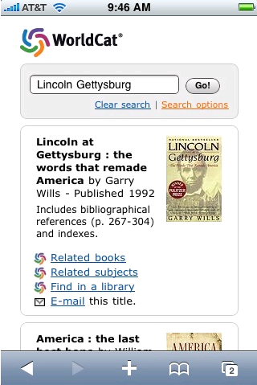
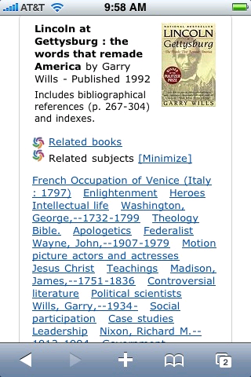
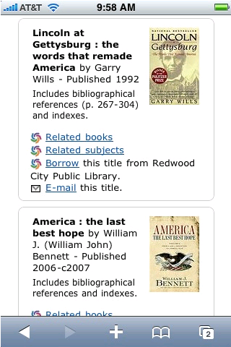
WorldCat API and the iPhone
Notes:
Another prototype interface uses the WorldCat API along with the WorldCat Identities API to deliver information to the Apple iPhone.
Image 1: Here’s a search result for Lincoln Gettysburg. Given the limited screen real estate on a mobile device, some hard choices need to be made about how much of a search interface to present, and how much data should reflect each title in the result. We include the work’s title, creators, and some publication data. We also show bibliographic notes, but limit their extent unless the user expands them.
Image 2: We link to related books and subjects using the WorldCat Identities API. Rather than completely refreshing the whole page, we use JavaScript and AJAX to update just a portion of the screen with more details from Identities, and make that easy to minimize.
Image 3: Using the WorldCat API we offer a list of nearby libraries that hold each title, and, when a library is selected, provide a link to the item in that library’s catalog, without losing the rest of the context of the search result.

Slide 10
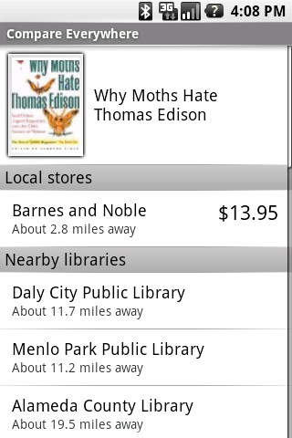
Android App: CompareEverywhere
When a book bar code is scanned a match selected, CompareEverywhere
looks for it at local stores, libraries, and online stores.
Nearby libraries are found by sending the user’s location and an identifier for the item to the WorldCat API.

Slide 11
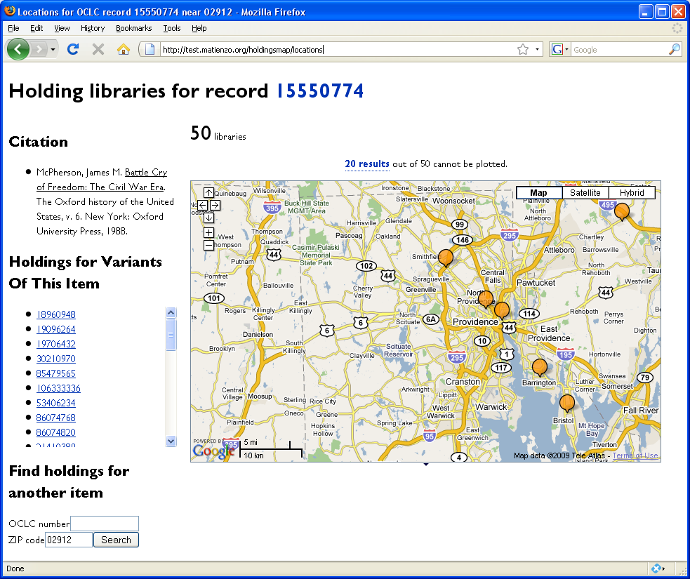
API Fun: Visualizing Holdings Locations
By Mark Matienzo, NYPL
http://thesecretmirror.com/code/api-fun-visualizing-holdings-locations

Slide 12
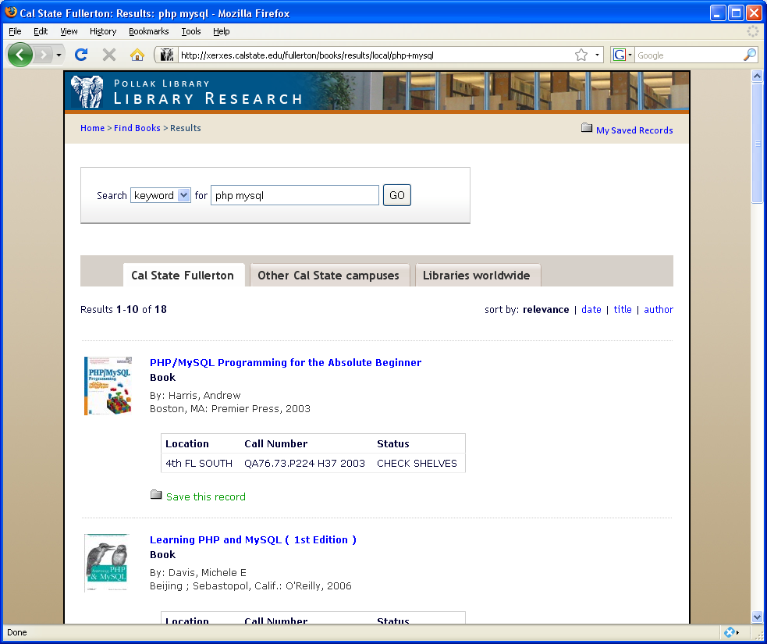
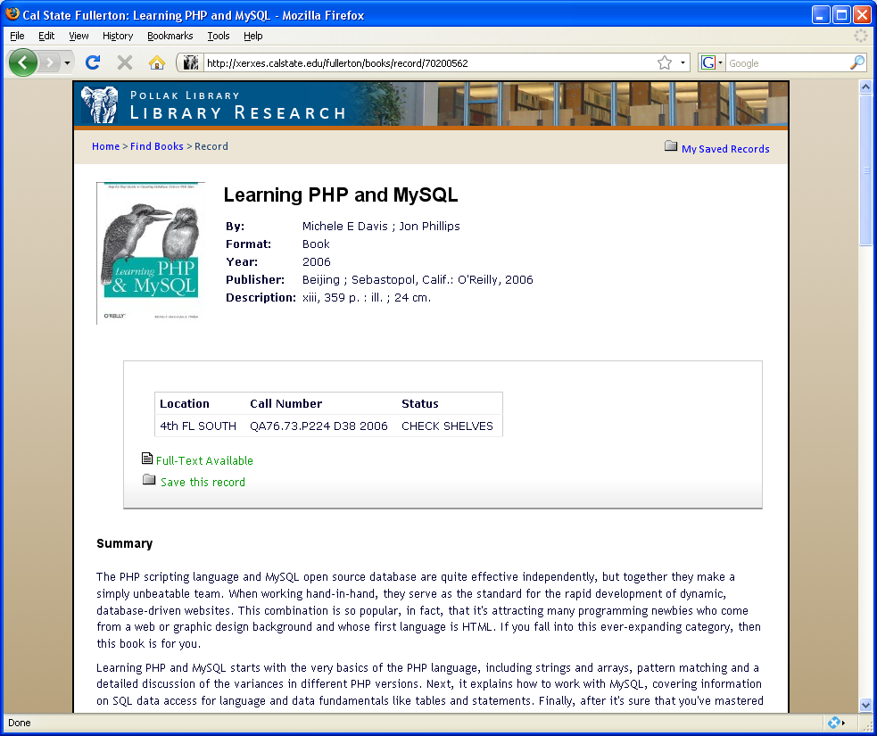
CSU Library Search
http://xerxes.calstate.edu/fullerton/books

Slide 13
The Programmable WorldCat
Combine Search API results in novel ways with other OCLC Web Services, including Identities, xISBN, Registry services, etc.
Embed within other platforms, e.g., Facebook, WordPress, etc.
Mashup with data from other sources and other web services, for example Google Maps, Yahoo News, Local Catalog web services, reading lists, etc.

Slide 14
www.worldcat.org/devnet/

