Slide 1

LibX 2.0 - an Open Source, Community Platform for Delivering Library Services
Code4Lib 2009 Preconference
Godmar Back and Mike Doyle
Virginia Tech

Slide 2
Ground Rules
Let’s make this interactive and informal
You need:
  Internet access
  Firefox 3
    Empty profile + 4 development extensions
  A SCP client – WinSCP on Windows will work
Code4Lib 2009

Slide 3
Outline
Background
  LibX and LibX Edition Builder
Talk about LibX 2.0
  Model, terminology, and rationale
Let’s study 3 examples
Build your own example
Discussion
Code4Lib 2009

Slide 4
LibX 1.0
Toolbar and right-click context menu
Adaptive and user-configurable context menus
OpenURL support
Magic Button (Google Scholar support)
Web Localization via Embedded Cues
Autolinking
Off-campus access via EZProxy or WAM
Support for CiteULike
Support for COinS
Support for xISBN
Show/Hide Hotkey
Code4Lib 2009

Slide 5
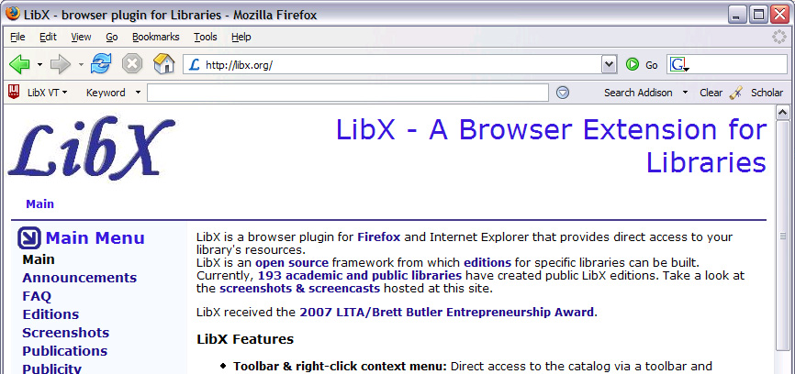
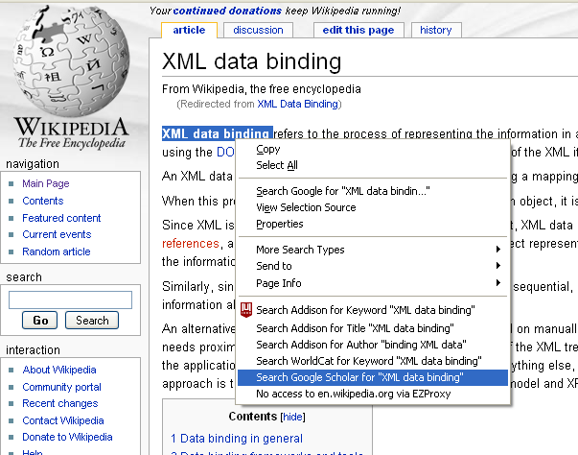
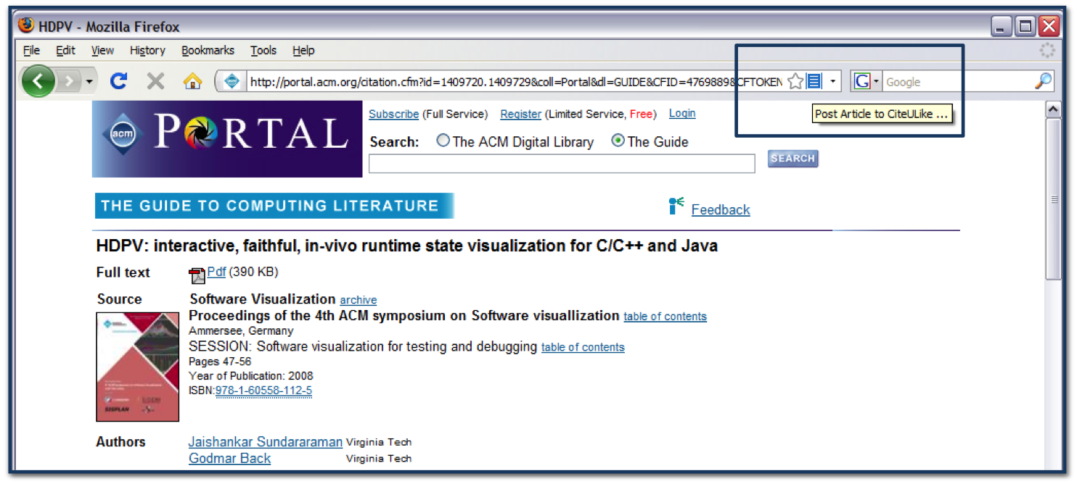
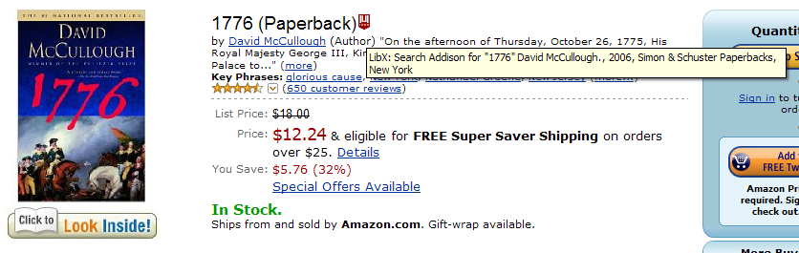
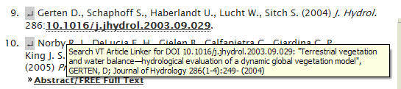
LibX 1.0
Toolbar and right-click context menu
Adaptive and user-configurable context menus
OpenURL support
Magic Button (Google Scholar support)
Web Localization via Embedded Cues
Autolinking
Off-campus access via EZProxy or WAM
Support for CiteULike
Support for COinS
Support for xISBN
Show/Hide Hotkey
Code4Lib 2009

Slide 6
The LibX Edition Builder
A configuration management tool for creating customized versions of LibX
  Customized version of LibX = LibX edition
Edition configuration includes descriptions of community-local resources:
  OPACs, OpenURL, Proxy, Databases, Links, Branding, …
Edition Builder is easy to use
  Makes heavy use of OCLC registries
  Uses sophisticated auto-detection techniques
  Usable by librarians, not just programmers
Anybody can create, share, and manage editions
Over 550 edition as of now, new ones created at a pace of 20/month
  Huge human investment
Code4Lib 2009

Slide 7

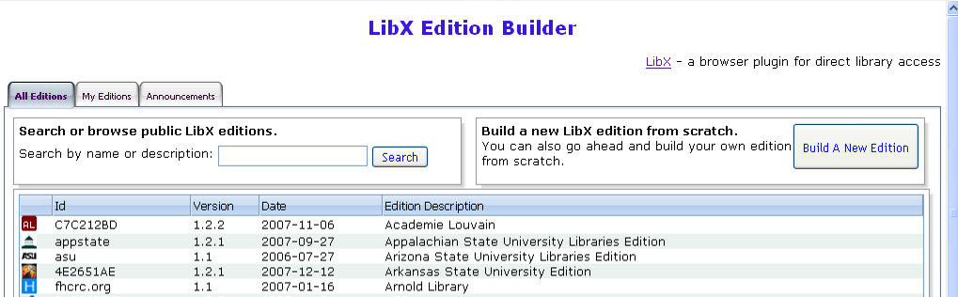
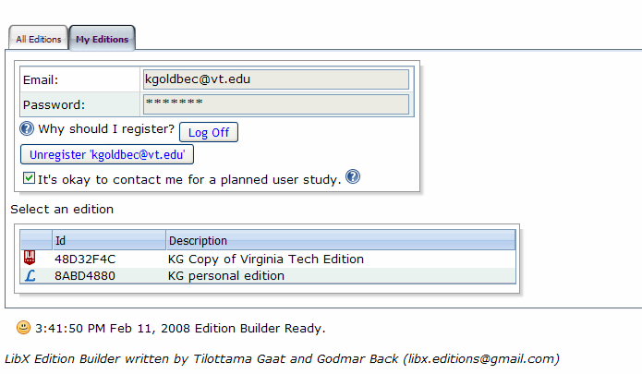
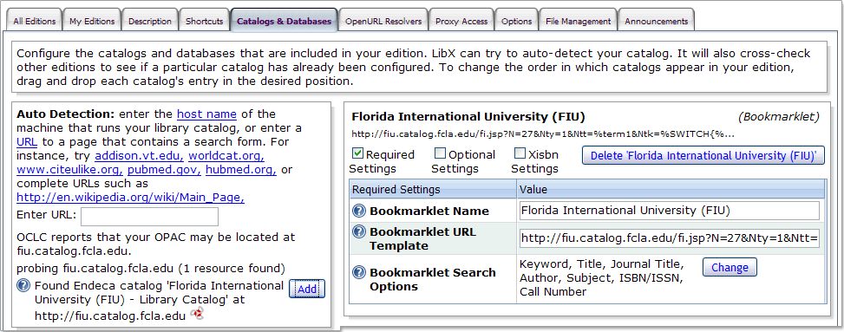
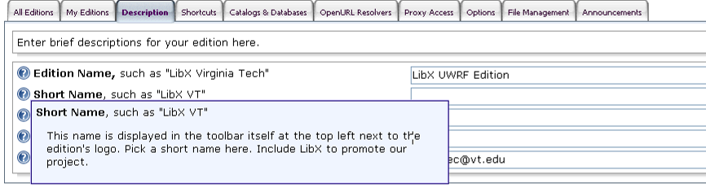
The LibX Edition Builder
Code4Lib 2009

Slide 8
Where to go from here?
A toolbar is great, but…
Emerging technology trends
  Service-oriented architectures, web services interfaces – soon even to ILS!
  Data mash-ups; HTML widgets
Educational trends: librarians, educators, and users create
  Online tutorials, subject guides, visualizations
  Social OPACs: tagging, reviews, recommender services
Code4Lib 2009

Slide 9




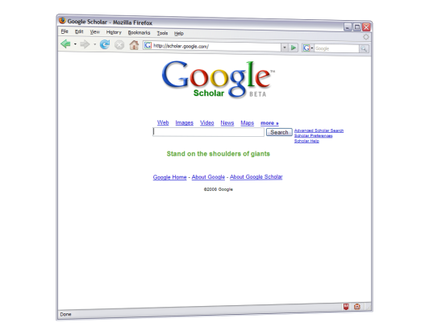
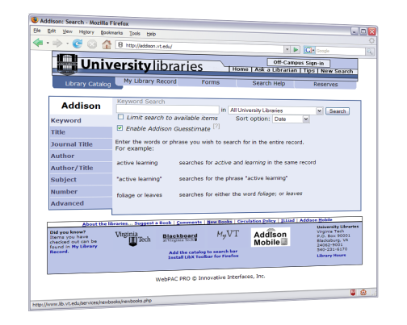
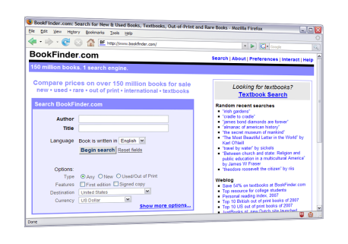
World Wide Web
But who will create those modules?
Library Resources and
Web Services
LibX 2.0 plugin: executes Libapps, merging library information into pages.
LibX 2.0
Users:
decide to which library services to subscribe, see expanded view of the web
Librarians: create or adapt Libapps from reusable, shareable modules
Code4Lib 2009

Slide 10
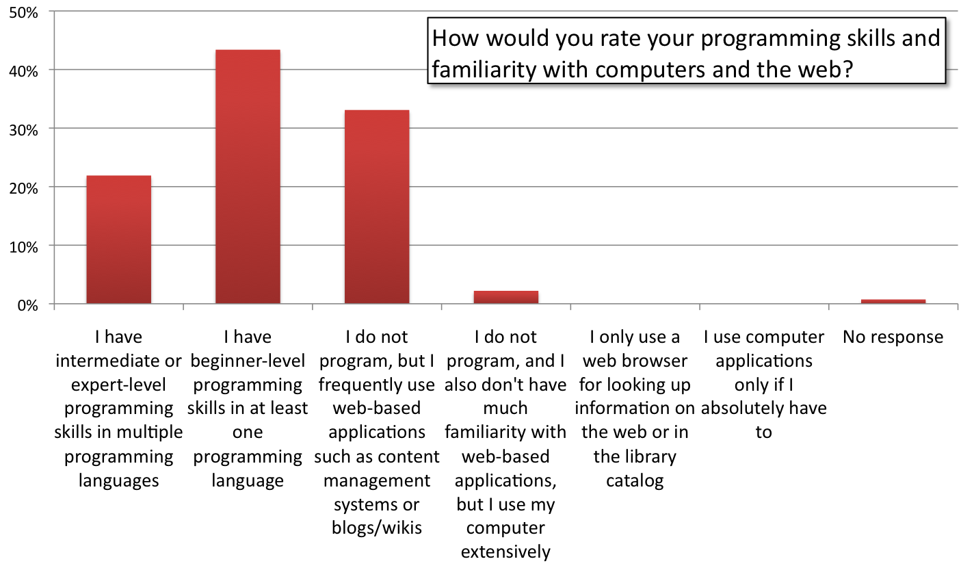
Edition Builder Survey: Programming Skills
Code4Lib 2009

Slide 11
The LibApp Model
How can the interaction of LibX with web content be modeled?
Typical tasks involve
  Examination of the page and extraction of information
  Processing of information
  Modification of the page
A Module is a small piece of JavaScript code along with a metadata description of its input and/or output
A Libapp is a group of modules
A Package is a folder of libapps and packages
Code4Lib 2009

Slide 12
Modules
Modules are represented via a URL and published via AtomPub
Modules can include JavaScript libraries (jQuery) and CSS stylesheets
  Execute in a parallel environment to the client page
Modules are trusted, with full access to LibX API, including edition configuration and user preferences
Modules communicate with each other via a tuple space abstraction
Code4Lib 2009

Slide 13
LibX Tuple Spaces
tuple = TAKE(template)
WRITE (tuple)
If a tuple matching template exists in the tuple space, remove it and return it
If no tuple exists, wait until a matching tuple is written, remove it and return it
Write a tuple into the space
If a TAKE is pending with a matching template, complete the TAKE
Tuples and Templates are JavaScript objects in JSON notation.
Tuple example: { isbn: “0743226720” }
Template example: { isbn : libx.space.WILDCARD } // any
Code4Lib 2009

Slide 14
LibApp Example
LibApp
yazproxy
Z39.50 Gateway
ILS-DI/libxess
jangle
OCLC
xISBN
Modules
ILS snapshot
xISBN
Service
Presearch
Service
Tuple Space
Tooltip
Display
(,,)
(,,)
ISBN
Scraper
(isbn: 006073132X,
location:, …)
Code4Lib 2009

Slide 15

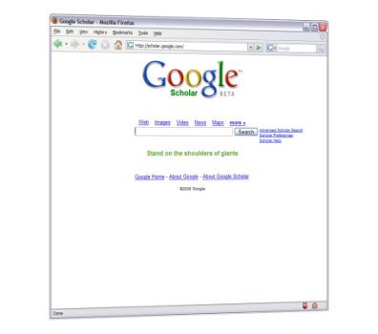


Jangle
ISBN Lookup
Display Result
{ display:
“ISBN 223.. is on the shelf”
}
ISBN Scraper
{ isbn: 2234532134 }
{ isbn: *}
{ display: * }
Tuple Space
Code4Lib 2009

Slide 16
Rationale for Tuple Spaces
Software Engineering
Asynchrony
Low coupling between modules
Independent composition
Simplicity
Suitable for metaprogramming by end users
Execution order independence
  User actions happen asynchronously
  Information arrives asynchronously
Code4Lib 2009

Slide 17
Initial Setup
1 Package: libxcore
1 LibApp in this package: google
2 Modules in this libapp:
getgooglekeyword and searchkeyword
Code4Lib 2009

Slide 18
LIBAPP EXAMPLE:
“GOOGLE CUE”
Code4Lib 2009

Slide 19
Step 1: Find Searchterms & Position
Description: Extract Keyword from Google
Include: /google(\.[a-z]+)?\.[a-z]+\/search.*q=/i
Require: jquery
/* Find a suitable location to include a cue */
var nArray = $("div div[id='prs'] b");
if (nArray.length == 0)
nArray = $("tr td span[id='sd']"); // old, before Aug 2008
var n = nArray[0];
// Extract search terms
var searchterms = unsafeWindow.document.gs.q.value; // LibX FF
libx.space.write({
keyword: searchterms,
position: n.parentNode.lastChild
});
Code4Lib 2009

Slide 20
INTERLUDE: JQUERY
Code4Lib 2009

Slide 21
Step 2: Place A Cue
Description: Link by Keyword
Include: /.*/
Guarded-By: { keyword: libx.space.WILDCARD }
Require: legacy-cues
// Create an old-style LibX cue with a keyword search on the
// primary catalog, insert it before tuple.position and animate it
var cue = new libx.cues.CatalogCue('Y', tuple.keyword);
cue.insertBefore(tuple.position);
cue.animate();
Code4Lib 2009

Slide 22
Transitioning from LibX 1.0 to 2.0
Complete redesign of LibX client code
Browser-independent, strictly object-oriented JavaScript code with proper namespacing and encapsulation
Provide full documentation (via jsdoc, accessible in about:libx)
Provide built-in interactive reflection of data structures
Include unit tests (run via Rhino)
Hot updatable
Code4Lib 2009

Slide 23
LibX 2.0 API
Uses namespaces:
  libx.utils.*, libx.services.*, libx.libapps.*, …
Uses OO classes
  var R = libx.core.Class.create( (optional: BaseClass),
  { prototype } )
  var r = new R();
Uses “inversion of control” throughout
  JavaScript is single-threaded, thus – anything that can’t be completed immediately must be expressed as a callback
Hides browser-specifics
Code4Lib 2009

Slide 24
Caching in LibX 2.0
Object cache (persistent):
  Goal: allow disconnected operation
  Used for packages, libapps, modules, and scripts
  Automatic expiration and update
  Stores file in “profile folder” – SHA1 encoded filenames
Memory cache (transient):
  Goal: reduce load on external services, speed up response for repeated requests
  Used for metadata services (xISBN, CrossRef, etc.)
Code4Lib 2009

Slide 25
Bootstrapping LibX and Caching
LibX 2.0 has a small core:
  Downloaded from libx.org/editionbuilder
Bootstrapped code:
  Downloaded on startup
    “global” – once per browser process
    “per-window” – once per browser window
  Code contained in modules
    Downloaded when module is run
Code is cached and subject to automatic updates
  In deployment: things will “just” work – updates will be picked up by clients after a short time period
  During development: developer must force the update, see next slide
Code4Lib 2009

Slide 26
Development vs. Caching
Less advanced
If you change a module
  Purge the feed containing the module,
  simply reload the page on which module runs
If you change a package or libapp
  Purge the feed, restart the entire browser
If you change bootstrapped global code
  Purge the file containing the code, restart the browser
If you change bootstrapped per-window code
  Purge the file containing the code, open new window
If you change the core
  Rebuild, reinstall
If in doubt: “Purge All”, restart.
LibX 2.0
LibApp API
LibX 2.0
Core API
More advanced
Code4Lib 2009

Slide 27
LIBAPP EXAMPLE:
“ALERT ACM PORTAL USERS”
Code4Lib 2009

Slide 28
Step 1: Arrangement
Description: Display a Help icon on the ACM page that plays a video when clicked.
Include: /portal\.acm\.org.*/
Require: jquery
// Place the current edition's icon into the ACM portal page, next to the
// current search button.
libx.space.write ( {
needsuserbutton: $('input[src="http://portal.acm.org/images/search_small.jpg"]'),
image: libx.edition.options.icon,
text: "Click for a short tutorial",
action: function () {
// When user clicks, offer to show a YouTube clip
libx.space.write ( { youtube: "ehksdsfEcQ5YnQ"} );
}
} );
Code4Lib 2009

Slide 29
Step 2: Place UI Button
Description: Place a clickable image into a page
Include: /.*/
Guarded-By: { needsuserbutton: libx.space.WILDCARD, action: libx.space.WILDCARD }
Require: jquery
// Create a link with an embedded image
var a = $("<a href='javascript:void(0);'/>");
a.append('<img border="0" src="' + tuple.image + '"/>');
a.attr( 'title', tuple.text || "");
// Insert link after element where a 'user button' is wanted
$(tuple.needsuserbutton).after(a);
// Associate onclick handler and animate
$(a).click(tuple.action).fadeOut("slow").fadeIn("slow");
Code4Lib 2009

Slide 30
Step 3: Create Youtube Clip
Description: Create a notification to play a YouTube video, based on Video ID
Include: /.*/
Guarded-By: { youtube: libx.space.WILDCARD }
// Create HTML based on tuple.youtube
libx.space.write ( {
notify : '<object width="425" height="344"><param name="movie" value="http://www.youtube.com/v/'+tuple.youtube+'&hl=en&fs=1"></param><param name="allowFullScreen" value="true"></param><param name="allowscriptaccess" value="always"></param><embed src="http://www.youtube.com/v/'+tuple.youtube+'&hl=en&fs=1" type="application/x-shockwave-flash" allowscriptaccess="always" allowfullscreen="true" width="425" height="344"></embed></object>',
options: { width: '450px' }
} );
Code4Lib 2009

Slide 31
Step 4: Display HTML Notification
Description: Display HTML notifications via an embedded panel using jGrowl
Include: /.*/
Guarded-By: { notify: libx.space.WILDCARD }
Require: jquery
Require: jgrowl
Require: jgrowl.css
// Set sticky:true unless provided in tuple.options
var jGrowlOptions = $.extend({}, {sticky:true}, tuple.options);
// Display notification
$.jGrowl( tuple.notify, jGrowlOptions );
Code4Lib 2009

Slide 32
LIBAPP EXAMPLE:
“COINS, THE LIBX 2.0 WAY”
Code4Lib 2009

Slide 33
COinS, the LibX 2.0 way
Include: /.*/
Description: Find COinS
Require: jquery
$(".Z3988").each(function () {
libx.space.write({
coins: this,
contextobj: this.getAttribute('title')
});
});
Code4Lib 2009

Slide 34
COinS, the LibX 2.0 way
Include: /.*/
Description: Link COinS
Guarded-By: { coins: libx.space.WILDCARD }
Require: legacy-cues
var cue = new libx.cues.StandardCoins(tuple.contextobj);
cue.insertBefore(tuple.coins);
Code4Lib 2009

Slide 35
Add Link/360 direct link
var link360 = libx.services.link360.getLink360(libx.edition);
if (link360)
link360.getMetadata({
query: tuple.contextobj,
type: 'article',
hasFullText: function (xmlDoc, url, databaseName) {
cue.setAttribute('href', url);
cue.setAttribute('title', "Users of " + libx.edition.links.primary.label
+ " click here for full text via " + databaseName);
cue.setImageAttribute('src', 'http://www.lib.vt.edu/images/getvtext.gif');
cue.animate();
},
});
Code4Lib 2009

Slide 36
LIBAPP EXAMPLE:
“AUTOLINKING”
Code4Lib 2009

Slide 37
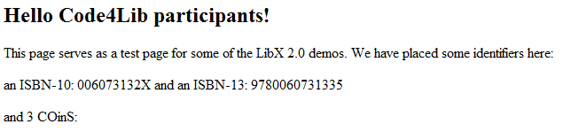
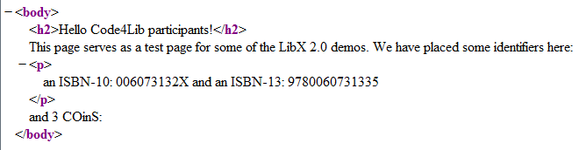
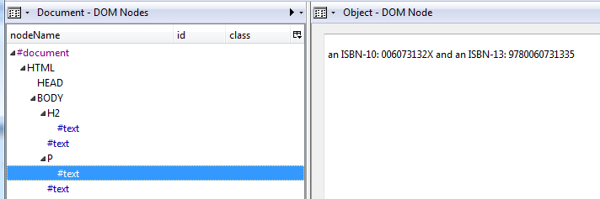
Text Structure of HTML
Code4Lib 2009

Slide 38
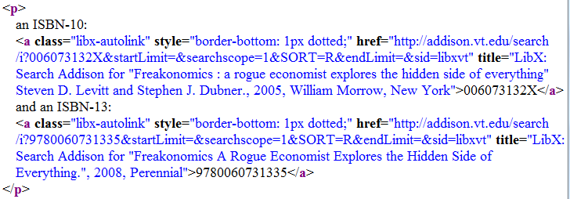
Autolinking
Must traverse DOM tree
For each text node, decide:
  Does it match a transformation pattern?
  If so, transform it – possibly breaking it up
Code4Lib 2009

Slide 39
Autolinking, cont’d
Traversal is expensive (pages can contains 10s of thousands of nodes)
  Can’t do it all at once lest browser becomes unresponsive, instead split in chunks
Must combine multiple transformations in one traversal
Implemented in libx.libapp.TextTransformer
Module: “RegExpTextTransformer:”
Code4Lib 2009

Slide 40
Finding ISBNs in a page
Description: Find ISBNs on Page
Include: /.*/
RegExpTextTransformer: /((97[89])?((-)?\d(-)?){9}[\dx])(?!\d)/ig
/* precond:
* match: contains matched element; textNode: contains matched textnode */
var replacementNode = textNode.ownerDocument.createTextNode(match[0]);
/* returns [ node, function ]
* 'replacementNode' will be inserted into the DOM at the place of the matched text.
Then function is called */
return [ replacementNode, function () {
libx.space.write({
autolinkisbn: isbn,
position: replacementNode
});
} ];
findisbnintext.mod
Code4Lib 2009

Slide 41
Linking ISBNs
Description: Create AutoLinks Around ISBNs
Include: /.*/
Guarded-By: { autolinkisbn: libx.space.WILDCARD }
Require: legacy-cues
/* Search primary catalog for ISBN/xISBN */
var cat = libx.edition.catalogs.primary;
var url = cat.makeSearch('i', tuple.autolinkisbn);
var cue = new libx.cues.Autolink(tuple.position, url, libx.locale.getProperty("isbnsearch.label",
cat.name, tuple.autolinkisbn));
libx.cues.addISBNMetadataTooltip(cue.link, cat.name, tuple.autolinkisbn);
Code4Lib 2009

Slide 42
LIBAPP EXAMPLE:
“MIX SERVICES”
Code4Lib 2009

Slide 43
Mix Services
See
googleintoaddison.app
searchgooglebooks.mod
Demonstrates use of LibX’s memory cache and Google search API
Code4Lib 2009

Slide 44
Challenges in LibX 2.0
Scalable Development Model
  Maximize reusability
  Leverage full spectrum of talents in the community
Scalable Architecture
User interface design
Sustainability
Code4Lib 2009

Slide 45
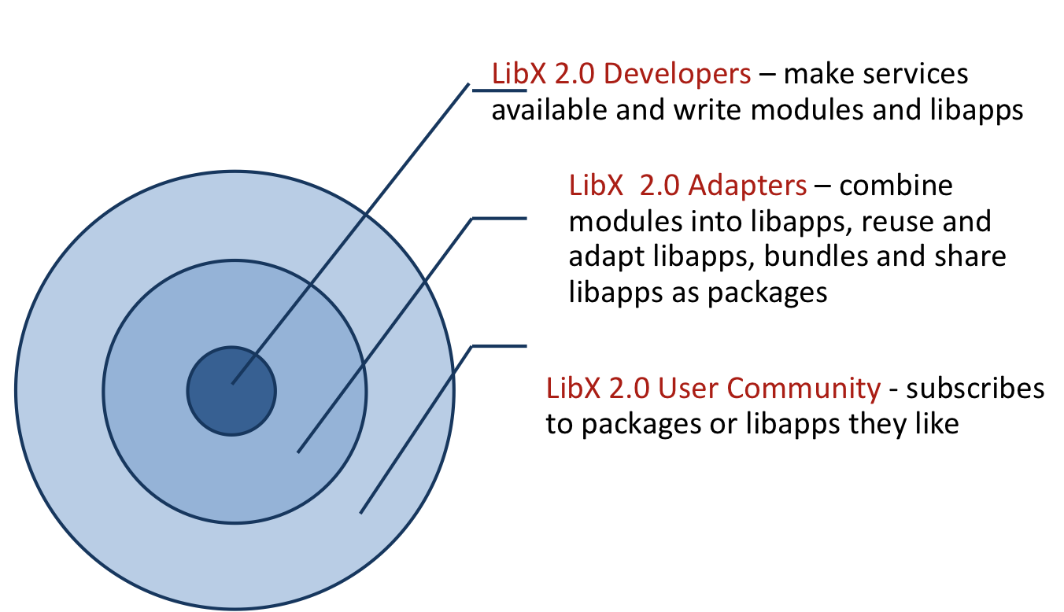
LibX 2.0 – Roles
Code4Lib 2009

Slide 46
LibX 2.0 Adapters
Web-savvy librarians
  Not programmers
Edition Builder will become a repository to manage LibX modules and libapps
  Adapters can add, combine, share, adapt, customize libapps
  Based on descriptions and metadata
Create localized services for their users
Provide feedback to developers
Code4Lib 2009

Slide 47
LibX 2.0 Users
Subscribe to services recommended by their edition maintainers using local settings
  Stay connected to their libraries
Decide which services they like
  Fine-grained control and preferences
Marketing
  Will help adapters by providing marketing kit
  Users must see benefits
Code4Lib 2009

Slide 48
LibX 2.0 Metadata and Repository
Based on tuple space model, create metadata descriptions for modules
Create a repository of modules, libapps, and packages
Integrate into Edition Builder
  Include consistency checking
This will be done during the next 2-3 years.
Code4Lib 2009

Slide 49
Call for Developers
Launched Developer Website
  http://developers.libx.org
Launched mailing list
  libx-dev@googlegroups.com
Transition path: update from LibX 1.5
Agile roll-out
Code4Lib 2009

Slide 50
LibX Team
Annette Bailey
Godmar Back
Kyrille Goldbeck
Mike Doyle
Arif Khokar
Travis Webb
Alumni
  Nathan Baker
  Tilottama Gaat
  Tobias Wieschnowsky
Code4Lib 2009

