Slide 1
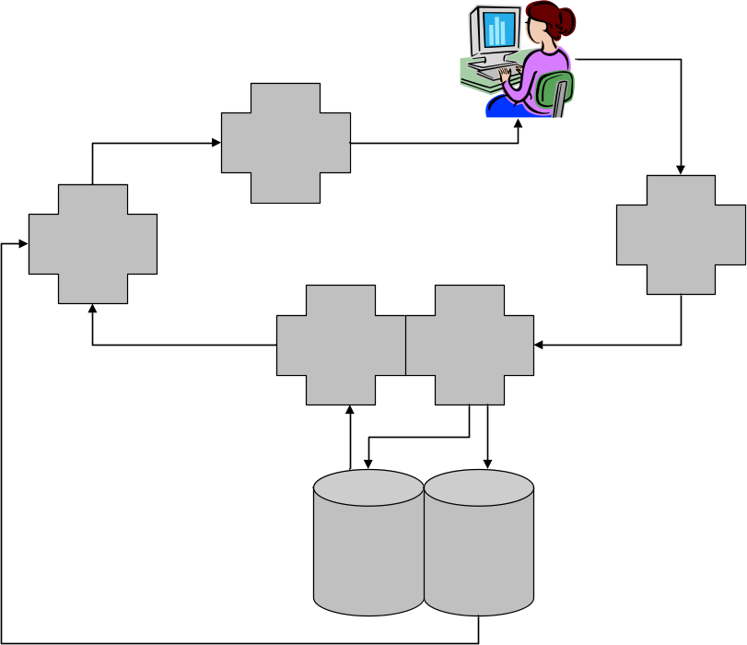
WikiD (Wiki/Data)
Jeffrey A. Young
OCLC Office of Research
jyoung@oclc.org
code4lib 2006
Oregon State University, Corvallis, Oregon
15 February 2006

Slide 2
WikiD Overview
WikiD is an open-source online database for servicing multiple data collections involving arbitrary schemas of XML
J2EE webapp
Customizable and extensible
  Displays (XSL)
  Crosswalks (XSL)
  Services (Java abstractions)
Built using modular standards-based APIs
  SRU/SRU Update
  OpenURL 1.0
  OAI-PMH 2.0
  RSS 2.0

Slide 3
OAI/WikiD Comparisons
OAI-PMH
Identifiable distributed “repositories”
oai:gsafd.oclc.org:localID
Identifiable “items”
oai:gsafd.oclc.org:GSAFD000001
Multiple metadataFormats
OAI Registry at UIUC
oai:url-registry.uiuc.edu:gsafd.oclc.org
Fixed OAI “verbs”
Repository-level “branding”
Read-only
Access latest records only
WikiD
Identifiable local “collections”
CollectionGsafd
Identifiable “items”
CollectionGsafd:GSAFD000001
Multiple recordFormats
“CollectionCollection”
CollectionCollection:CollectionGsafd
Extensible wiki-style “actions”
Collection-level XSL
Read/write
Access historical records

Slide 4
Primary Bootstrap Collections
CollectionCollection
  Collection items: descriptions of collections
CollectionExternalSchemas
  Collection items: descriptions of XML Schemas that are referenced by items in CollectionCollection
    Schema title (for use in pull-down menus)
    Namespace URI
    Schema URL
CollectionWikiPages
  Collection items: wiki markup pages
  Provides the user interface for WikiD

Slide 5
Persistent URIs
All items in all collections are referred to internally by URIs
  info:wikid/CollectionCollection:CollectionGsafd
  info:wikid/CollectionGsafd
  info:wikid/CollectionGsafd:GSAFD000001
The WikiD API can recognize and service shorthand forms
  CollectionCollection:CollectionGsafd
  CollectionGsafd
  CollectionGsafd:GSAFD000001
Persistent in the same sense that OAI identifiers persist

Slide 6
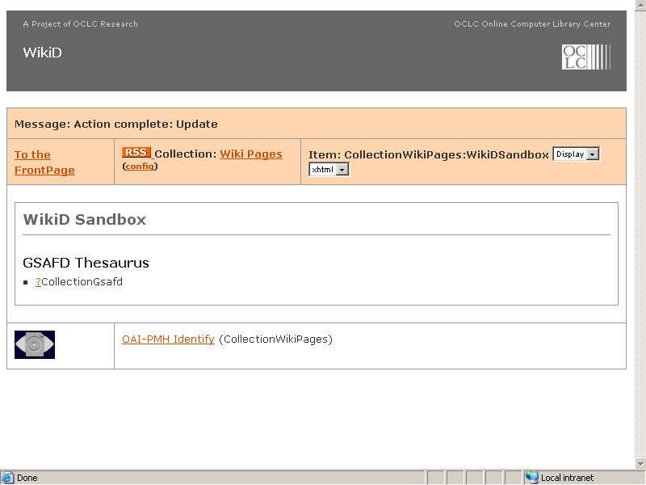

Slide 7
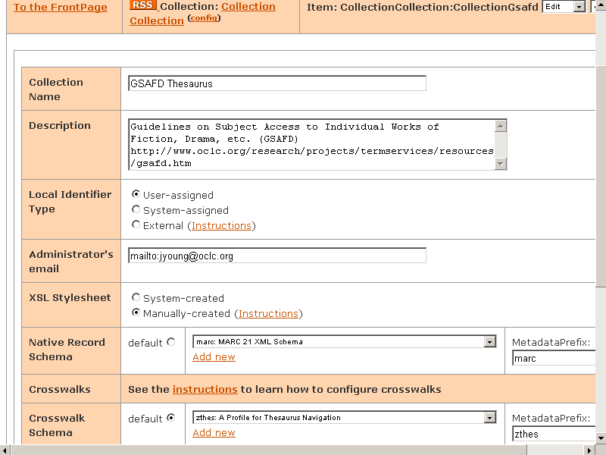

Slide 8
Content Storage Overview
Updates to items in WikiD are written to the fileserver according to the collection’s “native format”
But WikiD can’t intelligently index arbitrary XML, so it creates and indexes metadata instead
Metadata fields: (with their approximate OAI equivalents)
  Persistent item identifier (“local-identifier”)
  Collection identifier (“namespace-identifier”)
  Sort/brief display value (e.g. dc:title or MARC 245)
  Date created
  Date last updated (oai:datestamp)
  Relative URL containing the native record (dc:identifier)
The metadata records for all items in all collections get stored in a single SRU database (and also to the fileserver)

Slide 9
Content Storage Detail: WebEdit
A lightweight open-source web service to transform HTML form submittals into a target XML format
  HTML form fields get encoded in a linear XML structure
    <document>
    <fieldName1>fieldValue1</fieldName1>
    <fieldName2>fieldValue2</fieldName2>
    …
    </document>
  This document gets transformed into a metadata record by an XSL Stylesheet indicated by a hidden form field
  Included in this stylesheet are templates to construct the native record and Base64-encode it as an element in the metadata record

Slide 10
Content Storage Detail: SRU Update
A standards-based web service protocol developed by the SRU community to update XML records in an SRU database
Ralph Levan’s open-source implementation automatically handles the strange version-controlled native/metadata bifurcation described earlier
  Yanks the Base64-encoded native record from the metadata record, decodes it, and stores it on the fileserver
  Inserts the relative URL of the native record back into the metadata record
  Touches the metadata record’s date fields
  Stores/indexes the metadata record in the database

Slide 11
GSAFD Collection Description (Metadata)
Persistent item identifier
  CollectionGsafd
Collection identifier
  CollectionCollection
Sort/brief display value
  GSAFD Thesaurus
Relative URL containing the native record
  2006/01/27/20/inf_3awikid_2fCollectionCollection_3aCollectionGsafd_5f200601272016502020

Slide 12
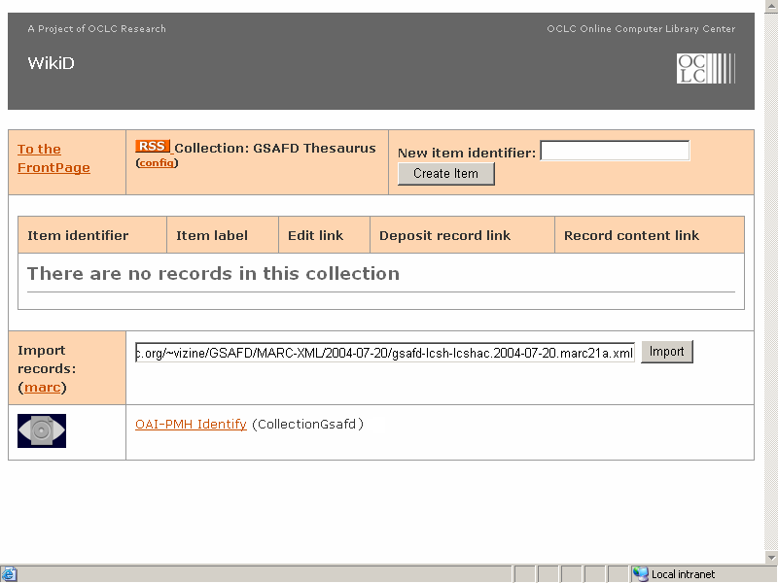
Notes:
At least three ways to add items to a collection:
Create a reference to it on a wiki pages (e.g. “CollectionGsafd:FooBarBaz”) and click on the hotlink
Enter a local identifier in the “New item identifier” field and click the “Create Item” button
If the collection is configured for system-assigned identifiers, the “New item identifier” field will be omitted
Enter a URL pointing to a collection of records in the native format
E.g. an OAI baseURL that supports the native recordPrefix/metadataPrefix (“marc” in this case)

Slide 13
GSAFD Item (Metadata)
Persistent item identifier
  GSAFD000001
Collection identifier
  CollectionGsafd
Sort/brief display value (taken from the MARC 245 field)
  Adventure fiction
Relative URL for the native file
  2005/06/10/23/inf_3awikid_2fCollectionGsafd_3aGSAFD000001_5f20050610232847520

Slide 14
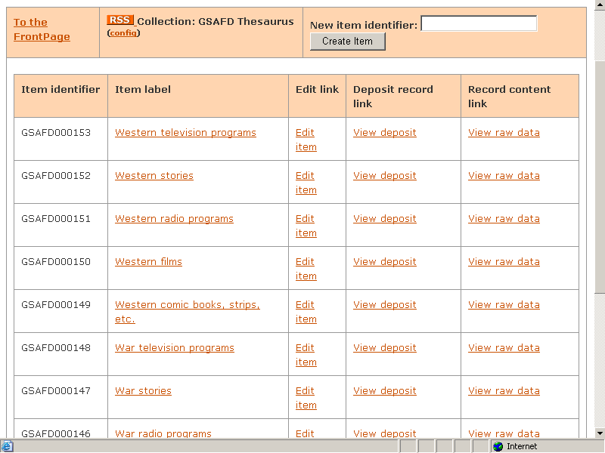

Slide 15
The Need for OpenURL 1.0
SRU is great for interactive searching, but sometimes we want to provide services involving more complex operations
  Dereference the native items in the metadata records
  Perform complex query chains
    Include a pull-down menu of alternative record formats obtained from the collection description record on an item-level record display
  Result transformations
    Crosswalks
    SRU to OAI-PMH
    SRU to RSS
OpenURL 1.0 gives us a single consistent API for performing any and all services that reference these items

Slide 16
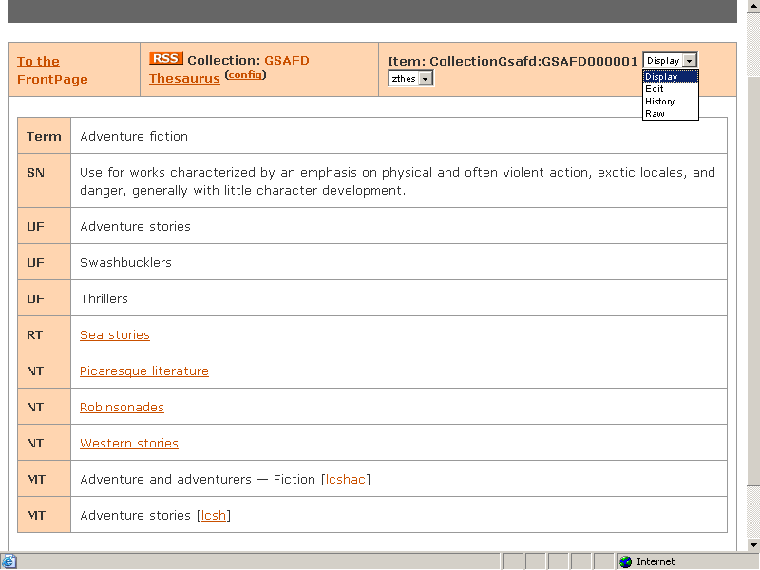

Slide 17
WikiD API
Although the OpenURL 1.0 API can mediate all conceivable functionality, the URLs involved are hideous
  http://localhost:8080/wikid/resolver?url_ver=Z39.88-2004&url_ctx_fmt=info%3Aofi/fmt%3Akev%3Amtx%3Actx&ctx_enc=info%3Aofi/enc%3AUTF-8&rft_id=info%3Awikid/CollectionWikiPages%3AFrontPage&svc_dat=action%3Dedit&rfr_id=info%3Asid/oclc.org%3Areferrer/WikiD
In contrast, the WikiD Servlet accepts wiki-style URLs
  http://localhost:8080/wikid/FrontPage?action=edit
  WikiD performs a simple mechanical mapping into the OpenURL equivalent and hands it off to the OpenURL resolver
Human users will generally prefer the WikiD API, but automated clients might prefer to access the OpenURL, SRU, WebEdit, and SRU Update APIs directly

Slide 18

Servlets and data flows
WikiD
OpenURL
1.0
WebEdit
SRW/U
Update
Pears
DB
Engine
File
system

Slide 19
Reference Links
WikiD project page
  http://www.oclc.org/research/projects/wikid/
WikiD demo
  http://alcme.oclc.org/wikid/
Notes:
Thus endeth the story

