Slide 1
RDF and RDA
declaring and modeling
library metadata

Slide 2
R&D: RDA in RDF or:
Can Resource Description become Rigorous Data?
Karen Coyle
Code4Lib 2008

Slide 3
So…
What Karen said…

Slide 4
Thank you
Any Questions?

Slide 5
So…
What Talis is doing…

Slide 6
Proof of Concept
Show how this technology could make our lives easier
Demonstrate that more rigorously modeled data improves interoperability
Or, at the very least, show something fairly cool
But…

Slide 7
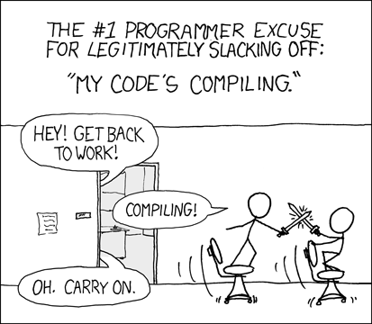
I’m Lazy
XKCD - http://xkcd.com/303/ Randall Munroe

Slide 8
Okay, Seriously
Metadata Normalization
  Is a serious pain in the @$$
  Is continual repetition of effort
  We’re all doing this over and over again
  Aren’t you tired of it?

Slide 9
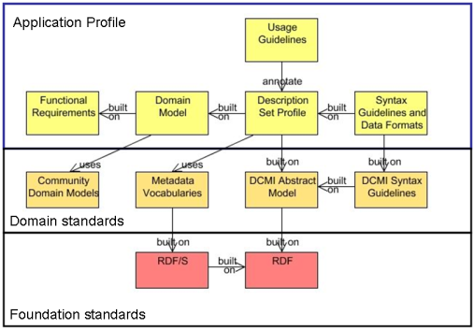
Dublin Core Singapore Framework

Slide 10
Singapore Framework
DCAM
  http://dublincore.org/documents/abstract-model/
Terms, Classes, Properties, Values
  http://dublincore.org/documents/dcmi-terms/
Application Profiles
Description Set Profiles
  http://dublincore.org/architecturewiki/DescriptionSetProfile

Slide 11
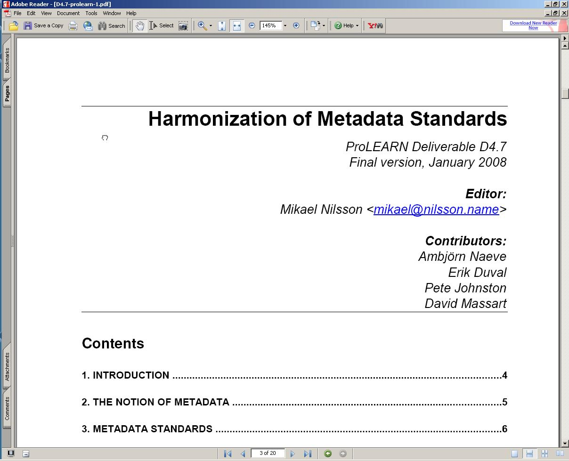

Slide 12
A Distinction
Metadata Harmonization:
  the “ability to use serveral different metadata standards in a single software system.”
Metadata Normalization:
  mapping serveral different metadata standards to a single schema or structure for use in a single software system.

Slide 13
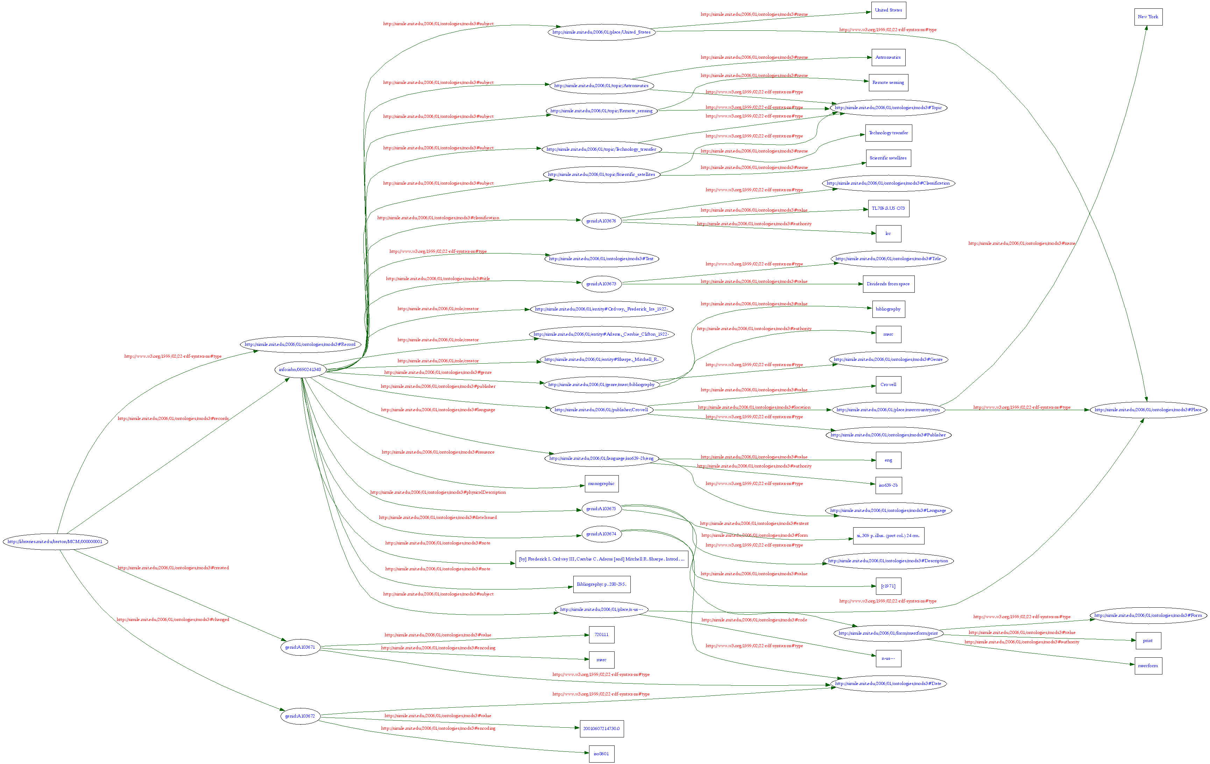

Slide 14
Record Graph
Does not include authority data
Coins new URI’s any non-literal value
Contains a few minor modeling errors
  <modsrdf:Publisher modsrdf:value="Crowell" rdf:about="http://simile.mit.edu/2006/01/publisher/Crowell">
  <modsrdf:location>
  <modsrdf:Place modsrdf:name="New York“
  rdf:about="http://simile.mit.edu/2006/01/place/marccountry/nyu"/>
  </modsrdf:location>
  </modsrdf:Publisher>

Slide 15
Authority Information
Controlled Vocabulary
SKOS for LCSH, Dewey, LCC, Mesh, others
Need a structure for Name Authorities
  Not FOAF
Standard URI’s for concepts and agents
  Possibly for FRBR Entities?

Slide 16
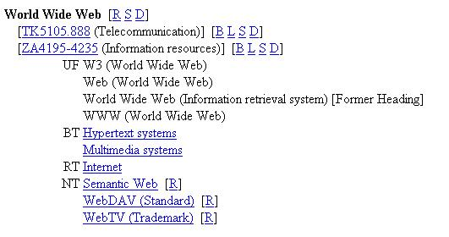
LCSH

Slide 17
LCSH in SKOS
<skos:Concept rdf:about="http://example.com/lcsh#95000541">
<skos:prefLabel>World Wide Web</skos:prefLabel>
<skos:altLabel>W3 (World Wide Web)</skos:altLabel>
<skos:altLabel>Web (World Wide Web)</skos:altLabel>
<skos:altLabel>World Wide Web (Information Retrieval System)</skos:altLabel>
<skos:broader rdf:about="http://example.com/lcsh#88002671" />
<skos:broader rdf:about="http://example.com/lcsh#92002381" />
<skos:related rdf:about="http://example.com/lcsh#92002816"/>
<skos:narrower rdf:about="http://example.com/lcsh#2002000569"/>
<skos:narrower rdf:about="http://example.com/lcsh#2003001415"/>
<skos:narrower rdf:about="http://example.com/lcsh#97003254"/>
</skos:Concept>

Slide 18
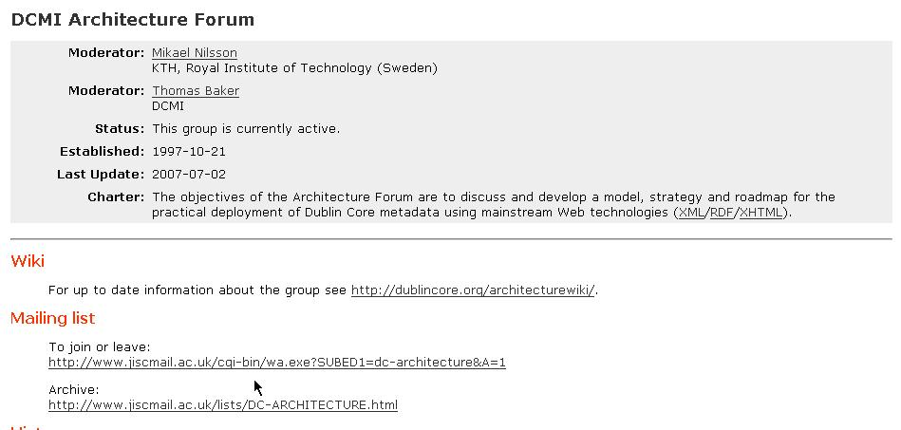
http://dublincore.org/groups/architecture/

Slide 19
DC2008
Berlin, Germany - Sept 22 - 26, 2008
Theme: “Metadata for Semantic and Social Applications”
Call for Papers closes March 30
http://dc2008.de/papers
  Many presentations here that DCMI community could benefit from hearing
  DCMI Community *needs* practical, technical, implementation perspective

Slide 20
Thank you
Any Questions?

