Slide 1
Chasing Babel
Code4lib 2006
February 16th, 2006
Devon Smith, Jean Godby, Eric Childress
{smithde,godby,eric_childress}@oclc.org
decasm on #code4lib

Slide 2
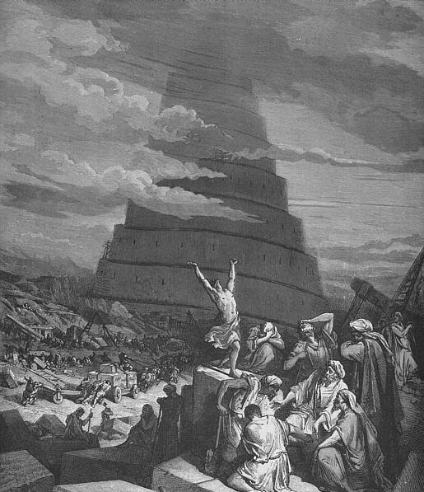
Confusion of Tongues
Notes:
“The Confusion of Tongues“ - Gustave Doré
http://en.wikipedia.org/wiki/Image:Confusion_of_Tongues.png
A quick note about the presentation. I started with a nice linear progression – problem, existing solutions, critique, our solution – then I realized the story wanted to be told differently. So, we’re going to be moving forward, but in a non-linear fashion. You’ll probably be a little confused early in the presentation, but I hope things will clear up as we progress. Let your confusion fuel your curiosity.

Slide 3
Translation Model - Metaphor
A
A
A
A
A
Notes:
This is a metaphorical view of the model we’re using to translate records.
Starting with the square, we take a record and change its shape. The content of the record, however, stays the same.
Then, in the next step, the shape stays the same and the content changes. But it’s just the presentation of the content that changes, not its meaning.
Then again with another translation – another presentation change.
Then, reversing the first step, the shape changes, but the content stays the same.

Slide 4
Seel Stack
Semantic Equivalence Expression Language
Seel
ROMPath
ROM/XML
Record Object Model
Notes:
This is the stack of tools we’re using to translate metadata.
At the bottom, we have “ROM/XML.” That’s Record Object Model, which uses an XML serialization.
Above that, we have ROMPath, which locates fields in ROM records.
Above that, there’s Seel, the Semantic Equivalence Expression Language.
It’s the tool that actually does translations.

Slide 5
Data Landscape
Many schemas
Versions of schemas
Different formats
Non-standard extensions
Application profiles
“Ish” Data – differing uses of standard elements
Homebrew data formats
Notes:
Ok. Back to the beginning of the story. Here’s the data landscape.
First, there are many schemas. Many MARCs, DC, ONIX, EAD, RSS, ATOM, GEM, LOM, plus countless homebrews
Then, you’ve got different versions of those schemas. ONIX 1.1, 1.2, 1.2.1, 2.0, 2.1; GEM 1, 2
Then, you’ve got different ways to serialize, or format, or encode that data. ISO 2709 vs XML vs text vs spreadsheet vs other?
And then there’s the non-standard extensions people often add to their data. DC.creator.name, .address, .email, .affiliation, etc
There’s also application profiles, which are mixes of elements from other standards. GEM, OAI, ONIX Message
Then there’s the case where one source uses one or a few elements consistently, but consistently “wrong.”
We call this “ish” data. That is, it’s MARC-ish, or DC-ish.
And, finally, there are who knows how much home-brew data out there.

Slide 6
Model Landscape - Direct
1
File of records in format X
STRUCTURAL TRANSFORM
&
SEMANTIC TRANSLATION
2
File of records in format Y
Notes:
Here’s the “standard” model for translation. It’s a straightforward mapping of the data, input directly to output.
It has some scalability issues, stemming from the fact that the processing of different things are bound together in a single tool. If you’ve got DC XML to MARC ISO, you’ve got processing that will read XML, write ISO, and encode the semantic mappings - all bound together in a single tool. These are logically distinct, and if separated, potentially reusable. For instance, imagine being able to swap out the ISO writer for an XML writer.

Slide 7
Features of a good model
Reflect the sub-tasks a person would go through to translate data
Minimize effort
Maximize utility
Notes:
After looking at that (those) model(s), we can ask ourselves, what would make a translation model good?
And basically, you want the model to reflect the approach a person would take when solving the problem. Howsoever they would break the task, so should the model.
Now that we’ve looked at that model, lets look at what you want from a translation model.
Basically, you want the model to reflect the approach a person would take when solving the problem. Howsoever they would break the task up, so should the model.
You also want the model to minimize the effort you have to put into translation.
And you want the model to maximize the utility of that effort. You want the biggest bang for your buck.

Slide 8
Translation Model
1
Transform to intermediate form
2
STRUCTURAL TRANSFORM
File of records in format X
SEMANTIC
TRANSLATION
Translate input semantics to CORE
3
CORE
SEMANTIC
TRANSLATION
Translate CORE to output semantics
5
4
STRUCTURAL TRANSFORM
Transform to output format Y
File of records in format Y
Notes:
With that in mind, let’s take another look at our model. This is a literal view of the model.
I’m going to run through it, then come back and explain it.
Starting with your input record, you parse it into an intermediate form,
then you translate the semantics of that record to this Core,
Then you translate again from the Core to the output,
An finally, you create a native syntax version of that record.
That first step reflects very well what a person would do first when translating records. You have to read the data in. The intermediate form is just a uniform structure for records. You really need a single structure for the translation tool to work on, so that the translation task is more managable.
The next thing a person would do is map the input to the output. We don’t do that – directly. Before getting to the output, we translate to this Core first. This is a Core in the “It’s in the middle sense,” not in the Dublin Core “it’s small sense,” and translations will actually be better when the Core is a union. You want all your input data to have a home in the Core. While this deviates from the logical approach a person would take, there are significant gains to be realized from doing so.
In the direct model we saw earlier, you have to create a new map whenever any of the syntax, structure or semantics of your input or output changes. In this model, translation logic is encoded independently of the syntactic processing, and all the input data is normalized into a single structure. That means that you only have to encode a map once, and it can be reused for any number of syntax or structure changes. Using a little combinatorics, the effort you have to expend with the direct model grows as N^2 – N. In this model, the effort only grows as 2N. One translation in, and another translation out. That’s a significant reduction in effort.
Further, when something is mapped to the Core, it is mapped to everything else that maps to the Core. That means that for that 2N effort, you still get N^2 – N utility.
So, in the model, we’ve separated the syntactic processing from the semantic mapping. This allows for the tools to be designed to do their “one thing” very well. It also means that different people can work on different parts of the translation task. One person can work on the native records, while another works on the mapping of the data.

Slide 9
Model – Key Points
Reflect the sub-tasks a person would go through to translate data
  Syntax and semantics processed separately
  Structure normalized
Minimize effort
  2 translation steps
  Effort reduced from N² - N to 2N
Maximize utility
  Mapped to Core → Mapped to everything
  2N effort gives N² - N utility
High degree of reusability
Notes:
Summarizing what I just said, this new model breaks apart the task the way a person would.
It minimizes the effort individuals have to expend to achieve their translation goals.
It maximizes the utility of the effort.
And component reuse is facilitated by this model to a very high degree.
This model is just plain fantastic.

Slide 10
Landscape - Tools
XSLT
XPath
DOM/XML
Notes:
Aside from general purpose programming languages, these are the tools most people are going to turn to for their crosswalking work. As you’ve already seen, that’s not what we’re doing. So, I’m going to hammer on them for a minute. But before I do, I just want to say that I’m beating on them in a particular context – crosswalking. Not styling XML for HTML presentation.

Slide 11
XSLT Stack Critique
DOM models Documents – not Records
Different models for selection and construction
  Reversible?
  Maintainable?
  Query-able?
User-unfriendly : How often is the metadata expert a programmer as well?
Path of least resistance leads to lesser model
Tools not designed for task
Notes:
First, the DOM models Documents, and I’m working with Records. That’s not a huge thing, really, but a tiny alarm goes off in my head when I hear that. Ding Ding Ding, you’re working with something that isn’t modeled in these tools.
Now, XPath is used to get elements from the input. DOM expressed as XML is used to create the output. This dichotomy is the root for the bulk of my critique.
Reversible?
Basically, if you’ve got DC title mapped to MARC 245/a in XSLT, you do not have MARC 245/a mapped to DC title. To get a reverse translation in XSLT, I’d have to use the input XPath to create output, and use the DOM object to select input. It may well be possible to do this. But it would be a serious kludge. Translations are assertions about semantic equality and equality is reflexive. A= B means B = A. In XSLT, I have to encode the same equality assertion twice to get a translation in forward and reverse.
Maintainable? (This is based on our actual experience with XSLT early in this project.)
The XPath makes it relatively easy to see what’s being mapped from the input. But …
Clutter is introduced into your semantic map, by the very nature of having to create a valid DOCUMENT. That clutter makes it hard sometimes for a person to see what the target of the mapping is. Just what am I mapping 521/a to? If you’re working in a group, other people can have a hard time figuring out what your doing. And sometimes it’s hard to remember what you did when you look at it down the road. (Can I get an Amen from the perl coders?)
And when you see crosswalks, they’re expressed in tables. Each row is a self-contained mini-crosswalk. While templates in XSLT allow for some modularity, they only allow for it. It’s left to convention to “enforce” it. It’s entirely possible that templates could be used to obfuscate what the mapping actually is.
Query-able?
We just said it’s hard to see with the eye what the assertions are in XSLT. It’s difficult for a machine to figure them out as well. You might want to do this if you wanted to create a view of the mappings – for instance, a simple HTML table. I think it would be difficult to run an XSLT map through an XSLT stylesheet to get the HTML table. And, even if you could do it, would that stylesheet be reusable across every map?
Also, and I’m teetering on the edge of this presentation’s scope, but imagine a tool that does some processing downstream. It would be great if you could have your tool pick up the output “path” from your map, and copy it to the tool where that process is defined.
User-unfriendly:
Basically, do you want to be the middle-man for every new mapping and for every change to an existing mapping. If at all possible, we’d like the maps to be simple enough for the experts to use, or at least simple enough for an interface to be developed on top of them.
Tools not designed to the task: Yes. Most if not all of use could use these tools to kludge up translations. Many of us have probably already done so. But if crosswalking is a serious part of your work, then kludges aren’t really the best way to go. You want tools that simplify the task of creating and maintaining the maps, in a scalable way. Because DOM, XPath and XSLT were not designed for this task, there’s no reason to think they will provide that for you.

Slide 12
Technology Stacks
(Reprise)
XSLT
Seel
XPath
ROMPath
DOM/XML
ROM/XML
Notes:
Now. Our solution. Our tools.
Just want to refresh your memories.
Record Object Model
ROMPath
Semantic Equivalence Expression Language

Slide 13
ROM/XML
Record Object Model
Set
+
Record
+
Field
(Name)
*
Field
?
Value
Data
(Attributes)
Notes:
The Record Object Model.
This is super dirt simple.
Just like the DOM has elements, but doesn’t dictate what they’re called, so too ROM has fields, but doesn’t tell you what they’re called.
It’s an empty container into which hierarchical fielded data can be dumped.
Basically, you start with a Set.
A set contains 1 or more Records.
A record contains 1 or more Fields.
A field has a name (which exists in a namespace).
And fields contain zero or more subfields.
A field can also optionally contain a Value.
A value contains data and attributes of that data.
Note, a field can have subfields and a value.

Slide 14
Seel & ROMPath
Simply and clearly equated
Reversible
Maintainable
Query-able
Atomic maps
  recombinant for application profiles
Cascading maps
Notes:
ROMPaths work on ROM the way XPath works on DOM – by selecting fields from the record for processing. You can select on a field’s name, position, value or attributes. No big surprise. However, ROMPaths do something that XPaths don’t – they can be used to construct fields in a record. They are used to locate fields in the input, and also in the output.
Seel maps simply and clearly put two ROMPaths in equality. Basically, Seel takes two ROMPaths, and asserts that they are equal.
Because of this, Seel maps are reversible. Previously, we’ve quoted 2N as the number of maps that have to be written to or from the Core. With a reversible translation tool, that gets cut in half. N.
The straight-forward manner in which the equality is stated makes these maps easily maintained. Each map is completely atomic, so each can be worked on independent of the others, and independent of extraneous “document” structure.
ROMPaths are simple and regular, and are clearly delineated from other parts of the map, so it’s quite easy to extract the basic logic from the maps, for reuse in other situations.
The atomic nature of the maps means they can be separated and recombined as needed to translate mixed up data.
Seel has been designed so that maps cascade. You can import the “standard” MARC to Core maps, and redefine only the ones that are Ish for a particular data stream. All the others will be applied normally.
Admission: Now, Seel and ROMPaths are expressed in XML. That means it’s unlikely that metadata experts are going to work directly in Seel. Mea culpa. But, because ROMPaths work double duty and because maps are atomic, the Seel model lends itself to a simple, table oriented interface. We don’t have one yet, but I’ve started looking at using, get this, XSLT to make HTML from Seel, which we may be able to use later, with AJAX, to create an interface.
That’s our tools. In a nutshell.

Slide 15
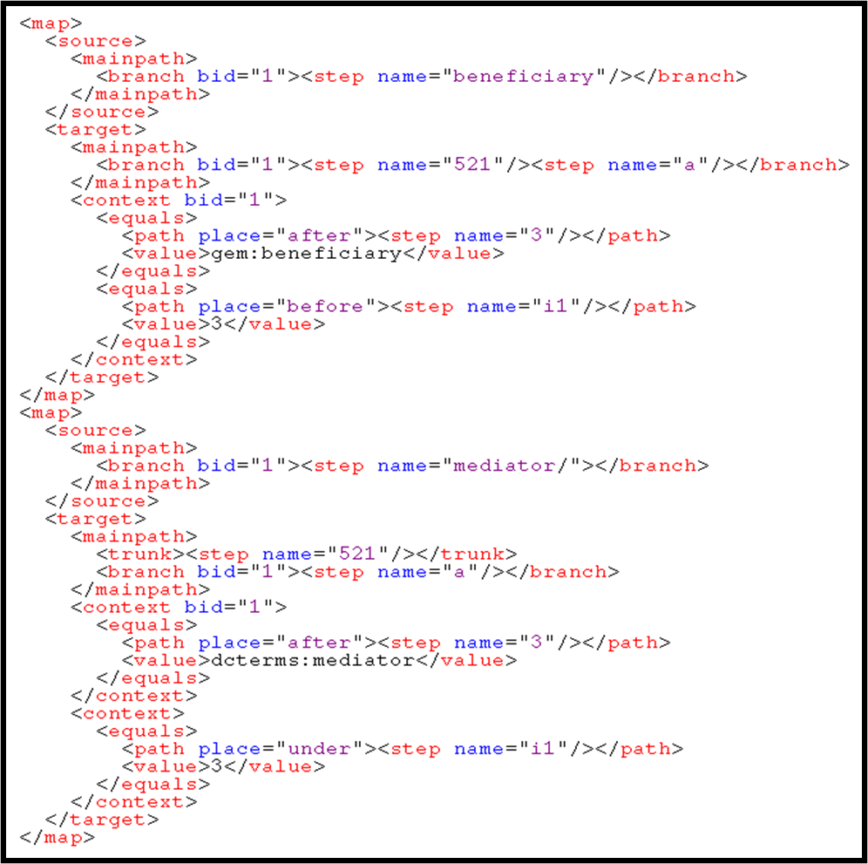
Seel Map = Crosswalk Row
GEM | MARC | Special instructions
Benbeficiary | 521 $a | i1 = 3; 521 $3 GEM: beneficiary
DC | MARC | Special instructions
mediator | 521 $a | i1 = 3; 521 $3 dcterms:mediator
Notes:
Here’s an example of Seel. There are two maps here.
And each one encodes what a person would express in a table format.
<click>
The table shows that the GEM element “beneficiary” maps to the MARC 521/a element. In the source element is a ROMPath that locates the beneficiary element in the input record. And, in the target is another ROMPath that locates 521/a in the target. The table also has a special instructions column, which here set’s an indicator, and a subfield 3 to indicate where the data came from. The information is captured in this context section. The context can be used to set any additional fields as needed to make the equality assertion true.
<click>
Here’s the table equivalent to the lower map. It maps the Dublin Core mediator element to 521/a as well, and also sets the indicators and the subfield 3, as before.

Slide 16
Status
Tools are being used in production
Moving forward with two translation model
Development continues on all fronts
http://www.oclc.org/research/projects/mswitch/1_schematrans.htm
Notes:
No, none of this is open source. It’s closed by default, but we’ve had discussions, and no final decisions have been made.

Slide 17
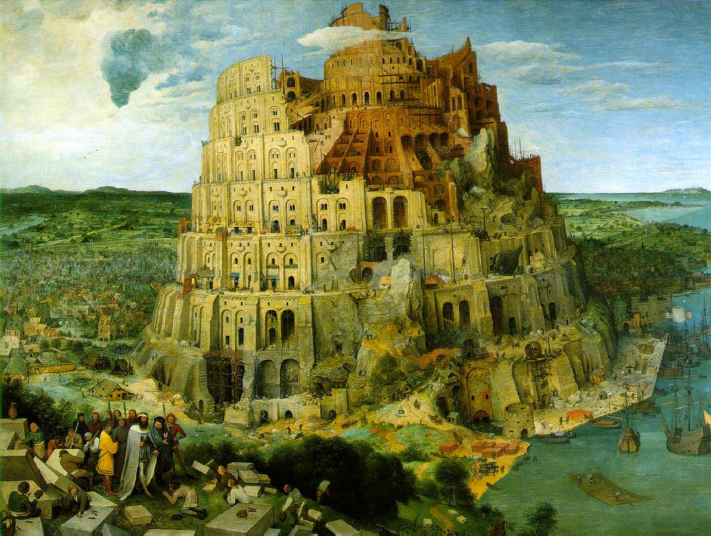
The Tower of Babel
Notes:
“The Tower of Babel” - Pieter Brueghel
http://commons.wikimedia.org/wiki/Image:Brueghel-tower-of-babel.jpg

Slide 18
Breakout?
Interesting possibilities in the model
Comparisons – XSLT & Seel
Core theoretical
“Coreground” processing
Seel interface
Native record reading and writing
More detail about implementation
Notes:
Interesting possibilities in the model
Stel, merging
RSS/Atom stuff??
Comparisons – XSLT & Seel
Core theoretical
communities of practice
grand unified metadata set
“Coreground” processing
Enhance, extend, improve, combine
Seel interface
swing gui, ajax
Native record reading and writing
record builder, Java classes, perl code
More detail about implementation
java impl, XML parsing of embedded parts, interpreter processing model
Examples
morfrom, morpath, seel
updated versions and old version

