Slide 1
XForms for Metadata Creation
Winona Salesky
University of Vermont
Michael Park
Brown University

Slide 2

The Problem
Notes:
The Center for Digital Initiatives at UVM, is fairly small, much of the work done for the creation of collections is spread over existing library departments, this includes much of the cataloging work. Generally speaking the collections selected for inclusion in the CDI are largely selected from the special collections department and most of them have no catalog records, or at most a collection level catalog record. For the CDI this means that in order to distribute the metadata creation to the library cataloging staff it was necessary to create a form or series of forms to allow users with no XML experience the ability to create metadata records.
Additionally development time was an important consideration. In order for us to use the system I had selected (a native XML database), it was necessary to have some way of allowing catalogers to enter records into the system quickly, this would keep me free to do development, and still keep the project growing.
Our choices were limited by time/knowledge – I’m an XML person, I don’t know java, and I’d rather avoid javascript if at all possible. What we/I did have was strong skills in XML related technologies, XSL/XPATH/XQuery

Slide 3

Enter XForms
“XForms is an XML application that represents the next generation of forms for the web.”
- XForms 1.1 Specification

Slide 4
XForms - the highlights
- Platform and device independent
- Separates data and logic from presentation
- XML in, XML out
- XML Schema validation
- Reduces or eliminates the need for scripting
- Does not require expensive round-tripping when the data is modified
Notes:
XForms offers some distinct advantages of traditional forms, but also some drawbacks, such as limited browser support. What made XForms worth the effort for me was that it is built to handle XML data. Considering the heavy/exclusive use of XML and XML based technologies in the CDI, XForms seemed like a perfect fit.

Slide 5
Anatomy of an XForm
The Model
<xforms:model>
<xforms:model>
<html>
  <head>
  </head>
  <body>
  </body>
</html>
<xforms:instance/>
<xforms:bind …/>
<xforms:submission …/>
The User Interface
<xforms:input/> <xforms:output/> <xforms:text/> <xforms:select1/> <xforms:repeat/>

Slide 6

Firefox XForms Extension
Notes:
I chose to use the firefox extension for our xforms implementation largely because of the quick development time and ease of integration into our existing platform. Also, I had a captive audience who I could be assured would be using firefox and the extension. Obviously not the case for everyone. I have been really happy with the extension though, and the recent implementations of some of the 1.1 specs. Mike is going to talk a bit more about server side solutions for XForms.

Slide 7

Demo
Notes:
Originally the CDI started out with Dublin Core records. Part of the reason we selected Dublin Core for our initial collections was the simplicity in creating XForms for Dublin Core. However, with the increased support for XForms 1.1 specs it became possible to move to a more complex record type. So we implemented a MODS form. The most significant improvement of 1.1 for the development of the MODS form is the ability to insert elements/nodes from a "template" instance into the main instance. This allows for the creation for the creation of a simple interface to a complex full implementation of MODS...
We do not generally start with a blank record, usually there is some preliminary metadata entered by the scanning technician about the item as it is scanned. Thus when the form enters the metadata queue it looks like this:
As you can see we allow for optional elements and attributes to be inserted, judicious use of select menus allow us to exercise control over fields and attributes with specific values. The use of dynamically updated instances allows us to use authority control for fields such as names and subjects. We store authority records as MADS records in the database, and the records can be searched and then inserted into the MODS record.
The form has now been in production for the past 3 months. we have created nearly 500 original records for a photograph collection in special collections.

Slide 8
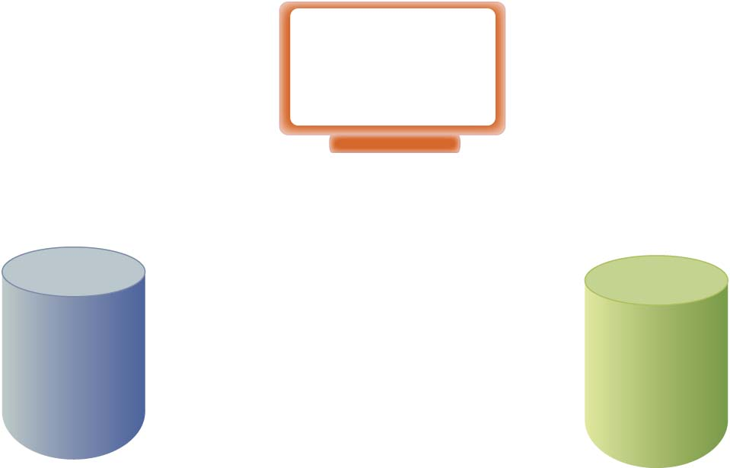
Putting it all together
Firefox Browser
MODS XForms
REST
REST
eXist
Solr
Notes:
A quick overview of the CDI architecture and how XForms ties into both our native XML database and Solr.

Slide 9
More Info
- Code:
  http://code.google.com/p/xforms4lib/
- Examples:
  http://cdi.uvm.edu/exist/xforms/mods
  http://cdi.uvm.edu/exist/xforms/modsSimple
- Blog:
  http://thedil.wordpress.com/category/mods/

Slide 10

Build a web-based XML editor ?!
Notes:
The Brown Center for Digital Initiatives needed a custom MODS XML editor to fit very specific requirements.
There were no available open source solution to fit our needs.

Slide 11


Why a MODS Editor ?
Metadata
Digital Repository
Notes:
We’ve begun the design of an Institutional Repository and need a way to collect metadata for the repository.
The tool will be for non-librarians (mostly faculty) to enter descriptive metadata about the digital assets they’ve deposited.
The current MODS editor is a desktop application that is very specific to the library and used by librarians.

Slide 12
Requirements
- Web-based
- Simple UI
- Support complex metadata
- Enforce correct data input
- Easily maintained
Notes:
Many users (faculty) on/off campus.
We only need to collect a certain minimum amount of metadata – make UI easy to enter the minimum required data.
Some faculty will want to enter larger amounts data – allow for optional metadata.
Control the accurate input of data as much as possible via choices and dynamic interaction – they are not librarians.
One place to maintain authority lists and selection values.

Slide 13

Demo
Notes:
Not in production yet – one piece of our new architecture.
Interactive – you can immediately see if a field is valid, etc.
Set focus
Read Only – submit button
Relevant
Required fields
Typing – field types
Submission is bound to validation of fields and required constraints
Help & hints
Repeat, Insert, and Delete elements
Toggle views
Pre-populated values

Slide 14

XForms – which one ?
- Architecture
- Implementation
Client
Server
Notes:
Now you’ve seen it I’ll explain how it was created.
(XForms is a specification by the W3C). I had to chose an XForms processor.
Decision – will the processor live on the client-side or server-side?
I had to chose server-side because of the potentially large number of external users.
Can’t expect the users to install plug-ins or extensions. Needs to work in standard web browsers.
There are only 2 open source server side options – Chiba or Orbeon.

Slide 15

Why Orbeon ?
- Robust open source web app
- XForms engine for Java applications
- Documentation
- Active community
- AJAX technology
- Widgets
Notes:
Orbeon is an extremely robust open source solution. It lets you build enterprise level forms by leveraging all the available XML related technologies.
Fairly steep learning curve because it is so robust.
I’m a Java programmer so the option to use their XForms engine in a Java web application appealed to me.
Plenty of documentation. Examples and tutorials to demonstrate all the features available.
The Orbeon developers are constantly improving it. Latest version is very stable. Supports the most current XForms specification, 1.1.
Uses AJAX technology so you get a desktop-like application feel to your application.
Orbeon has many useful extensions - inspector widget. Allows you to see your xml instances as they’re being updated so you can debug.

Slide 16


How it all works
Orbeon
eXist
XML
REST
AJAX
MODS editor
Notes:
Orbeon uses AJAX technology to create an interactive MODS User Interface.
The MODS records are stored in the eXist open source XML database.
With eXist and XForms you can leverage REST services. The XForms submission supports REST and eXist offers a REST API to perform the usual DB operations.
(This allows the metadata to be accessed by other apps. i.e., metadata librarian review.
With XForms it is easy to make an HTTP PUT and GET to create and edit MODS records. )

Slide 17
XForms - the downside
- It’s all XML !
- Appears large and complicated
- XForms is not a Web standard
- Implementations aren’t there yet
Notes:
There is plenty of downside.
It requires knowledge of XML (especially XPATH) – along with XPATH and XML Schema.
XForms can seem inordinately large and complicated at first - steep learning curve.
It's still a relatively new specification, seeing mostly early-adopter use. No native web-browser support yet. It requires additional software, plug-ins or extensions.
Most implementations don’t support the full XForms specification and still have bugs.

Slide 18

XForms - the upside
- XML, XML, XML
- Create an entire application
- No scripting
- Strong typing
- Interactive UI
Notes:
XML is at the heart of the language. It’s a means to manipulate and validate XML.
More than a web language. It’s a way to create an entire application.
You get all the features of your typical application with no scripting. Instead, you focus on the XML model.
Strong typing allows for easier input validation.
Most of all, you can create a sophisticated User Interface.

Slide 19
The MODS editor Code
- Code and documentation:
http://dl.lib.brown.edu/its/software/metadata/
- Example:
http://riker.services.brown.edu:8080/repo/mods/demo.html
- Questions:
michael_park_1@brown.edu
Notes:
Still in Dev
I have posted the code and documentation on the Brown Center for Digital Initiatives website.

Slide 20


