Slide 1
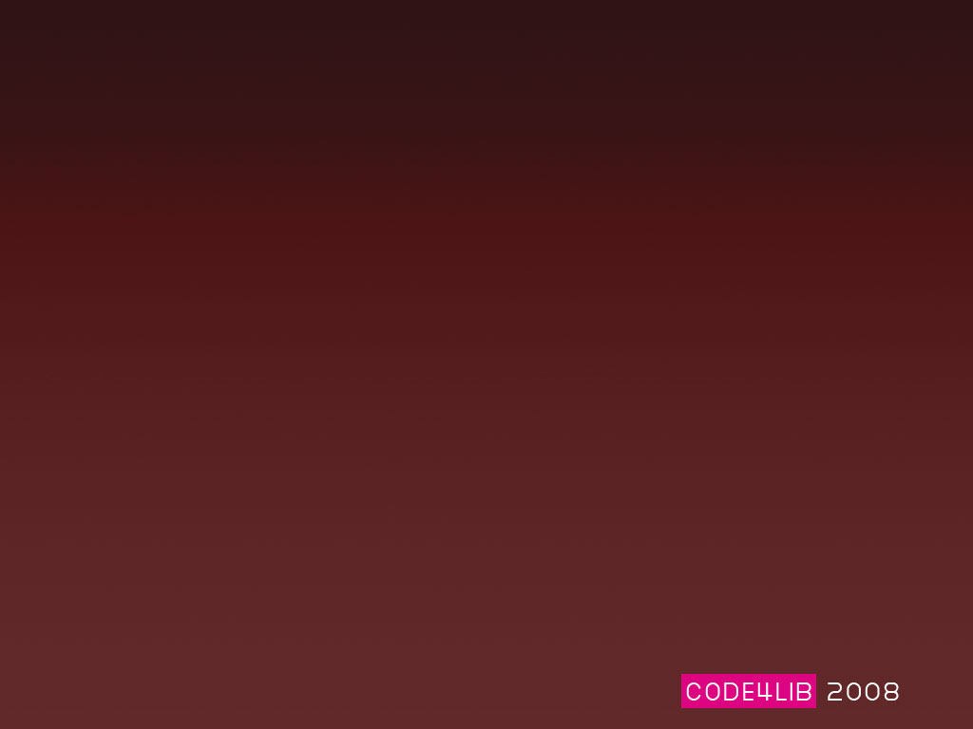
Using a CSS Framework or
How to spend less time making CSS layouts and more time at the Tugboat Brewpub
Chris Barr, Villanova University

Slide 2
Play along at home. http://vufind.org/demo/css/layout.css

Slide 3
Framework
“a set of tools, libraries, conventions, and best practices that attempt to abstract routine tasks into generic modules that can be reused.”

Slide 4
Why we use a CSS Framework?
Normalize code base
Well documented
Browser compliance (with some hacks baked in)
Easily create multiple layouts
We’ve got better things to do than finding novel ways of creating columns

Slide 5

Yahoo User Interface Library

Slide 6
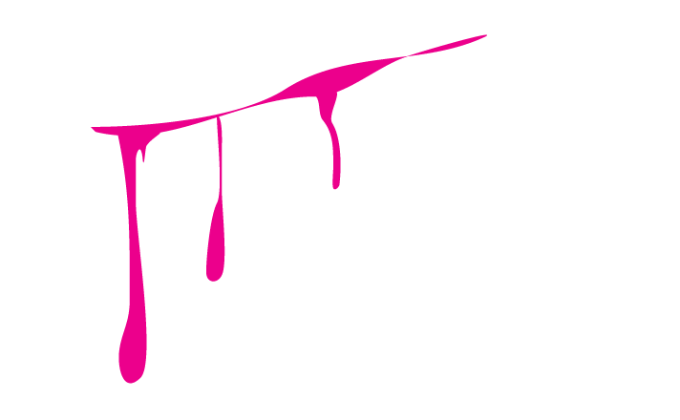
Microsoft? User Interface Library

Slide 7
What we like about YUI
4 standard size layouts out of the box
Ems based (nice zoom layouts)
Source order independence
A-grade browser compliance
BSD License

Slide 8
The YUI CSS Files
Reset.css
Fonts.css
Grids.css
And a helper… base.css

Slide 9
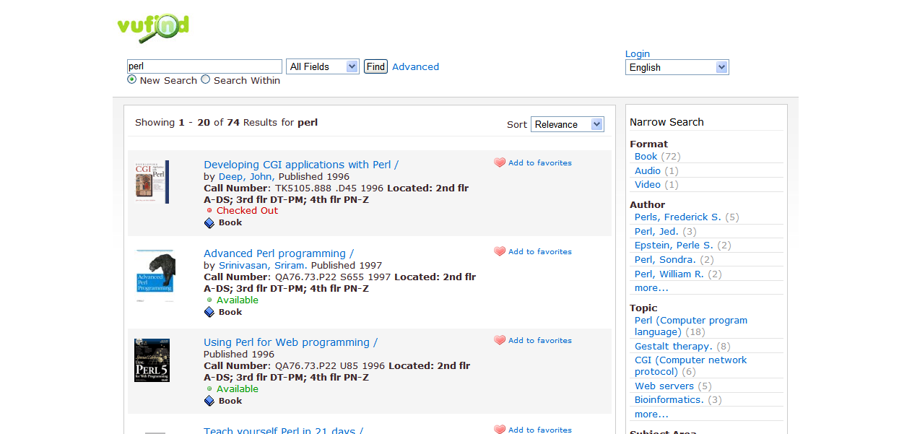

Slide 10
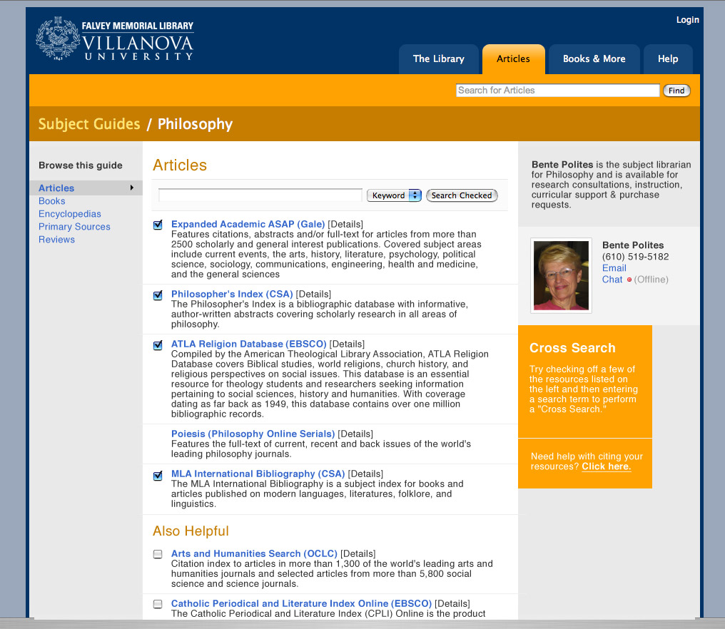

Slide 11
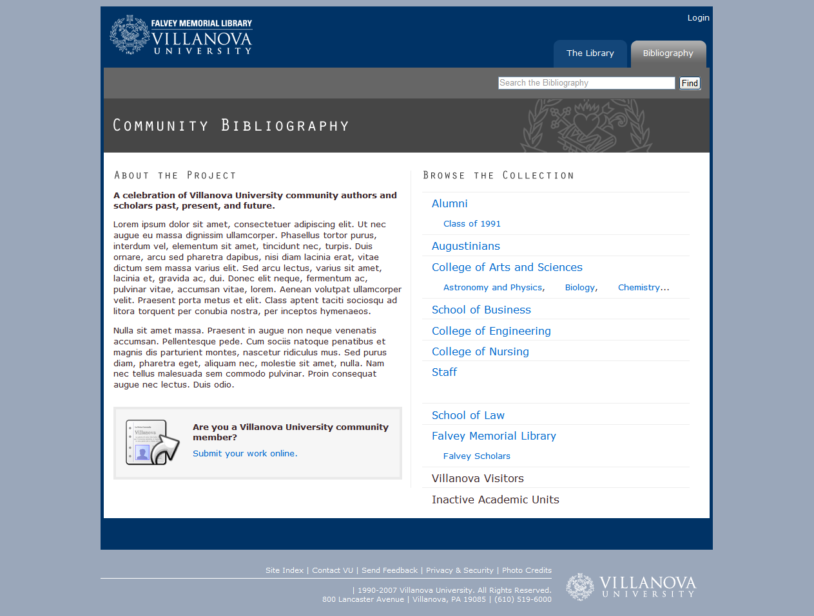

Slide 12
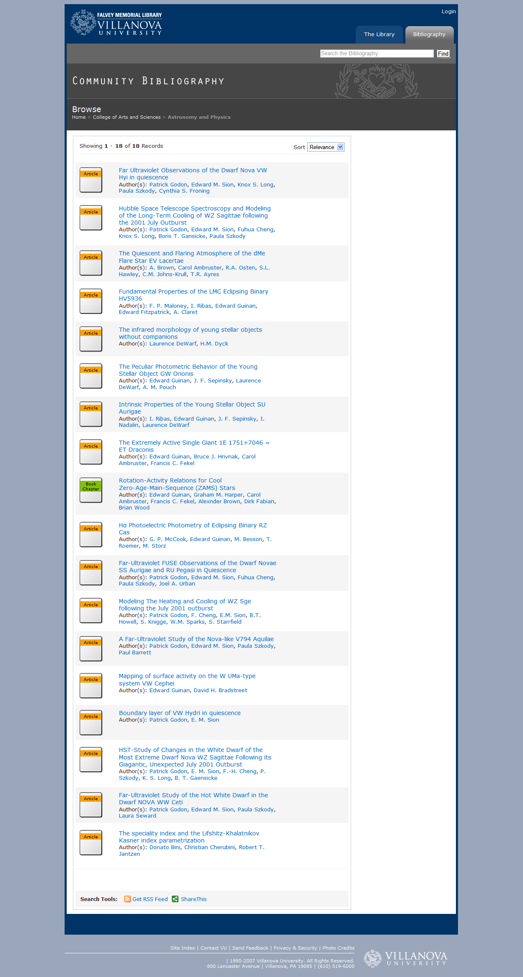

Slide 13
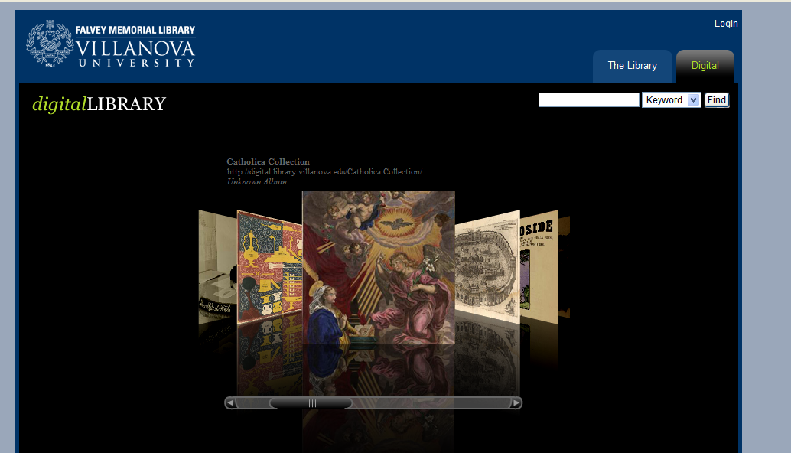
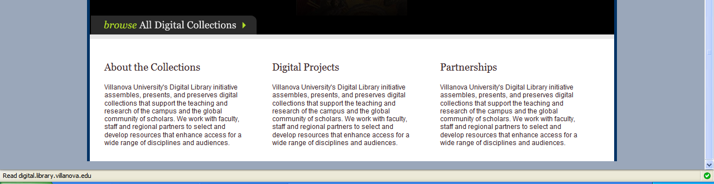

Slide 14


Slide 15
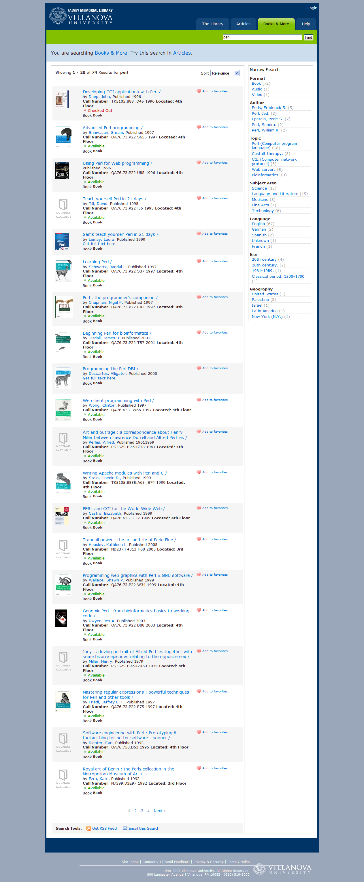

Slide 16
Let’s play!

