Slide 1

Bill Erickson, Systems Developer
Jason Etheridge, PINES System Support Specialist
Brad LaJeunesse, PINES System Administrator
Mike Rylander, Database Developer

Slide 2
A Quick History of the PINES Consortium
Started as a Y2K project.
  Many libraries were running on antiquated automation systems.
  Some libraries were still manual!
Additionally, the idea of a “statewide library card” had been gaining political support.
Joining PINES is completely voluntary and free to the library system.

Slide 3
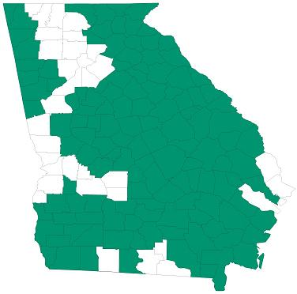
The PINES Consortium Today
~250 Libraries
~8 Million Holdings
~1.5 Million Patrons
~15 Million Annual Circ

Slide 4
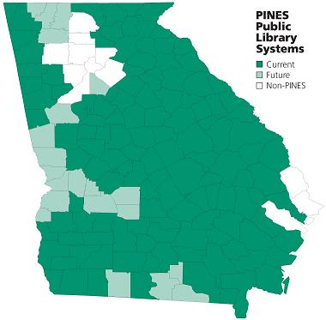
The PINES Consortium Tomorrow
~300 Libraries
~10 Million Holdings
~2 Million Patrons
~25 Million Annual Circ

Slide 5
PINES Management
Policies are defined by the PINES Executive Committee, an elected body of library directors.
The Georgia Public Library Service (Georgia’s state library) provides helpdesk support, systems administration, and training, creating an economy of scale.

Slide 6
So, Where Does Evergreen Come In?
The end of the contract with our current ILS vendor was coming up, and we knew we were not happy with what we had.
We invited the major ILS vendors to Atlanta for demonstrations and talks.
Afterwards, we decided to explore the possibility of doing it ourselves.

Slide 7
The Evergreen Solution
Open-source software, released under the GPL.
  We did not want to develop just another homegrown ILS. We want Evergreen to spread beyond Georgia.
Designed from the ground up to support and scale to a state-wide library consortium.
Assembled a team to design and develop the software.

Slide 8
In the beginning…

Slide 9
Genesis 1:1
Step outside the library world for a moment, and examine library data and procedures.
  Is the data driving the procedure, or is the procedure driving the data?
  From this, we learn that the data and the procedures are orthogonal.
  Do these processes REALLY make any sense, or are we just doing this because it is what we’ve always done? Librarians are great at making up workarounds that then get grandfathered into procedure.

Slide 10
Genesis 1:2
Choose from existing and develop new policies that actually meet the needs of the consortium.
  Importance of focus groups, consisting of librarians that work the circ desk, do the cataloging, know the workflow.
  “Pretend it is magic”
Design data containers that model the chosen policies.

Slide 11
Genesis 1:3
Find existing open source software that provides needed functionality.
  Postgres Database
  Apache Webserver
  XUL/Mozilla Framework
  Jabber (XMPP)
  Ed Summers
  And a bunch of other packages…
Then build what could not be found.

Slide 12
Surf’s up. (OpenSRF)

Slide 13
OpenSRF (“open surf”)
Service Request Framework.
OpenSRF Router provides failover and load balancing.
Server libraries exist in Perl and C, client libraries exist in Perl, C, and Javascript.
Provides an HTTP gateway for secure, scalable remote access.
Allows for the development of additional gateway interfaces, such as the Open-ILS XML gateway.

Slide 14
OpenSRF Communication Overview
App Server
Jabber
App Server
Client
App Server
Jabber
Router
All app server processes connect to the jabber server.
All server processes register with the jabber router
All requests for a given application will be directed to the jabber router and routed to the next server process
The app server will then respond directly to the client, at which point the client has the option to keep the OpenSRF session open for stateful communication.

Slide 15
OpenSRF Applications
Each OpenSRF application implements a specific set of logic.
  open-ils.storage
  open-ils.auth
  open-ils.search
  Etc…
Application logic is exposed via a registered API.
  open-ils.auth.session.retrieve
  open-ils.storage.cachable.direct.metabib.author_field_entry.search_fts.field.atomic
  Etc…

Slide 16
OpenSRF Methods
Create a useful function.
Language-specific idioms provide method parameters, metadata, and a client response handle.
Register the method with the local OpenSRF application instance.

Slide 17
Benefits
Provides extensible framework, unlike traditional “black box” ILS modules.
Allows developers to focus on their primary objective: implementing business logic.
What you get for free:
  Network communication
  Fault tolerance and load balancing
  Method call parameter validation
  Centralized Logging
  API publishing and revision control
  Session management
  Object caching and persistence
  Centralized application configuration
  And tons more…

Slide 18
For example…
open-ils.supercat
  Leverages published open-ils.storage and opensrf.settings API’s.
  Provides access to alternate formats of bibliographic records.
  Provides structured access to Open-ILS metarecords.
  Basis for publishing interfaces for unAPI, OpenSearch, Bookbag, etc.
  …initial version written in an afternoon.

Slide 19
Development Schedule
Alpha Release: July 2005
Beta Release: Spring 2006
Production Release: Summer 2006
PINES “go-live”: September 2006

Slide 20
Questions?

