Slide 1

Fedora 4
The Incredible Shrinking Repository
Esmé Cowles
Code4Lib • Raleigh, NC • 2014-03-26

Slide 2
Confession

Slide 3

Fedora is a popular repository

Slide 4


...the foundation of Hydra and Islandora

Slide 5
...used by many august institutions

Slide 6

...but not by UC San Diego

Slide 7
Repository Development
UCSD DAMS Repository
Partial clone of Fedora 3 REST API
Hydra Head frontend
  https://github.com/ucsdlib/damspas/

Slide 8
Fedora 4
Working on Fedora 4
Unlikely spokesman for Fedora
...but maybe a good spokesman for Fedora 4

Slide 9
Big Promises

Slide 10

Performance
REST API can handle files of any size (tested up to 1TB)
Millions of objects
Ingest performance
Clustering
Photo: http://www.flickr.com/photos/laurenprofeta/3223035171

Slide 11

Flexibility
Hierarchy
Multiple storage backends
Asynchronous I/O planned
Policy-driven storage
Pluggable auth
Photo: http://www.flickr.com/photos/mikecogh/7970493050

Slide 12
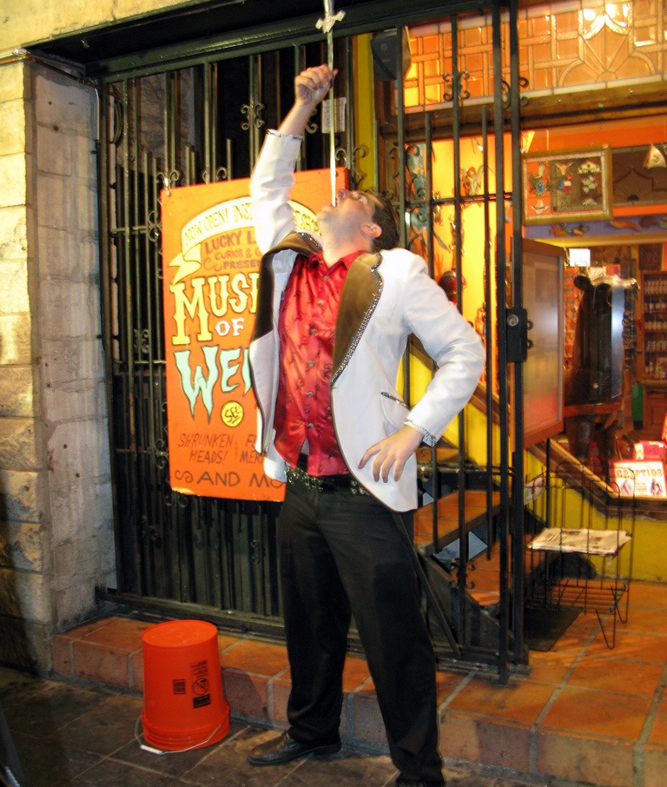
Federation
Filesystem federation
Fedora 3 federation
Pluggable
Photo: http://www.flickr.com/photos/jairus/3353333656

Slide 13
RDF
Fedora 4 is not a triplestore
But it speaks RDF
Metadata everywhere
SPARQL query and updates
So...

Slide 14

Indexer
Triplestore (Jena, Sesame, ...)
  SPARQL Update
Solr & Elasticsearch
Pluggable
Photo: http://www.flickr.com/photos/96208357@N00/5598956842/

Slide 15
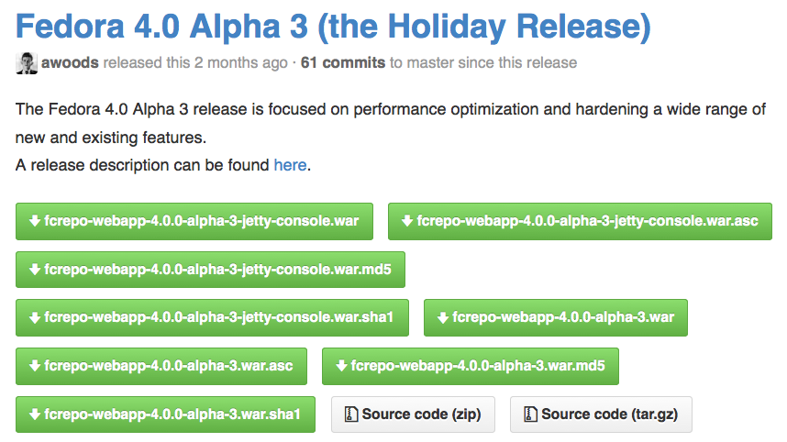
Easy
One-click install
Easy to run in Tomcat, Jetty, etc.

Slide 16

The Future
Alpha 4 just released
github.com/futures/fcrepo4/releases
Beta release in June
4.0 release
Photo: http://www.flickr.com/photos/louripperts/8221292621/

Slide 17
Join Us
Github:
http://github.com/futures/fcrepo4/
Wiki:
https://wiki.duraspace.org/display/FF
Mailing List:
https://groups.google.com/group/fedora-tech
IRC:
#duraspace-ff

