Slide 1
E-Matrix : an [open source] ERM
Emily Lynema
NCSU Libraries

Slide 2
What does it do?
ERM -> ERasM (emphasis on seriality)
FRBR-ish data model
Load/Merge data from external sources
  Unicorn, SFX as authoritative data sources
  Upload COUNTER, impact factor, list price, LJUR
Licenses, contacts, notes, evaluative data, notes
Organization name authority
Local subject hierarchy mapping
Notes:
Includes: journals, newspapers, monographic series, article databases, packages
Using our ILS as an authoritative data source means we can bring in serials like government docs that are loaded into the catalog with URLs, but aren’t in the knowledgebase.
Local journal utilization report<number>

Slide 3
What does it do?
Modular design
  synchronizers export and re-format external data
  core application for staff
  web services make data available to applications on the library web site
Focus on integration with discovery tools
  Journal list (print & electronic), Database list (subject-based, A-Z), Browse Subjects, Catalog

Slide 4
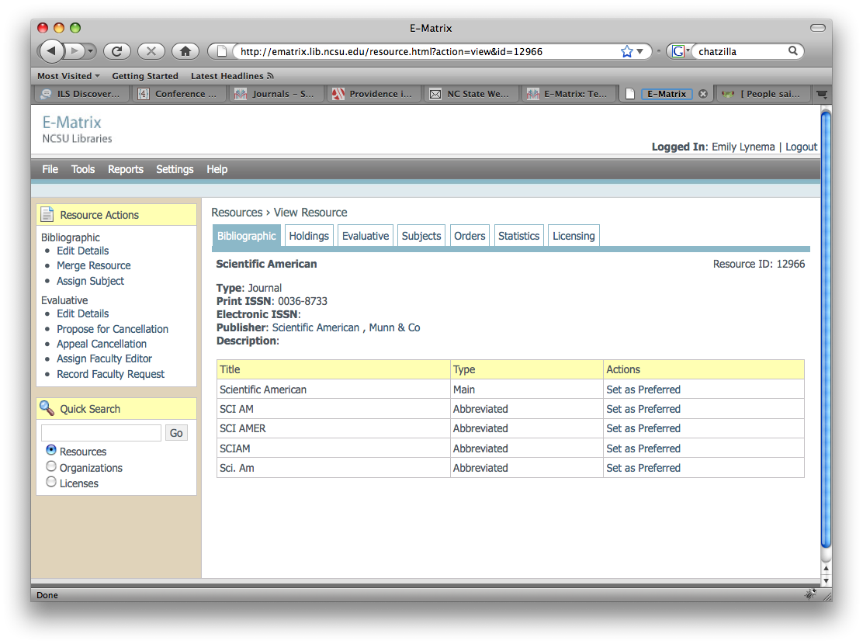

Slide 5
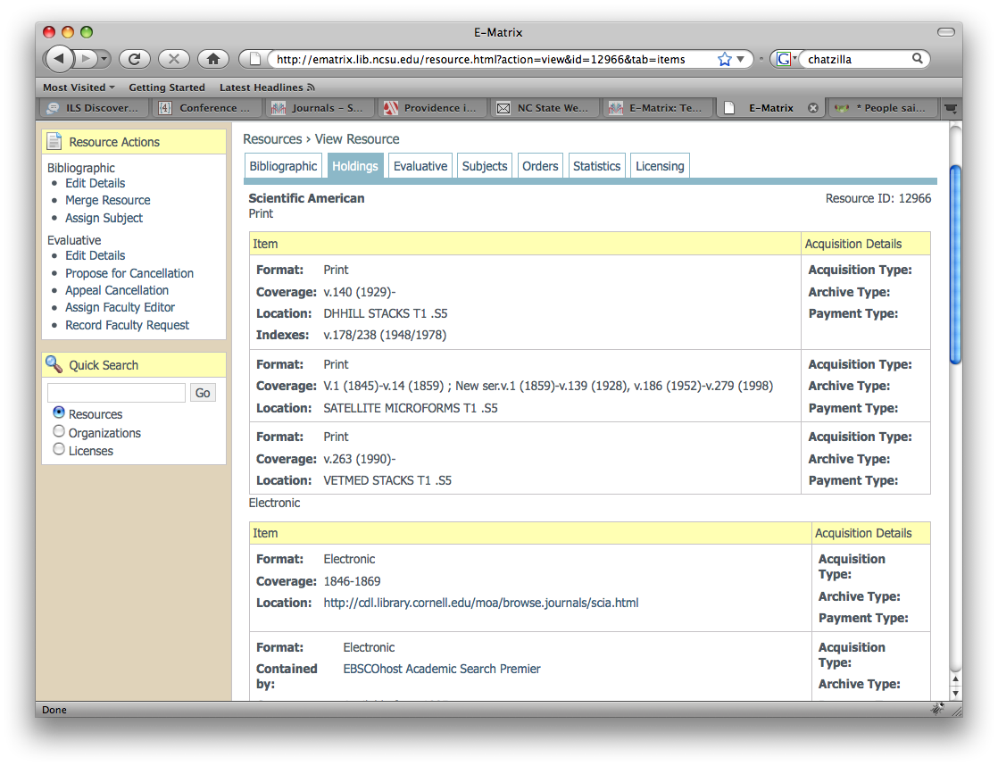

Slide 6
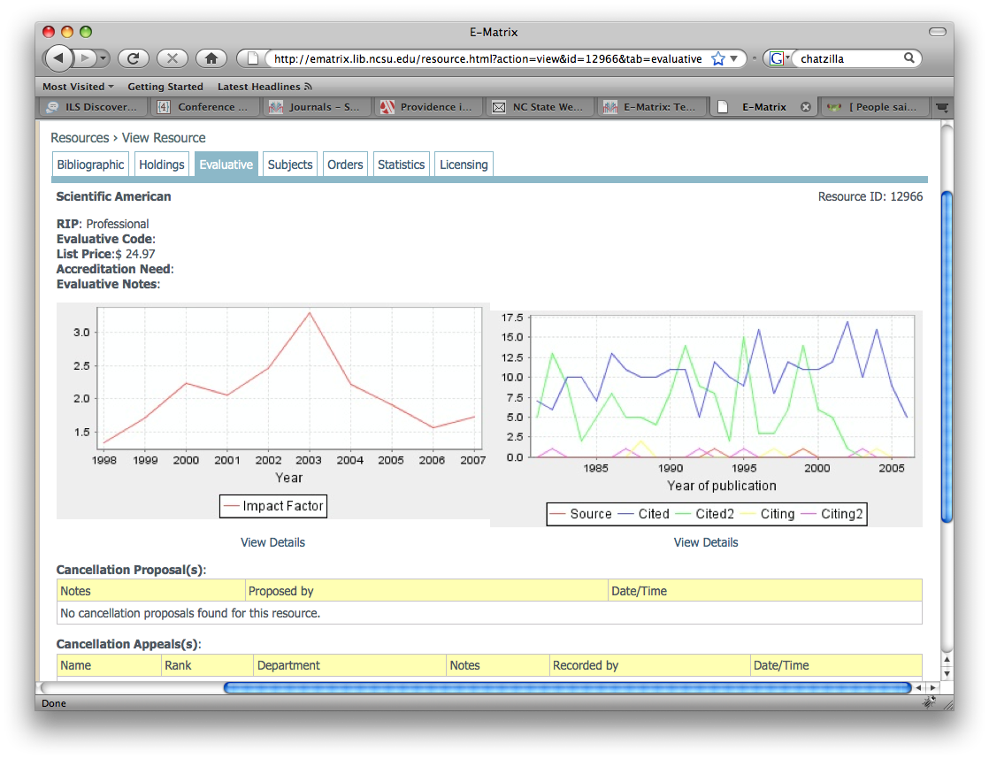

Slide 7
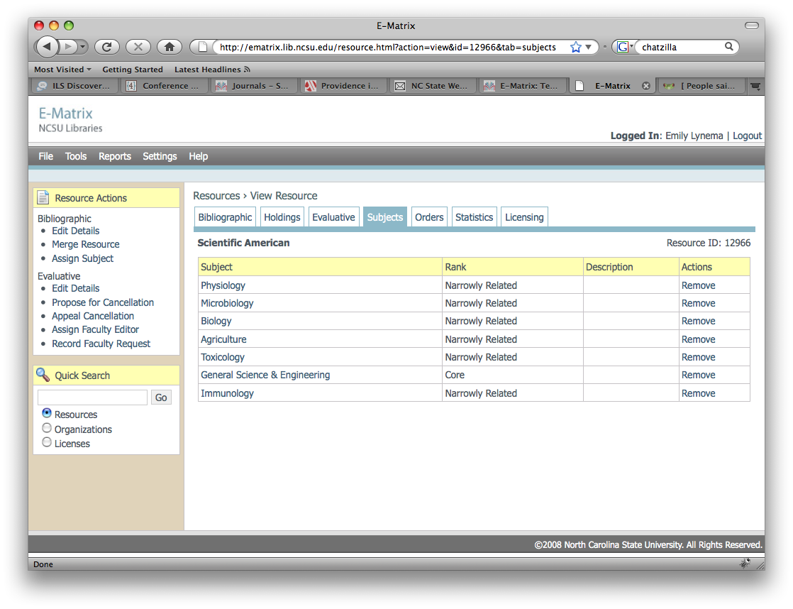

Slide 8
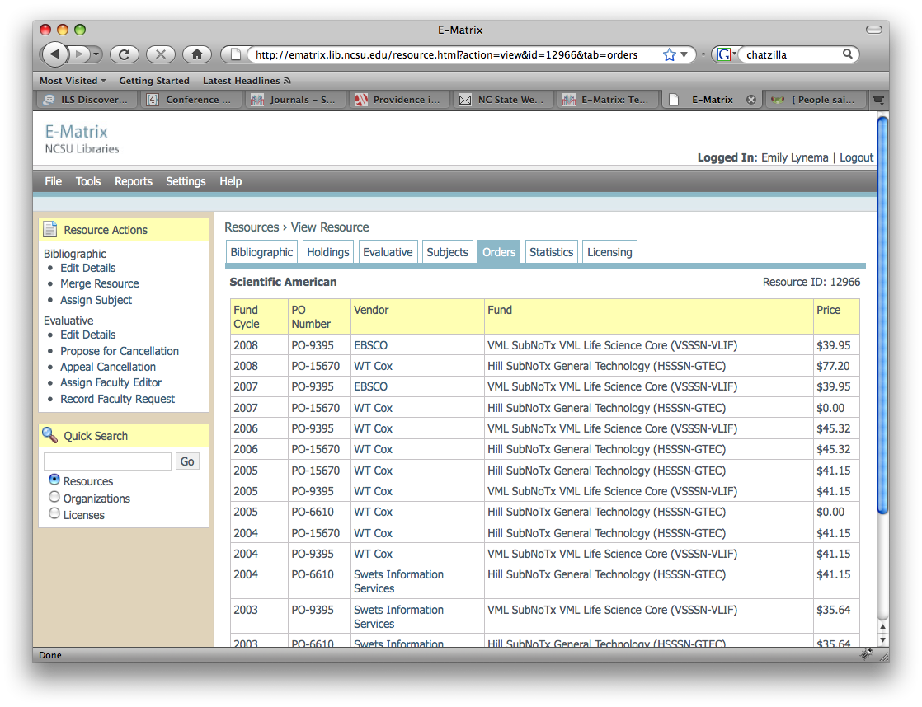

Slide 9
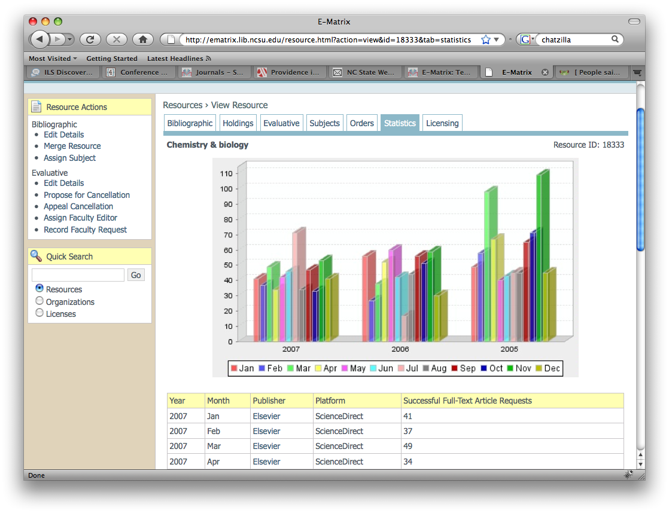

Slide 10
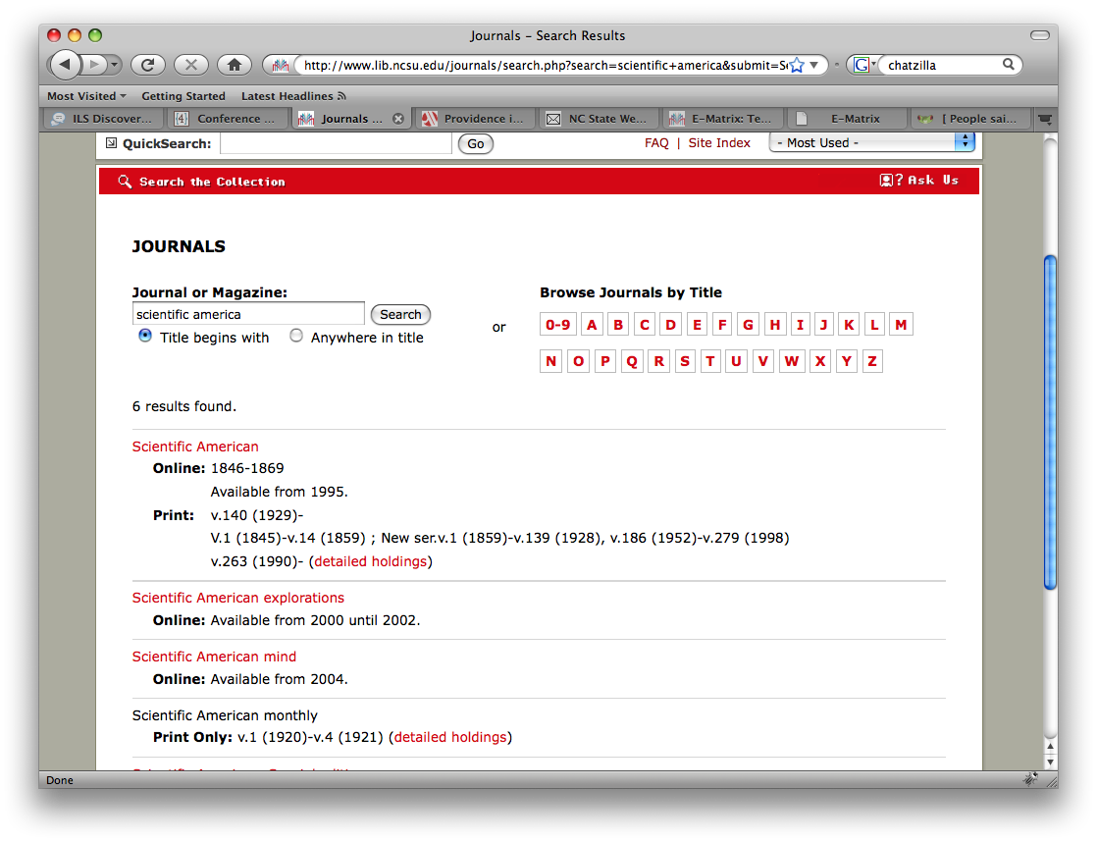

Slide 11
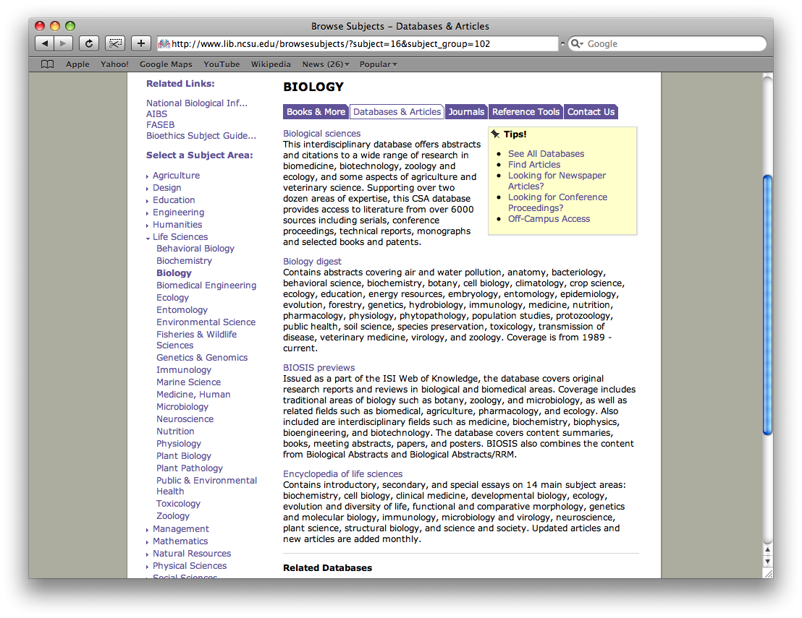

Slide 12
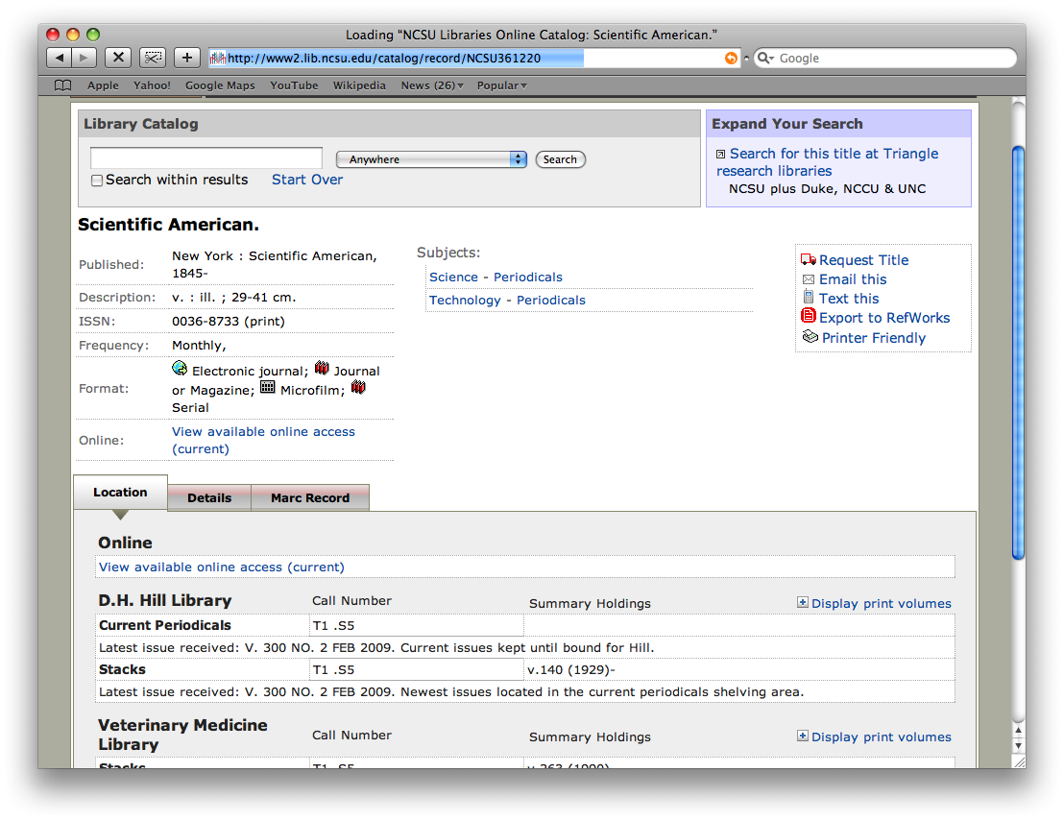

Slide 13
Next Up
Technology tools: PostgreSQL, Java (Spring, Hibernate)
Development: customizable workflow management
Open Source?
  Very early in process
  Campus technology transfer for GPL approval
  Community development / governance?

Slide 14
More Info
Questions?
Interested in contributing/beta partnership?
Interested in using something like this?
emily_lynema@ncsu.edu
#code4lib: ejlynema

