Slide 1
WorldCat Identities
Ralph LeVan
Senior Research Scientist, OCLC
levan@oclc.org
Code4Lib Pre-Conference
Brown University
23 February 2009

Slide 2
The Basics
Introduction to Identities
Link to an Identity using a persistent URL
Link to an Identity from a Bib record using OpenURL
Search for an Identity using the NameFinder
Search for an Identity using SRU
Understanding an Identity record

Slide 3
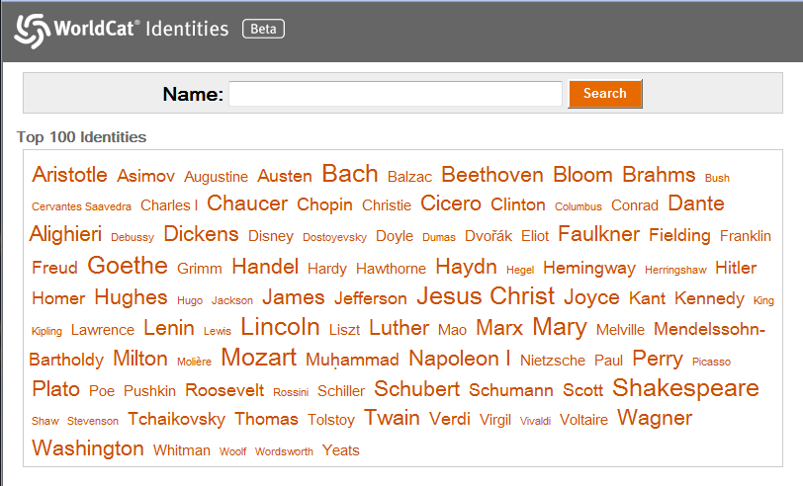
http://worldcat.org/identities/

Slide 4
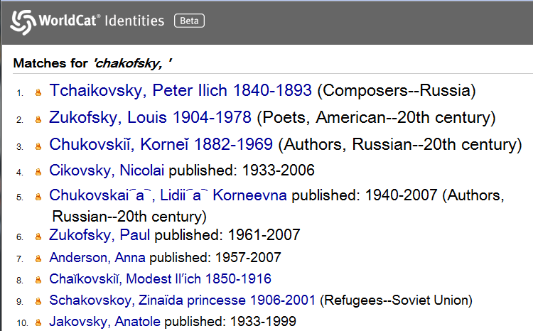
Name Searches

Slide 5
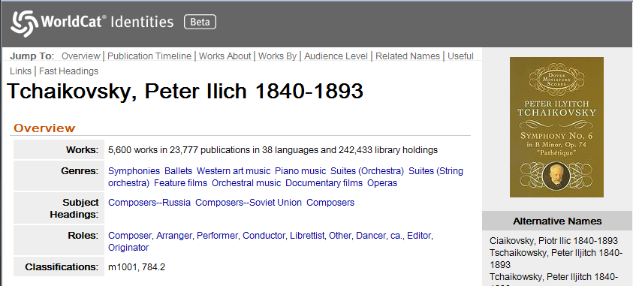
Identity Record

Slide 6
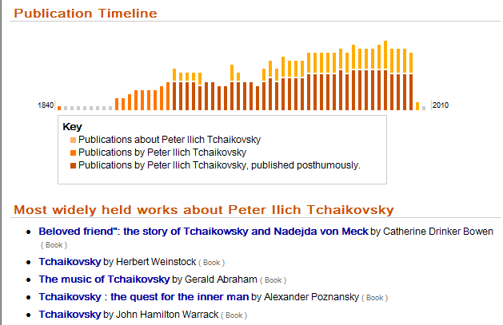
Identity Record

Slide 7
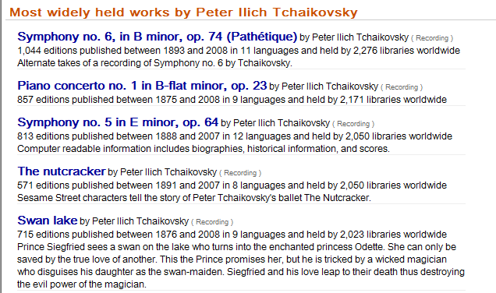
Identity Record

Slide 8
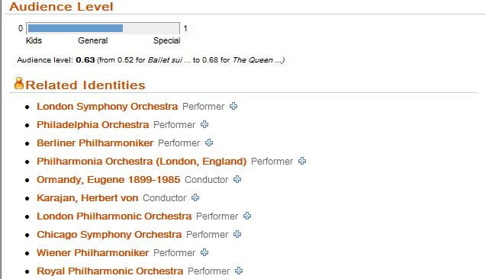
Identity Record

Slide 9
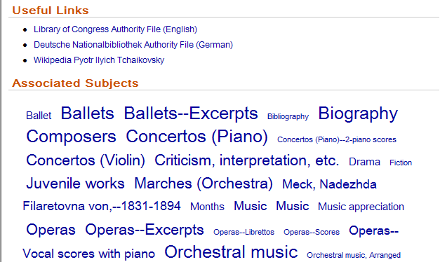
Identity Record

Slide 10
Link to an Identity using a persistent URL
Two forms:
  http://worldcat.org/identities/lccn-n82-54463
  http://worldcat.org/identities/np-levan,%20ralph%20r
Feel free to try to hack your own URL’s, but you’re unlikely to get a hit unless you happen to have an LCCN
Notes:
The first form is for Identities that have LCCN’s. For everyone else, their name is used. The np- at the front stands for “name personal”. There are also corporate (nc-) and subject (ns-) names in the database.

Slide 11
Link to an Identity from a Bib record using OpenURL
http://worldcat.org/identities/find?url_ver=Z39.88-2004&rft_val_fmt=info:ofi/fmt:kev:mtx:identity&rft.namelast=Hickey&rft.namefirst=Thomas&rft_id=info:oclcnum/9746645
The boilerplate is mandatory
namelast and oclcnum are usually sufficient
  When they result in no Identity or multiple Identities, then the namelast and namefirst are used in a NameFinder search and the results returned
Notes:
The is eminently hackable. It’s one way to get to the NameFinder interface. Under the covers, the lastname and oclcnum are used in an SRU search and, if successful, an SRU response is returned. If unsuccessful, then a NameFinder search is done and a NameFinderResult is returned with a ranked list of names to pick from.

Slide 12
Search for an Identity using the NameFinder
http://worldcat.org/identities/find?fullName=ralph+levan
The reverse form is accepted:
  fullName=levan,+ralph
Use corporateName to restrict to corporate names
Use familyName and firstName if you have a tricky 2-part last name

Slide 13
NameFinder Results Record
<nameAuthorities query="levan, ralph" maxList="10" hitCount="68">
<match type="ExactNameParts" usage="7" score="2000">
<establishedForm>LeVan, Ralph R.</establishedForm>
<uri>/identities/np-levan, ralph r</uri>
<key>np-levan, ralph r</key>
<citation>An architecture for scholarly…</citation>
<pubDates>1994-2005</pubDates>
<nameType>personal</nameType>
</match>
Notes:
maxList (an optional parm on the request) is probably misnamed. It is actually the minimum number of names to return.
Results are grouped by type and ranked within each type by a formula that combines usage and score.

Slide 14
NameFinder Results
maxList (an optional parm on the request) is probably misnamed. It is actually the minimum number of names to return.
Results are grouped by type and ranked within each type by a formula that combines usage and score.

Slide 15
NameFinder Result Types
Types, in order of appearance, are:
  ExactMatchesWithDates
  ExactMatches
  ExactNameParts
  FuzzyFirstName
  FuzzyFamilyName
  FuzzyName
  FreeTextName

Slide 16
Search for an Identity using SRU
http://worldcat.org/identities/search/Identities
Federates results from 4 other databases:
  http://worldcat.org/identities/search/PersonalIdentities
  http://worldcat.org/identities/search/CorporateIdentities
  http://worldcat.org/identities/search/SubjectIdentities
  http://worldcat.org/identities/search/AbandonedIdentities
Zillions of indexes
NameFinder uses the SRU databases for all its searching
Notes:
AbandonedIdentities are Identities whose persistent URL has gone away from the other databases. I try to either remap the old URL to a new one, or salvage the old Identity record if the old Identity has just gone away.

Slide 17
Finding the Identity record in a response
Today, Identity records are embedded in an SRU searchRetrieveResponse
Sometime in the near future, they will be returned as bare records, if accessed via OpenURL or persistent URL
Notes:
Nearly everything we do is through some sort of gateway to and SRU database. We’ve just been passing the SRU responses back. But, that’s clearly immature behavior; when an Identity record is expected as a response, and Identity record should be returned, not a record embedded in an SRU response.

Slide 18
Identity Record
<Identity type="personal" xmlns="">
Types are:
  personal
  corporate
  subject
  abandoned

Slide 19
Identity Record Elements
creationtime
pnkey
biogSHs
audLevel
authorityInfo
associatedNames
nameInfo
by
about
bestCover
embarassing junk

Slide 20
biogSHs
A list of biographical subject headings, e.g. Composers
Each biogSH has a count of the number of works it appears in for that Identity and normalized and display forms of the subject heading
<biogSH count="17618" norm="COMPOSERS GERMANY">Composers--Germany</biogSH>

Slide 21
audLevel
Audience Level information about the works of that Identity
Instances of the works with the lowest and highest audience levels are listed and the average audience level is given
http://www.oclc.org/research/projects/audience/
<audLevel>
<min>
<level>0.56</level>
<title>Mr. Bach comes to call</title>
</min>
<avg><level>0.66</level></avg>
<max>…</max>
</audLevel>

Slide 22
authorityInfo
Only occurs if the Identity was found the LC Name Authority File
Contains:
  the linking value for any authority files
  the standard form of the name using MARC subtags
  any alternate forms of the name

Slide 23
authorityInfo
<authorityInfo>
<wikiLink>Johann_Sebastian_Bach</wikiLink>
<lccn>n 79021425</lccn>
<arn>oca00255223</arn>
<headingUse>a</headingUse>
<pnd>102936056</pnd>
<standardForm>
<suba>Bach, Johann Sebastian,</suba><subd>1685-1750</subd>
</standardForm>
<x400><rawName>
<suba>Bakh, Iogann Sebastian,</suba><subd>1685-1750</subd>
</rawName></x400>
</authorityInfo>

Slide 24
associatedNames
A list of names found with the Identity in WorldCat records
Use the normName field to link to other Identity records
The relator field tells how they are related using MARC codes
  http://www.loc.gov/marc/relators/relacode.html
<name count="1207">
<normName>lccn-n82-96229</normName>
<rawName><suba>Rilling, Helmuth</suba></rawName>
<relator count="682">cnd</relator>
</name>

Slide 25
nameInfo
The rawName is present for non-Latin names
The latinName is the latinized form of the name
tag is the MARC field the name was found in most often
<rawName>
<suba>Bach, Johann Sebastian</suba><subd>1685-1750</subd>
</rawName>
<latinName>
<suba>Bach, Johann Sebastian</suba><subd>1685-1750</subd>
</latinName>
<tag>100</tag>

Slide 26
nameInfo
FAST Headings are our improved version of LC Subject Headings
  http://www.oclc.org/research/projects/fast/
http://www.loc.gov/marc/languages/language_code.html
<genres>
<genre count="61997" norm="MUSIC">Music</genre>
</genres>
<fastHeadings><fast count="4208" norm="fst00846088" size="1" tag="650">Cantatas, Sacred--Excerpts</fast>
</fastHeadings>
<languages count="37">
<lang code="zxx" count="35365"/>
</languages>

Slide 27
nameInfo
dates contains a list of years in which works by or about the Identity were published
<birthDate>1685</birthDate>
<deathDate>1750</deathDate>
<dates>
<date aboutCount="1" aboutScaled="0.00" byCount="2" byScaled="1.00" count="3" scaled="1.58">1700</date>
</dates>
<totalHoldings>754085</totalHoldings>
<recordType>scor</recordType>
<ddc>786.4</ddc>
<lcc>m2020</lcc>

Slide 28
nameInfo
relators is a list of relator codes (see above) associated with the Identity
For each code there is a list of up to 20 OCLC numbers of works that contained the Identity with that relator code
<relators>
<relator code="cmp" count="1976">
<oclcnum>ocn056624047</oclcnum>
</relator>
</relators>
<workCount>14151</workCount>
<recordCount>65524</recordCount>
<fictionCount>52</fictionCount>

Slide 29
by and about
contain a list of up to 20 citations for works either by or about the Identity
<citation>
<uniqueHoldings>2858</uniqueHoldings>
<holdings>18226</holdings>
<numEditions>1446</numEditions>
<oclcnum>ocn000966189</oclcnum>
<exprid>sw000290621:lccn-n79-21425</exprid>
<isFiction>False</isFiction>
<recordType>rcrd</recordType>
<date>1988</date>
<languages count="9“><lang code="zxx" count="1015"/></languages>
<dates different="100" first="1800" last="2007"/>
<audLevel>0.56</audLevel>
<creator>Bach, Johann Sebastian</creator>
<title>Mr. Bach comes to call</title>
<genres> <genre count="2" norm="SACRED VOCAL MUSIC">Sacred vocal music</genre></genres>
<summary>Tells how Mr. Bach...</summary>
<cover oclc="ocn051719567" type="isbn">1895404711</cover>
</citation>

Slide 30
Links
http://outgoing.typepad.com/outgoing/2007/02/worldcat_identi.html
http://outgoing.typepad.com/outgoing/2008/06/linking-to-worl.html

