Slide 1
Batch OCR with
Open Source Tools
Jonathan Brinley
Adelie Design
(ex-Ball State University)

Slide 2
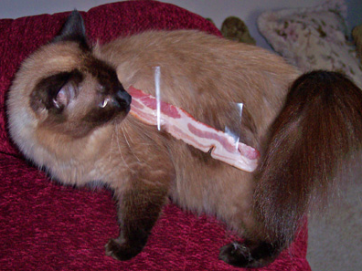
http://whatever.scalzi.com/2006/09/13/clearly-you-people-thought-i-was-kidding/

Slide 3
Tesseract
  http://code.google.com/p/tesseract-ocr/
OCRopus
  http://code.google.com/p/ocropus/

Slide 4
How to OCR an Image
$ ocroscript recognize /path/to/file.png > /path/to/output.html

Slide 5
hOCR
<body>
<div class="ocr_page" title="bbox 0 0 2548 3300; image /path/to/scanned/image.png">
<span class="ocr_line" title="bbox 659 143 863 177">Some Text</span>
<span class="ocr_line" title="bbox 723 275 916 324">More Text</span>
</div>
</body>

Slide 6
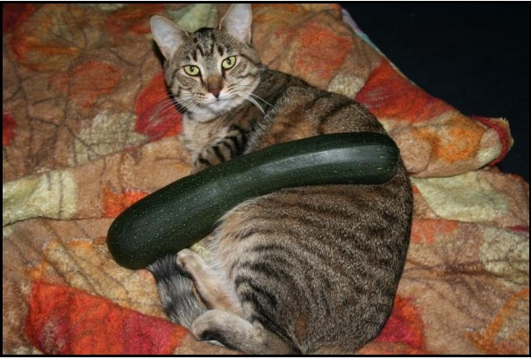
http://www.brainofshawn.com/2007/08/05/givin-scalzi-a-hand/

Slide 7
HocrConverter.py
from HocrConverter import HocrConverter
hocr = HocrConverter("myHocrFile.html")
hocr.to_text("output.txt")
hocr.to_pdf("myImageFile.png", "output.pdf")

Slide 8
Learn More or Get the Code
http://xplus3.net/2009/04/02/convert-hocr-to-pdf/
jonathanbrinley@gmail.com

