Slide 1
Public Datasets In the Cloud
Michael Klein and Rosalyn Metz

Slide 2
Agenda
  What do we mean by the cloud?
  What is data in the cloud?
  Examples of data in the cloud
  Publish your data in the cloud!

Slide 3
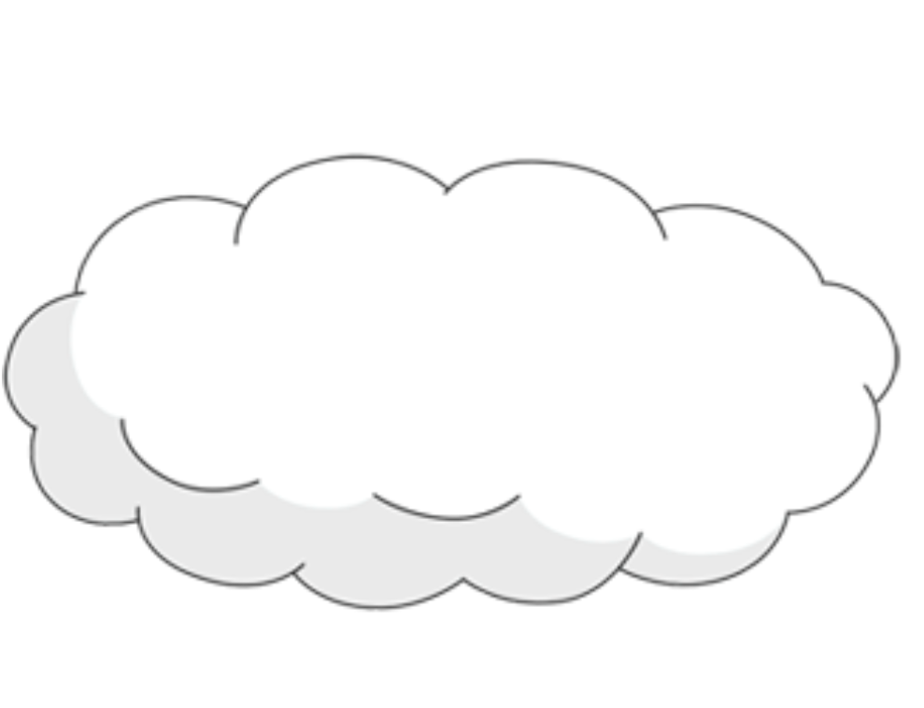
What do we mean by “the cloud”?

Slide 4
5 Characteristics
  On demand self service
  Broad Network Access
  Resource Pooling
  Rapid Elasticity
  Measured Service

Slide 5



3 Service Models
  Infrastructure as a Service (IaaS)
  Platform as a Service (PaaS)
  Software as a Service (SaaS)

Slide 6
What is data in the cloud?

Slide 7
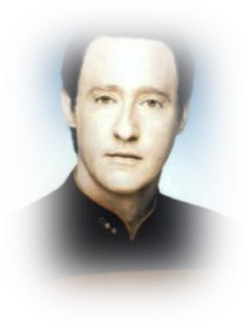

Slide 8
no, we’re talking about...
  data whose primary presentation is “raw data”
  data that can be used outside the defined constructs of the raw data
  data that corresponds to one of the cloud based service models
    ie. SaaS, PaaS, IaaS

Slide 9
we are not talking about…
  data you can download from a website
  data catalog sites like data.gov

Slide 10
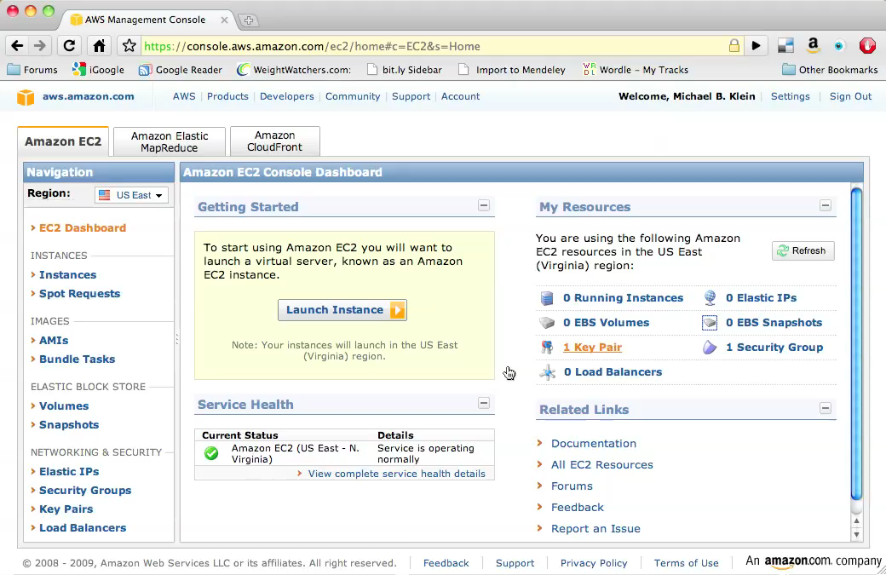
Infrastructure

Slide 11
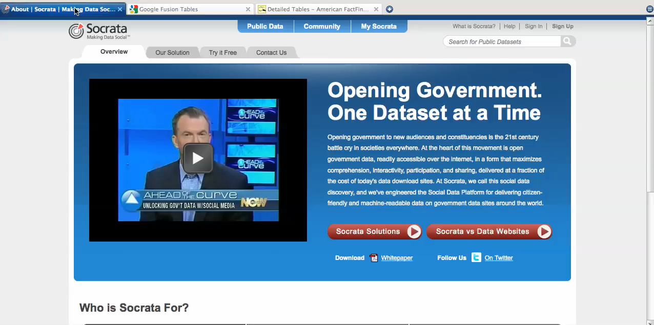
Platform

Slide 12
Patron Discovery
  Cloud datasets have huge research value
  How can we make patrons aware of them?
  How can we facilitate use of these resources?
    Complete access is beyond our scope
    Cataloging is not
    What level of automation is possible?
    Screencasts? Tutorials? Library instruction?
Notes:
That's why they're there!

Slide 13
Pushing Library Data to the Cloud
  Secondary uses of library data
    Research
    Testing
    Unified indexing
  Not just bibliographic data
    Usage/Borrowing
      Can we anonymize enough to share it safely and ethically?
      Institutional Review Board concerns
    Anything from the archives world?

