Slide 1
Free the Data: creating a web services interface to the online catalog
Emily Lynema
NC State University Libraries
Code4lib 2007
February 28, 2007

Slide 2
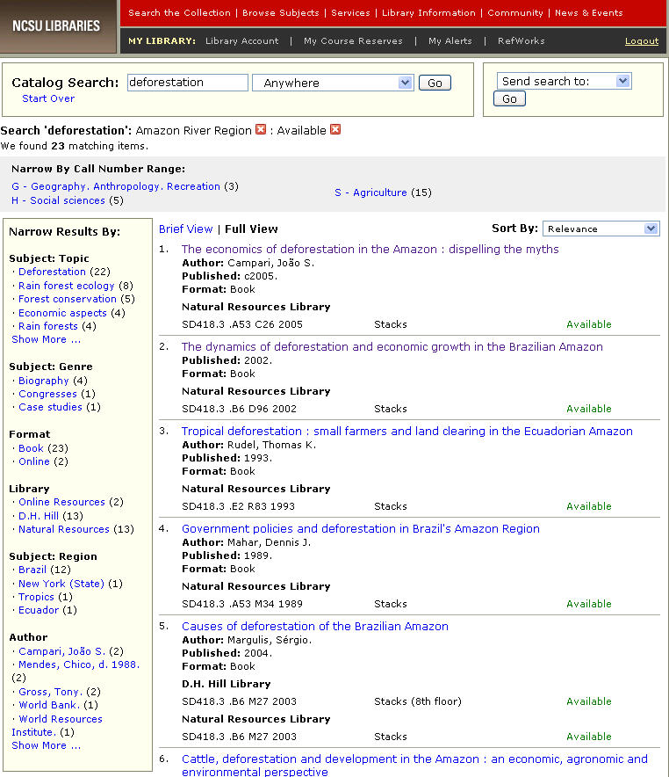
Context
Endeca ‘Information Access Platform’
Enterprise search and faceted navigation
Home Depot, Lowe’s, Circuit City, Dice [etc.]
FCLA, McMaster
Notes:
So, I don’t think I can get away without a context slide. As I’m assuming most of you know, NCSU Libraries went live with a new catalog about 14 months ago, using a commercial search and faceted navigation application from Endeca called the ‘Information Access Platform.’ It’s behind many commercial websites, and soon will be providing search for a few of our library colleagues, like FCLA in Florida and McMaster in Canada, as well.

Slide 3
Features
Stopwords and automatic stemming (nouns)
Automatic spell correction & did you mean suggestions
Customizable relevance ranking algorithms
Faceted navigation and true browse
Improved response time
Persistent URLs (no sessions!)
Notes:
I hope you’re not expecting to hear our talk about our Endeca implementation, since that’s not what this talk is about. But I will give the 2-second spiel. We got a lot of new features in our catalog – you can see a short list here. Some of the most important might be the customized relevance ranking and improved response time, although the faceted navigation capabilities have garnered by far the most attention. We pretty much like all the features. And if you want to know more, you know where I’ll be the next couple of days.

Slide 4

Architecture
Information Access Platform
NCSU exports and reformats
Data Foundry
MDEX Engine
Raw MARC data
Parse text files
Indices
Flat text files
HTTP
HTTP
NCSU Web Application
Notes:
I wanted to spend a minute on system architecture because it had an impact on how we built a web services interface to our catalog. Endeca co-exists fairly peacefully with our SirsiDynix Unicorn ILS and our Web2 OPAC. We export data from our ILS for import into Endeca. The really relevant portion of this diagram is the fact that the front-end web application is completely separate from Endeca’s back-end, and simply submits queries via HTTP GET requests to the back-end service, then parses the results with Endeca’s Java API.
While some institutions see the fact that we had to build our own user interface as a hindrance, we see it as more of a feature. Because of this architecture, our work to enable a web services platform on top of the catalog data was simply building another interface….albeit an XML one. No screen-scraping or direct database querying is required.

Slide 5
The very beginning
OCLC Research Software Contest
  The idea of an availability web service that could report on holdings to other sites
Functionality
  Submit ISBN
  XML response returns availability and location
  If not owned or no copies available, looks for similar ISBN via xISBN service.
Notes:
This began as a small project Tito Sierra and I worked on for the OCLC Research Software Contest. Now, we lost out to Ross’s umlaut (justifiably in my mind), but we did start building a platform for web services access to our library catalog.
We created an ‘availability’ web service that reported current availability for an ISBN via XML. Just to make it interesting, if we don’t own it, the service looks for other ISBNs that might be currently available via OCLC’s xISBN.

Slide 6
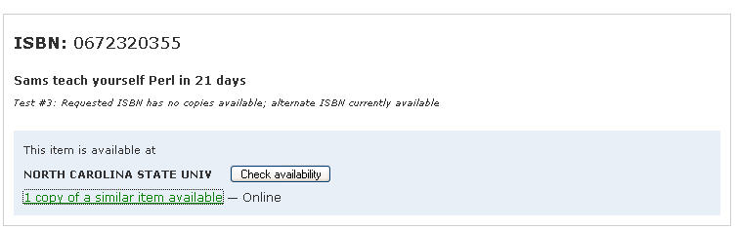
Catalog Availability
More details:
  http://www.lib.ncsu.edu/catalog/ws/documentation/availability.html
Try it out:
  http://www.lib.ncsu.edu/catalogs/?service=availability&isbn=0743222326
Notes:
This is a prototype for how this service might be incorporated into other tools. For example, we envisioned this in conjunction with a union catalog like WorldCat, where WorldCat may know that we own a title, but doesn’t know whether we have any copies available. In this example, we don’t have any available copies of the requested ISBN, but xISBN tells us we do have a copy of a related item available. In this case, it’s just the e-book version of the title.

Slide 7
Introducing CatalogWS
Rest web API for dynamically querying information from the NCSU Libraries Catalog
http://www.lib.ncsu.edu/catalog/ws/
Have fun!

Slide 8
Motivations
Initial impetus – 2 requests
  Can we have RSS feeds for the catalog?
  Can we integrate catalog results into library website QuickSearch?
Where did we end up?
  Generic XML layer on top of catalog searching
  Capability for server-side user-defined XSL transformations

Slide 9
Why go there?
More open access to the data available in our library catalog
Core XML schema can be re-used and modified via stylesheets
Enable other developers in the library to build applications using catalog data
Reduce bottleneck
Notes:
We’re hoping that this reduces bottleneck when it comes to developing with catalog data. And that’s good, because when I have to do everything, a lot of things don’t get done.

Slide 10
Using the service
Base: http://www.lib.ncsu.edu/catalogws/?
Parameters:
  service (required)
    availability | search
  query (required)
    Any term(s)
  output (opt)
    Default: xml | rss | opensearch | json
http://www.lib.ncsu.edu/catalogws/?service=search&query=deforestation
Notes:
The basic parameters are the service being requested (either the initial availability service or the more full-featured search service, the query, and the output (which defaults to our custom xml response). Other available output types are rss, opensearch, and json.

Slide 11
Additional functionality
count
  default: 30
  max: 50
offset
  default: 0
sort
  default: relevance | date_desc | date_asc | call_number | most_popular
style
  URL of XSL to transform to custom output
Notes:
Because we’re trying to create a full-featured XML layer on top of our catalog, we defined a number of additional parameters that dpulicate functionality available in our HTML catalog interface. None of these parameters are required. The most interesting is style. If the consumer wants output in a different format, he/she can pass in a URL to an external stylesheet and the service will perform the transformation. They can even can request a standard output format (like rss or opensearch) and then transform that [I think].

Slide 12
Technical overview
Separate web application handles web service requests
Java and Tomcat
XOM for XML creation and XSL transformation
Saxon 8.8 for XSLT 2.0 functionality
org.json Java package for easy XML => JSON
Notes:
The technical architecture of the web services interface to the catalog is pretty simple, since all the real work is being done in the back-end

Slide 13
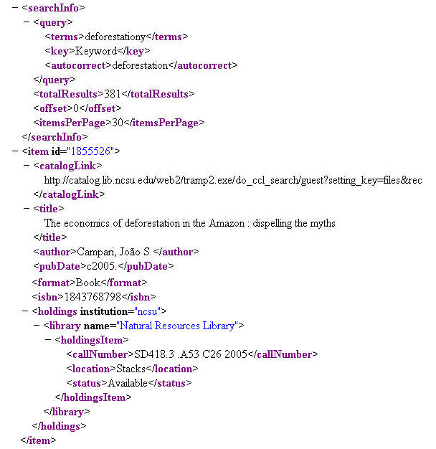
XML response
Defined with Relax NG Schema
Data from search results page
  Search information
  Results
  Facets
Notes:
When we looked at our XML response, you have to remember that we are using data from the search results page. For this reason, we didn’t want to delve into MARCXML. We’re only providing a very short summary for each item, and we have lots of other search-related data we want to provide.
Search information: query terms, fields, spell correction, facets applied, number of results
Results: Title, author, published date, ISBN/ISSN, format, holdings
Facets: wanted to enable applications to actually use facets for refining without sending them back to our HTML interface. For each facet value: label, results count, link to web services request with facet applied

Slide 14
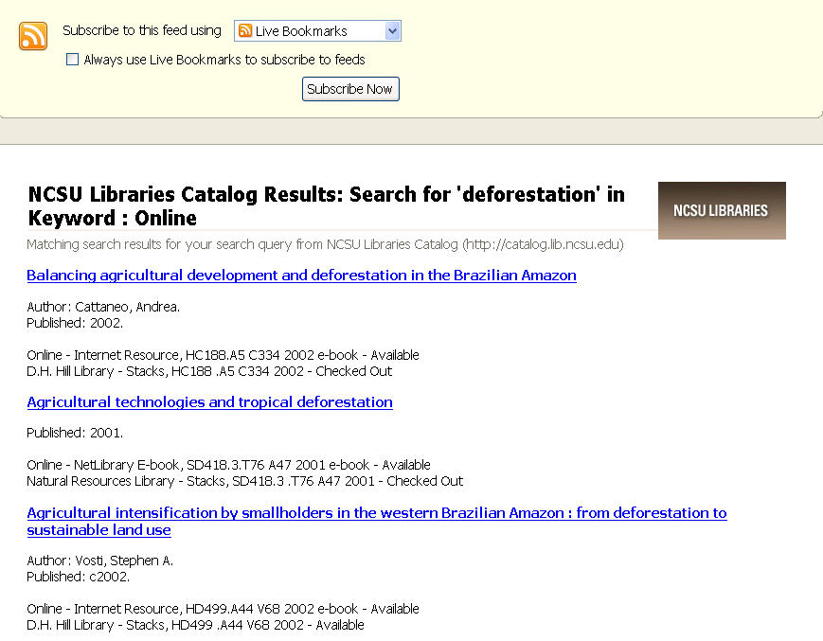
RSS
Notes:
Looking at the services we’re building on top of our core XML, the simplest is RSS. Transform from our core XML response to RSS via XSLT. We plan to make these RSS feeds available from every search results page.

Slide 15
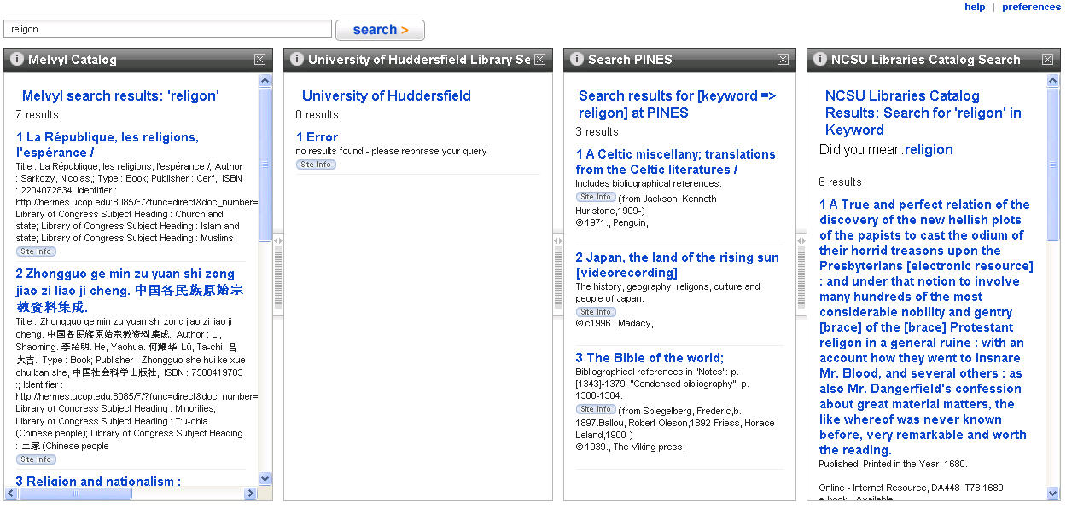
OpenSearch
Notes:
If you don’t know much about OpenSearch, it’s a simple extension to RSS/Atom (or even XHTML). Our service simply adds a few extra lines of output to our RSS feeds.
Here’s what OpenSearch looks like when we’ve added the NCSU Libraries catalog as an OpenSearch provider to A9. You’ll see other illustrious catalogs have already beaten us there – Melvyl, University of Huddersfield (Dave Pattern) and Georgia Pines (among others).
I wanted to note one of the interesting little things you can do with OpenSearch. You can specify a corrected spelling for a search term in the output from your search, and if the aggregator supports it, it will suggest the term to the user. In this search, the user misspelled religion. You can see that we do find some results for the misspelling in the catalogs (including ours), but you can also see a corrected selling suggestion in the NCSU Libraries column.

Slide 16
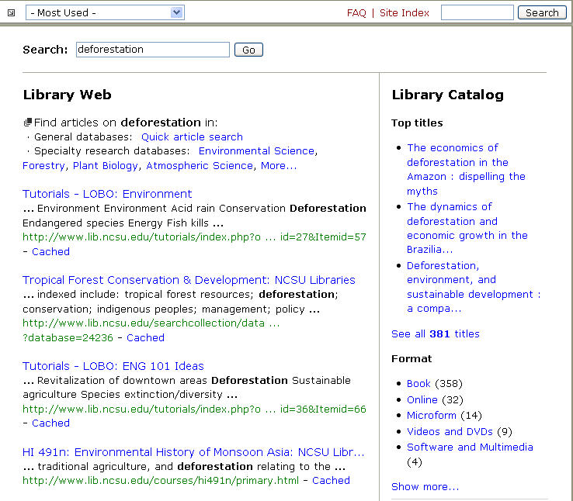
QuickSearch
Notes:
I mentioned that QuickSearch integration was another motivator for this project. QuickSearch is our library web site search engine, available on pretty much every page on the site.
Here is what the QuickSearch results provide:
Pre-programmed ‘best bets’
Database recommendations
Pass through links to search other collections
journals, electronic theses, reference sources
In the past, provided a pass-through link to the library catalog. Now we will be able to show the top few titles from the catalog, and the values from the format facet. The goal is to provide users with some information scent about the library catalog – to show them what types of resources they’ll find there – maybe that’s where they should be looking.

Slide 17
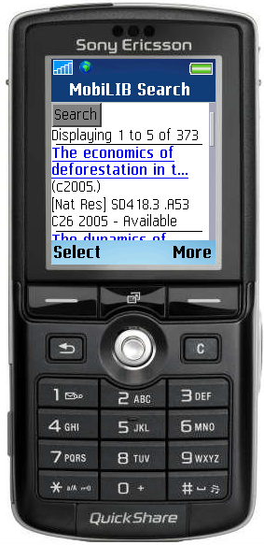
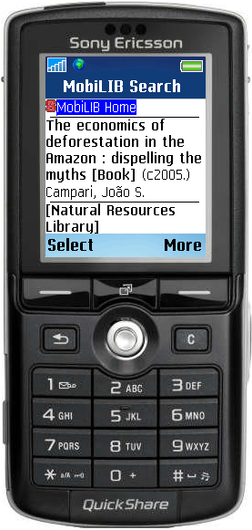
Mobile device searching
Notes:
Another service that’s in the works is a catalog search interface for use with mobile devices. The really cool thing about this service is that it makes use of the style parameter in the web service request – so all that is needed to create this interface are a couple stylesheets that transfom the core XML into simplified XHTML to serve as output. And, I didn’t have to make any changes to the existing catalog application in order to enable this service (I didn’t even have to know about it!).

Slide 18
I promised I would talk about…
Experimenting with facet data in OpenSearch
  Early plan: 2 OpenSearch requests for QuickSearch integration: 1 for results, 1 for facets
  Why request twice when you could do it once?
  But what if OpenSearch could do both…
    Existing query role=subset
    Extended OpenSearch parameters to create a facet parameter for use in the OpenSearch URL template.
    <opensearch:Query xmlns:custom=“http://www.lib.ncsu.edu/catalogws/1.0” role=“subset” searchTerms=“deforestation”
    custom:facet=“4294963641” />
Notes:
As I mentioned before, our initial plan was simply to implement RSS feeds and then provide an OpenSearch layer on top of that. But to get both titles and facets into QuickSearch, we were stuck with the idea of having to make 2 requests – one for title results and one for facets results via OpenSearch.
Issuing unnecessary requests to my back-end service provider didn’t sit well with me. We soon realized it made the most sense to create a generic XML response that included both items and facets.
But what if OpenSearch itself could do both results and facets? Just like OpenSearch has defined a standard way to indicate a spelling correction, there is also a way to indicate a search that is a subset of the search that was performed. To me, subsets scream of facets. Would need to extend the OpenSearch parameters to create a facet parameter for use in the URL template.
Then the results could include a Query element like this, which show how to limit the original search of deforestation to a particular facet value – items that are about Latin America (Subject: Region).
Would this work? Disadvantage: do any OpenSearch aggregators actually implement this? Plus, if you look at our results page, there are often 50 – 60 possible facet values showing. Would you create a custom query element in the response for each of these possible subsets? Is there an easier way?

Slide 19
Questions?
NCSU Endeca project site (w/slides):
  http://www.lib.ncsu.edu/endeca
CatalogWS project site:
  http://www.lib.ncsu.edu/catalog/ws/
Emily Lynema
  Systems Librarian for Digital Projects
  emily_lynema@ncsu.edu

