Slide 1
Iterative Development:
Done Simply
Emily Lynema
NCSU Libraries
Code4Lib 2010
Notes:
Abstract: With a small IT unit and a wide array of projects to support, requests for development from business stakeholders in the library can quickly spiral out of control. To help make sense of the chaos, increase the transparency of the IT "black box," and shorten time lag between requirements definition and functional releases, we have implemented a modified Agile/SCRUM methodology within the development group in the IT department at NCSU Libraries. This presentation will provide a brief overview of the Agile methodology as an introduction to our simplified approach to iteratively handling multiple projects across a small team. This iterative approach allows us to regularly re-evaluate requested enhancements against institutional priorities and more accurately estimate timelines for specific units of functionality. The presentation will highlight how we approach each development cycle (from planning to estimating to re-aligning) as well as some of the actual tools and techniques we use to manage work (like JIRA and Greenhopper). It will identify some challenges faced in applying an established development methodology to a small team of multi-tasking developers, the outcomes we've seen, and the areas we'd like to continue improving. These types of iterative planning/development techniques could be adapted by even a single developer to help manage a chaotic workplace.

Slide 2
Outline
Problem
What is Agile?
What is Scrum?
Agile case study: NCSU Libraries
  Iterative development done simply
Challenges
Outcomes
Notes:
What does agile look like @ NCSU Libraries, which I’ve labeled ‘iterative development done simply.’

Slide 3
Problem
You have too much to do
NCSU Libraries
  6 developers
  >250 library staff
Core Information Systems
  3 full-time developer positions
  18 supported applications
  9 in active development
Notes:
Looking primarily at development positions, not at product managers and some of the many library folk who do some coding here and there.
Core Information Systems:
Sirsi, E-Matrix
Endeca, Search TRLN, WorldCat Local
Journal List, Database List
SFX, 360 Link, Summon
ILLiad, Web2, EZProxy / EZProxy Administrator
ReservesDirect
Journey, ClassMate
Campus Data warehouse
And more In the future: Umlaut, Mobile Device Applications, Interactive Rich Media development

Slide 4
Problem
Priorities change frequently
Requirements change frequently
  or are undefined
No business analysts
Emergencies happen
Notes:
Have to constantly adapt to emergencies.

Slide 5
And more problems….
IT black box
  How long?
  When will it be ready?
  When will you work on my stuff?
  Are you actually doing anything?
  What do I have to do to get something done?

Slide 6
What is Agile?
“Agile development is a method of building software by empowering and trusting people, acknowledging change as norm, and promoting constant feedback”
Shuh, Peter (2005). Integrating Agile Development in the Real World. p.2.

Slide 7
What is Agile?
Response to waterfall approach
Values:
  Individuals and interactions
  Working software
  Customer collaboration
  Responding to change
Manifesto for Agile Software Development. Accessible at http://agilemanifesto.org/
Notes:
Individuals and interactions over specific processes and tools. People working together to write software, using a set of processes that fits the team and environment.
Working software that does something is more useful than a huge stack of requirements and design documentation. Working software is the measure by which a project is evaluated.
Customer collaboration over contract negotiation. Collaborating with customers keeps project teams focused on customer needs, as identified directly by the customers.
Responding to change over following a plan. Change is a fact of life. We cannot hold development projects in a steady state after initially defining requirements. Agile development includes practices to help teams adjust to change, including short feedback loops.

Slide 8
What is Scrum?
A common agile methodology
Roles
  Product Owner
  ScrumMaster
  Team
Artifacts
  Product Backlog
  Sprint Backlog
Notes:
Product Owner: decides on and prioritizes functionality; serves as single point of contact to answer team’s questions about functionality; decides whether to release
ScrumMaster: guides team throughout the process, helping resolve obstacles and remove impediments and run interference
Team: does the work; produces something releasable by end of sprint , consists of programmers, testers, UI designers, etc.
Product Backlog – all functionality and work that would like to have done for a product, fairly coarse-grained (all tasks not yet fleshed out), rough time estimates;
Sprint Backlog – work defined for turning product backlog for a single sprint into potentially deliverable product functionality; more finely-grained tasks developed as start of sprint (4-16 hours).

Slide 9

A Scrum Sprint
Image from www.mountaingoatsoftware.com/scrum

Slide 10
A Scrum Sprint
Sprint Planning
  Commit to certain functionality & estimate
  Produces Sprint Backlog
Daily Scrum
  15 minutes @ start of day
  What have you done since last Scrum?
  What will do before next Scrum?
  What obstacles?
Notes:
Daily scrum helps bring the team together and holds each member accountable to the rest of the team – builds on sense of collective ownership. Reveals problems that can be solved together and keeps team members from waiting on each other.

Slide 11
A Scrum Sprint
Sprint
  Team does the work!
Sprint Review
  Show off completed functionality
Sprint Retrospective
  What went well during the Sprint?
  What could be improved for the next?
Notes:
Sprint: team members have responsibilities: attend Daily Scrum, keep work updated in Sprint Backlog, communicate!
Sprint Review: informal demo, whole team participates, afterwards Product Owner determines whether or not to deploy new functionality

Slide 12
Agile Case Study:
NCSU Libraries

Slide 13
Why Agile @ NCSU?
Tackle big problems in small pieces
Be more transparent
Be more adaptable
Produce tangible results quickly and frequently

Slide 14
What is Agile @ NCSU?
Loosely based on Scrum
  Iterative development cycles followed by release
Just-in-time planning & documentation
Collaboration with customers
  Cross-functional teams w/IT point person
  Developers participate
Joint project ownership
Notes:
Just in time planning and documentation: rather than trying to produce all requirements and documents in advance, define and produce them as needed for each individual cycle.
Collaborating with customers – developers communicate directly with the costumers and work to define requirements, rather than having a requirements document handed to them.ß
Working toward the agile practice of collective ownership and trying to get our developers to share work across projects. Everyone does what needs to be done, whether it is working with customers, design, database changes, testing, or communication.

Slide 15
NCSU Toolbox
Product & Sprint backlog: JIRA
Requirements: Confluence + JIRA
Sprint planning: Google docs + JIRA
Daily Scrum
Sprint demo: Product Team meetings
Sprint retrospective
Notes:
What are some of the specific tools from the Agile / Scrum toolbox that we use?

Slide 16
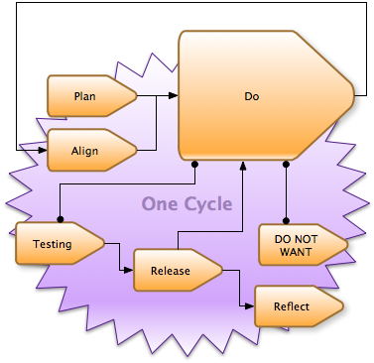
Notes:
One of my developers made some pretty funny diagrams for a panel about agile within the campus community. I”ll speed through some of the diagrams I included here, but they’ll be posted online with slides.

Slide 17
Iteration done simply
6 week iteration
  1 week planning
  4 weeks development
    Re-align as necessary
  1 week testing / release
Notes:
In iteration done simply at NCSU Libraries, one cycle is a 6 week iteration that generally goes plan -> do -> align -> test -> Release. Just because follow that order, doesn’t mean that we only do things in that order though; focus on planning at the outset but continue to plan as needed throughout the cycle, focus on clearing testing at the end but make every effort to test as we go.
In particular, the week focused on planning and testing at the beginning and the end helps give us a buffer when estimating how much work we can complete so that we can handle support emergencies that come up.

Slide 18
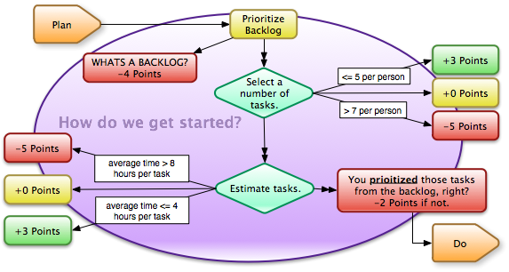
Sprint Planning
Notes:
Remember, the goal of sprint planning is to select a number of tasks from the backlog, estimate them fully, and then commit to accomplishing this work in the sprint

Slide 19
Sprint Planning
Use 1 week to plan across multiple projects
Day 1
  High level overview of upcoming projects out 3 – 6 months
  Prioritize projects for the next iteration based on IT staff input
Notes:
One of the more challenging aspects of trying to work in the Scrum mindset has been planning work for a given cycle. As I’ll mention when discussing challenges, this is because we work across multiple projects within a given sprint, each of which has its own product owners, and functionality which might not yet have been fleshed out well enough to estimate.

Slide 20
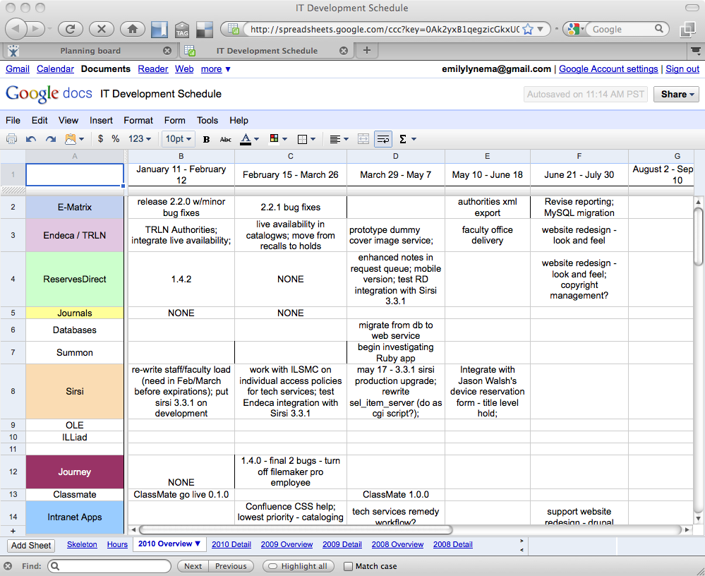

Slide 21
Sprint Planning
Days 2 – 5
  Meet with product owners for each prioritized project
    All team members who will be participating
    Outline work
    Prioritize work
    Collaboratively estimate work

Slide 22
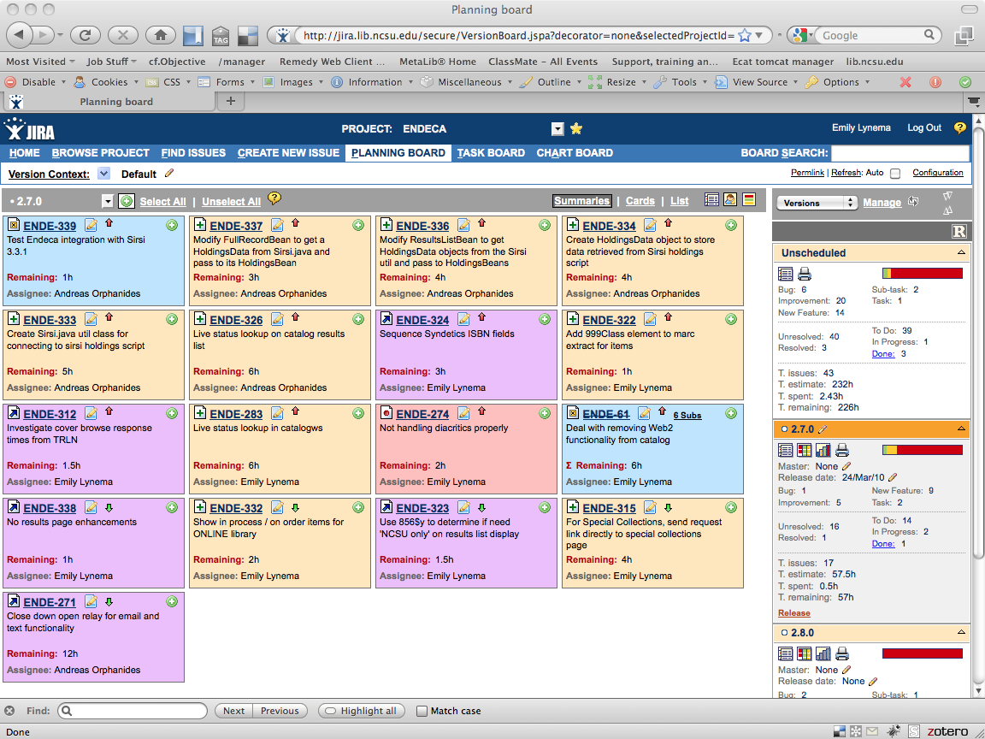
Notes:
Outcome is a set of fully estimated tasks in JIRA for a given release. We use a release in JIRA to represent the work that will be accomplished in a given iteration. This is essentially our sprint backlog. Our product backlog is the ‘Unscheduled’ set of tasks in JIRA. We sometimes use future release designations to help give high level relative priorities to the future work.

Slide 23
Sprint Planning
Day 6
  Re-prioritize based on estimates & time available
  Scope down at project or work level

Slide 24
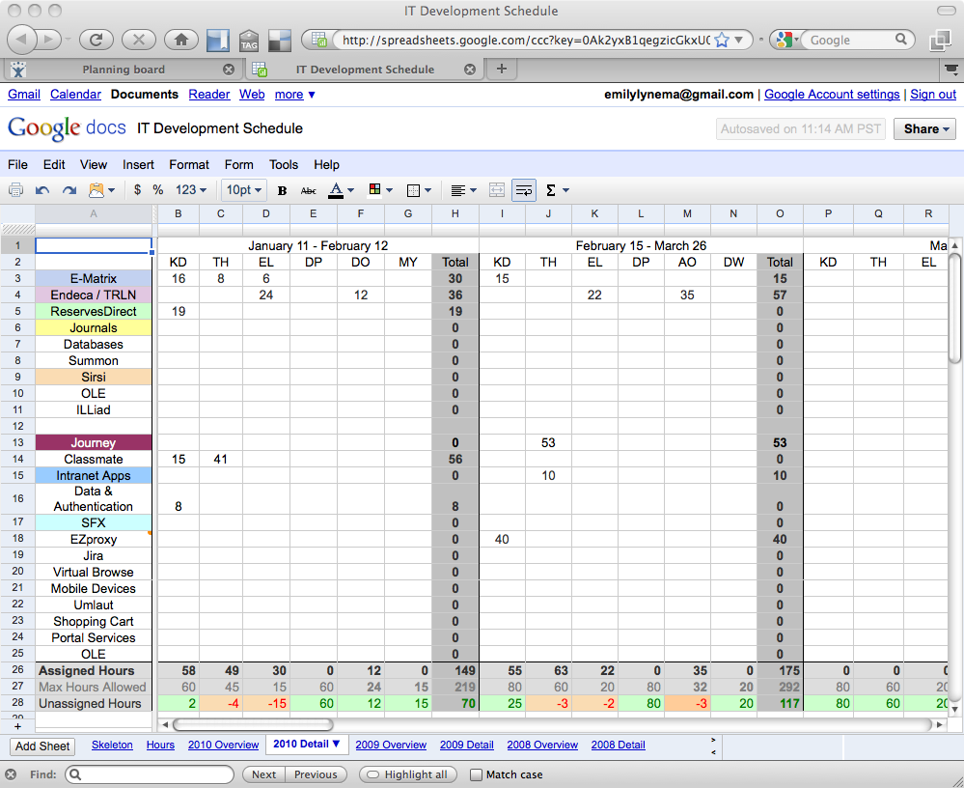

Slide 25
Development
Get it done
Daily scrum 10 – 15 minutes
  Identify obstacles and priorities
  Emphasize collaboration
Weekly review
  How does progress look for cycle?
  Requires estimation and work logging
Subversion -> JIRA integration
Notes:
Weekly review – a non-SCRUM approach to handle changing requirements and other external support factors while still being able to complete *something* at end of sprint.

Slide 26
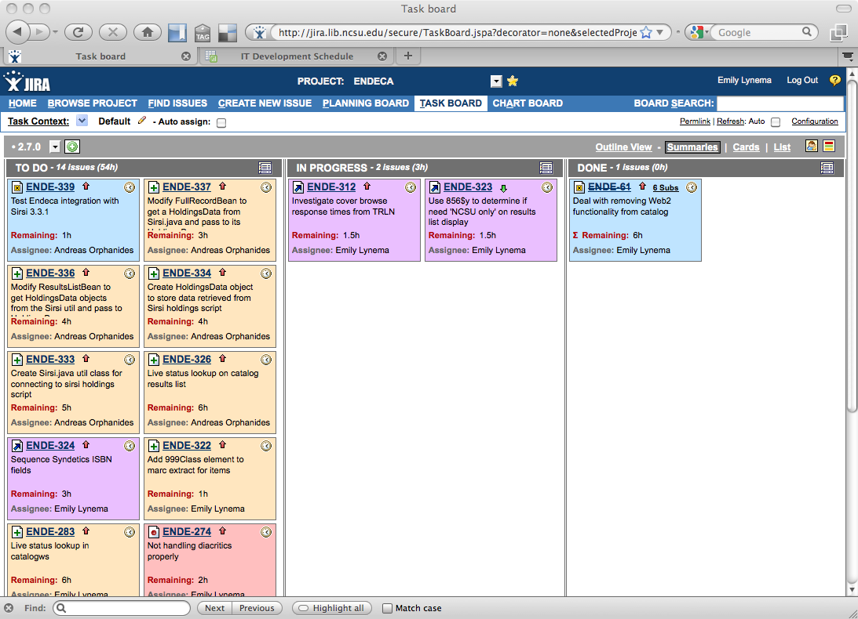
Notes:
JIRA taskboard where we spend our time. Shows tickets unstarted, in progress, completed, and visually see where the balance of work remains.

Slide 27
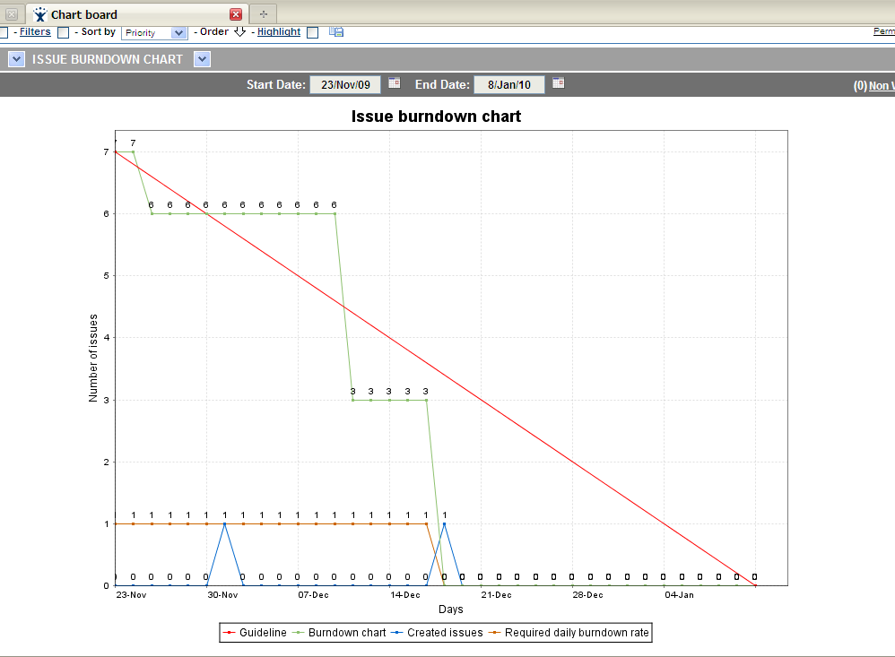
Notes:
Burn-down chart – shows amount of work remaining over time and velocity towards goal – must have both estimates and time remaining for this to be helpful

Slide 28
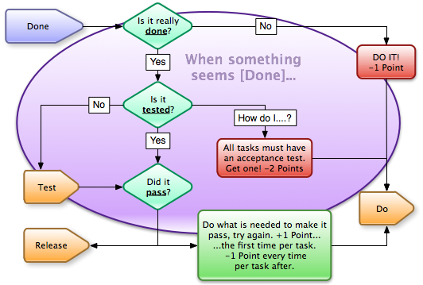
Testing / Release
Notes:
This is not technically a part of Scrum, but the basic goal is to make sure to reserve time to handle bugs and customer feedback on features at the end of the cycle, and also time to schedule and get updates deployed.

Slide 29
Testing / Release
Testing throughout cycle
  Utilize weekly emails
  Demo at regular meetings
  Close tickets when tested
Notes:
Actually, try to focus on working with product teams (customers) to test throughout the cycle. Try to push out changes weekly to a test server for them to test and approve. Utilize regular meetings with these teams to demo at every opportunity.
Having some success getting our actual library staff serving on product teams to put comments in JIRA after testing issues. This way we know when we can close them and can use this technique to make sure that everything has been tested.

Slide 30
Challenges
Multiple small projects within a cycle
  Not traditional for Agile practices
Lack of documented requirements
  What are user stories and when do you need them?
  Teams of librarians work slowly
Notes:
Multiple projects across a single team in a given cycle – haven’t yet seen any agile writeups applied to this situation. We have changed the planning phase of our cycle to try to accommodate for this scenario. We estimate tasks for each project, meet together to add up the estimation against expected availability for each developer, and collaboratively reduce the tasks for the cycle if necessary (usually we start by prioritizing the most important projects).
Documented requirements (or user stories) are one of our weakest links. Traditionally have recorded requirements within individual tasks in JIRA.
However, this is less effective for larger pieces of functionality. Beginning to work with Confluence to outline requirements. However, still working toward what user stories would look like and when we might want to create them (taking a course on agile requirements this spring).
Another challenge with requirements is simply that librarians work slowly. While they are available to the team throughout the cycle, they do not always respond quickly to email and meetings are difficult to schedule as they are involved in many, many other projects. We work to outline requirements in advance of the cycle in regular meetings, and then spend special effort at the start of each cycle eliciting details. Now that we are working more iteratively, we find that we are better able to make a ‘best guess’ and then refine further in future iterations.

Slide 31
Challenges
Prioritization difficult for library staff
  Work at release level
Testing
  How and when to automate for small projects?
  No ‘QA’ experts
Simultaneously handle support and development
Notes:
Product backlog is supposed to be prioritized. But library staff have a difficult time prioritizing issues against each other. They work best talking generally about what they think should be part of a given iteration. Then we negotiate with them about what we think we can accomplish. The IT product manager plays a large role in determining final priorities here.
Testing – “the weakest link”. For smaller projects w/o massive codebase, when is it faster and better to automate testing? No QA experts, so try to utilize product teams with regular updates throughout the cycle. In the end, developers and IT product managers have to do first pass at QA testing. Have not done a good job defining acceptance tests for each piece of functionality.
Our group is responsible both for real-time support and development. How to handle? Working toward documenting time spent on real-time support emergencies in JIRA and track how much effort spent on that vs. development. This feeds our estimation of how many hours are available for each person for each cycle; assume some time goes to support.

Slide 32
Outcomes
Positive movement across multiple projects
  Individual development efforts timeboxed
  In 2009, ~31 releases across 6 projects
  Increased user satisfaction
Increased flexibility to adapt to changing priorities and needs
Notes:
Timeboxing of efforts within a 6-week development cycle helps keep us from getting bogged down in large implementations that go on for months and months and keep team from working on other projects. Instead, focus on the outset on a simplified set of work that can be accomplished in 1 cycle and then re-evaluate institutional priorities at the end of that cycle. This reduces feeling of black box stall on any given project.
Users hate seeing nothing. Using these methods, more people have seen some results faster. Incremental improvements that happen regularly produce much more positive feedback and energy both within the development team and out to our customers in the library.
Adapt to changing priorities. For example, move our EZProxy Administrator tool to the top of the list as needed for Shibboleth integration. We would not have been able to do this without causing problems if we had been already committed to months of development and a huge feature list for ReservesDirect, our course reserves system. Constant re-evaluation also always priorities within a project to change – since we haven’t committed beyond the current cycle this is easy to accommodate.

Slide 33
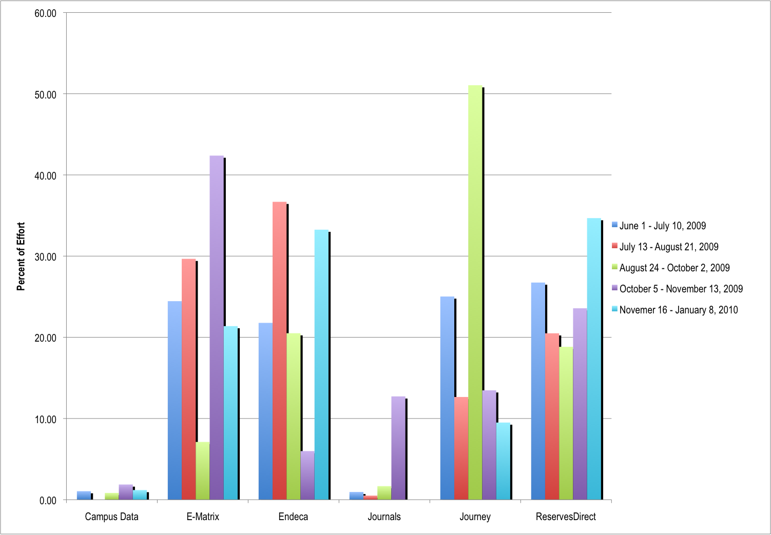

Slide 34
Resources
Agile for All blog: http://www.agileforall.com/blog/
Succeeding with Agile: http://blog.mountaingoatsoftware.com/
Agile Project Management with Scrum ISBN: 073561993X
Agile Software Development with Scrum ISBN: 0130676349

Slide 35
Emily Lynema
Associate Head, IT
NC State University Libraries
emily_lynema@ncsu.edu

