Slide 1
Enhancing Discoverability with Virtual Shelf Browse
Andreas Orphanides
Emily Lynema
Cory Lown
NCSU Libraries
Code4Lib 2010
24 February 2010

Slide 2
Outline
Motivation
Demonstration
Implementation
  Back-end
  Front-end
Outcomes
Future

Slide 3
Why browse?
Universal
  We almost all browse shelves
  The shelf is going away
  Users like recommendations
Local
  No more OPAC
  New ARS
Notes:
Browsing is a fairly universal behavior. We do it in bookstores all the time. Consciously or not, nearly all library users find themselves browsing around the shelf after they go into the stacks to retrieve a specific item. And they find good stuff that way.
But as we buy more and more digital resources and replace our print stacks with Learning Commons, this physical shelf becomes less and less complete. The question becomes - How can we continue to provide this serendipitous discovery in an online environment?
The more our patrons use Amazon, Netlix, and Pandora, the more they become accustomed to having resources ‘recommended’ to them. Libraries have been trying to use subject headings to do this for many years, but most patrons have never really gotten it. We see a shelf browse tool as the first step toward new intuitive ways for users to “find more like this” in the library.
This came to a head for NCSU Libraries in summer of 2009:
1. As Endeca customers since 2006, we finally ‘turned off’ our old OPAC which provided call number searching and a simple call number browse feature.
2. We are moving to an automated retrieval system in our new library building in 2012, and there is concern amongst users about no longer being able to physically browse the shelves.

Slide 4
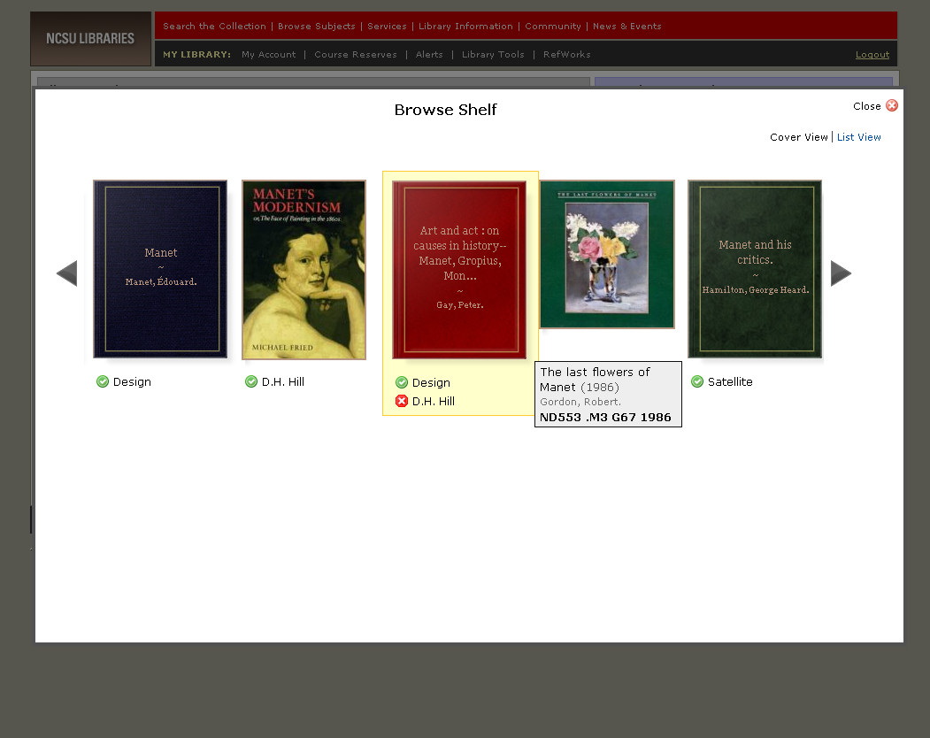
Notes:
Demo placeholder for cover browse demo - popup

Slide 5
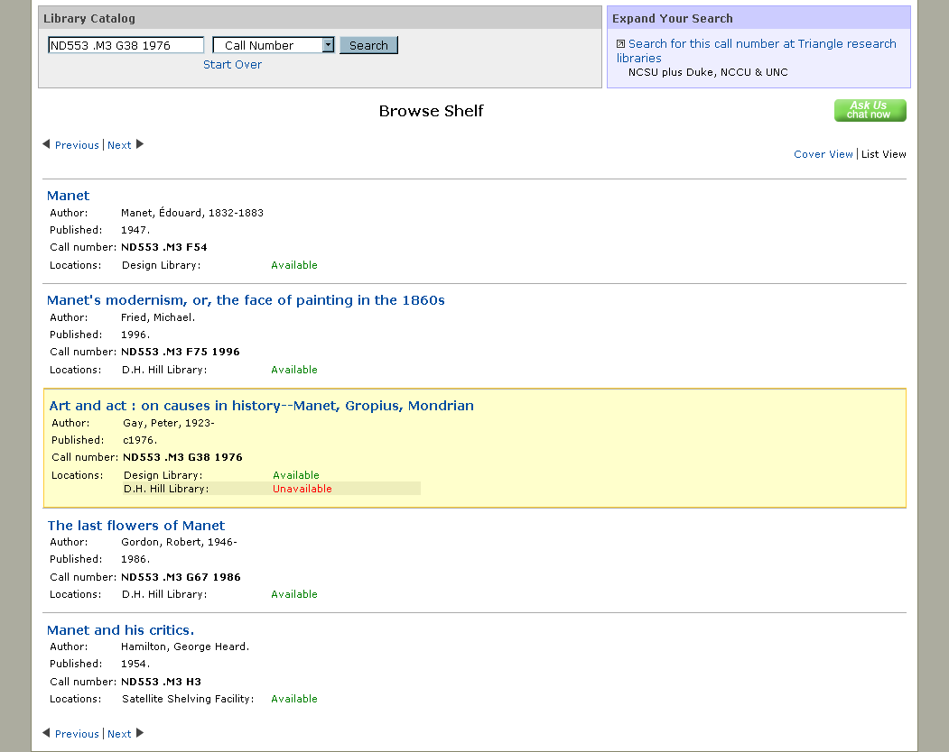
Notes:
Demo placeholder for cover browse demo - fullscreen

Slide 6
Data Model: Goals
Browse arbitrary number of titles around a known item in call number order
Include online + all locations
Support browse searching
  Partial and non-matches
Browse by title – NOT by item
Forgiving call number searching
Notes:
Obvious primary goal: provide ability to browse through an arbitrary number of titles from a known item in call number order
Additionally: include online content and all branch library holdings together
Support browse searching for call numbers as well as support for partial/non-matching "your call number would be here"
Browse by title rather an by item. We might have 50 copies of a single title the user shouldn't have to browse through all of them.
Try to make call number searching as forgiving as possible.

Slide 7
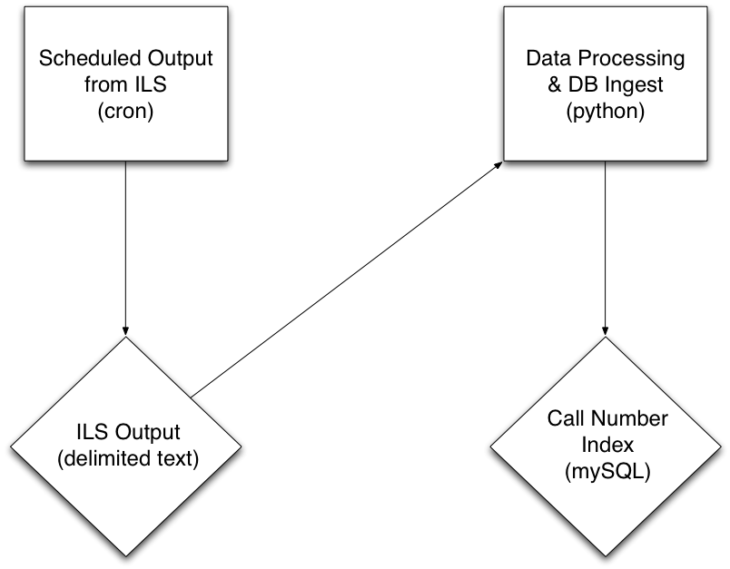
Notes:
A scheduled daily process outputs all our ILS records into a delimited text file
We order the lines in that text file by the padded call number from the ILS
A Python script runs through the file and creates a version of the call number with spaces stripped out for searching
The script also adds what we're calling a group id to each line. The group id starts at 0 and increments by catalog key rather than by line, so groups colocated items with the same title together. The group id also preserves the call number order of the records so that we can use run of the mill SQL queries to get consecutive records out of the database.
We dump all this into a mySQL database table that gets rebuilt every day.

Slide 8
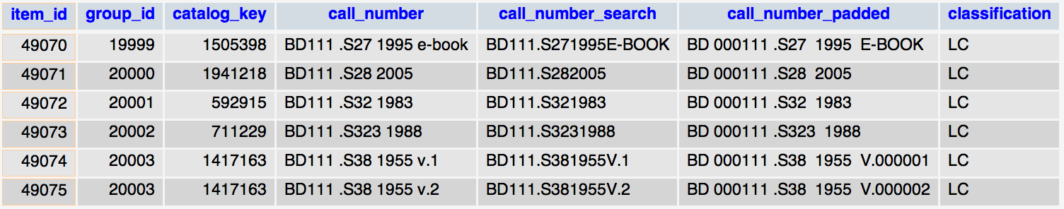
Notes:
Here's what a few rows in the database looks like.

Slide 9
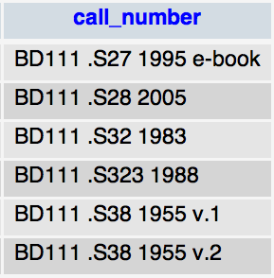
Notes:
We have the version of the call number that comes out of the ILS with no modification

Slide 10
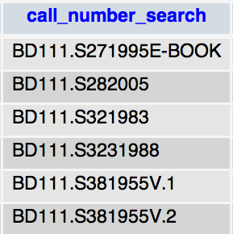
Notes:
We store a version of the call number with spaces stripped out to provide somewhat more forgiving call number search – the user doesn't have to get the spacing exactly right to get a match.

Slide 11
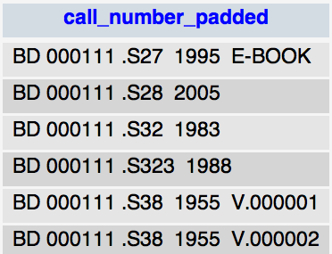
Notes:
We store the padded version of the call number from the ILS, which we used to sort the records before processing and also for satisfying call number search cases where the call number the user searches for is not in our system. We can place the user in the index close to where that call number would have been had it existed. Of course for this to work the users input has to look enough like a call number that we can pad it out on the fly.

Slide 12
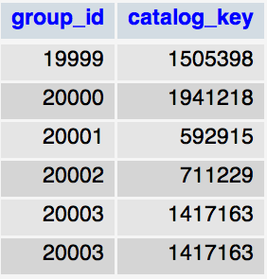
Notes:
And finally here is the group id we add that maintains call number order and groups colocated titles together. You can see that the same group id is assigned to the last two rows because they share a catalog key and thus the same title.

Slide 13
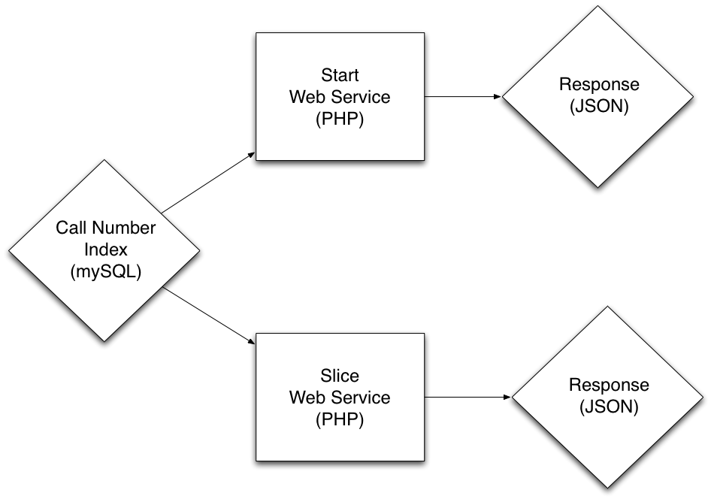
Notes:
_x000f_On top of the database we've built a web service built in php that takes requests over HTTP and returns a bit of JSON.
This is really two different services in one.
The Start service returns an items location in the index.
The Slice service returns a set of records in call number order.

Slide 14
Start: Begins With
SELECT group_id
FROM sorted_call_no_index
WHERE call_number_search
LIKE 'BD111.S30%'
ORDER BY call_number_padded
LIMIT 1
Notes:
Start service take a call number or a catalog key.
For call numbers we use a like query that is in effect a begins with search
The service responds with a group id which is the location of that item in the index.

Slide 15
Start: Closest Match
SELECT group_id
FROM sorted_call_no_index
WHERE call_number_padded
> 'BD 000111 .S30'
AND classification = 'LC'
AND call_number_padded != ''
LIMIT 1;
Notes:
If the call number just isn't in the index we pad out the users input if possible and try a comparison query to return the location in the index closest to where that call number would have been.

Slide 16
Slice Web Service
SELECT group_id, catalog_key, MIN(call_number)
FROM sorted_call_no_index
WHERE group_id
BETWEEN 20000 – 0
AND 20000 + 20
GROUP BY group_id;
Notes:
The slice service simply takes the group id returned by the start service and can do simple math on it to get the records around that item.
So in this case we're requesting the records starting from group id 20000 up to 20020.

Slide 17
Slice Web Service
SELECT group_id, catalog_key, MIN(call_number)
FROM sorted_call_no_index
WHERE group_id
BETWEEN 20000 – 0
AND 20000 + 20
GROUP BY group_id;
Notes:
This will return the catalog keys for those consecutive items with which we can retrieve metadata from the catalog about those items.
Turn it over the Dre to talk about the front end application.

Slide 18
Front-end: Goals
Access to “infinite” shelf
Interactive visual browsing experience
Design cues from Google Books
High performance
Satisfy both patrons and staff
Notes:
Access to infinite shelf: no limit to ability to browse left and right; continually request next / previous titles
Interactive visual browsing: minimal metadata, ajax interaction
From google books: Cover surrogates and mouse-overs
High performance: pre-fetch titles and covers in advance
Satisfy both patrons and staff: list view vs. cover view

Slide 19
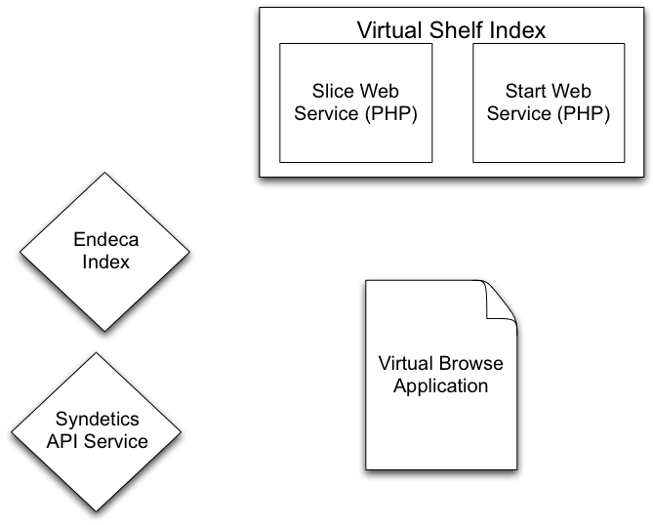


Slide 20
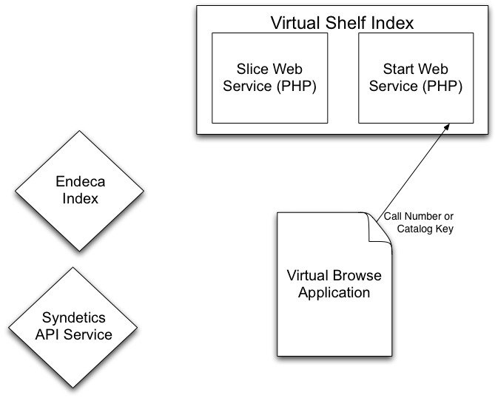

Slide 21
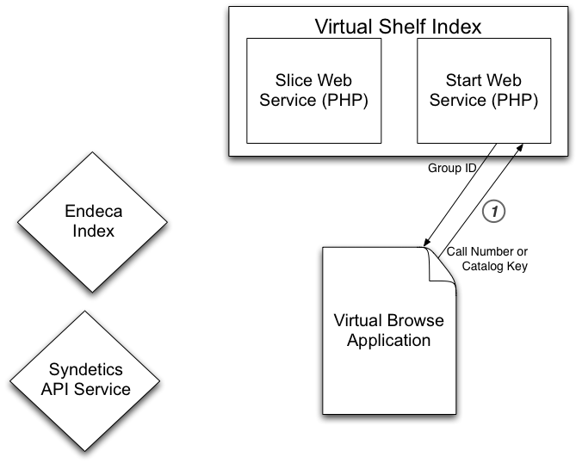

Slide 22
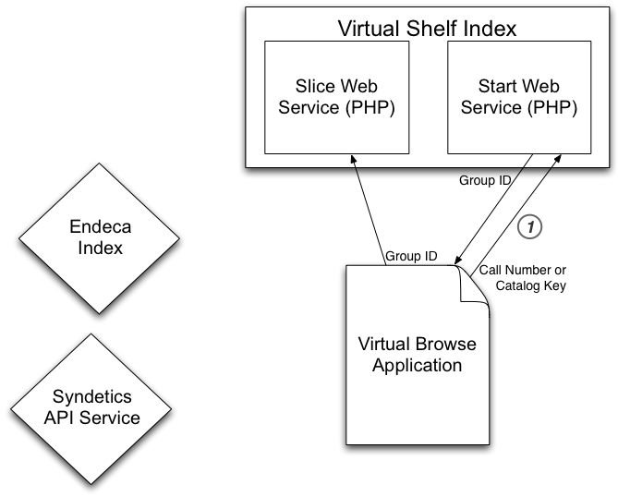

Slide 23
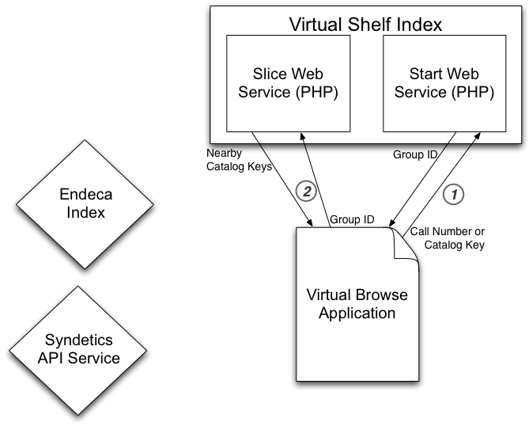

Slide 24
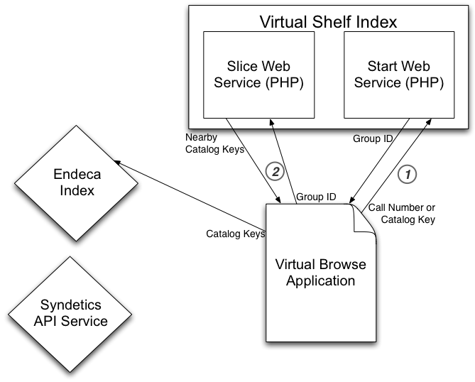

Slide 25
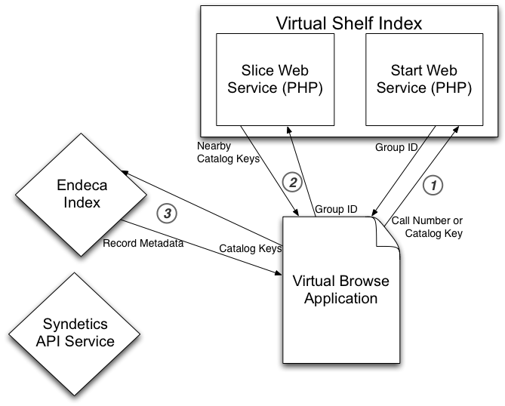

Slide 26
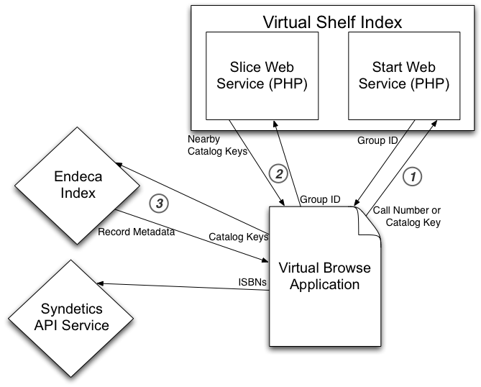

Slide 27
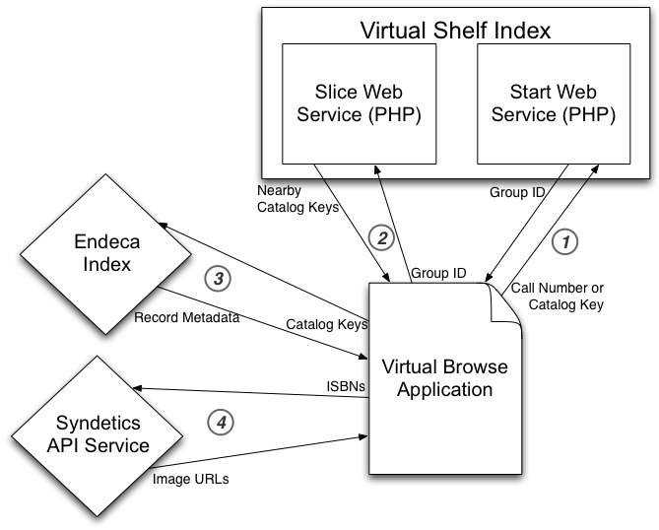

Slide 28
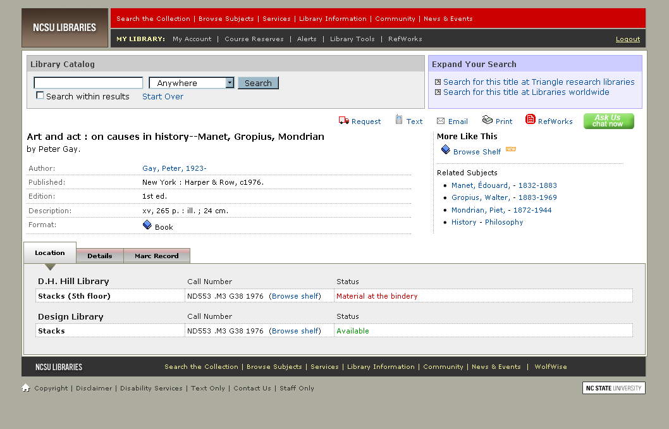
JQuery Plugins
Library website:
jQuery
Notes:
Our library website uses the jQuery library for most of its javascript needs, including many components of the cover browse system. In addition, we made use of several jQuery plugins to provide enhanced interactivity.

Slide 29
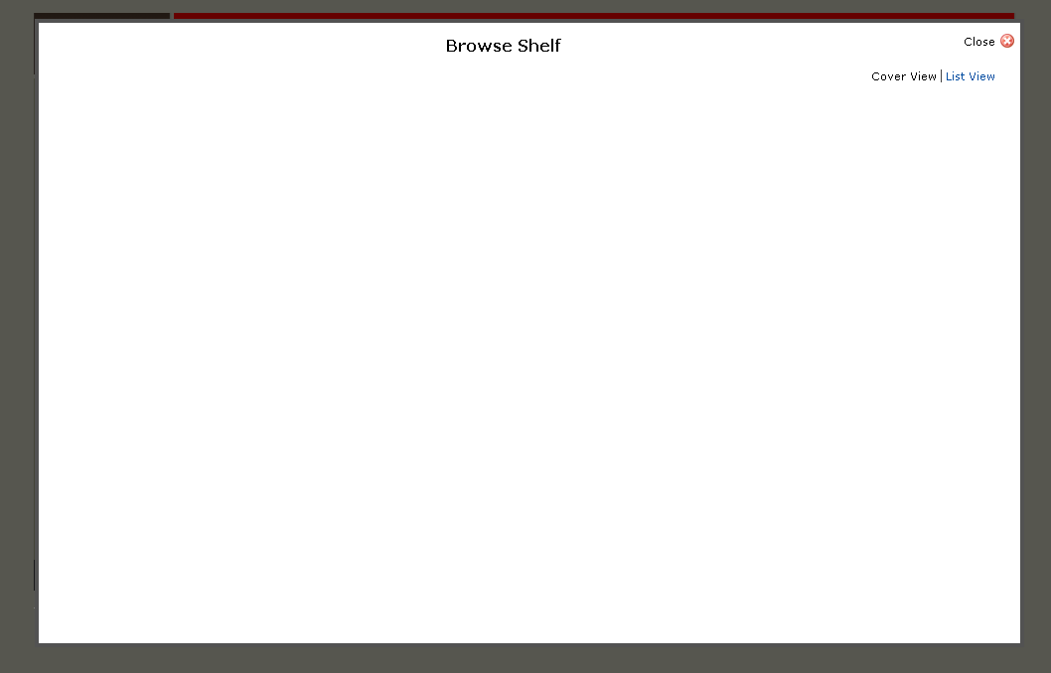
JQuery Plugins
Library website:
jQuery
Popup Frame:
Thickbox
Notes:
The browse shelf window pops up in a modal, in-browser popup created using the Thickbox plugin.

Slide 30
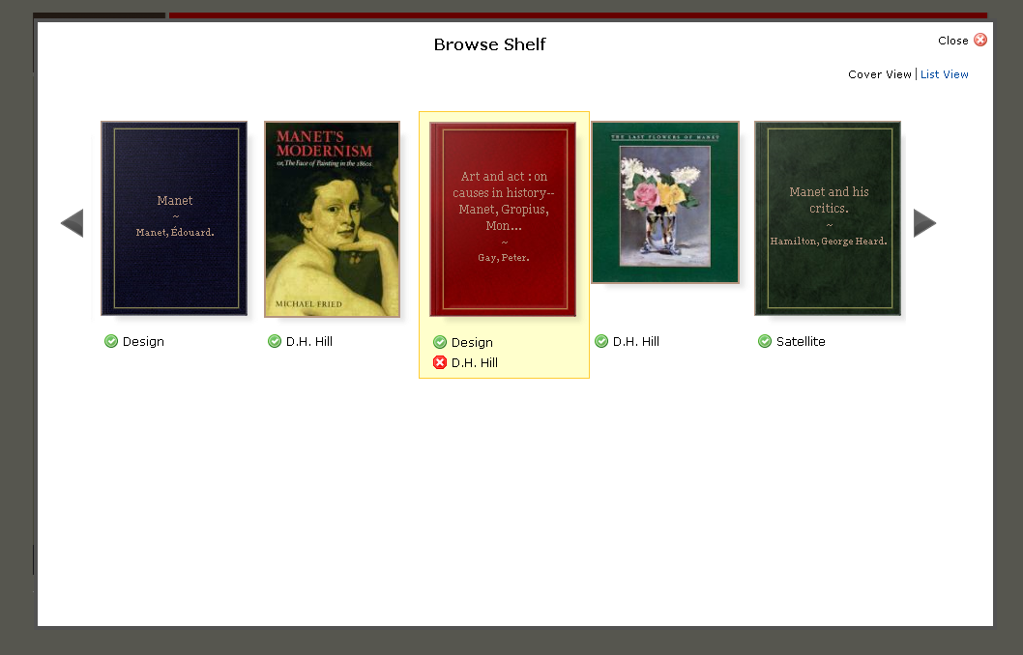
JQuery Plugins
Library website:
jQuery
Popup Frame:
Thickbox
Cover Carousel:
jCarousel
Notes:
The images and metadata appear in an animated carousel made using the jCarousel plugin.

Slide 31
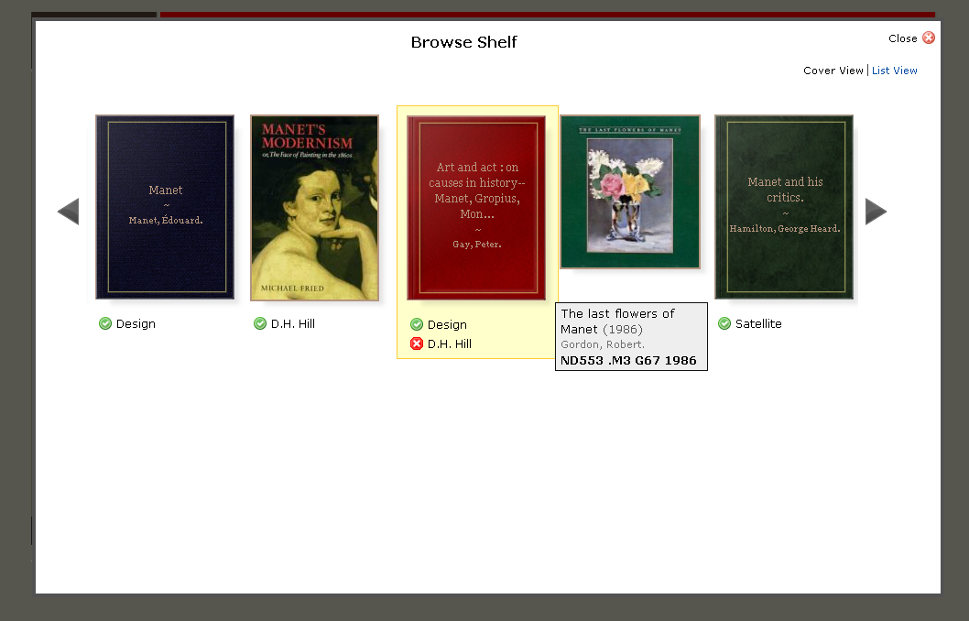
JQuery Plugins
Library website:
jQuery
Popup Frame:
Thickbox
Cover Carousel:
jCarousel
Mouseovers:
SimpleTip
Notes:
Additional metadata is provided when mousing over the cover images. The mouseovers are provided via the SimpleTip jQuery plugin.

Slide 32
Front-end: Challenges
DOM = SLOW
Plugin + Plugin + Plugin = Headache
Remote servers = Latency roulette
Too much Ajax = Browser bottleneck
IE != Your friend
Notes:
Our initial approach to dynamically loading data into the carousel involved continually adding elements to the DOM to create a larger and larger carousel. This had the fatal flaw of creating a huge DOM that, after a few navigations, was so big that it slowed to a crawl. We created a more streamlined carousel that dynamically unloaded data as it left the viewing area, but it still requires a lot of DOM manipulation and is slower than we’d like.
We encountered a lot of challenges getting the three jquery plugins to play nicely. A lot of headaches were due to the plugins’ extensive use of CSS positioning and z-indexing, which required a lot of CSS massage to get everyone to get along.
For both our bib data and our cover images, we rely on remote servers, both of which sometimes have unpredictable response times. Sometimes a “perfect storm” of slow response times from both servers is encountered, which can make the application respond very poorly. To address these problems, we have changed the way we make queries to Endeca, and we’re currently developing a method to cache data more dynamically in the application without using additional DOM manipulation.
Finally, we faced that horrible truth that every web author faces: once you make it work, you need to then go back and make it work in IE.

Slide 33
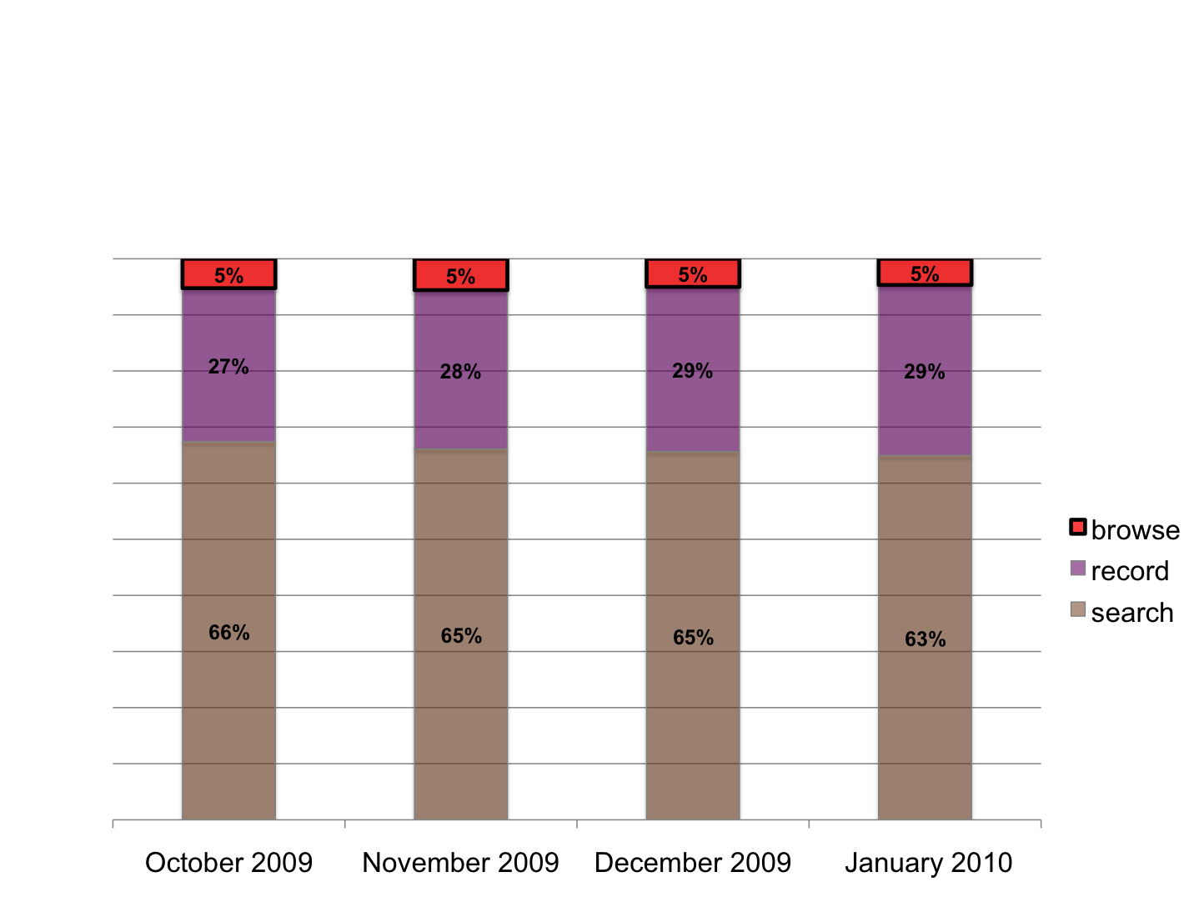
Usage
Notes:
Made available to the public in September 16, 2009.
Remains at a steady 5% of catalog usage, when compared to searching and viewing the full record, even with dip in usage in December / January
Have not marketed the service yet.

Slide 34
Anecdotal Feedback
very positive reaction
“find more” resonates with current behavior
where is “browse shelf”?
“open the book” within browse context
don’t care about call number specifics
Notes:
Feedback from about 15 students and faculty
People have trouble finding the link to browse shelf on the full record page – just don’t see it

Slide 35
Future
TRLN consortial implementation
  Filtering across institution / location
Virtual Browse Project
  Find more along other dimensions of likeness
  More integrated presentation of 3rd party supplemental content and licensed full text
Notes:
Other opportunities to ‘find more’ besides just call numbers so that we can continue to explore new ways to meet patrons’ expectations of having resources recommended to them.

Slide 36
Thanks!
Andreas Orphanides
NCSU Libraries Fellow
andreas_orphanides@ncsu.edu
Emily Lynema
Associate Head, Information Technology
emily_lynema@ncsu.edu
Cory Lown
NCSU Libraries Fellow
cory_lown@ncsu.edu

Slide 37
More Information
Project Page:
http://www.lib.ncsu.edu/dli/projects/virtualshelfindex/
Web Service Docs:
http://www.lib.ncsu.edu/catalog/virtualshelfindex/documentation.html
Try It:
http://www2.lib.ncsu.edu/catalog/record/NCSU1879640

