Slide 1

Sustaining Your Open Source Project Through Training
Bess Sadler - Stanford University Library
bess@stanford.edu
@eosadler

Slide 2
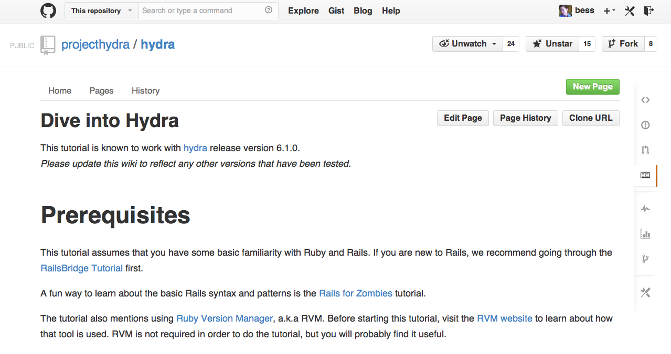
https://github.com/projecthydra/hydra/wiki/Dive-into-Hydra
http://projecthydra.org

Slide 3
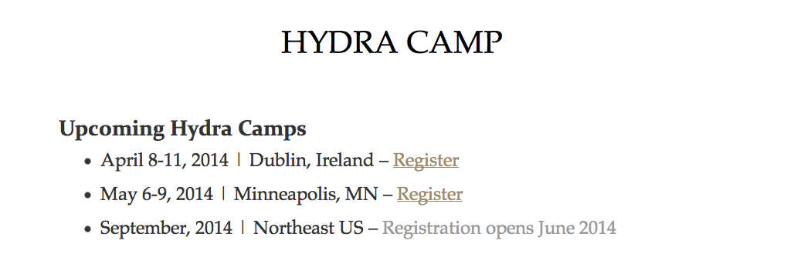
http://curationexperts.com/about/hydra-camp/

Slide 4
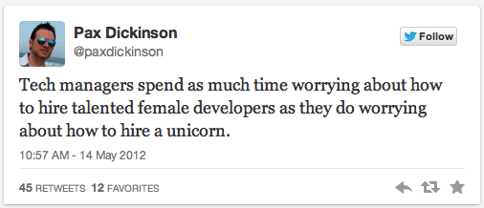

Slide 5
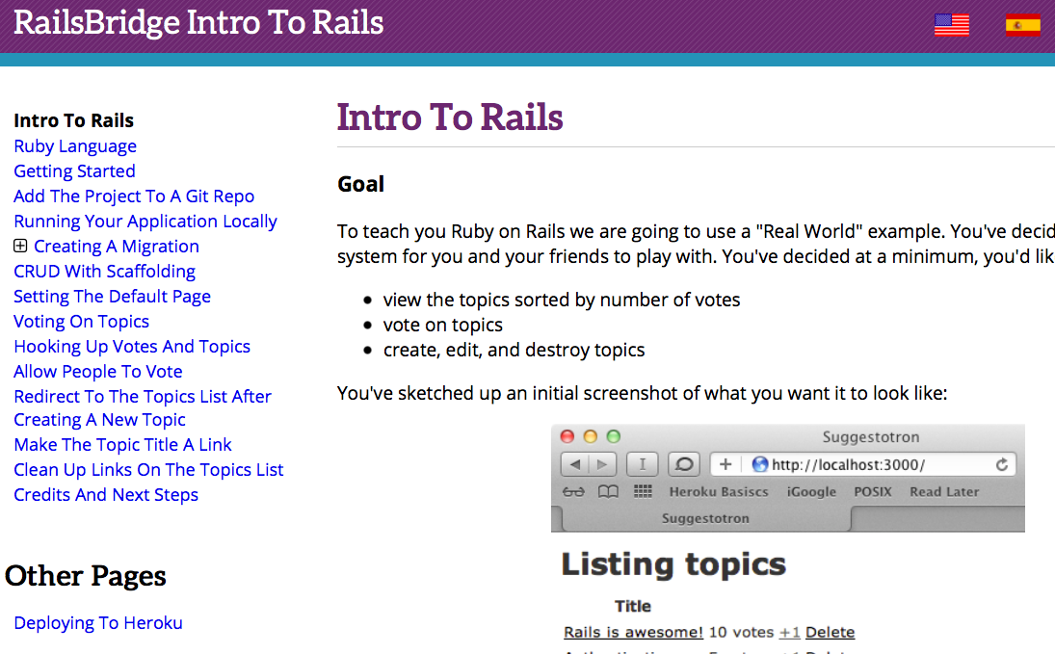
http://curriculum.railsbridge.org/intro-to-rails/

Slide 6
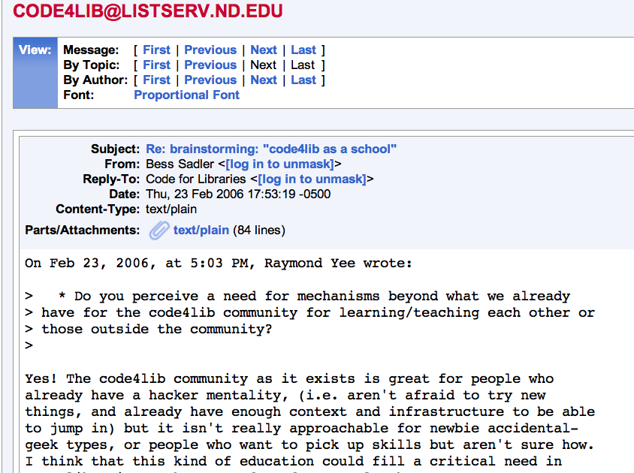

Slide 7
Questions?
bess@stanford.edu
@eosadler

